Slide 1
Alternative Mining Puzzles
Blockchains & Cryptocurrencies
Instructors: Matthew Green & Abhishek Jain

Slide 2
Puzzles are the core of Bitcoin
Determine the incentive system, and nature of puzzles determines behavior of miners
Basic features of Bitcoin’s proof-of-work puzzle (recap)
Puzzle is difficult to solve, so large-scale attacks are difficult
… but not too hard, so honest miners are compensated
What other features could a puzzle have?
Notes:
Recap to earlier lectures?

Slide 3
This lecture (and later)
Alternative puzzle designs
Used in practice, and research proposals
Variety of possible goals
ASIC resistance, pool resistance, environmental-friendliness, intrinsic benefits...
Essential security requirements

Slide 4
Basic Puzzle Requirements

Slide 5
Puzzle requirements
Cheap to Verify
since other users have to verify solutions
Adjustable difficulty
E.g., due on increase in hash rate or more users
In PoW puzzles, chance of winning should be proportional to computing power (e.g., hash power in Bitcoin)
Large players get only proportional advantage
Even small players get proportional compensation

Slide 6

Bad PoW puzzle: a sequential puzzle
Consider a puzzle that takes N steps to solve
a “Sequential” Proof of Work
N
Solution Found!

Slide 7

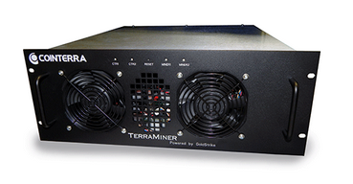
Bad PoW puzzle: a sequential puzzle
Problem: fastest miner always wins the race!
Solution Found!
Notes:
Clipart: from tango project, public domain

Slide 8
ASIC Resistant (PoW) Puzzles

Slide 9
ASIC resistance - Why? (1 of 2)
Goal: Ordinary people with idle laptops, PCs, or even mobile phones can mine!
Lower barrier to entry
Approach: Reduce the gap between custom hardware and general purpose equipment

Slide 10
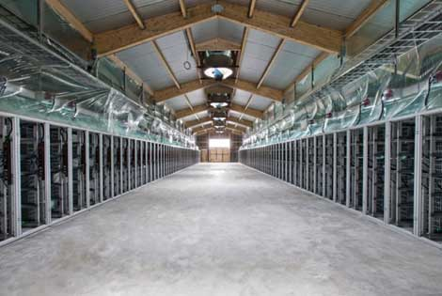
ASIC resistance - Why? (2 of 2)
Goal: Prevent large manufacturers from dominating the game
“Burn-in” advantage
In-house designs
Approach: reduce the “gap” between future hardware and the custom ASICs we already have
Notes:
Image taken from lecture 5

Slide 11
Memory hard puzzles
Premise: the cost and performance of memory is more stable than for processors
10000
Processors
1000
“performance gap”
Memory
Performance
100
Storage
10
‘80 ‘90 ‘00 ‘10 ‘14
Time

Slide 12
scrypt
Colin Percival, 2009
Memory hard hash function
Constant time/memory tradeoff
Memory consumes a large amount of on-chip area. High memory requirement => small number of hashing engines on special-purpose chips
Widely used alternative PoW puzzle (e.g., Litecoin)
Also used in Password-hashing
1. Fill memory with random values
2. Read from the memory in random order
Notes:
[5, 4, 1, 1, 0, 0],
[3, 4, 0, 2, 1, 1],
[3, 3, 1, 1, 1, 4],
[0, 2, 3, 4, 4, 5],
[4, 2, 2, 5, 4, 2],
[3, 4, 4, 3, 5, 3]])

Slide 13
scrypt - step 1 of 2 (write)
Input: X
V₁ = H(X)
V₂ = H(V₁) = H(H(X))
V₃ = H(V₂) = H³(X)
…
V_{N} = H^{N}(x)
V₁ | V₂ | V₃ | ... | ... | ...
... | ... | ... | ... | ... | ...
... | ... | …. | ... | ... | ...
... | ... | ... | … | ... | ...
... | ... | ... | ... | ... | ...
... | ... | ... | ... | ... | V_{N}
V₁
V₁ | V₂
V₁ | V₂ | V₃

Slide 14
scrypt - step 2 of 2 (read)
V₁ | V₂ | V₃ | ... | ... | ...
... | ... | ... | ... | ... | ...
... | ... | …. | ... | ... | ...
... | ... | ... | … | ... | ...
... | ... | ... | ... | ... | ...
... | ... | ... | ... | ... | V_{N}
Input: X
A := H^{N+1}(X)
For N iterations:
i := A mod N
A := H(A xor V_{i})
Output: A

Slide 15
scrypt - time/memory tradeoff
Why is this memory-hard?
Reduce memory by half, 1.5x the # steps
V₁ |  | V₃ |  | V₅
... |  | ... |  | ...
... |  | …. |  | ...
... |  | V_{i-1} | V_{i} | ...
... |  | ... |  | ...
... |  | ... |  | ...
Need to access V_{i} where i is even?
Access V_{i-1}
Compute V_{i} = H(V_{i-1})

Slide 16
scrypt
Disadvantages: Also requires N steps, N memory to check
Is it actually ASIC resistant?
scrypt ASICs are already available
Exploit time-memory trade-offs, lower values of N, etc.
Notes:
Fair use because its cited by source?

Slide 17
Academic research
Many subsequent candidates: Argon2i (winner of PW-hashing contest), Ballon-Hashing, etc.
Proofs of memory hardness in various models using graph pebbling techniques (see, e.g., Alwen-Serbeninko’15 and many subsequent works)

Slide 18
Cuckoo hash cycles
John Tromp, 2014
Memory hard puzzle that’s cheap to verify
Input: X
For i = 1 to E:
a := H₀(X + i)
b := N + H₁(X + i)
edge(a mod N, b mod N)
Is there a cycle of size K? If so, Output: X, K edges
N

Slide 19
Even more approaches
More complicated hash functions
X11: 11 different hash functions combined (subsequent iterations: X13, X14, X15, X17)
Moving target
Change the puzzle periodically

Slide 20
Counter argument: SHA2 is fine
Bitcoin Mining ASICs aren’t changing much
Big ASICs only marginally more performant than small ones
Affordable ASIC
Expensive ASIC
SHA2
SHA2
SHA2
SHA2
SHA2
Ordinary SHA2 Circuit
SHA2
SHA2
SHA2
SHA2
SHA2
SHA2
SHA2
SHA2
SHA2
SHA2
SHA2
SHA2
SHA2
SHA2
...
...

Slide 21
Proof-of-useful-work

Slide 22
Recovering wasted work
Recall: power consumed by Bitcoin network in 2017 ~ power consumed by Denmark
Natural question:
Can we recycle this and do something useful?

Slide 23
Candidates - needle in a haystack
Natural choices:
- Protein folding (find a low energy configuration)
- Search for aliens (find an anomalous region of a signal)
Challenges:
Problem must be pseudorandomly sampled (e.g., based on hash of last block) since no central trusted party available
Randomly chosen instances must both be useful and hard
Notes:
Finding 3d configuration of a molecule that has very low potential energy
Searching for radio signals within signals from space that have anomalous patterns that might indicate extraterrestrial life.
These have been good candidates for crowdsourced distributed computing problems in the past.
But there are challenges to be overcome for using such problems in blockchain design

Slide 24

Primecoin
Sunny King, 2013
Puzzle based on finding large prime numbers
Cunningham chain:
p₁, p₂, … p_{n} where p_{i} = 2^{i} a + 1
Each p_{i} is a large (probable) prime
p₁ is divisible by H(prev || mrkl_root || nonce)

Slide 25
Primecoin
Many of the largest known Cunningham chains have come from Primecoin miners
Hard problem? Studied by others (e.g., PrimeGrid)
Usefulness? Some applications to crypto (e.g., Young-Yung’98)

Slide 26
Recovering wasted hardware
Estimate: more than $100M spent on customized Bitcoin mining hardware
This hardware investment is otherwise useless
Idea: a puzzle where hardware investment is useful, even if the work is wasted?

Slide 27
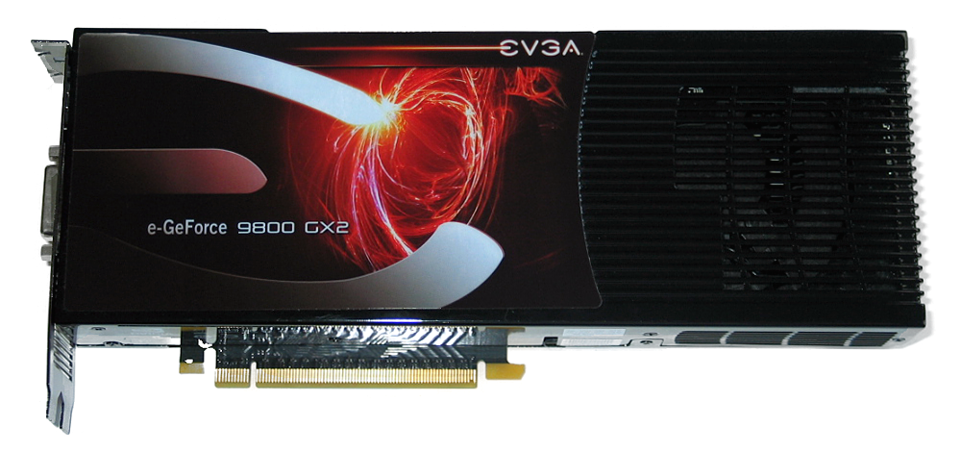
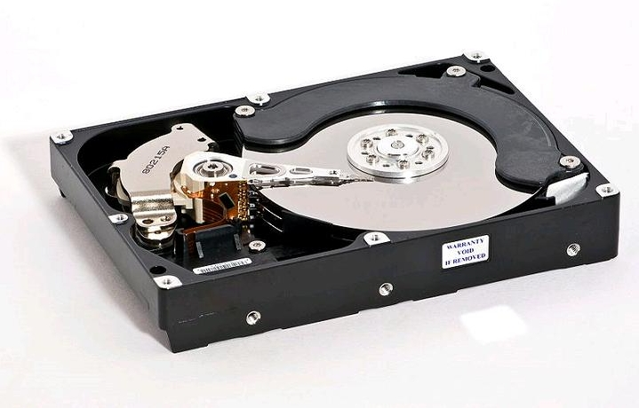
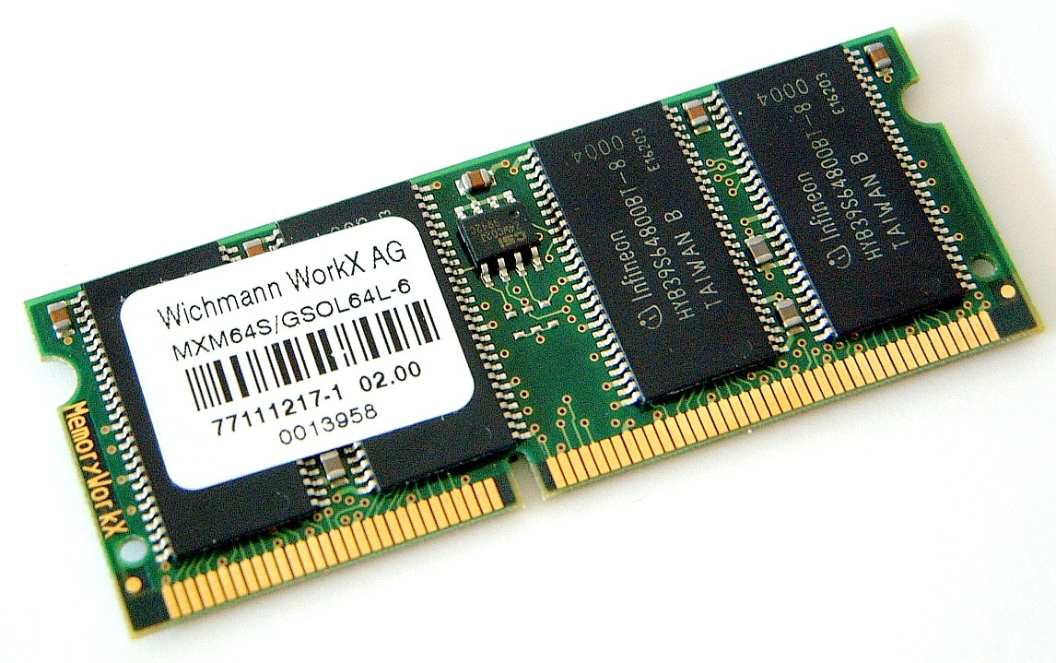
Permacoin - Mining with storage
Permacoin
Miller et al., 2014
Bitcoin
Side effect:
Massively distributed, replicated storage system
Notes:
hard disk image from wikipedia

Slide 28
Permacoin
Assume we have a large file F to store
For simplicity: F is chosen globally, at the beginning, by a trusted dealer
Each user stores a random subset of the file

Slide 29
Storage-based puzzle
1. Build a Merkle tree, where each leaf is a segment of the file
2. Generate a public signing key pk, which determines a random subset of file segments
F₁
F₂
F₄
F₅
3. Each mining attempt:
F₂
F₄
a) Select a random nonce
b) h1 := H(prev || mrkl_root || PK || nonce)
c) h1 selects k segments from subset
d) h2 :=
H(prev || mrkl_root || PK || nonce || F)
e) Winner if h2 < TARGET
F₀
F₁
F₁
F₂
F₂
F₂
F₃
F₄
F₄
F₄
F₅
F₅
F₆
F₇
Notes:
too much text here

Slide 30
Reducing Bitcoin’s “honesty” cost
“Honest” miners validate every transaction
Validation requires the UTXO database (GBs)
Maintaining the UTXO database doesn’t pay
Idea: use Permacoin to reward UTXO storage

Slide 31
Proofs of Space
Require non-trivial storage (as opposed to computational power) to solve a puzzle [Dziembowski et al. CRYPTO’15, Ateniese et al. SCN’14]
More environmental-friendly
Used in SpaceMint, Burstcoin, Chia …

Slide 32
Summary
Useful proof-of-work is a natural goal
(while maintaining security requirements)
The benefit must be a pure public good
Viable approaches include storage, prime-finding, others may be possible
Realized benefit so far has been limited

Slide 33
Nonoutsourceable Puzzles

Slide 34
Large mining pools are a threat
Bitcoin’s core value is decentralization
If power is consolidated in a few large pools, the operators are targets for coercion/hacking
Position: large pools should be discouraged!
Analogy to voting: It’s illegal (in US) to sell your vote

Slide 35
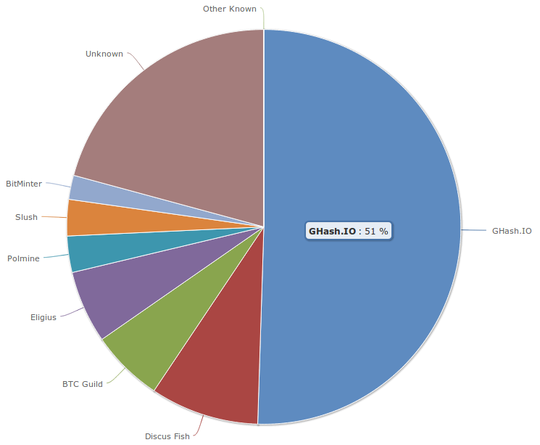
June 12, 2014
GHash.IO large mining pool crisis
Notes:
From blockchain.info

Slide 36
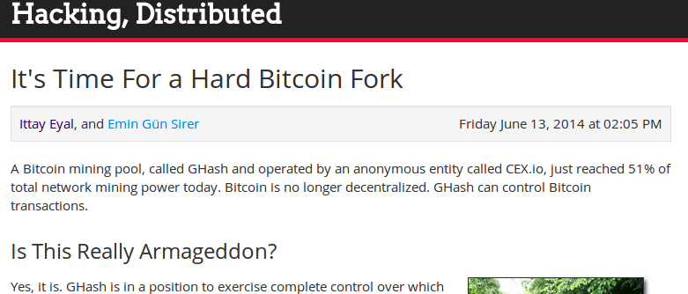

Slide 37
Observation:
Pool participants don’t trust each other
Pools only work because the “shares” protocol lets members prove cooperation

Slide 38

Standard Bitcoin mining pool
Payout dividing among members
Pool Operator
“shares”:
proof that a member is
“toeing the line”
Pool Members
Solution found!

Slide 39
The Vigilante Attack
Suppose a Vigilante is angry with a large pool
He submits “shares” like normal….
… but if he finds a real solution, discards it
Pool output is reduced, Vigilante loses a little

Slide 40



The Vigilante Attack
Payout dividing among members
Pool Operator
Solution
discarded
“shares”:
proof that a member is
“toeing the line”
Pool Members
Notes:
guy fawkes, trashcan, and key icons from openclipart

Slide 41
Encouraging the Vigilante
Whoever FINDS a solution spends the reward
Approach:
- searching for a solution requires SIGNING, not just hashing. (Knowledge of a private key)
- Private key can be used to spend the reward

Slide 42
Encouraging the Vigilante
Pool Operator
“shares”
Pool Members
Solution found!
Take the money and run!
Notes:
Key from openclipart

Slide 43
Nonoutsourceable puzzle
Signature needed to find solution
Solution:
(prev, mrkl_root, nonce, PK, s1, s2)
such that:
H(prev || PK || nonce || s1) < TARGET
VerifySig(PK, s1, prev || nonce)
VerifySig(PK, s2, prev || mrkl_root)
Public Key
Second signature spends reward

Slide 44
Proof-of-Stake
“Virtual Mining”

Slide 45


Bitcoin Mining has an unnecessary step
Proof-of-Work Mining:
Earn mining rewards
Spend money on power and equipment
Miner
Find puzzle solutions
Notes:
Factory image from wikipedia
Miner image from Lecture 4

Slide 46
Bitcoin Mining has an unnecessary step
Proof of Stake:
Creator of next block chosen at random based on current stake in the system
Assuming all the money owned/used by miners is in the system, this mechanism cuts the middle man (equipment manufacturer)

Slide 47
Potential benefits
Lower overall costs
- No harm to the environment
- Savings distributed to all coin holders
Stakeholder incentives - good stewards?
No ASIC advantage
51% attack maybe harder

Slide 48
Variations of Virtual Mining
Proof-of-Burn: mining with a coin destroys it
Proof-of-Deposit: can reclaim a coin after some time
Proof-of-Activity: any coin might be win (if online)

Slide 49
Questions with Virtual Mining
Is there any security that can only be gained by consuming “real” resources?
If so, then “waste” is the cost of security
If not, then PoW mining may go extinct

Slide 50
Examples of PoS based Cryptocurrencies
Peercoin
Blackcoin
Nxt
Neucoin
…

Slide 51
Examples of secure PoS systems
Algorand [Full version: Chen-Micali’17]
Ourboros [Kiayias-Russel-David-Oliynykov’17]
Snow white [Daian-Pass-Shi’17]

Slide 52
Conclusion
Many possible design goals
Prevent ASIC miners from dominating
Prevent large pools from dominating
Intrinsic usefulness
Eliminate the need for mining hardware at all
Further research required to understand the best tradeoffs
Many competing systems already co-exist

