Slide 1

Introduction to the Django Framework
University of Computer Studies, Yangon

Slide 2
Outlines
Django Framework Design Principle
Installing Django
Start a Django Project
Exploring project structure﻿
Launching Django Server

Slide 3
What is Web Framework?
Web framework is a set of components designed to simplify your web development process.
It has basic structuring tools in it, which serve as a solid base for project.
It allows user to focus on the most important details and project’s goals instead of creating things, that user can simply pull out of the framework.

Slide 4
What is Django?
Django is a web application framework written in Python programming language.
It is based on Model-View-Controller (MVC) server-side framework designed to operate with relational databases.
The Django is very demanding due to its rapid development feature.
It takes less time to build application after collecting client requirement.
Django is designed in such a manner that it handles much of configure things automatically, so we can focus on application development only.

Slide 5
Popularity
Django is widely accepted and used by various well-known sites such as:
Instagram
Mozilla
The Washington Times
Pinterest
Bitbucket
Disqus

Slide 6
Features of Django
Rapid Development
Secure
Scalable
Fully loaded
Versatile
Open Source
Vast and Supported Community

Slide 7
Django as an MVC Design Pattern
MVT Architecture
Models
Describes your data structure/database schema
Views
Controls what a user sees
Templates
How a user sees it
Controller
The Django Framework
URL parsing

Slide 8
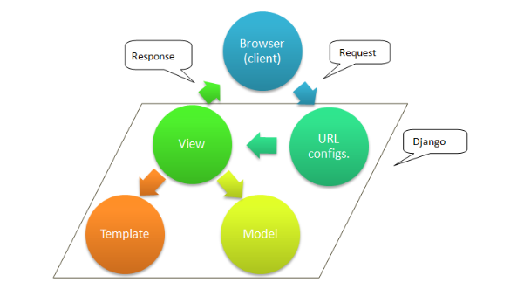
Django Architecture

Slide 9
Installing Django
Normally, there are two ways of installation:
via Pycharm
via command line
In this lecture, create django project via Pycharm.

Slide 10
Start a Django Project
Firstly, launch PyCharm Community Edition.
From the main menu, choose File | New Project, or click the New Project button in the Welcome screen. The New Project dialog opens.

Slide 11
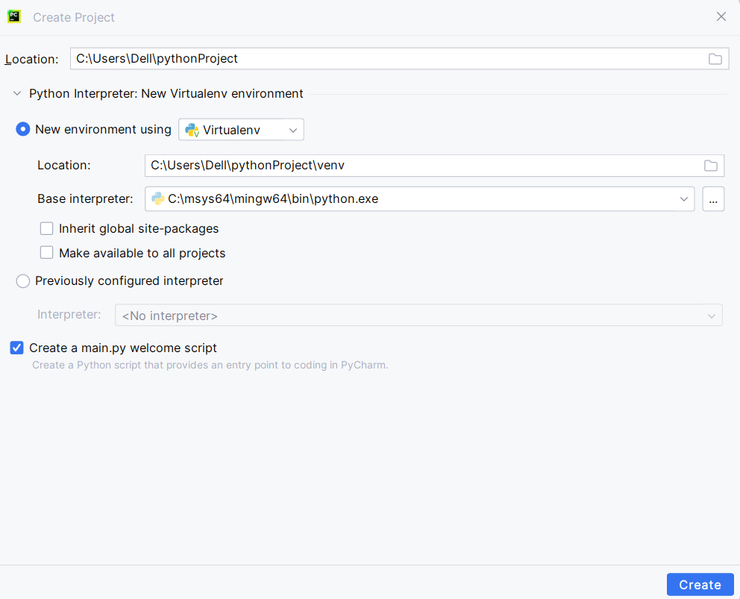
Getting Start with Django in PyCharm Community Edition
File → New Project
Location → C:\Users\Dell\ProjectName
New environment using → Virtualenv
Click Create.

Slide 12
Install Django in PyCharm
pip install Django==4.0.3 (or) git clone https://github.com/django/django.git
(venv) PS C:\Users\Dell\MyDjango> django-admin --version
4.0.3
(venv) PS C:\Users\Dell\MyDjango>
Notes:
activate
pip install –upgrade pip

Slide 13
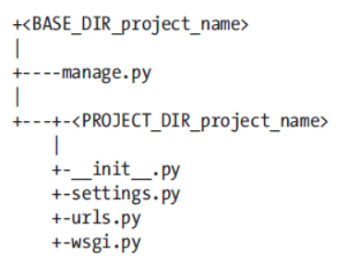
Start a Django Project
To start a Django project you must use the django-admin executable that comes with Django.
A directory called <project_name> is created containing the default Django project structure.
[user@.... ~]$ django-admin startproject <project_name>

Slide 14
Start a Django Project (Cont’d.)
This command will run the manage.py file and create a new application called <application_name> in your project’s folder.
[user@.... ~]$ python manage.py startapp <application_name>

Slide 15
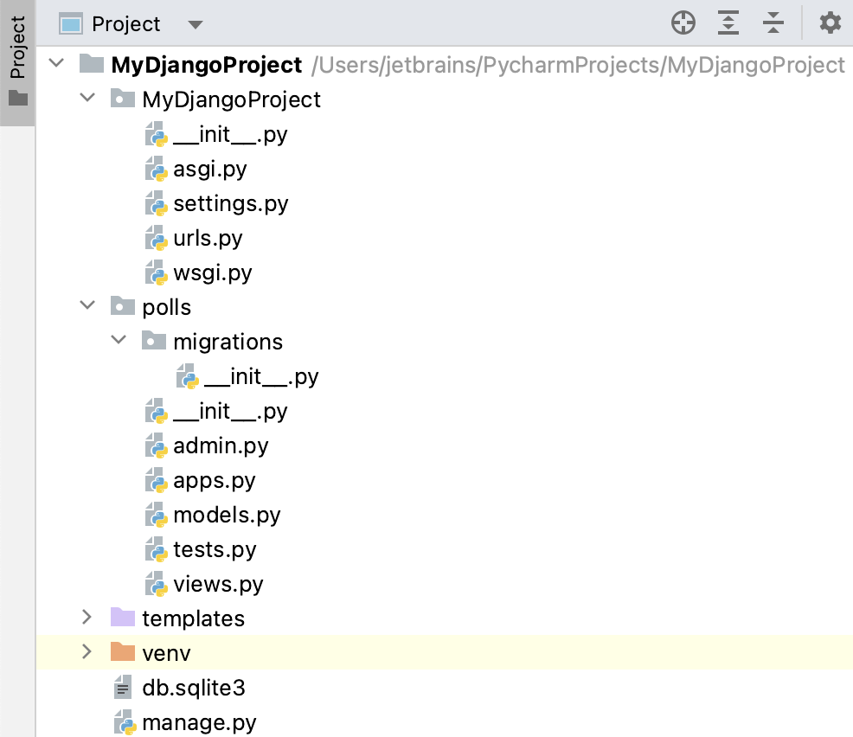
Exploring project structure﻿
The newly created project contains Django-specific files and directories.

Slide 16
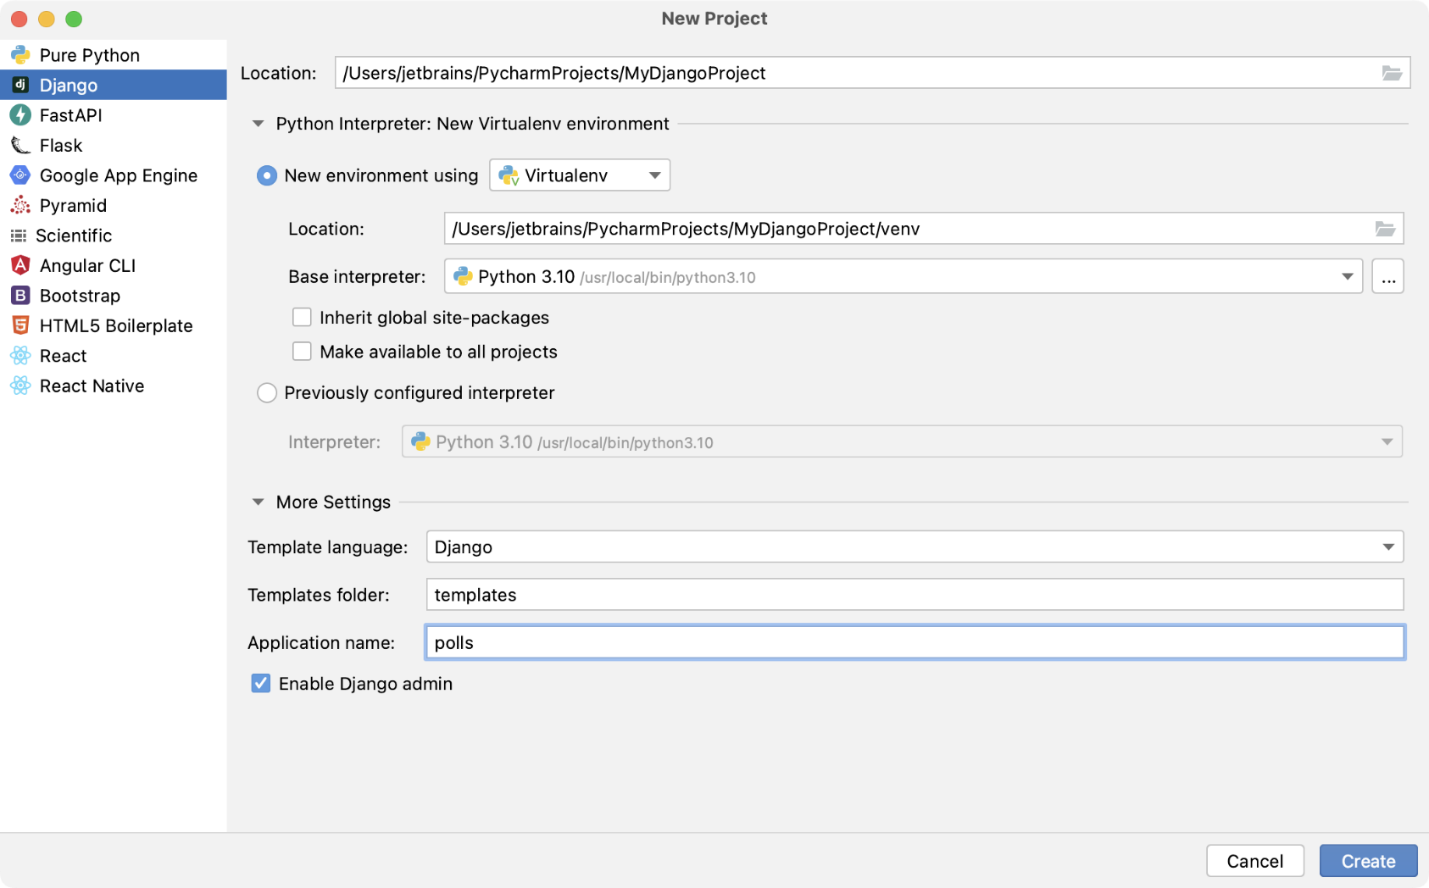
Start Django in PyCharm Professional Version

Slide 17
Getting start with Django in Pycharm(Cont’d)
In the New Project dialog, do the following:
Specify project type Django.
If required, change the default project location.
Select New environment using Virtualenv
Click More settings (More Settings), and specify polls in the Application name field.
Click Create.

Slide 18
Structure of the Project
The “MyDjangoProject” folder is in the project container and it is made up of two elements:
manage.py is a command-line utility that lets you interact with your Django project.
The nested directory MyDjangoProject is the actual Python package for your project. It has four files:
MyDjangoProject/__init__.py: This empty file tells Python that this directory should be considered a Python package.
MyDjangoProject/settings.py: This file contains configuration for your Django project.
MyDjangoProject/urls.py: This file contains the URL declarations for your Django project.
MyDjangoProject/wsgi.py: This file defines an entry-point for WSGI-compatible web servers to serve your project.
Notes:
WSGI – Web server gateway interface
WSGI is a specification that describes the communication between web servers and Python web applications or frameworks. It explains how a web server communicates with python web applications/frameworks and how web applications/frameworks can be chained for processing a request.

Slide 19
Structure of the Project﻿(Cont’d)
The nested directory “<app_name>” contains all the files required for developing a Django application:
<app_name>/_init_.py tells Python that this directory should be considered a Python package.
<app_name>/models.py: In this file, we'll create models for our application.
<app_name>/views.py: In this file, we'll create views.
templates directory is by now empty. It will contain Django templates.

Slide 20
Launching Django server﻿
All Django projects have a built-in web server to observe an application in a browser as changes are made to project files.
[user@.... ~]$ python manage.py runserver
python manage.py runserver starts a development web server on http://127.0.0.1:8000/ which is the local address on your system.

Slide 21
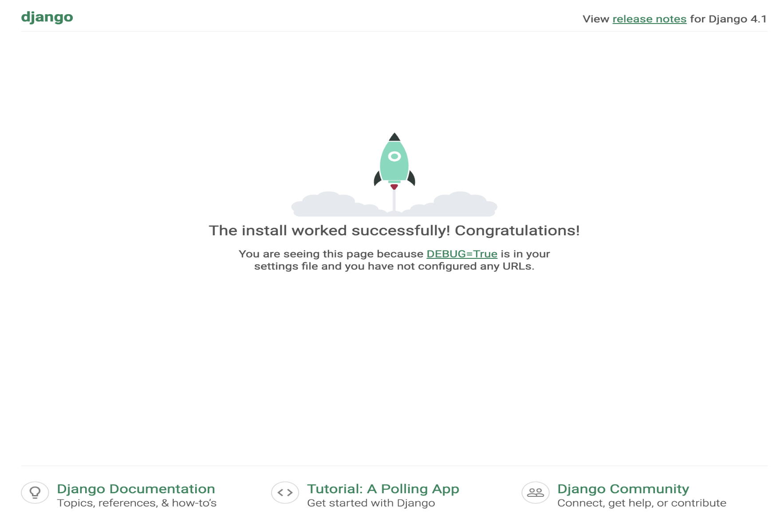
Launching Django server﻿(Cont’d)
The following page opens:

Slide 22
Thank You

