Slide 1
Chapter-3
Information Systems, Organizations, and Strategy
Outlines
3.1 Organizations and Information Systems
3.2 How Information Systems Impact Organizations and Business Firms
3.3 Using Information Systems To Achieve Competitive Advantage
3.4 Using Systems For Competitive Advantage: Management Issues
3.5 Hands-on Mis Projects

Slide 2
Learning Objectives
To know the feature of organizations that to build and use information systems successfully
To develop competitive strategies using information systems by Porter’s competitive forces model
To understand the value chain and value web models for strategic information system applications
To provide businesses by using synergies, core competencies, and network-based strategies
To understand the challenges of strategic information systems and how should they be addressed

Slide 3
3.1 Organization and Information Systems
Information systems and organizations influence one another
Information systems are built by managers to serve the interests of the business firm.
The organization must be aware of and open to the influences of information systems to benefit from new technologies.
The interaction between information technology and organizations is complex and is influenced by many mediating factors

Slide 4
Mediating Factors
The organization’s structure,
business processes,
politics,
culture,
surrounding environment, and
management decisions

Slide 5
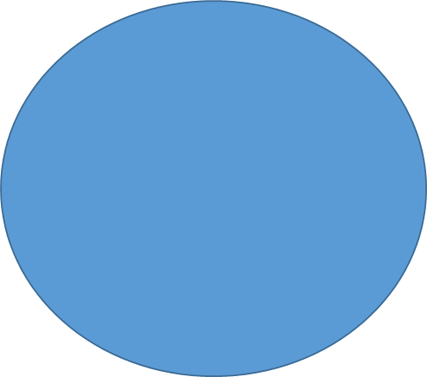
The Two-way Relationship Between Organizations And Information Technology
structure,
Business processes,
Politics,
culture,
surrounding environment, and
management decisions
Mediating factors
Organizations
Information Technology

Slide 6
The Technical Microeconomic Definition of the Organization

Slide 7
What is an organization?
Technical definition:
Stable, formal social structure that takes resources from environment and processes them to produce outputs
A formal legal entity with internal rules and procedures, as well as a social structure
Behavioral definition:
A collection of rights, privileges, obligations, and responsibilities that is delicately balanced over a period of time through conflict and conflict resolution

Slide 8
Features of Organizations
Organizations arrange specialists in a hierarchy of authority in which everyone is accountable to someone.
authority is limited to specific actions governed by abstract rules or procedures.
These rules create a system of impartial and universal decision making.
Organizations try to hire and promote employees based on qualifications and professionalism
The organization is devoted to the principle of efficiency: maximizing output using limited inputs.
Other features include business processes, organizational culture, organizational politics, surrounding environments, structure, goals, constituencies, and leadership styles.

Slide 9
Routines and business processes
Routines (standard operating procedures)
Precise rules, procedures, and practices developed to cope with virtually all expected situations
Business processes: Collections of routines
Business firm: Collection of business processes

Slide 10
Organizational politics, culture and environment
Organizational politics:
People in organizations occupy different positions with different specialties, concerns, and perspectives.
they naturally have divergent viewpoints about how resources, rewards and punishments should be distributed .
they result in political struggle for resources, competition, and conflict within every organization.
Political resistance is one of the great difficulties of bringing about organizational change—especially the development of new information systems.

Slide 11
a firm that bring about significant changes in strategy, business objectives, business processes, and procedures become politically charged events.
Managers know how to work with the politics of an organization will be more successful in implementing new information systems.
Politics may defeat plans for an IS.

Slide 12
Organizational culture:
Encompasses set of assumptions that define goal and product
What products the organization should produce
How and where it should be produced
For whom the products should be produced
May be powerful unifying force as well as restraint on change
Organizational environments:
Organizations can influence their environments
Environments generally change faster than organizations
IS can be instrument of environmental scanning, act as a lens

Slide 13
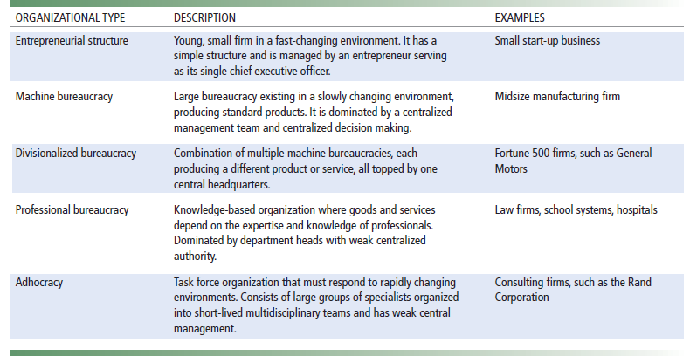
Organizational structure
Have a structure or shape.
identifies five basic kinds of organizational structure

Slide 14
Other Organization Features
Organizations have goals
coercive goals (e.g., prisons);
utilitarian goals (e.g., businesses)
normative goals (universities, religious groups)
Use different means to achieve them.
Constituencies: serve different groups
Leadership styles: democratic or authoritarian
Tasks and technology ( routine and nonroutine)

