Slide 1
Chapter - 4
Ethical and Social Issues in Information Systems

Slide 2
Outlines
4.1 Understanding Ethical And Social Issues Related To Systems
4.2 Ethics In An Information Society
4.3 The Moral Dimensions Of Information Systems
4.4 Hands-on Mis Projects

Slide 3
Recent cases of failed ethical judgment in business
Lehman Brother, Minerals Management Service, Pfizer
In many, information systems used to bury decisions from public scrutiny
Ethics
Principles of right and wrong that individuals, acting as free moral agents, use to make choices to guide their behaviors

Slide 4
A Model For Thinking about Ethical, Social, And Political Issues
Society as a clam pond
IT as rock dropped in pond, creating ripples of new situations not covered by old rules
Social and political institutions cannot respond overnight to these ripples- it may take years to develop etiquette, expectations, laws
Requires understanding of ethics to make choices in legally gray areas

Slide 5
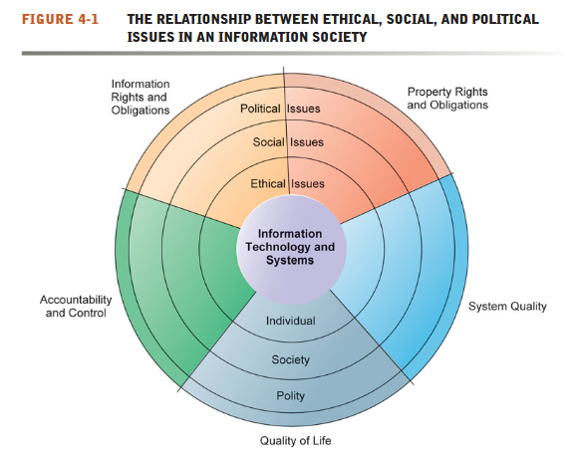

Slide 6
Five Moral Dimensions Of The Information Age
The major ethical, social, and political issues raised by information systems include the following moral dimensions:
Information rights and obligations
Property rights and obligations
Accountability and control
System quality
Quality of life

Slide 7
Information rights and obligations. What information rights do individuals and organizations possess with respect to themselves? What can they protect?
Property rights and obligations. How will traditional intellectual property rights be protected in a digital society in which tracing and accounting for ownership are difficult and ignoring such property rights is so easy?
Accountability and control. Who can and will be held accountable and liable for the harm done to individual and collective information and property rights?
System quality. What standards of data and system quality should we demand to protect individual rights and the safety of society?
Quality of life. What values should be preserved in an information- and knowledge-based society? Which institutions should we protect from violation?
Which cultural values and practices are supported by the new information technology?

Slide 8
Key Technology Trends That Raise Ethical Issues
Doubling of computer power
More organizations depend on computer systems for critical operations
Rapidly declining data storage costs
Organizations can easily maintain detailed databases on individuals
Networking advances and the internet
Copying data from one location to another and accessing personal data from remote locations is much easier
Advances in data analysis techniques
Companies can analyze vast quantities of data gathered on individuals for:
Profiling
Combining data from multiple sources to create dossiers of detailed information on individuals
Nonobvious relationship awareness (NORA)
Combining data from multiple sources to find obscure hidden connections that might help identify criminals or terrorists

