Slide 1
Management Information Systems (IS-311)
Text Books
Source: Kenneth C. Laudon & Jane P. Laudon (2012),
Management Information Systems: Managing the Digital Firm, Twelfth Edition, Pearson.

Slide 2
Chapter 1
Information System in Global Business Today
Outlines
1.1 The Role of Information Systems in Business Today
1.2 Perspectives on Information Systems
1.3Contemporary Approaches to Information Systems
1.4 Hands on MIS projects

Slide 3
Learning Objectives
Understanding the effects of information systems on business and their relationship to globalization.
Explain why information systems are so essential in business today.
Define an information system and describe its management, organization, and technology components.
Define complementary assets and explain how they ensure that information systems provide genuine value to an organization.
Describe the different academic disciplines used to study information systems and explain how each contributes to our understanding of them.
Explain what is meant by a sociotechnical systems perspective
Dedicated to helping you make decisions about information technology and information systems

Slide 4
The New Yankee Stadium Looks to the Future
Problem- Yankee fans choosing to watch games on TV or choose other forms of entertainment
Solutions- Use information systems to enhance experience. Game coverage, statistics, delivered via ubiquitous HDTV monitors, mobiles can order concessions, view replays
Cisco Systems provides technology to make Yankee Stadium the most wired in all of baseball
Demonstrates IT’s role in providing new products and services
Illustrates the benefits of utilizing networks and mobile applications to enhance entertainment, information

Slide 5
1.1 The Role of Information Systems in Business Today
How information systems are transforming business
Every day by observing how people conduct business
To rapidly changing customer demand, reduce inventories to the lowest possible levels, and achieve higher levels of operational efficiency
Use social networking tools to connect their employees, customers, and managers worldwide
- Increase in wireless technology use, Web sites
- Increased business use of Web technologies
-Cloud computing, mobile digital platform allow more distributed work, decision-making, and collaboration
Globalization opportunities
Internet has drastically reduced costs of operating on global scale
Presents both challenges and opportunities

Slide 6
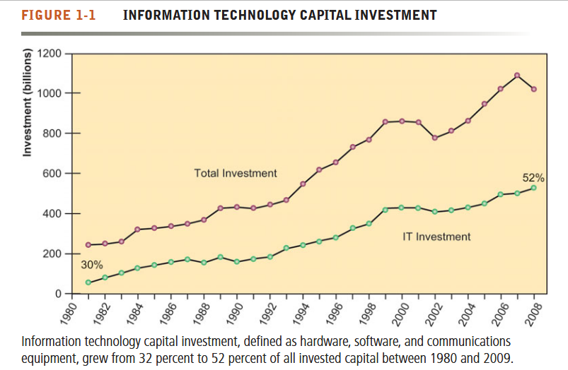
How Information Systems are Transforming Business

Slide 7
THE EMERGING DIGITAL FIRM
A digital firm in which nearly all of the organization’s significant business relationship with customers, supplier and employees are digitally enabled and mediated.
Digital firms allows a lot of business to buy, sell, advertise and solicit customer feedback online.
Digital firms offer extraordinary opportunities for more flexible global organization and management.
Digital firms sense and respond to their environment far more rapidly than traditional firms, giving them more flexibility to survive in turbulent times ( example : covid period ).

Slide 8
Cont.
In the emerging, fully digital firm
Significant business relationships are digitally enabled and mediated
Core business processes are accomplished through digital networks
Key corporate assets are managed digitally
Digital firms offer greater flexibility in organization and management
Time shifting, space shifting

Slide 9
What’s New In Management Information Systems?
the technology area there are three interrelated changes:
(1) the emerging mobile digital platform,
(2) the growth of online software as a service, and
(3) the growth in “cloud computing” where more and more business software runs over the Internet.
Table 1.1 What’s new in MIS
Example –
Change technology- Cloud computing platform emerges as a major business area of innovation
Business impact- A flexible collection of computers on the Internet begins to perform area of innovation tasks traditionally performed on corporate computers.

