Slide 1

Setup Django Project
University of Computer Studies, Yangon

Slide 2
Outlines
Set up a Database for a Django project
Set up Content: Understand URLs, Templates and Apps
Set up the Django admin site

Slide 3
Install Python Database Packages
To connect to a database in Django, it is necessary to install Python package to communicate with user database brand.
Each database relies on different packages, but installation process is straightforward with the pip package manager.
By default, PyCharm automatically creates an SQLite database for a Django project.

Slide 4
Python Packages for Different Database
Database | Python package | pip installation syntax
PostgreSQL | psycopg2 | pip install psycopg2
MySQL | mysql-python | pip install mysql-python
Oracle | cx_Oracle | pip install cx_Oracle
SQLite | Included with Python 2.5+ | N/A
Notes:
Pip is a package-management system written in python.
- To install and manage software packages.

Slide 5
Creating a database
The Django configuration to connect to a database is done inside the settting.py file of a Django project in the DATABASES variable.
DATABASES = { 'default': { 'ENGINE': 'django.db.backends.sqlite3', 'NAME': BASE_DIR / 'db.sqlite3', } }

Slide 6
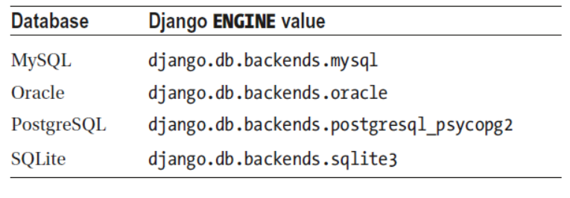
Creating a database
ENGINE and NAME which represent a database engine (i.e., brand) and the name of the database instance, respectively.
Django ENGINE value for different databases.

Slide 7
Creating a database with SQLite
One of the most common tasks that can do right now to test a database connection is to migrate the project’s data structures to the database.
The Django database migration process ensures all Django project logic associated with a database is reflected in the database itself.
When you start a Django project, there are a series of migrations Django requires that create tables to keep track of administrators and sessions.
Notes:
To do that, press Ctrl+Alt+R and type migrate followed by Enter in the manage.py console, that opens and run a migration as run the command makemigrations polls

Slide 8
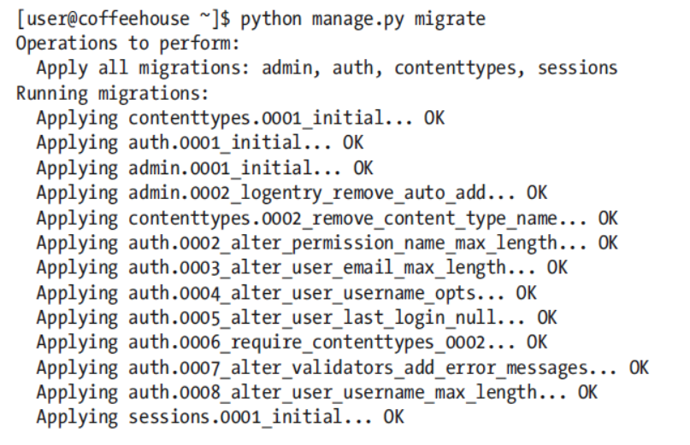
Connect Django Database
[user@ucsy ~]$ python manage.py migrate
If connection to the database is successful, Django applies a series of migrations that create database tables to manage users, groups, permissions, and sessions for a project.
Notes:
Test Django Database Connection and Build Django Base Tables

Slide 9
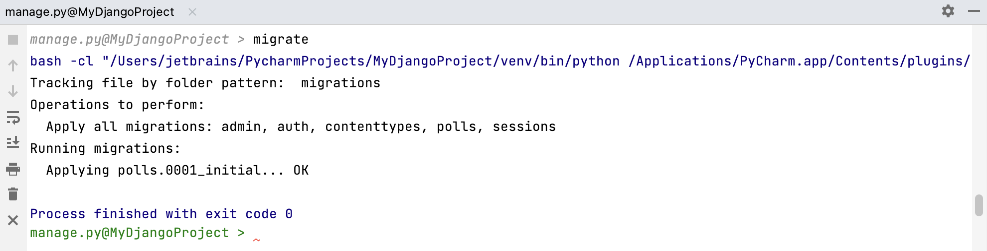
Creating a database with SQLite
Migrations are human-editable files, in which Django stores changes to data models.
To apply changes and create tables in the database for the two new models, run the migrate command again:

Slide 10
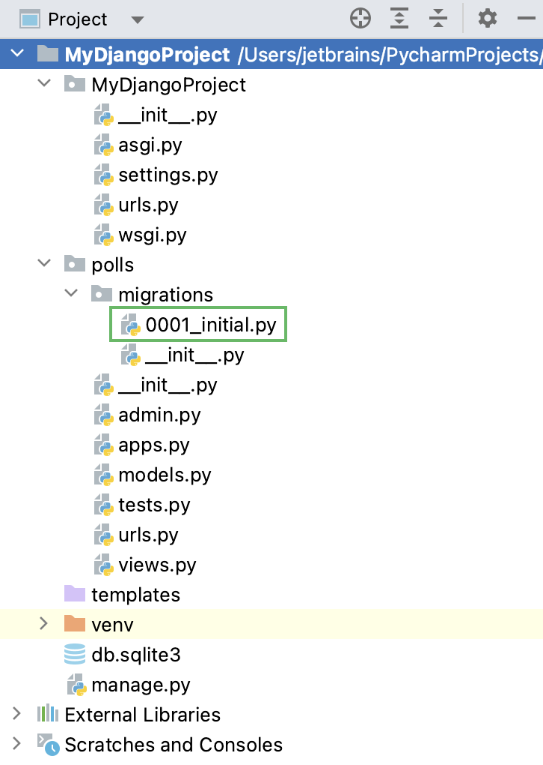
Creating a database with SQLite
The polls/migrations directory now contains the migration file 0001_initial.py:

Slide 11
Set Up Content
Content in Django projects works with three major building blocks: urls, templates, and apps.
Create and configure Django urls, templates, and apps separately, which is part of Django’s loosely coupled architecture design principles.
Urls define the entry points or where to access content.
Templates define the end points that give form to the final content.
Apps serve as the middleware between urls and templates, altering or adding content from a database or user interactions.

Slide 12
Static Content Vs Dynamic Content
To run static content you only need to create and configure Django urls and templates.
To run dynamic content - built from a database or user interactions - you need to create and configure Django apps, in addition to urls and templates.

Slide 13
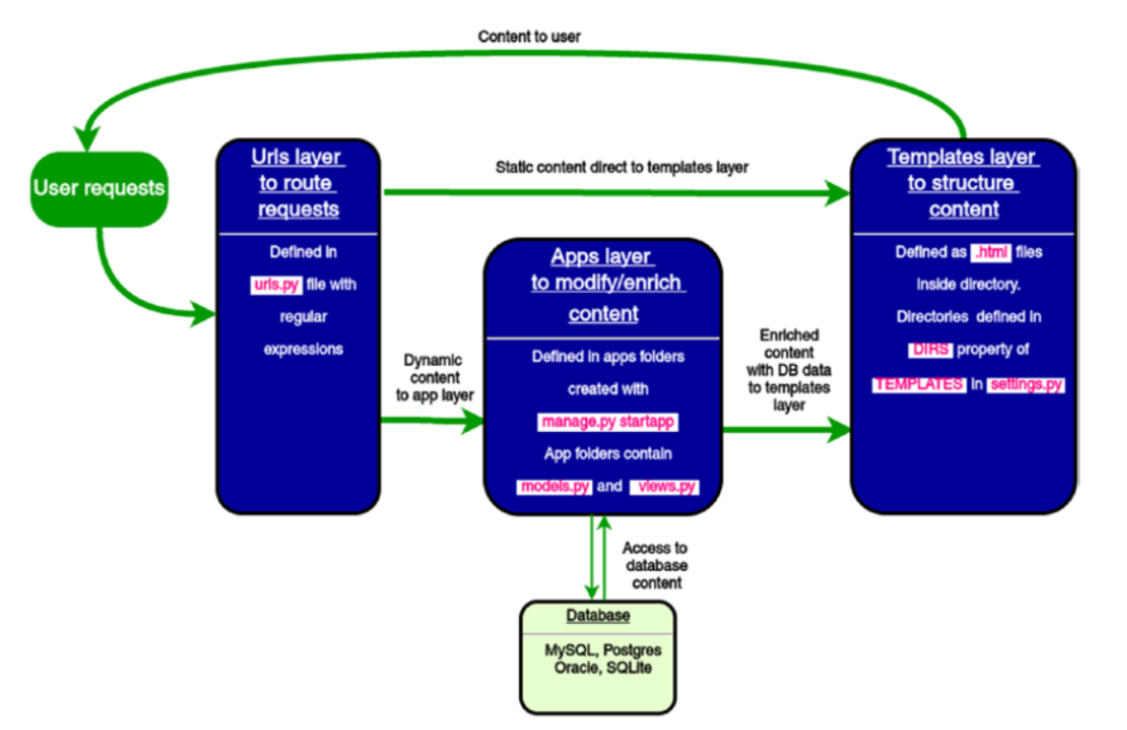
Django workflow for urls, templates, and apps Django workflows for Urls, Templates, and Apps

Slide 14
Create and Configure Django Urls
Since Django is a web application framework, it gets user requests by URL locater and responds back.
To handle URL, django.urls module is used by the framework.
The main entry point for Django urls is the urls.py file
from django.contrib import admin from django.urls import path from django.views.generic import TemplateView
... ...
urlpatterns = [ path('admin/', admin.site.urls), path('',TemplateView.as_view(template_name='home.html')), ]
Notes:
http://127.0.0.1:8000/admin

Slide 15
Create and Configure Django Urls(Cont’d)
The path method comes from the django.urls package.
The path function takes the first argument as a route of string or regex type.
TemplateView.as_view(template_name='homepage.html’)
This last action is a helper method to direct the requesting party to a template that takes the argument template_name = 'homepage.html‘
Django that requests for the home page should return the content in the template homepage.html.

Slide 16
Create and Configure Django Templates
By default, Django templates are interpreted as HTML.
This means Django templates are expected to have a standard HTML document structure and HTML tags (e.g., <html>, <body>).
Use a regular text editor to create Django templates and save the files with an .html extension.
create a file named homepage.html
Save the file on your system, in a subdirectory called templates in Django project’s MyDjangoProject.

Slide 17
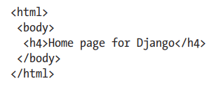
Create and Configure Django Templates(Cont’d)
It is needed to configure a Django project so it can find the templates in this directory.
In the settings.py file of the Django project, you need to define the template directory in the DIRS property of the TEMPLATES variable.

Slide 18
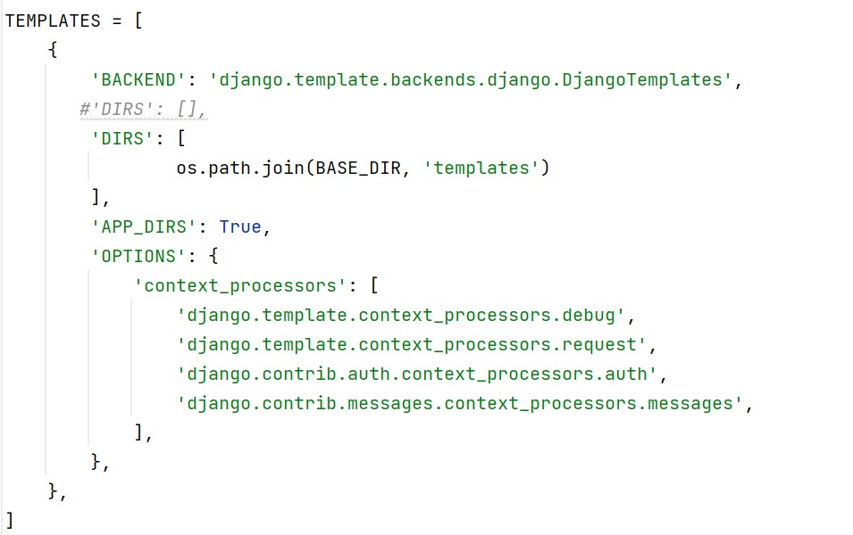
Create and Configure Django Templates(Cont’d)

Slide 19
Create and Configure Django Apps
Django apps are used to group application functionality.
In order to work with content from a database or user interactions it is needed to create and configure Django apps
A project can contain as many apps as they are needed
For example, if you have a project for a coffeehouse, you can create an app for stores, another app for menu items, another app for about information, and create additional apps as they’re needed.
Django apps are normally contained in subdirectories inside a project

Slide 20
Create and Configure Django Apps(Cont’d)
By default, all django projects are enabled with six apps provided by the framework.
These apps are
django.contrib.admin
django.contrib.auth
django.contrib.contenttypes
django.contrib.sessions
django.contrib.messages
and django.contrib.staticfiles

Slide 21
Set Up the Django admin Site
The Django admin site provides a web-based interface to access the database connected to a Django project.
Admin site can expose all Django project-related data structures linked to a database
It is easy for experts and novices alike to perform database CRUD operations
Notes:
As project grows, admin site can be a vital tool to administer the growing body of information in the database connected to a project.
CRUD is the acronym for CREATE, READ, UPDATE and DELETE.

Slide 22
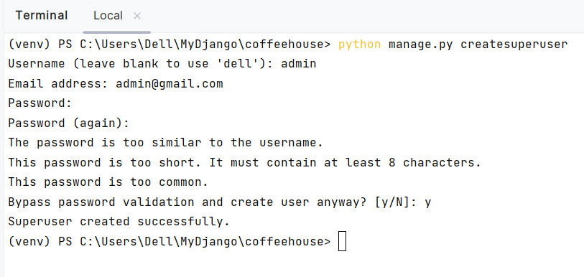
Set Up the Django admin Site(Cont’d)
By default, the Django admin is enabled on all Django projects.
Firstly, we need to create a superuser.
To do that, type the createsuperuser command in the manage.py console, specify your email address, and password:

Slide 23
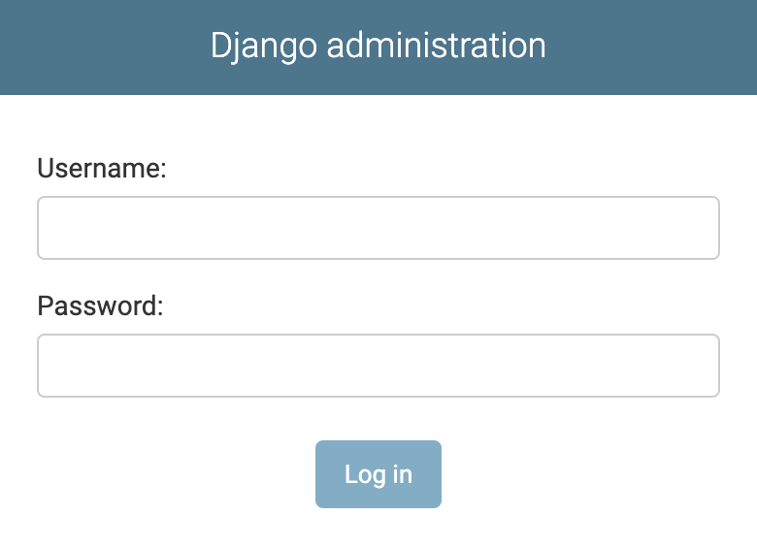
Set Up the Django admin Site(Cont’d)
Now go to /admin/ on your Django server, for example, http://127.0.0.1:8000/admin/.
You will see the following login page:

Slide 24
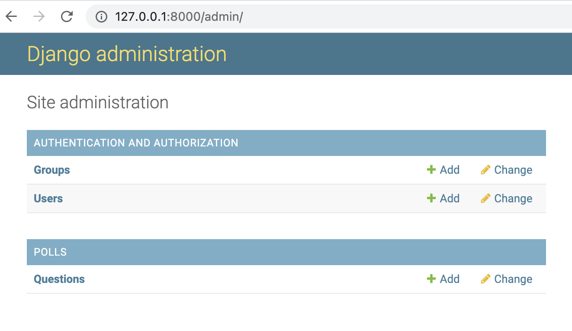
Admin Site App
introduce the superuser username and password you just created into the interface in the following:
User’s credentials (e.g., password, email, username) can change or new users can add directly from this Django admin site screen

Slide 25
Thank You

