Slide 1
Chapter – 6 Django - Forms

Slide 2
Outlines
What is Django Form?
Django Form Workflow
Building a Form in Django
Instantiating Form in Django
Accessing Form Values
Validating Form Values

Slide 3
Django – Forms Processing
Django provides a Form class that is used to create HTML forms.
Each field in the form class maps to an <input> element in the HTML form, each of which is the class itself.
It manages form data and performs validation while submitting the form.
Notes:
Django Create Project: django-admin startproject first_project
Django Create App: python manage.py startapp myapp
Run App : python manage.py runserver

Slide 4
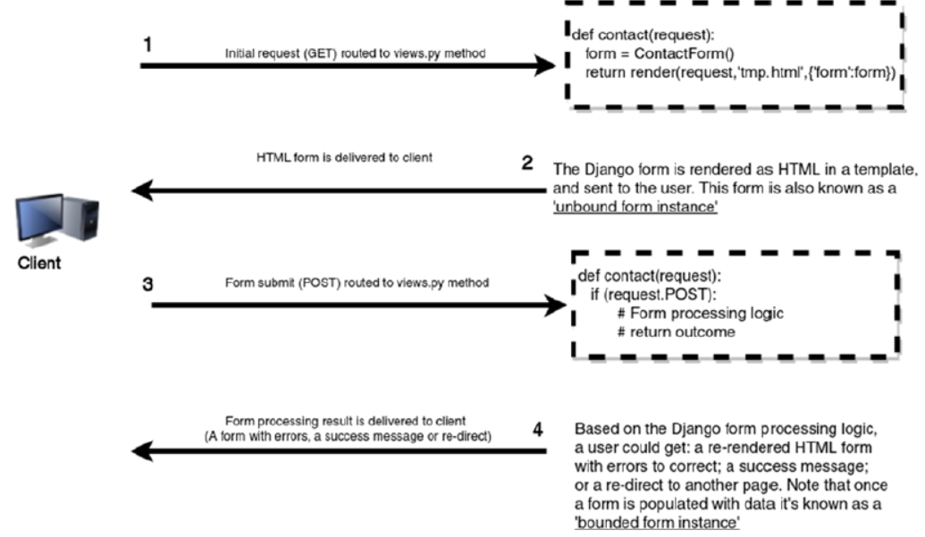
Django Form Workflow

Slide 5
Building a Form in Django
Let's add a forms.py in file in “application” folder to contain our application forms.
from django import forms
class StudentForm(forms.Form):
username = forms.CharField (label = 'Enter your name:', max_length = 100)
password = forms.CharField (label = 'Enter Password:', widget = forms.PasswordInput())
email = forms.EmailField (label = 'Enter Your Email')

Slide 6
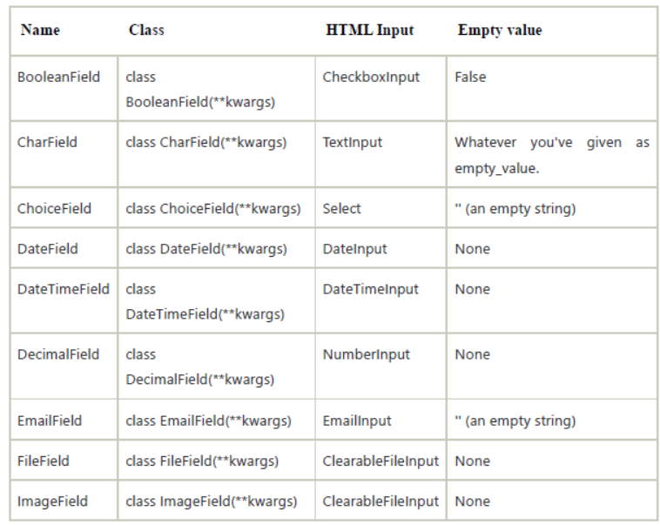
Some Useful Form Fields in Django

Slide 7
Instantiating Form in Django
It needs to instantiate the form in views.py file.
from django.shortcuts import render
from myapp.form import StudentForm
def index(request):
student = StudentForm()
return render(request, "index.html", {'form' : student})
Passing the context of form into index template.

Slide 8
The Template (index.html)
<!DOCTYPE html>
<html lang="en">
<head>
<meta charset="UTF-8">
<title>Index</title>
</head>
<body>
<form method="POST" class="post-form">
{% csrf_token %}
{{ form.as_p }}
<button type="submit" class="save_btn">Save</button>
</form>
</body>
</html>

Slide 9
Output Options
There are other output options-
{{ form.as_table }} will render them as table cells wrapped in <tr> tags
{{ form.as_p }} will render them wrapped in <p> tags
{{ form.as_ul }} will render them wrapped in <li> tags
{% csrf_token %} is a special tag reserved for cases when a web form is submitted via POST and processed by Django.
The csrf initials mean Cross-Site Request Forgery, which is a default security mechanism enforced by Django.
The inclusion of a CSRF token in a web form makes it very difficult to forge a user’s request.

Slide 10
URL in urls.py
Run Server and access the form at browser by localhost:8000/index.
from django.contrib import admin
from django.urls import path
from myapp import views
urlpatterns = [
path('admin/', admin.site.urls),
path('index/', views.index),
]

Slide 11
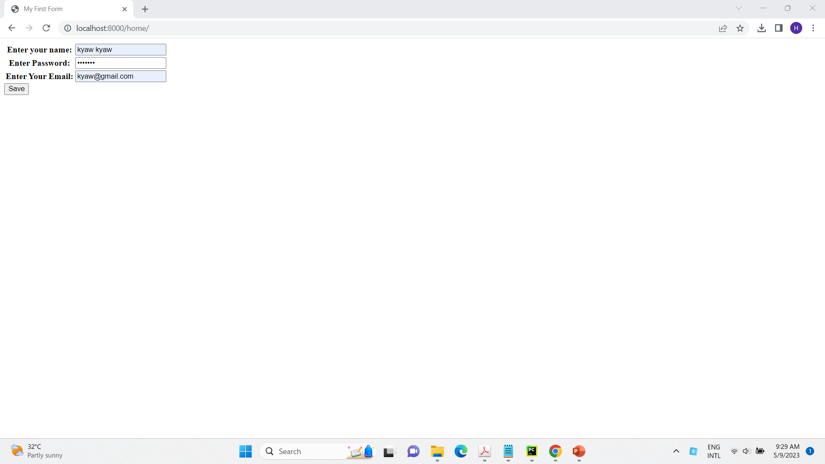
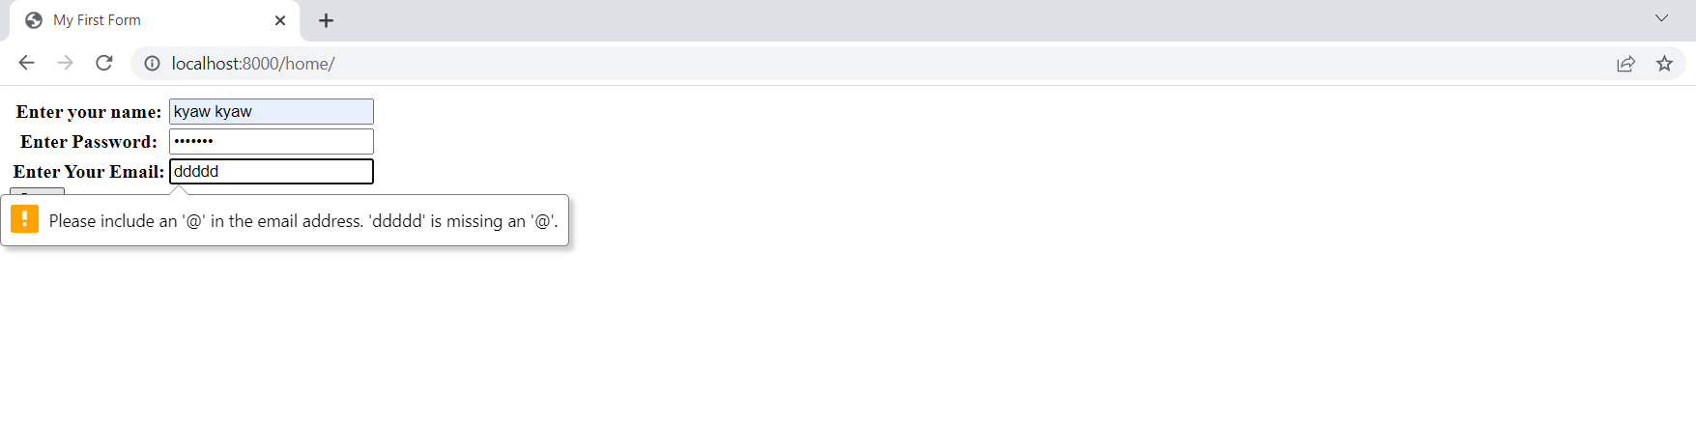

Slide 12
Accessing Form Values
Once a user fills out a Django form, the form is sent back to the server to be processed and performs an action with the user data.
Advantages : Django form processing is you can use the request.POST variable to create a bound form instance.
Syntax :
form.cleaned_data['name']
form.cleaned_data['age']

Slide 13
forms.py
class LoginForm(forms.Form): name = forms.CharField(label='Enter user name:', max_length=100) password = forms.CharField(label='Enter Password:’, widget=forms.PasswordInput())
views.py
def login(request): if request.method == 'POST': login_form = LoginForm(request.POST) if login_form.is_valid(): name = login_form.cleaned_data['name'] password = login_form.cleaned_data['password'] return HttpResponse('Welcome ' + name) else: pass else: login_form = LoginForm() return render(request,"login.html",{'form':login_form})

Slide 14
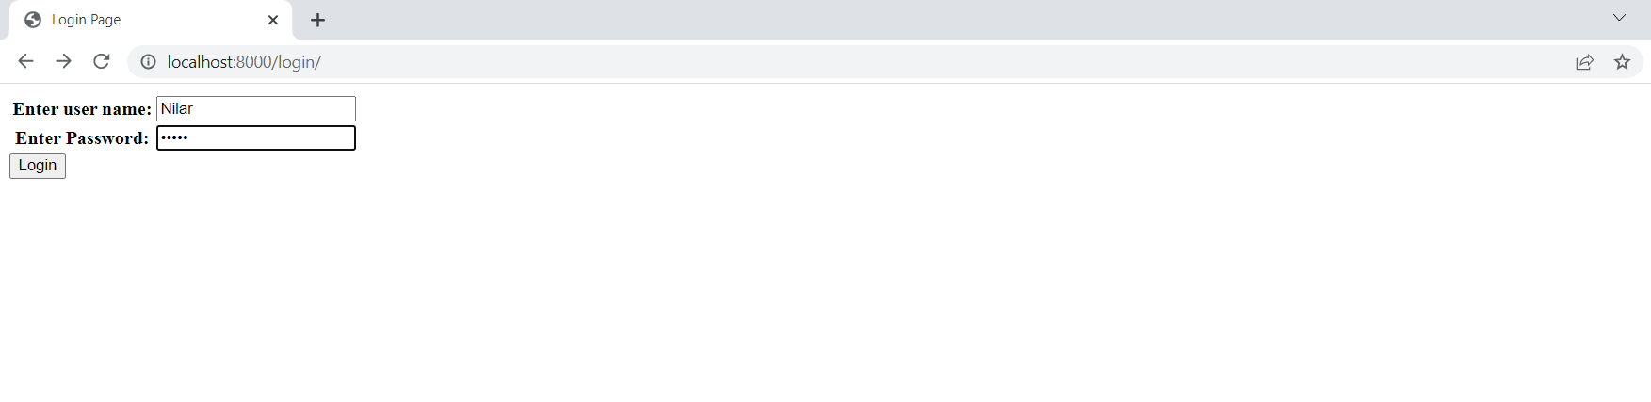
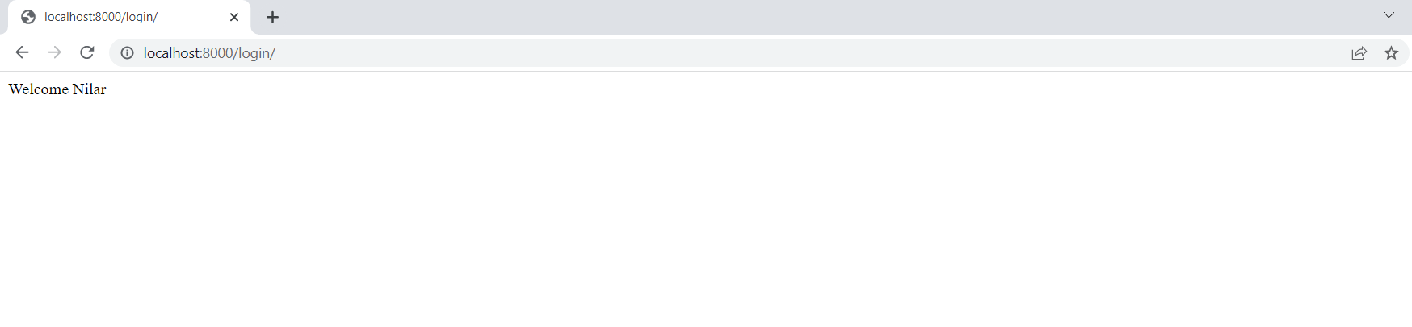

Slide 15
Validating Form Values
Call the is_valid() method on the instance to determine if the included values comply with a form’s field definitions.
is_valid() method returns a Boolean True or False value.
Calling is_valid() creates the cleaned_data dictionary on the form instance to hold the form field values that passed validation rules.

Slide 16
Example : Django form is_valid()
from django.http import HttpResponseRedirect
if request.method == 'POST':
form = ContactForm(request.POST)
if form.is_valid():
return HttpResponseRedirect('/about/contact/thankyou')
else:
pass
else:
form = ContactForm()
return render(request, 'about/contact.html', {'form':form})

Slide 17
Example : Validation with custom validator method
from django import forms
def validate_comment_word_count(value):
count = len(value.split())
if count < 30:
raise forms.ValidationError(('Please provide at least a 30 word message,
%(count)s words is not descriptive enough'), params={'count': count})
class ContactForm(forms.Form):
name = forms.CharField(required=False)
email = forms.EmailField(label='Your email’)
comment = forms.CharField(widget=forms.Textarea,validators=[validate_comment_word_count])
forms.py
def contact(request):
c_form = ContactForm(request.POST) return render(request, "contact.html", {'form': c_form})
views.py

Slide 18
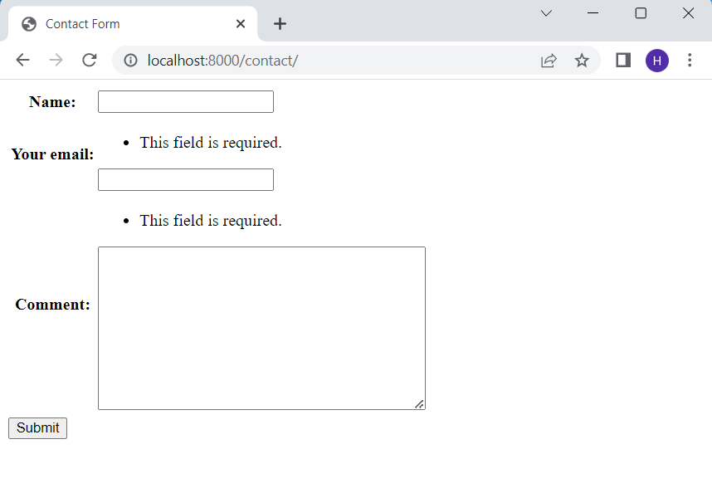

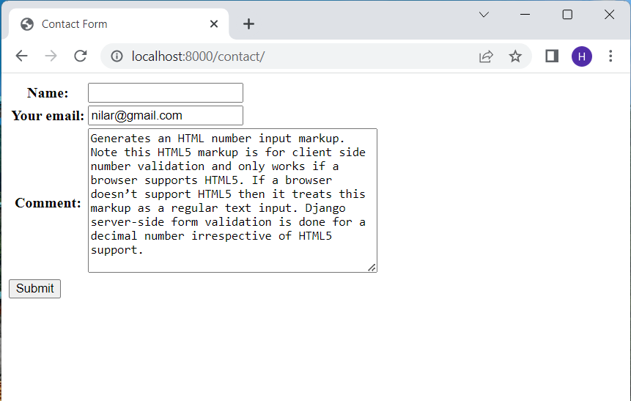
Notes:
Note - The default number of rows of Textarea is 10.

Slide 19
Example : Validation with clean_<field>() methods
from django import forms
class ContactForm(forms.Form):
name = forms.CharField(required=False)
email = forms.EmailField(label='Your email')
comment = forms.CharField(widget=forms.Textarea)
def clean_name(self):
value = self.cleaned_data['name']
if value.isupper():
raise forms.ValidationError("Please don't use all uppercase for name”, code='uppercase’)
return value
def clean_email(self):
value = self.cleaned_data['email']
if value.endswith('@hotmail.com'):
raise forms.ValidationError("Please don't use a hotmail email”, code='hotmail’)
return value

Slide 20
Django Form Field Widget
Field Type | Django Field Type | HTML output | Django Widget | Validation Behavior
Boolean | Forms.BooleanField() | <input type='checkbox' ...> | Forms.widgets. CheckboxInput() | Generates HTML checkbox input markup to obtain a Boolean True or False value; returns False when the checkbox is unchecked, True when the check box is checked.
Boolean | Forms.NullBooleanField() | <select><option value="1" selected="selected">Unknown </option><option value="2">Yes </option><option value="3">No </option></select> | Forms.widgets. NullBooleanSelect() | Works just like BooleanField but also allows "Unknown" value; returns None when the Unknown(1) value is selected, True when the Yes(2) value is selected and False when the No(3) value is selected.
Text | Forms.CharField() | <input type=“text” …> | Forms.widgets. TextInput() | Generates HTML text input markup.
Text(specified) | Forms.CharField() | <input type=“email” …> | Forms.widgets. EmailInput() | Generates HTML email input markup. Note this HTML5 markup is for client-side email validation and only works if a browser supports HTML5. If a browser doesn’t support HTML5, then it treats this markup as a regular text input.

Slide 21
Django Form Field Widget
Field Type | Django Field Type | HTML output | Django Widget | Validation Behavior
Text(Specialized) | forms.GenericIPAddressField() | <input type="text" ...> | forms.widgets.TextInput() | Works just like CharField, but server-side Django validates the (text) value can be converted to an IPv4 or IPv6 address (e.g., 192.46.3.2, 2001:0db8:85a3:0000:0000:8a2e:0370:7334).
Text(Specialized) | forms.SlugField() | <input type="text" ...> | forms.widgets.TextInput() | In Django a ‘slug’ is a value that contains only lowercase letters, numbers, underscores and hyphens, which is typically used to sanitize URLs and file names (e.g., the slug representation of 'What is a Slug?! A sanitized-string' is what-is-a-slug-a-sanitized string.
Files(Specialized) | forms.ImageField() | <input type="file" ...> | forms.widgets.ClearableFileInput() | Generates HTML file input markup so an end user is able to select an image file through his web browser. Works just like File Field but provides additional utilities to handle post-processing of images using the Pillow package.

Slide 22
Django Form Field Widget
Field Type | Django Field Type | HTML output | Django Widget | Validation Behavior
Date/time | forms.DateField() | <input type=“text” ...> | forms.widgets.DateInput() | Server-side Django validates the (text) value can be converted to a datetime.date, datetime.datetime, or string formatted in a particular date format (e.g. 2017-12-25, 11/25/17).
Date/time | forms.TimeField() | <input type="text" ...> | forms.widgets.TextInput() | Server-side Django validates the (text) value can be converted to a datetime. time or string formatted in a particular time format (e.g., 15:40:33, 17:44).
Date/time | forms.DateTimeField() | <input type="text" ...> | forms.widgets.DateTimeInput() | server-side Django validates the (text) value can be converted to a datetime. datetime, datetime.date, or string formatted in a particular datetime format (e.g. 2017-12-25 14:30:59, 11/25/17 14:30).

Slide 23
Django Form Field Widget
Field Type | Django Field Type | HTML output | Django Widget | Validation Behavior
Number | forms.IntegerField() | <input type="number" ...> | forms.widgets.NumberInput() | Generates an HTML number input markup. If a browser doesn’t support HTML5 then it treats this markup as a regular text input. Django server-side form validation is done for an integer number irrespective of HTML5 support.
Number | forms.DecimalField() | <input type="number" ...> | forms.widgets.NumberInput() | supports HTML5. If a browser doesn’t support HTML5 then it treats this markup as a regular text input. Django server-side form validation is done for a decimal number irrespective of HTML5 support.

Slide 24
Django Form Widget - Example (1)
forms.py
class Registration(forms.Form): username = forms.CharField() password = forms.CharField(widget=forms.PasswordInput()) confirm_password = forms.CharField(widget=forms.PasswordInput()) email = forms.EmailField(label='Enter your Email') agree = forms.BooleanField(label='I\'m Agree')
def register(request): form = Registration(request.POST or None) return render(request, 'registration.html', {'form': form})
views.py

Slide 25
Example (2)
forms.py
BIRTH_YEAR_CHOICES = ["1980", "1981", "1982", "1983", "1984"] FAVORITE_COLORS_CHOICES = [ ("blue", "Blue"), ("green", "Green"), ("black", "Black"),
]
CHOICES = [("1", "First"), ("2", "Second")]
class SelectionForm(forms.Form): date_of_birth = forms.DateField(widget=forms.SelectDateWidget(years=BIRTH_YEAR_CHOICES)) favorite_colors = forms.MultipleChoiceField( required=False, widget=forms.CheckboxSelectMultiple, choices=FAVORITE_COLORS_CHOICES, ) choice_field = forms.ChoiceField(widget=forms.RadioSelect, choices=CHOICES)

Slide 26
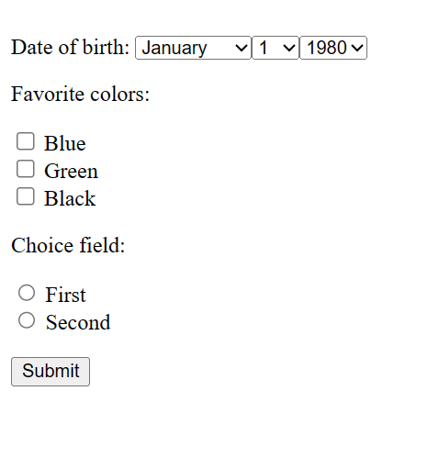
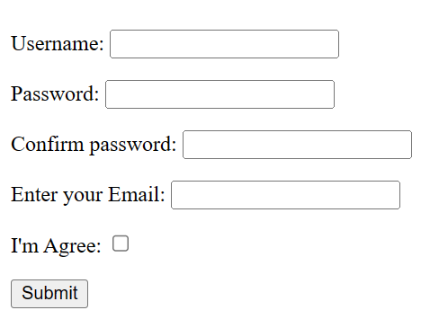
Output:

Slide 27
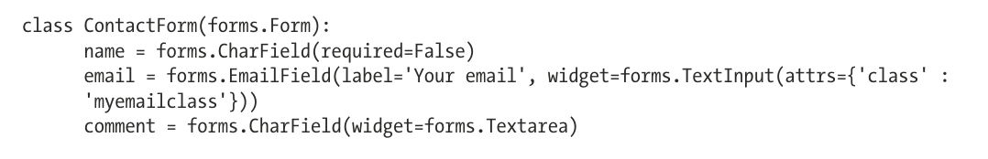
Widget definition to add custom CSS class

Slide 28
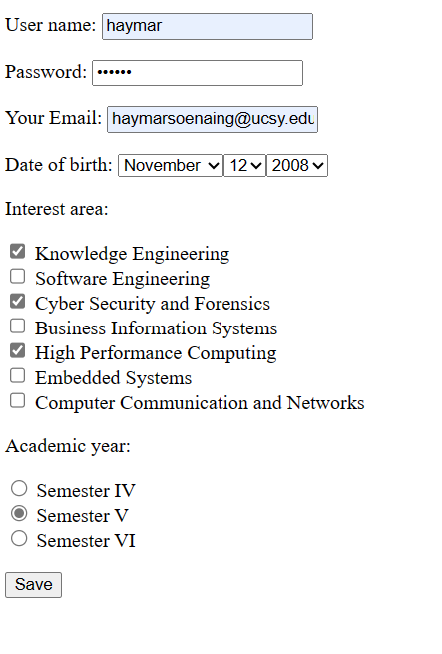
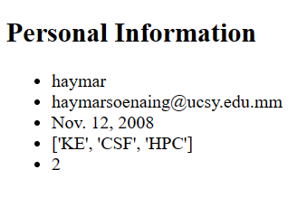
Exercise
Display the input of name, email, date of birth, selected interested area and academic year field on another page ‘list.html’.

Slide 29
Quiz – (1)

Slide 30
Tutorial – (1)

Slide 31
Assignments – (1)

Slide 32
Thank You!

