Slide 1


Slide 2
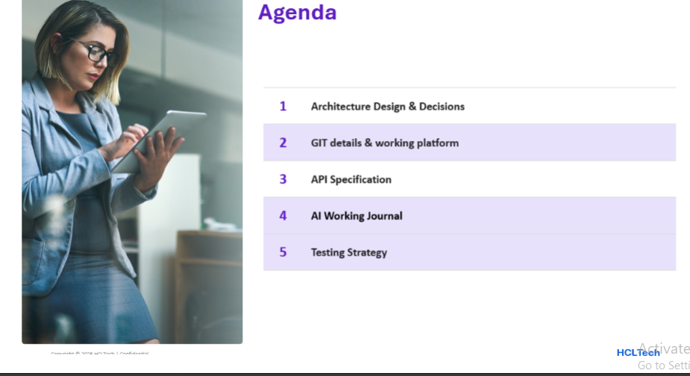

Slide 3
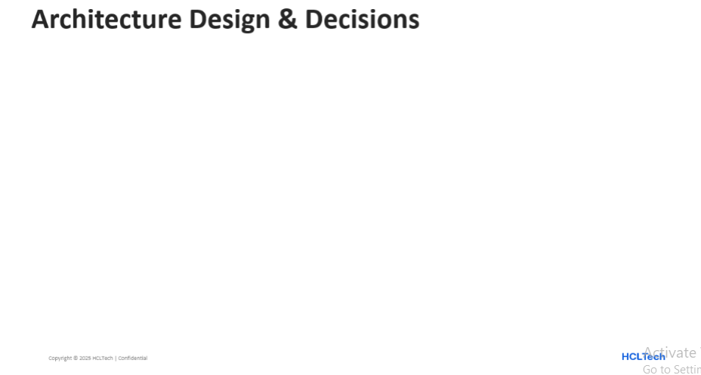
Layered architecture with a domain core - dependencies point inward
api -> service -> domain; infrastructure -> domain
domain is framework/persistence-free - pure business models
api never touches infrastructure directly - always via service
DTOs stay in api; JPA entities stay in infrastructure; only domain models cross
Explicit mapper at every boundary
RequestDtoToDomain, DomainToResponseDto, PolicyMapper
Key decisions
Contract-first OpenAPI is the source of truth
Specification pattern for composable, injection-safe filtering
PolicyExpiry centralizes the 30-day expiring-soon rule
@RestControllerAdvice for safe errors - no stack traces
CorrelationIdFilter + SLF4J MDC for request tracing
Enforced rules: <=200-line files, <=50-line methods, complexity <4, Optional over null

Slide 4
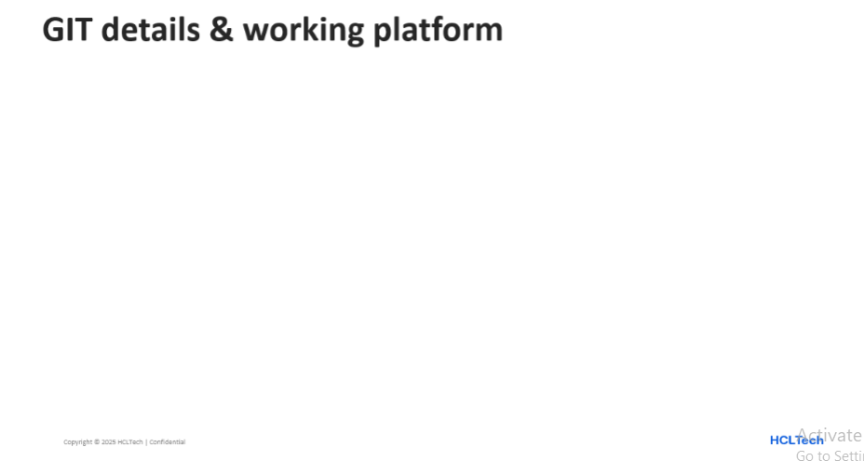
Repository
Remote: github.com/may2313ank/chubb-insurance.git
Default branch: main
target/ and Maven wrapper internals are git-ignored
Working platform
OS: Windows 11
Java 21 (LTS); build via Maven 3.9 wrapper (./mvnw)
IDE: IntelliJ IDEA; AI assistant: Claude Code
DB: H2 in-memory (dev/test); PostgreSQL 16 target
Tech stack (pinned)
Spring Boot 3.4.1 (latest - 1, for stability)
springdoc-openapi (Swagger UI) 2.7.0
JUnit 5 via spring-boot-starter-test

Slide 5
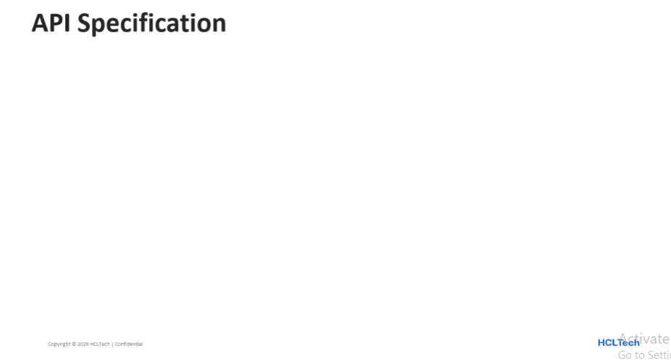
Contract-first OpenAPI 3.0.3 - served at /swagger-ui.html from the static YAML
Base path: /api/v1/policies
GET /api/v1/policies - paginated list; filters (status, lineOfBusiness, region, date range) + free-text q; page/size/sort
GET /api/v1/policies/{id} - full detail of one policy by UUID
PATCH /api/v1/policies/flag - bulk-flag by id list; returns requested/flagged/missing
GET /api/v1/policies/summary - counts by status, premium by line of business, expiring-soon count
Frontend shaping: display values (Active, Singapore), isExpiringSoon, totalElements/totalPages, {amount, currency}
Errors: standard ErrorResponse; 400 / 404 / 503; never exposes stack traces

Slide 6
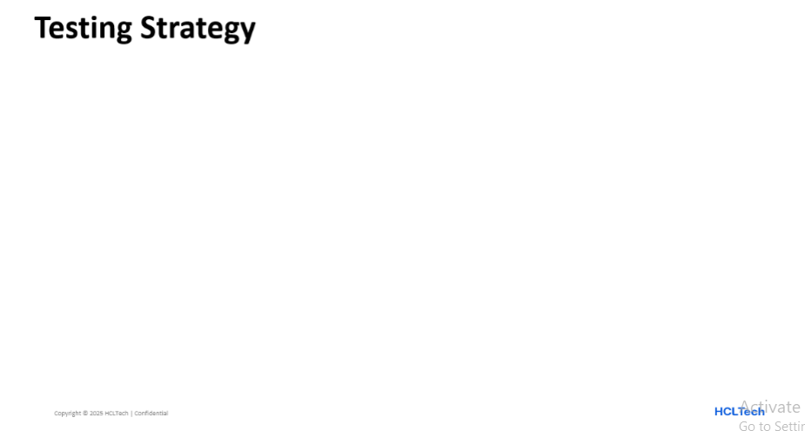
26 tests, all green - layered to mirror the architecture
PolicyServiceTest (5) - unit (Mockito): business logic & 404 path
PolicyControllerTest (8) - web slice (@WebMvcTest + MockMvc): endpoints, validation, JSON shape
CorrelationIdFilterTest (3) - unit: ID generation, inbound-header reuse, MDC cleanup
PolicySpecificationFactoryTest (4) - unit: filter predicate construction
PolicyRepositoryIntegrationTest (6) - integration (@DataJpaTest + H2): filtering, search, aggregation, expiry
Principles: unit for service & controller; integration incl. DB; naming method_scenario_outcome; error paths (400/404/503) covered

Slide 7


