Slide 1
[Begin Turn]
Space: play attempted
'd': dumping
ADVANCE
'p': pass
ADVANCE
Valid?
SCORE, ADVANCE
ELSE, reset

Slide 2
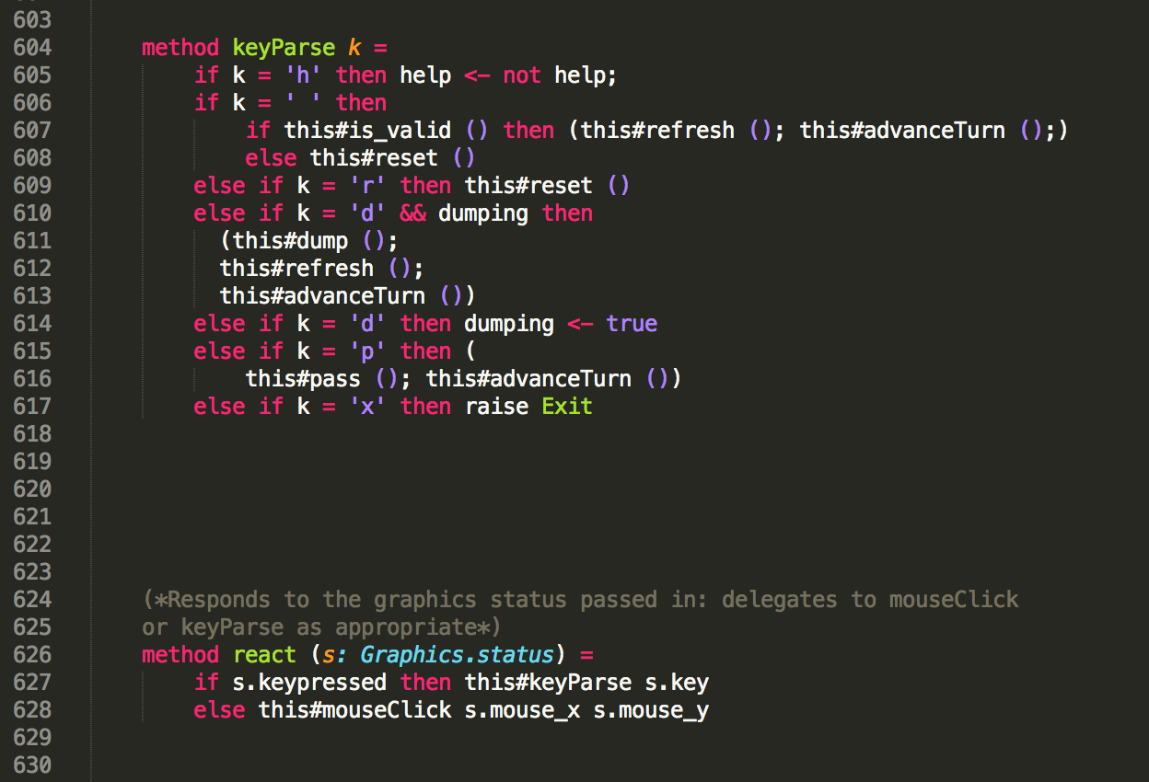

Slide 3
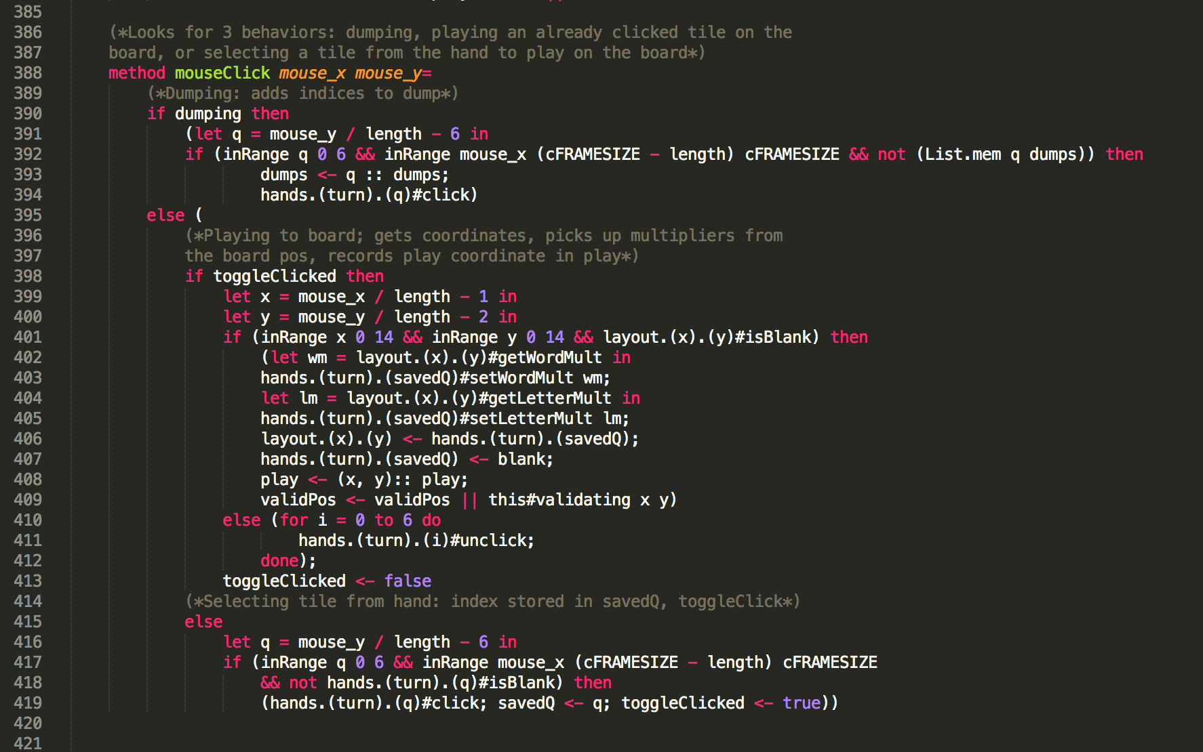

Slide 4
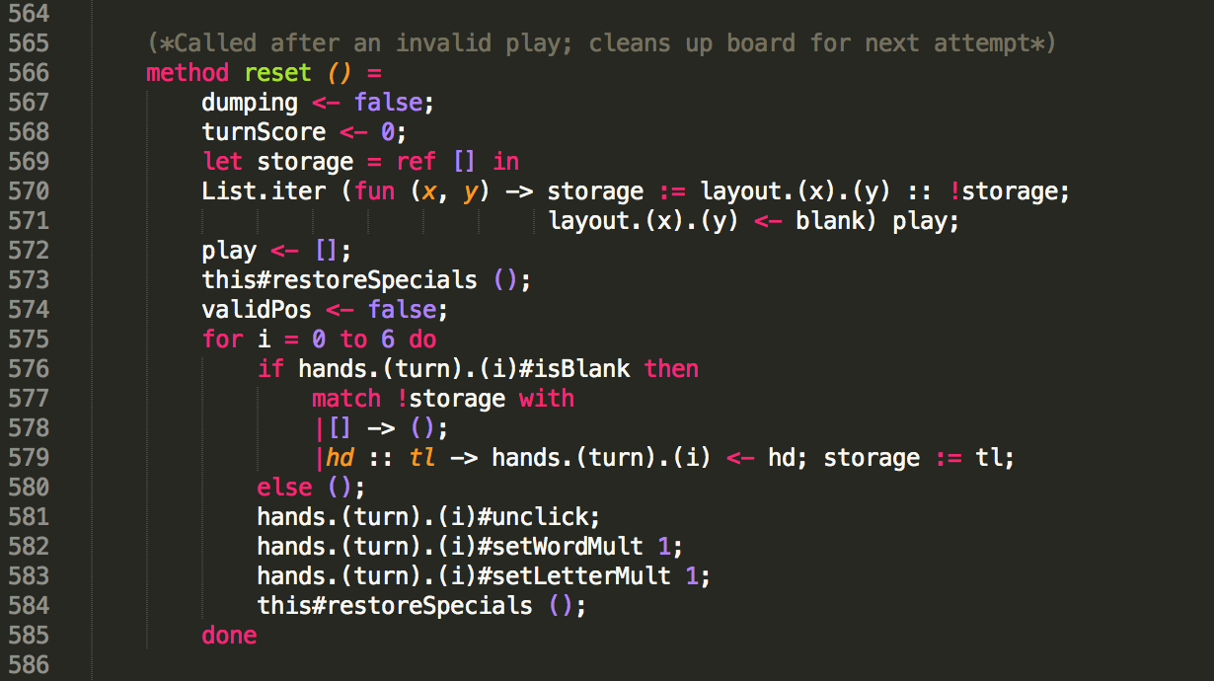
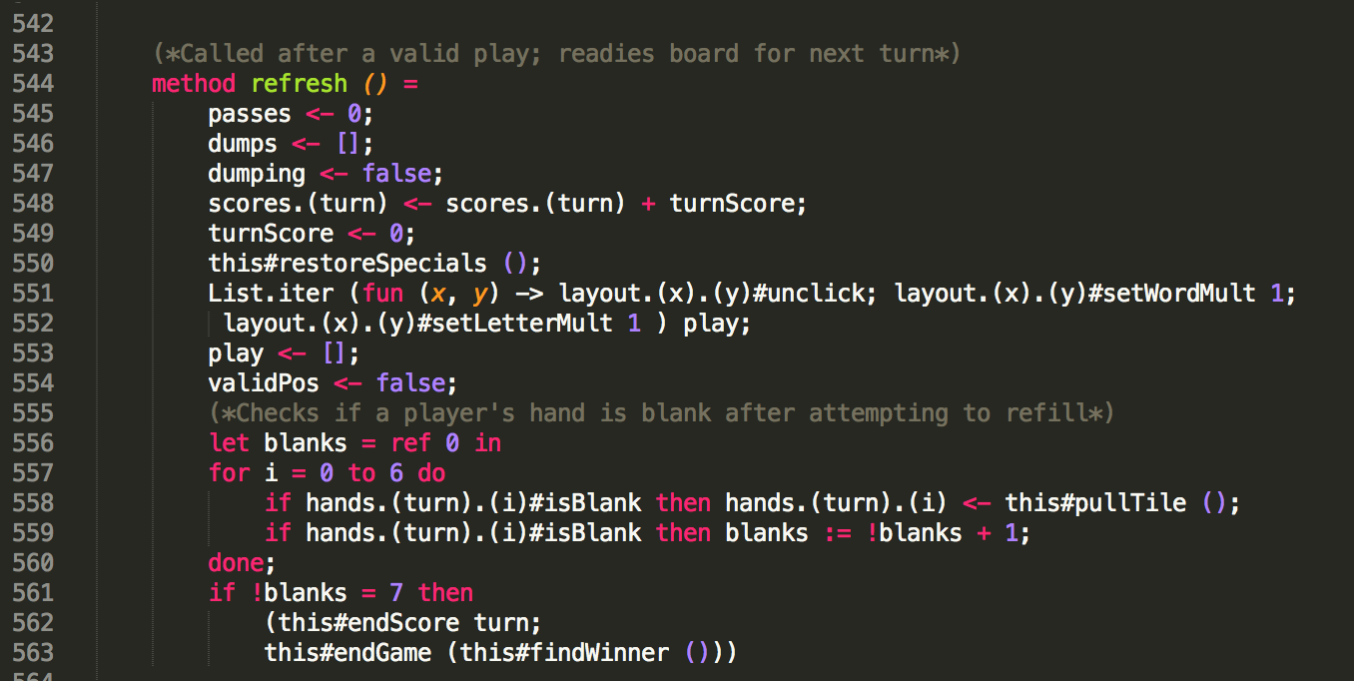

Slide 5
is_valid ()
Main word valid (including adjacent tiles)?
Each played tile has legal perpendicular word (or empty)?
Valid position for word?
SCORING: takes place as each condition checked
Includes special cases to handle 0-, 1-tile plays

Slide 6
Visual Intuition
?
?
_{H}
?
?
?
?
?
_{C}
?
?
_{H𝛔(3)}
_{H𝛔(2)}
_{H𝛔(1)}
_{H𝛔(4)}
_{H𝛔(5)}
_{H𝛔(6)}
_{B}
?
?
?
?
?
?
?

Slide 7
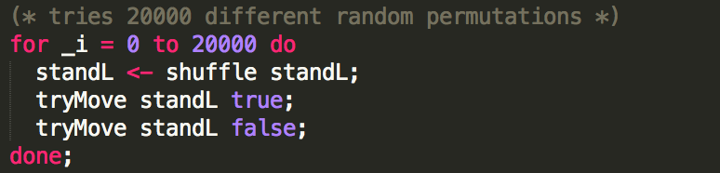
AI Core Loop

Slide 8
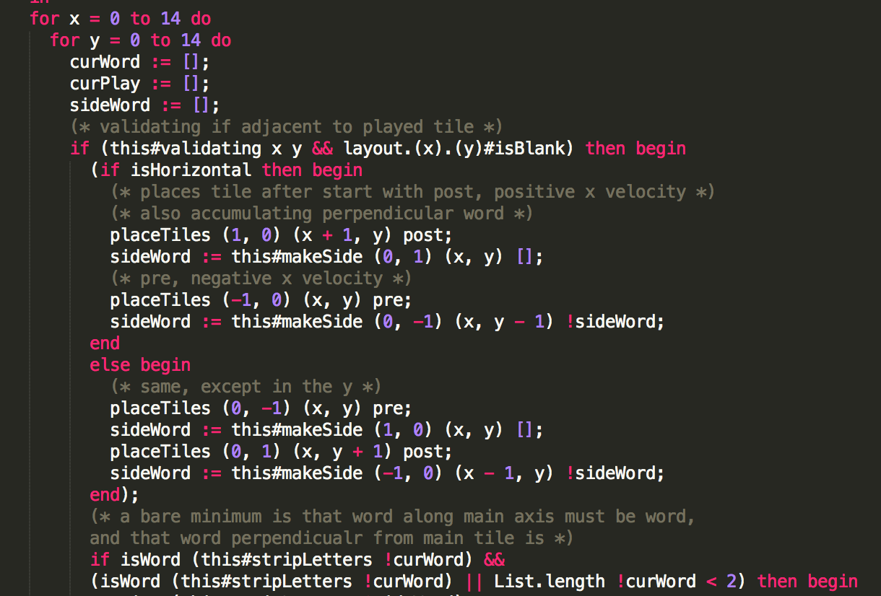
AI Board Loop

Slide 9
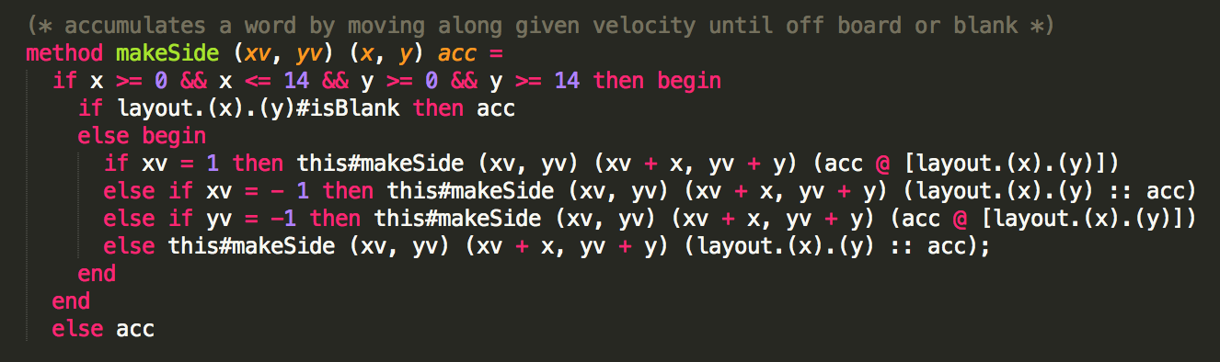
Incident word compiler

