Slide 1
Beyond the Hotspot: Spatial and Longitudinal Analysis of Differing Heat Exposure and Warming Trajectories In Bangladesh, 1983-2016
Maya Arnott
P9380: Advanced Public Health GIS | Spring 2026
29 April 2026
P9380: Advanced Public Health GIS | Columbia University Mailman School of Public Health | Spring 2026
1 / 12

Slide 2
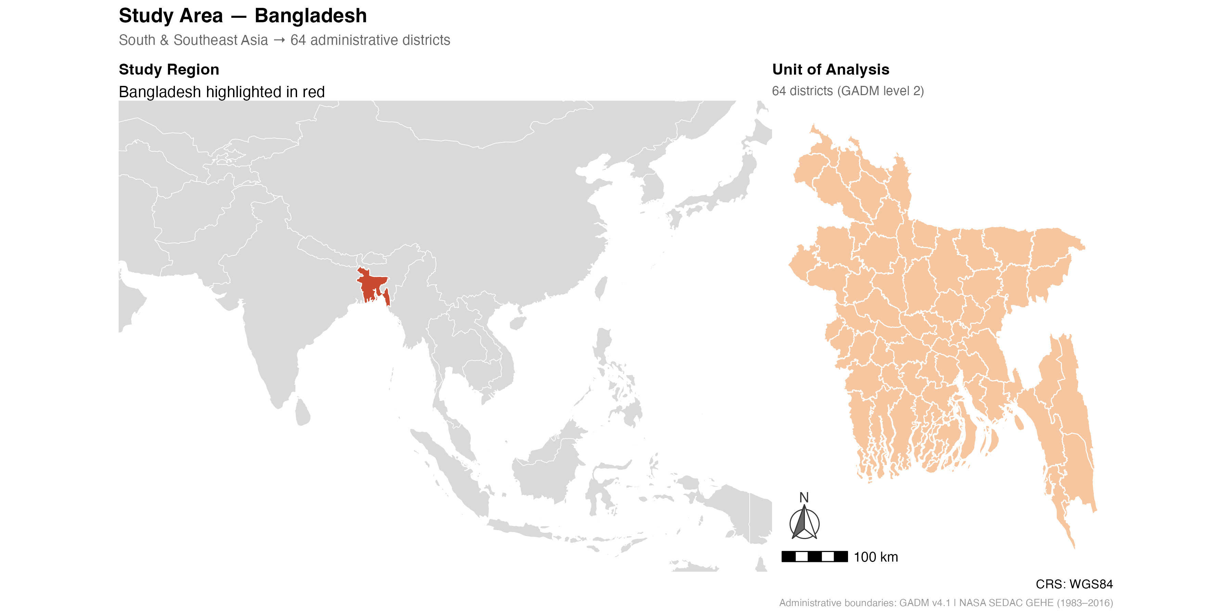
Introduction
Section I
Public Health Background
Extreme humid heat is one of the most lethal consequences of climate change and Southeast Asia contribute more than half of all global deaths attributed to high temperatures [1]. The problem is spatial because Asia is warming twice as fast as global averages [2].
Research Question
Where is extreme humid heat currently most severe in Bangladesh, and do those areas align with future risk hotspots?
Analytical Approach (Preview)
This project applies a spatial analytical framework to 34 years of satellite data including:
Bivariate Local Indicators of Spatial Association (LISA)
Emerging Hotspot Analysis (EHSA)
Bayesian model
To 64 administrative districts in Bangladesh to examine the spatial and temporal structure of extreme heat risk.
Figure 1. Study Region. [South Asia, Natural Earth]
Figure 2. Study Area. [Bangladesh, GADM boundaries, 2022].
P9380: Advanced Public Health GIS | Columbia University Mailman School of Public Health | Spring 2026
2/ 12

Slide 3
Literature Review
Section II
Theoretical Framework
Key Evidence from the Literature
Gap & Contribution
Heat risk is socially unequal [3]
Impacts are worst where adaptive capacity is lowest
Climate change reinforces inequality [4]
Historical warming increased global inequality by ~25%
South Asia is a global hotspot [5]
Region records highest frequency of extreme heat events between 1900 and 2023
Heat vulnerability is spatially clustered [6]
Evidence of high-high clusters in urban heat vulnerability
Spatial autocorrelation detected using Moran’s I
Prior studies map static heat vulnerability snapshots
Limited use of longitudinal satellite-based district trends
Few analyses look at the divergence between current exposure and future warming trajectories across Bangladeshi districts
Could help determine whether adaptation resources are being directed towards the right places
Environmental justice framework: The burden of environmental hazards is not randomly distributed
Climate exposure is heterogenous: Heat risk is shaped by the interaction of physical geography and socioeconomic structure that cannot be shown by one single metric or map
P9380: Advanced Public Health GIS | Columbia University Mailman School of Public Health | Spring 2026
3 / 12

Slide 4
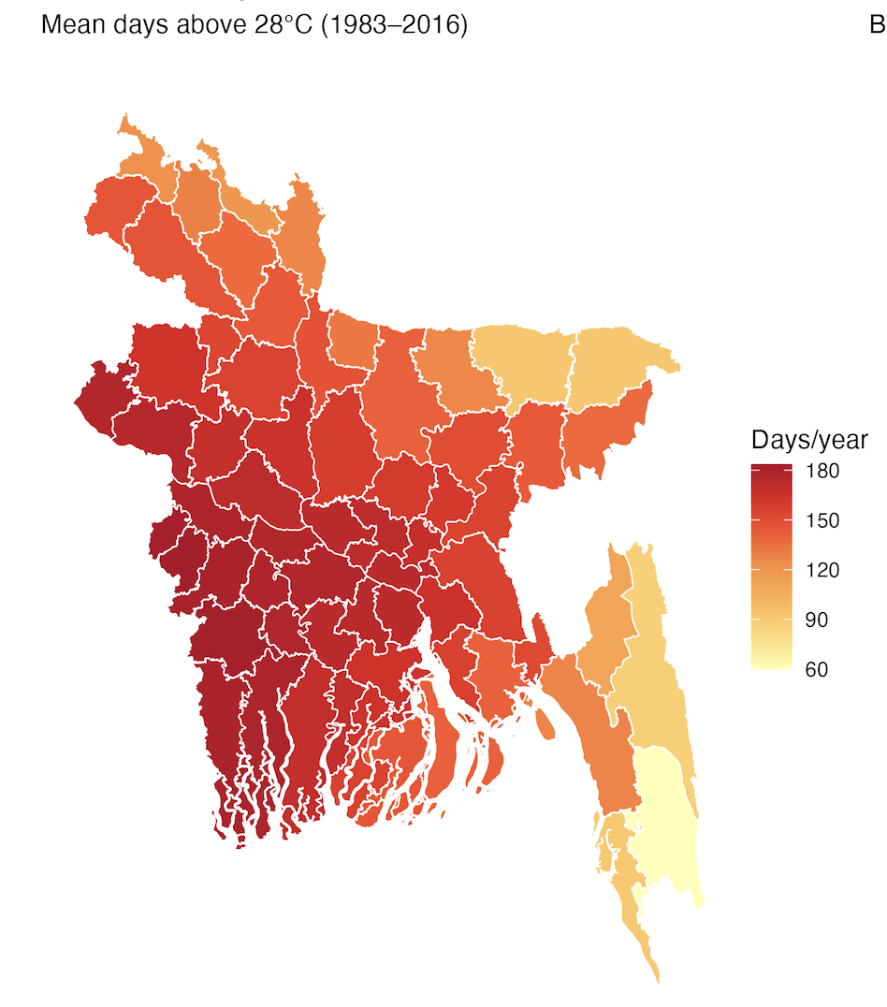
Methods: Data & Study Area
Section III | Part 1 of 3
Mean Days Above WGBTmax28°C threshold (1983-2016)
Data Source | Variable(s) | Spatial Unit | Year(s)
NASA SEDAC Global Extreme Heat Events (GEHE) [7] [8] | Days above WBGTmax28°C threshold | Raster (~4.6km pixel) | 1983–2016
Meta / Facebook Relative Wealth Index [9] | Relative Wealth Index (RWI) score | Point → aggregated to district | 2021
SRTM via NASA (geodata) [10] | Mean elevation & Distance to Coast (meters) | Raster (1km) → aggregated to district | 2000
GPWv4 NASA SEDAC [11] | Population count | Raster (2.5 arc-min) → aggregated to district | 2015
GADM v4.1 [12] | Administrative Boundaries | Polygon (district, level 2) | 2022
Natural Earth [13] | Country boundaries | Polygon (country) | 2024
World Bank [14] | GDP per capita (US) | Country | 2019
Spatial Weights:
Bivariate LISA: Queen contiguity via rgeoda:queen_weights()
EHSA: Queen contiguity via sfdep:st_contiguity()
BYM2: Binary adjacency matrix via nb2mat()
Figure 3. Mean extreme heat exposure by district in Bangladesh.
Data: NASA SEDAC GEHE. Spatial Unit: 64 administrative districts (GADM Level 2)
P9380: Advanced Public Health GIS | Columbia University Mailman School of Public Health | Spring 2026
4 / 12

Slide 5
Methods: Variables
Section III | Part 2 of 3
Outcome
Predictors
Spatial Structure
Heat Exposure
Outcome: WGBT > 28°C days/year (a measure of dangerous, hot-humid conditions)
Distribution: Continuous, ranging from 59.7 to 183.4 days/year
Pixel-level raster values extracted and averaged to district level
Warming Trend
Outcome: change in heat days over time
Definition: OLS slope coefficient from linear regression of annual heat days on time
Distribution: Continuous, ranging from 0.894 to 1.424 days/year
Pixel-level slopes extracted and averaged to district level
Source: NASA SEDAC Global Extreme Heat Events, 1983-2016
Key predictor of interest:
Relative wealth index: derived measure of economic status
Covariates (all were z-score standardized)
Mean elevation
Distance to coast
Population density
No district-level healthcare access data was available
Spatial Setup
Districts (n = 64), Neighbors: Queen contiguity, Weights: Row-standardized (ESDA), binary (BYM2)
Spatial Structure
Moran's I — Heat Exposure: I = 0.764, p < 2.2e-16, Strong positive spatial autocorrelation
Moran's I — Warming Trend: I = 0.716, p < 2.2e-16, Strong positive spatial autocorrelation
P9380: Advanced Public Health GIS | Columbia University Mailman School of Public Health | Spring 2026
5/ 12

Slide 6
Methods: Analytical Strategy
Section III | Part 3 of 3
Step 1
ESDA
Step 2
Modeling
Step 3
Diagnostics
Exploratory Spatial Data Analysis
Spatial Statistical Model
Model Diagnostics & Validation
• Global Moran’s I
Tested whether heat exposure and warming trends were spatially clustered across Bangladesh districts
Results: I = 0.764 and I = .716, respectively, both p < 2.2e-16 • Bivariate LISA
To test whether high heat exposure districts are spatially associated with high warming trend neighbors
Results = Identified 11 low heat/high trend districts • Projected crisis timeline analysis
To identify how many years it would take for 11 low heat-high trend districts to reach high heat numbers using a linear extrapolation
[R: spdep, sfdep, ggplot2]
• Warming Trend BYM2
Used to estimate district-level warming rates, accounting for spatial dependence
• Justification
Bayesian methods capture uncertainty better for small sample n
Adjusts for unmeasured spatial factors
[R: INLA]
• Morans I on residuals
Used to verify that BYM2 models addressed spatial autocorrelation
• DIC/WAIC
Used to evaluate model fit and predictive accuracy without overfitting
[R: spdep, INLA, ggplot2]
P9380: Advanced Public Health GIS | Columbia University Mailman School of Public Health | Spring 2026
6 / 12

Slide 7
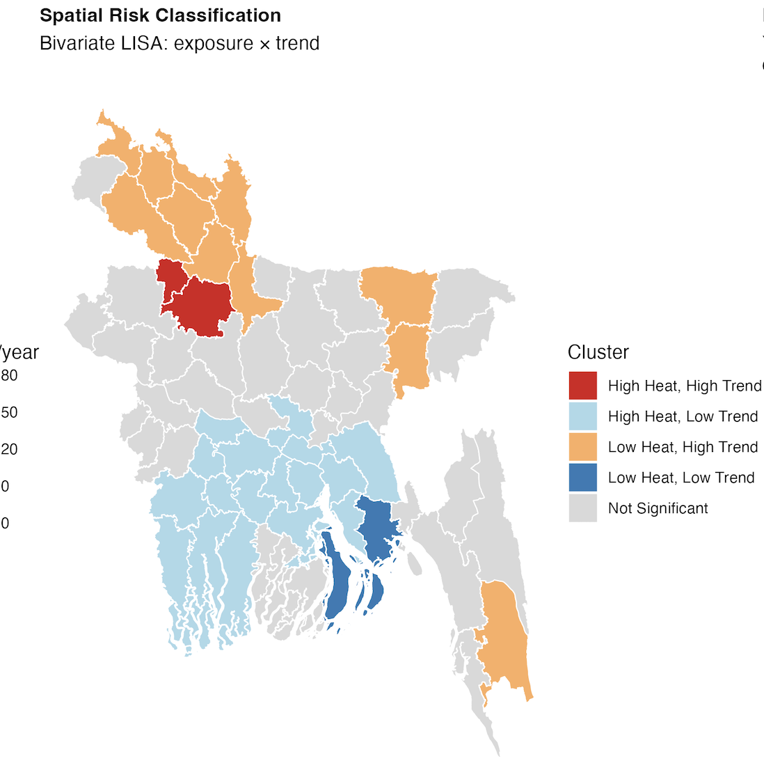
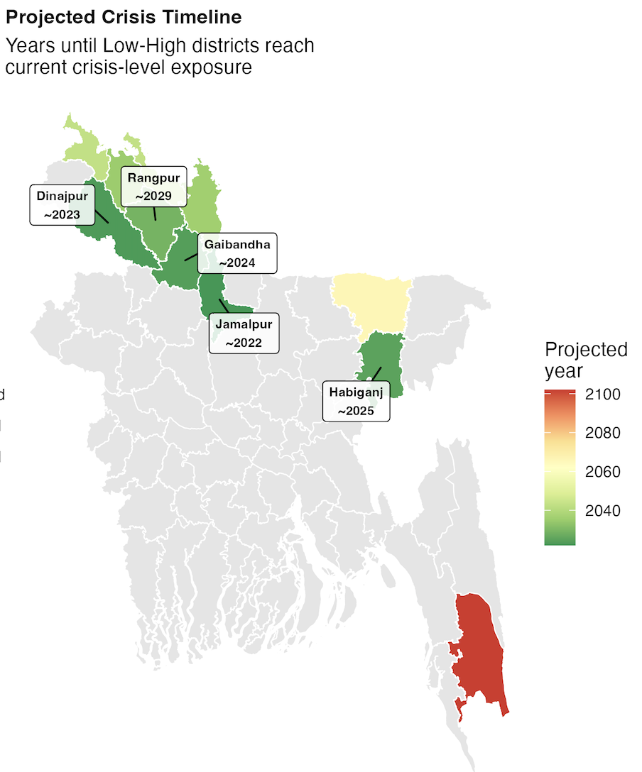
Results: Spatial Analysis & Maps
Section IV | ESDA & Spatial Patterns
Figure 4. Bivariate LISA – Heat exposure x warming trend. 11 Low heat/high trend districts
in the north represent the critical overlooked risk zones. Data: NASA SEDAC GEHE (1983-2016). Created in R.
Figure 5. Linear extrapolation of projected heat risk for the 11 low heat/high trend districts identified.
Data: NASA SEDAC GEHE (1983-2016). Created in R.
Spatial Statistics: Total districts classified: 32 (50%). High Heat/High Trend: n = 2 (3%). Low Heat/Low Trend: n = 2 (3%).
Low Heat/High Trend: n = 11 (11%). High Heat/Low Trend: n = 17 (27%) . Not significant n = 32 (50%) .
P9380: Advanced Public Health GIS | Columbia University Mailman School of Public Health | Spring 2026
7/12

Slide 8
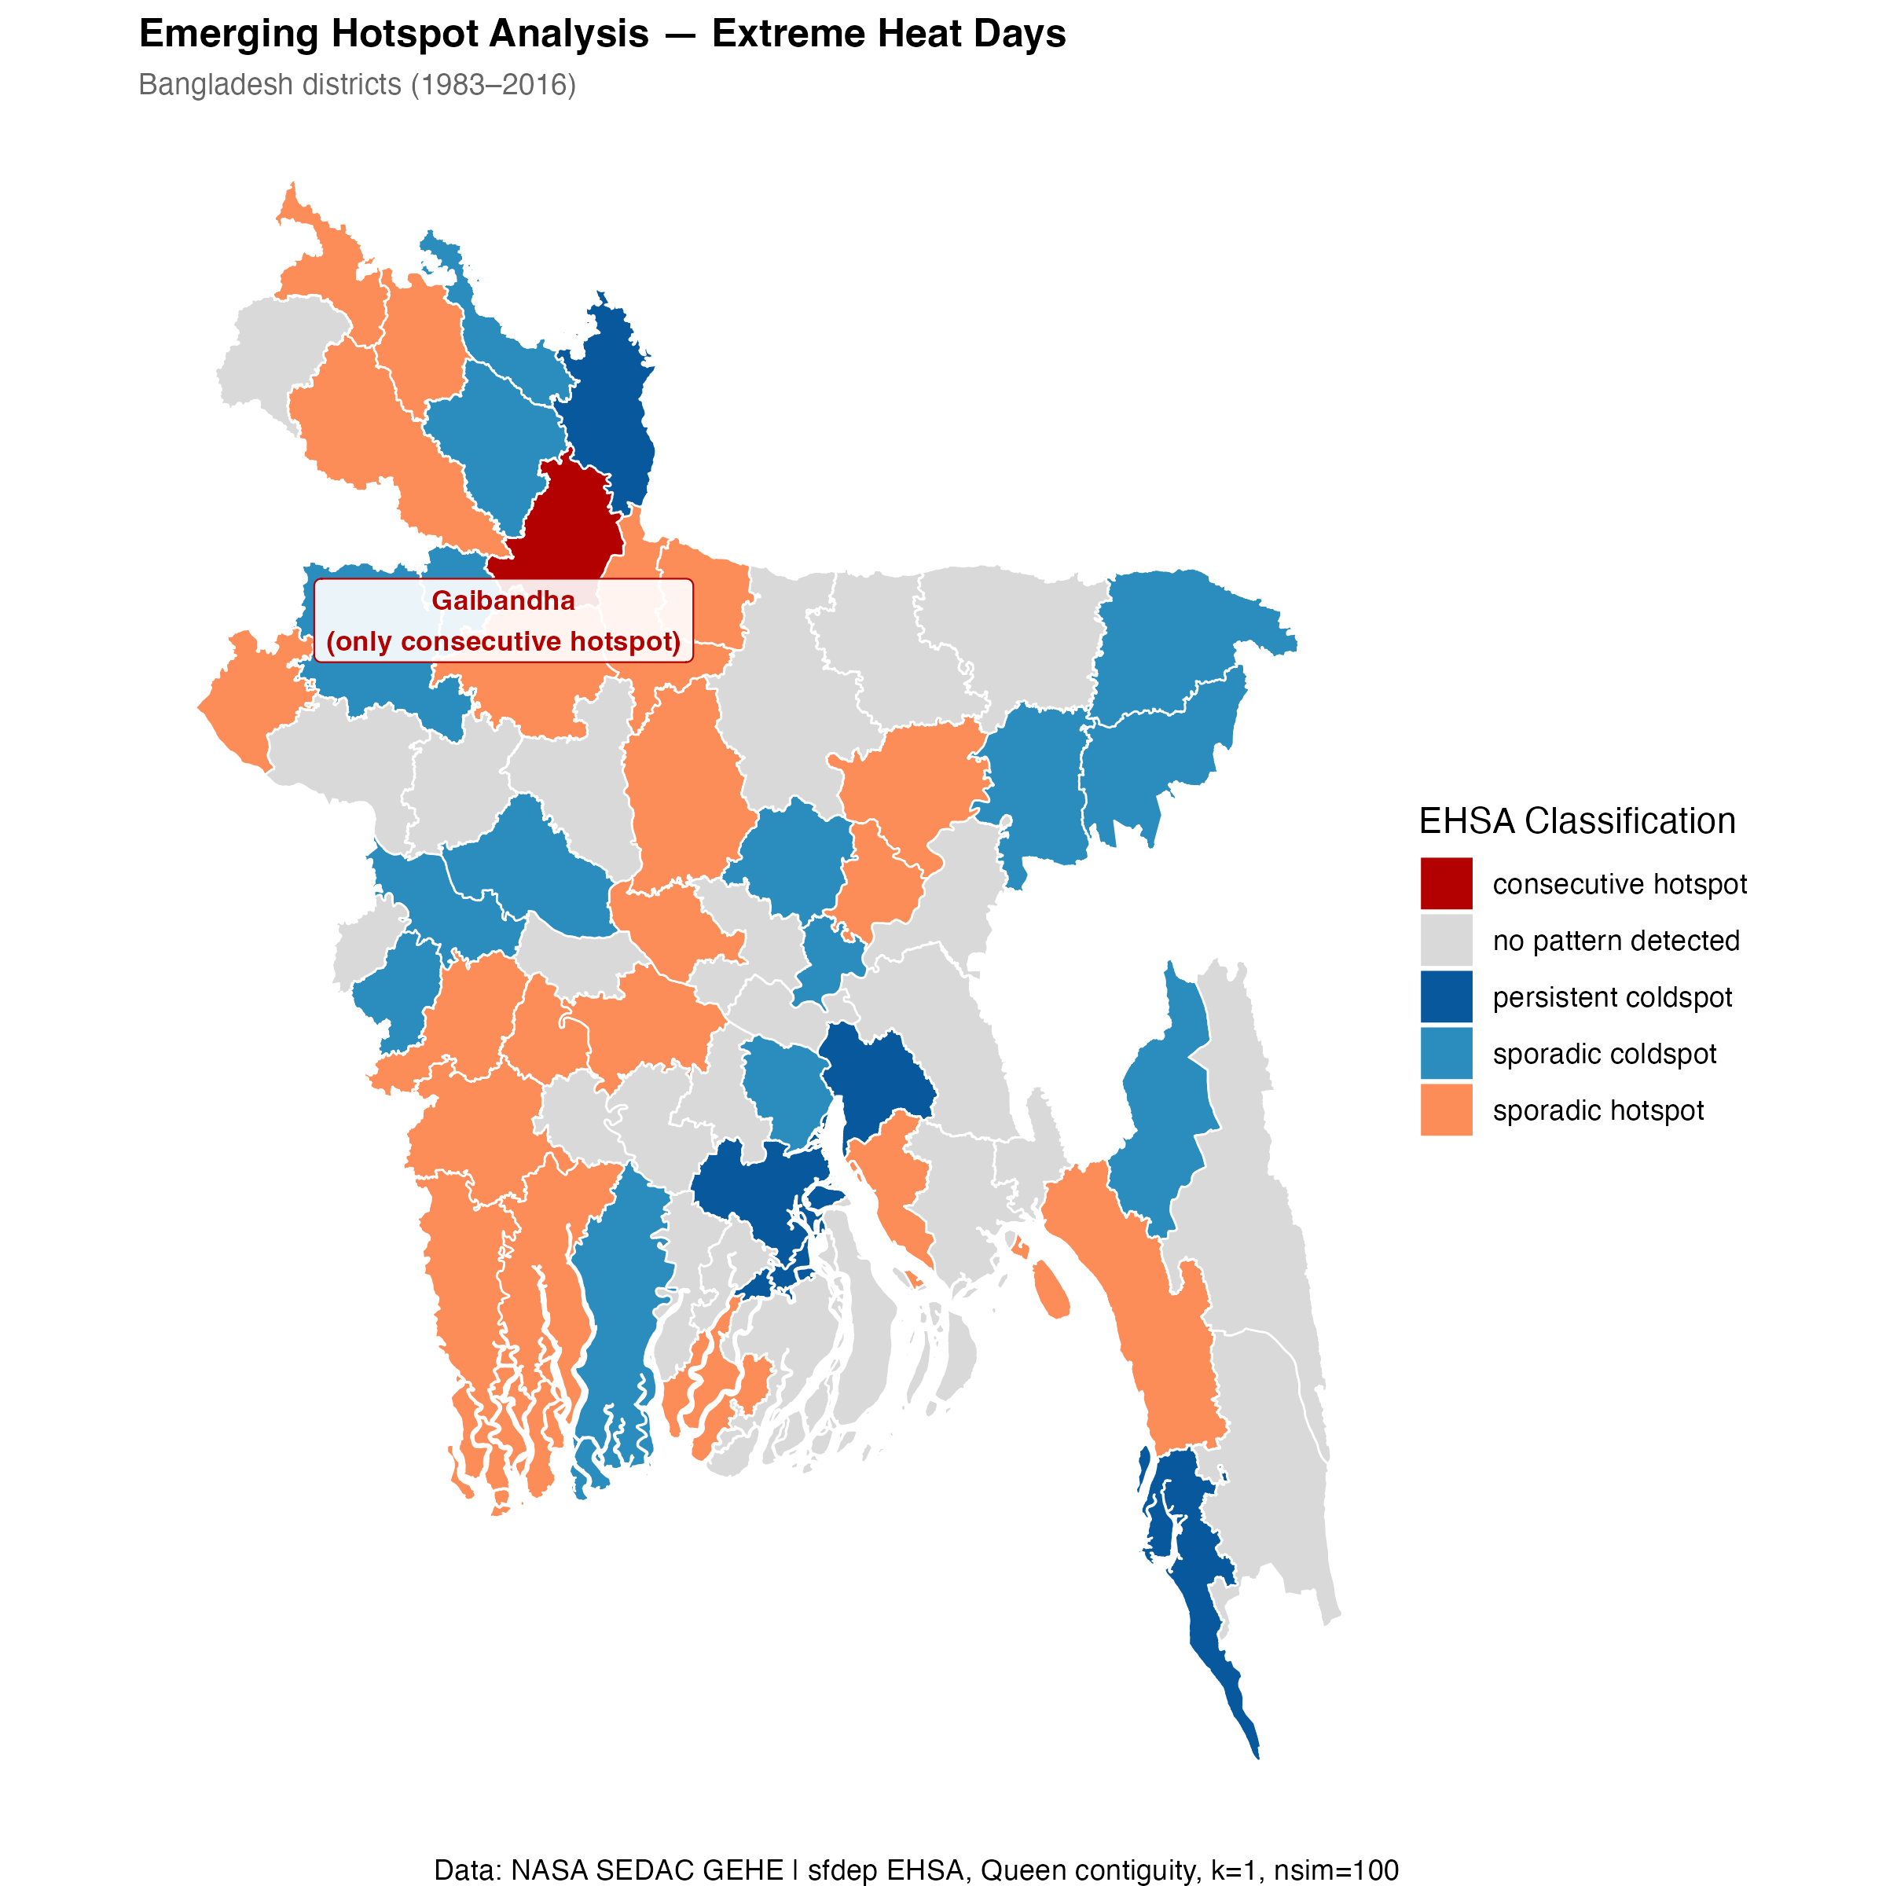
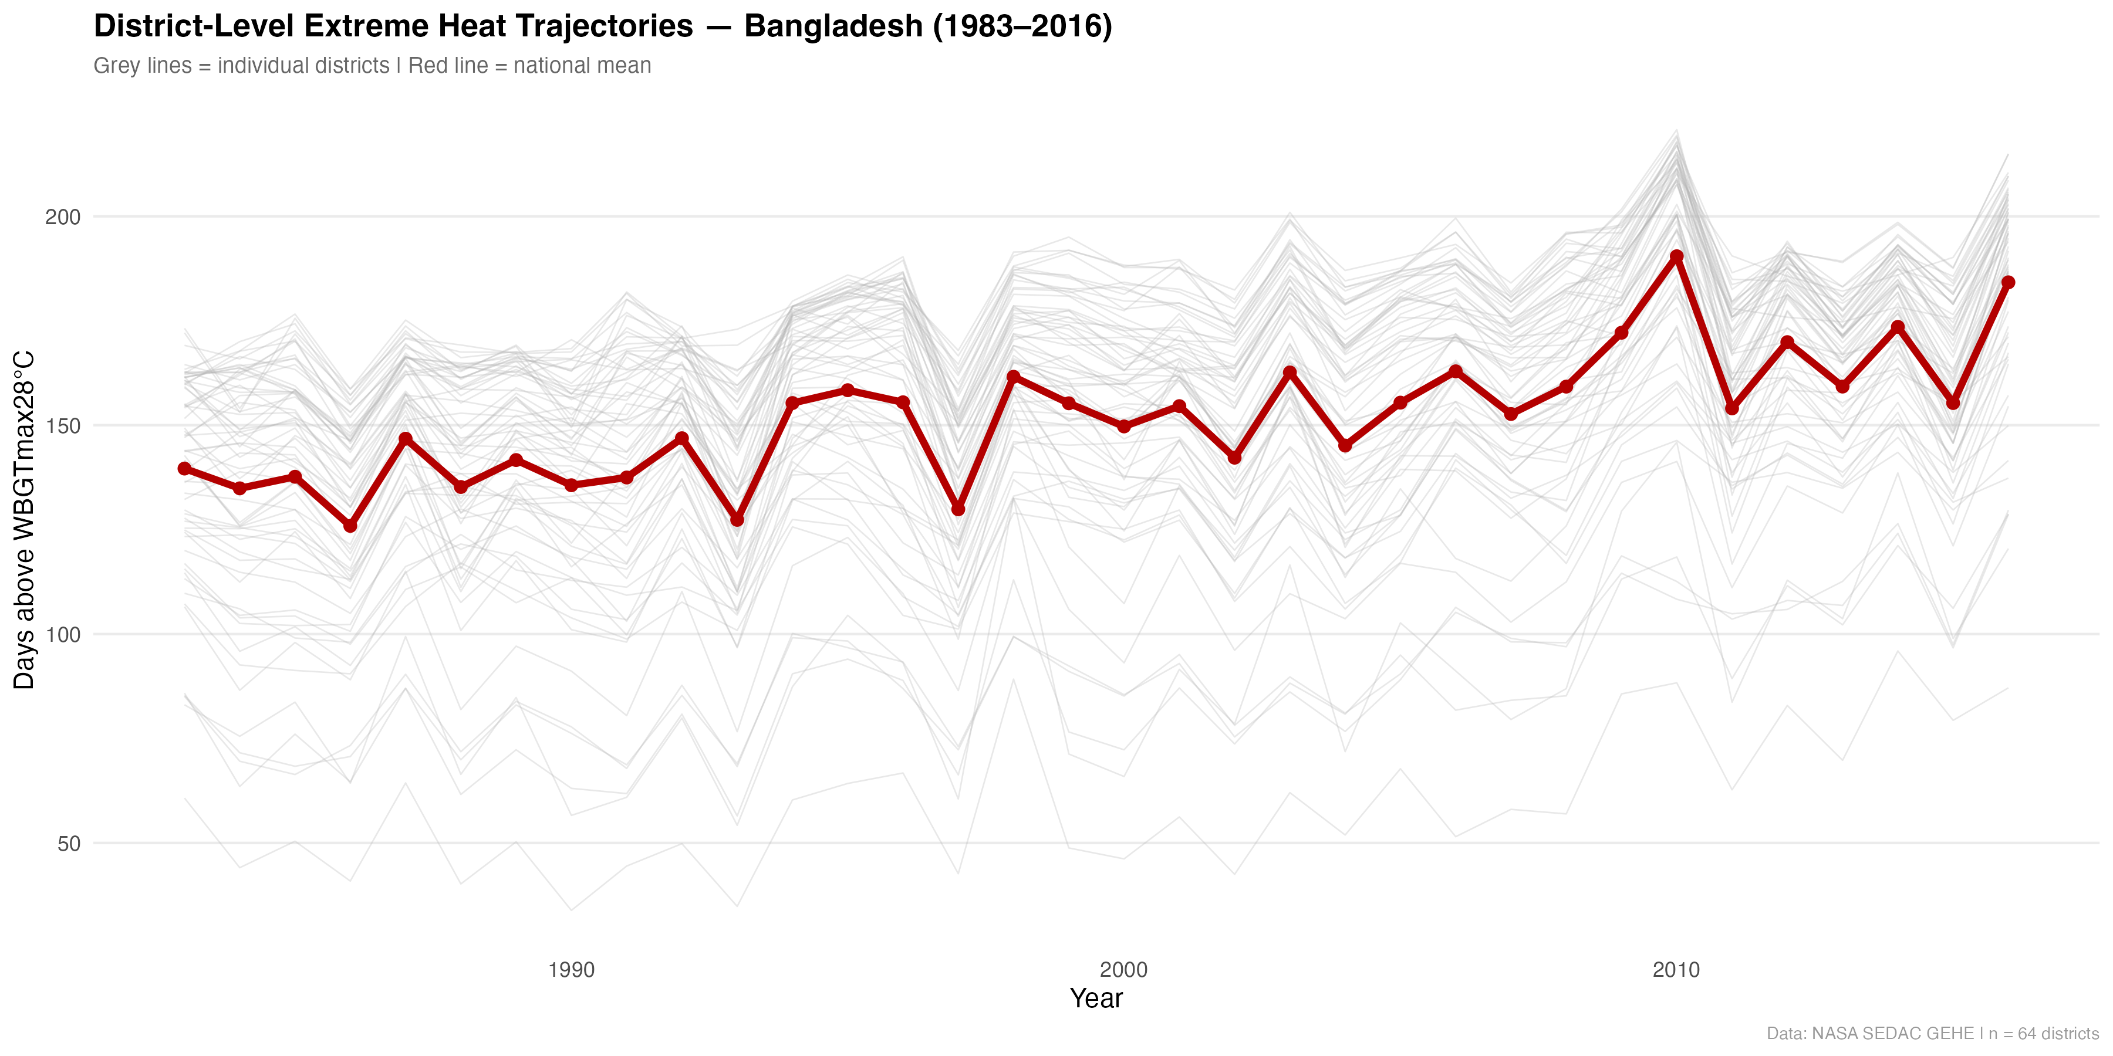
Results: Spatial Analysis & Maps
Section IV | ESDA & Temporal Dynamics
Gaibandha (Rangpur Division) is the sole consecutive hotspot,
corroborating the bivariate LISA and crisis timeline findings.
Figure 7. Extreme heat trajectories. Data: NASA SEDAC GEHE (1983-2016). Created in R.
Figure 6. Emerging hotspot analysis . Districts classified by temporal hotspot pattern across 34-year study period (1983-2016). Queen contiguity, k = 1, nsim = 100. Data: NASA SEDAC GEHE (1983-2016). Created in R.
Spatial Statistics: Consecutive hotspot: n=1 (2%). Sporadic hotspot: n=20 (31%). Oscillating coldspot: n=19 (30%).
Sporadic coldspot: n=15 (23%). Persistent coldspot: n=4 (6%). No pattern detected: n=5 (8%).
P9380: Advanced Public Health GIS | Columbia University Mailman School of Public Health | Spring 2026
8/12

Slide 9
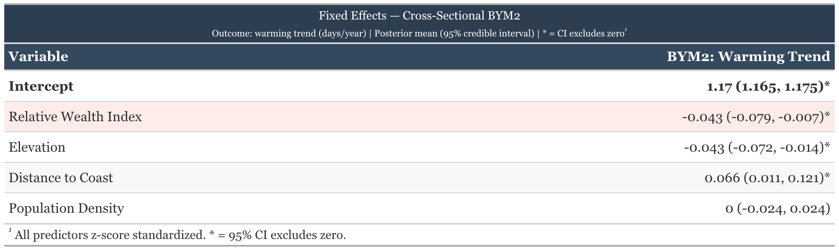
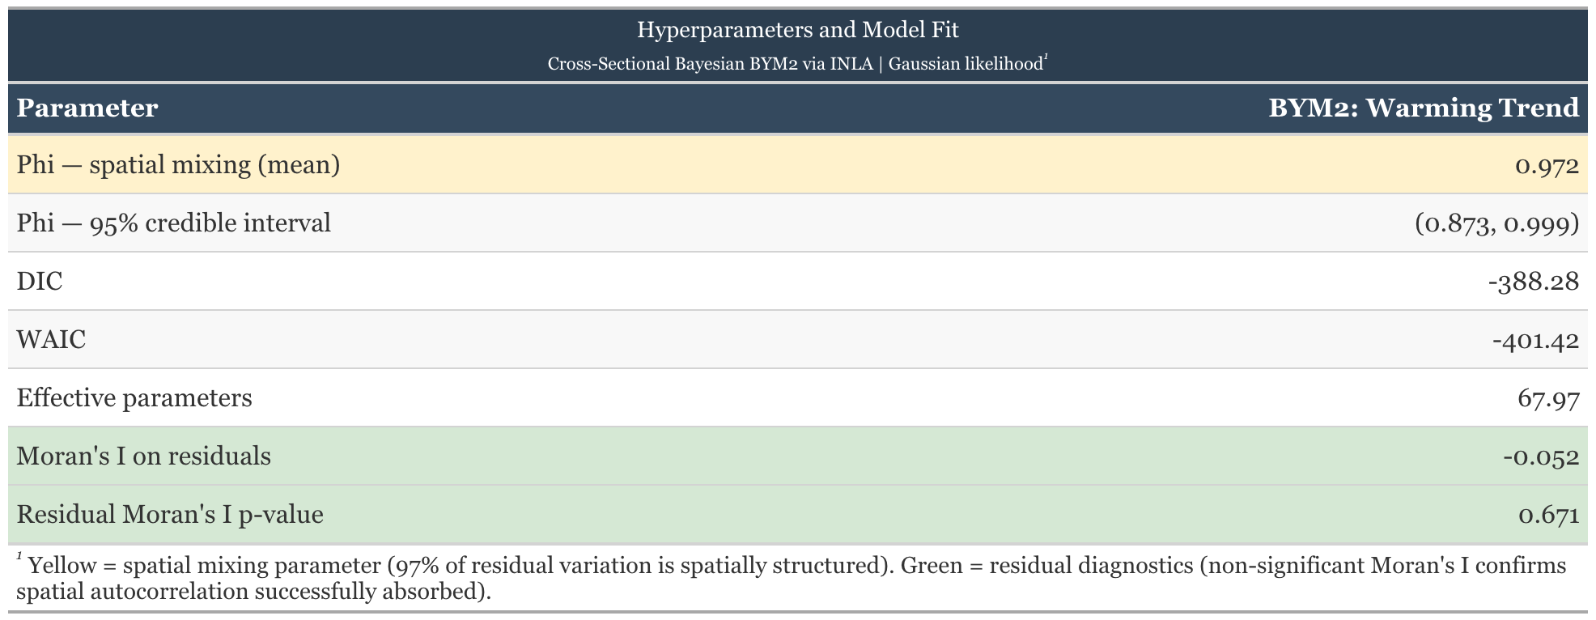
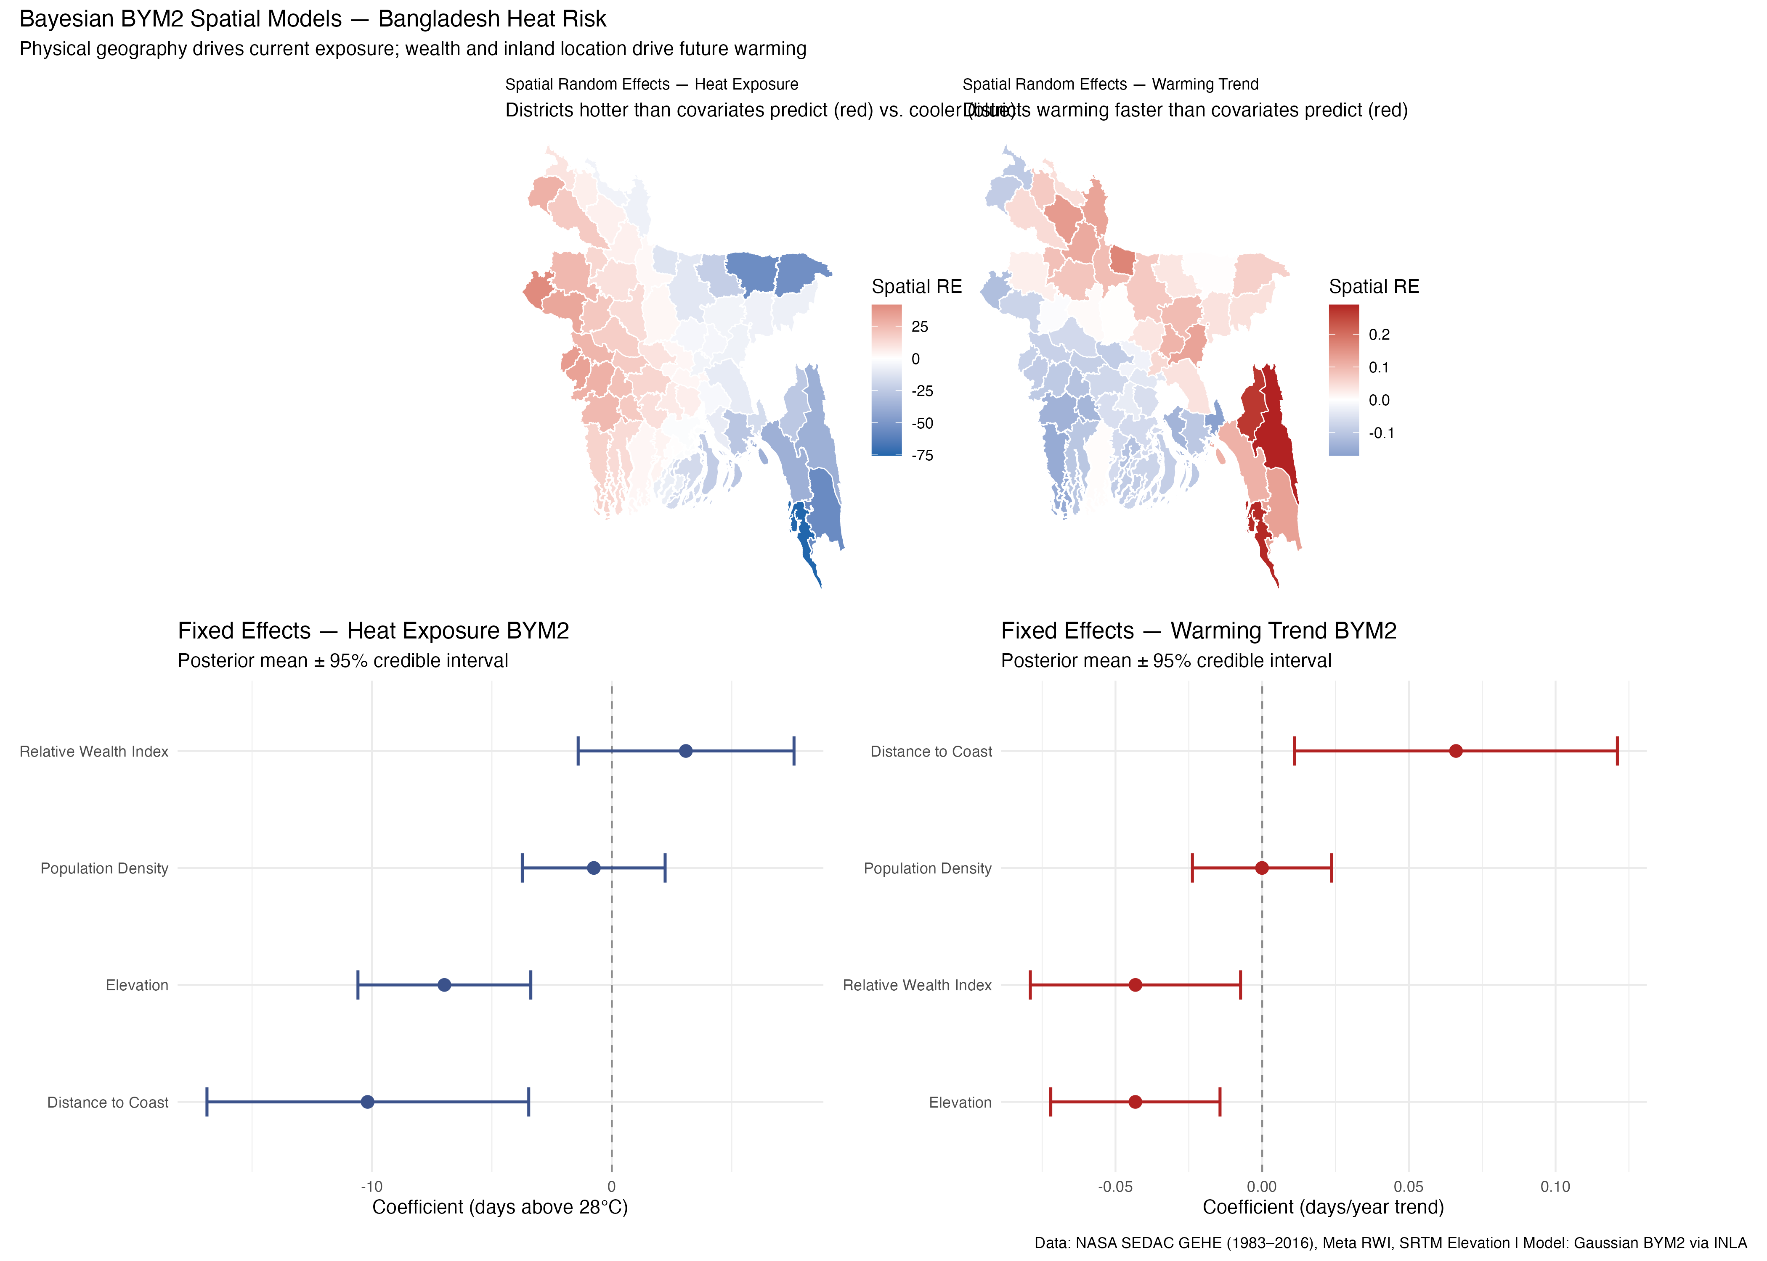
Results: Statistical Models
Section IV | Model Results & Interpretation
Key Findings
Higher relative wealth index was associated with slower warming (posterior mean = -0.043, 95% CI: -0.079 to -0.007)
The more inland, the faster warming occurs (posterior mean = 0.066, 95% CI: 0.011 to 0.121)
• Spatial mixing parameter Phi = 0.972, indicating significant spatial dependence. • Moran's I on residuals = -0.052 (p = 0.671), confirming spatial autocorrelation is addressed.
Both tables were created in R (gt)
Figure 8. Fixed effects coefficient plots for BYM2 model
Data: NASA SEDAC GEHE (1983-2016) & Meta RWI. Created in R.
P9380: Advanced Public Health GIS | Columbia University Mailman School of Public Health | Spring 2026
9/12

Slide 10
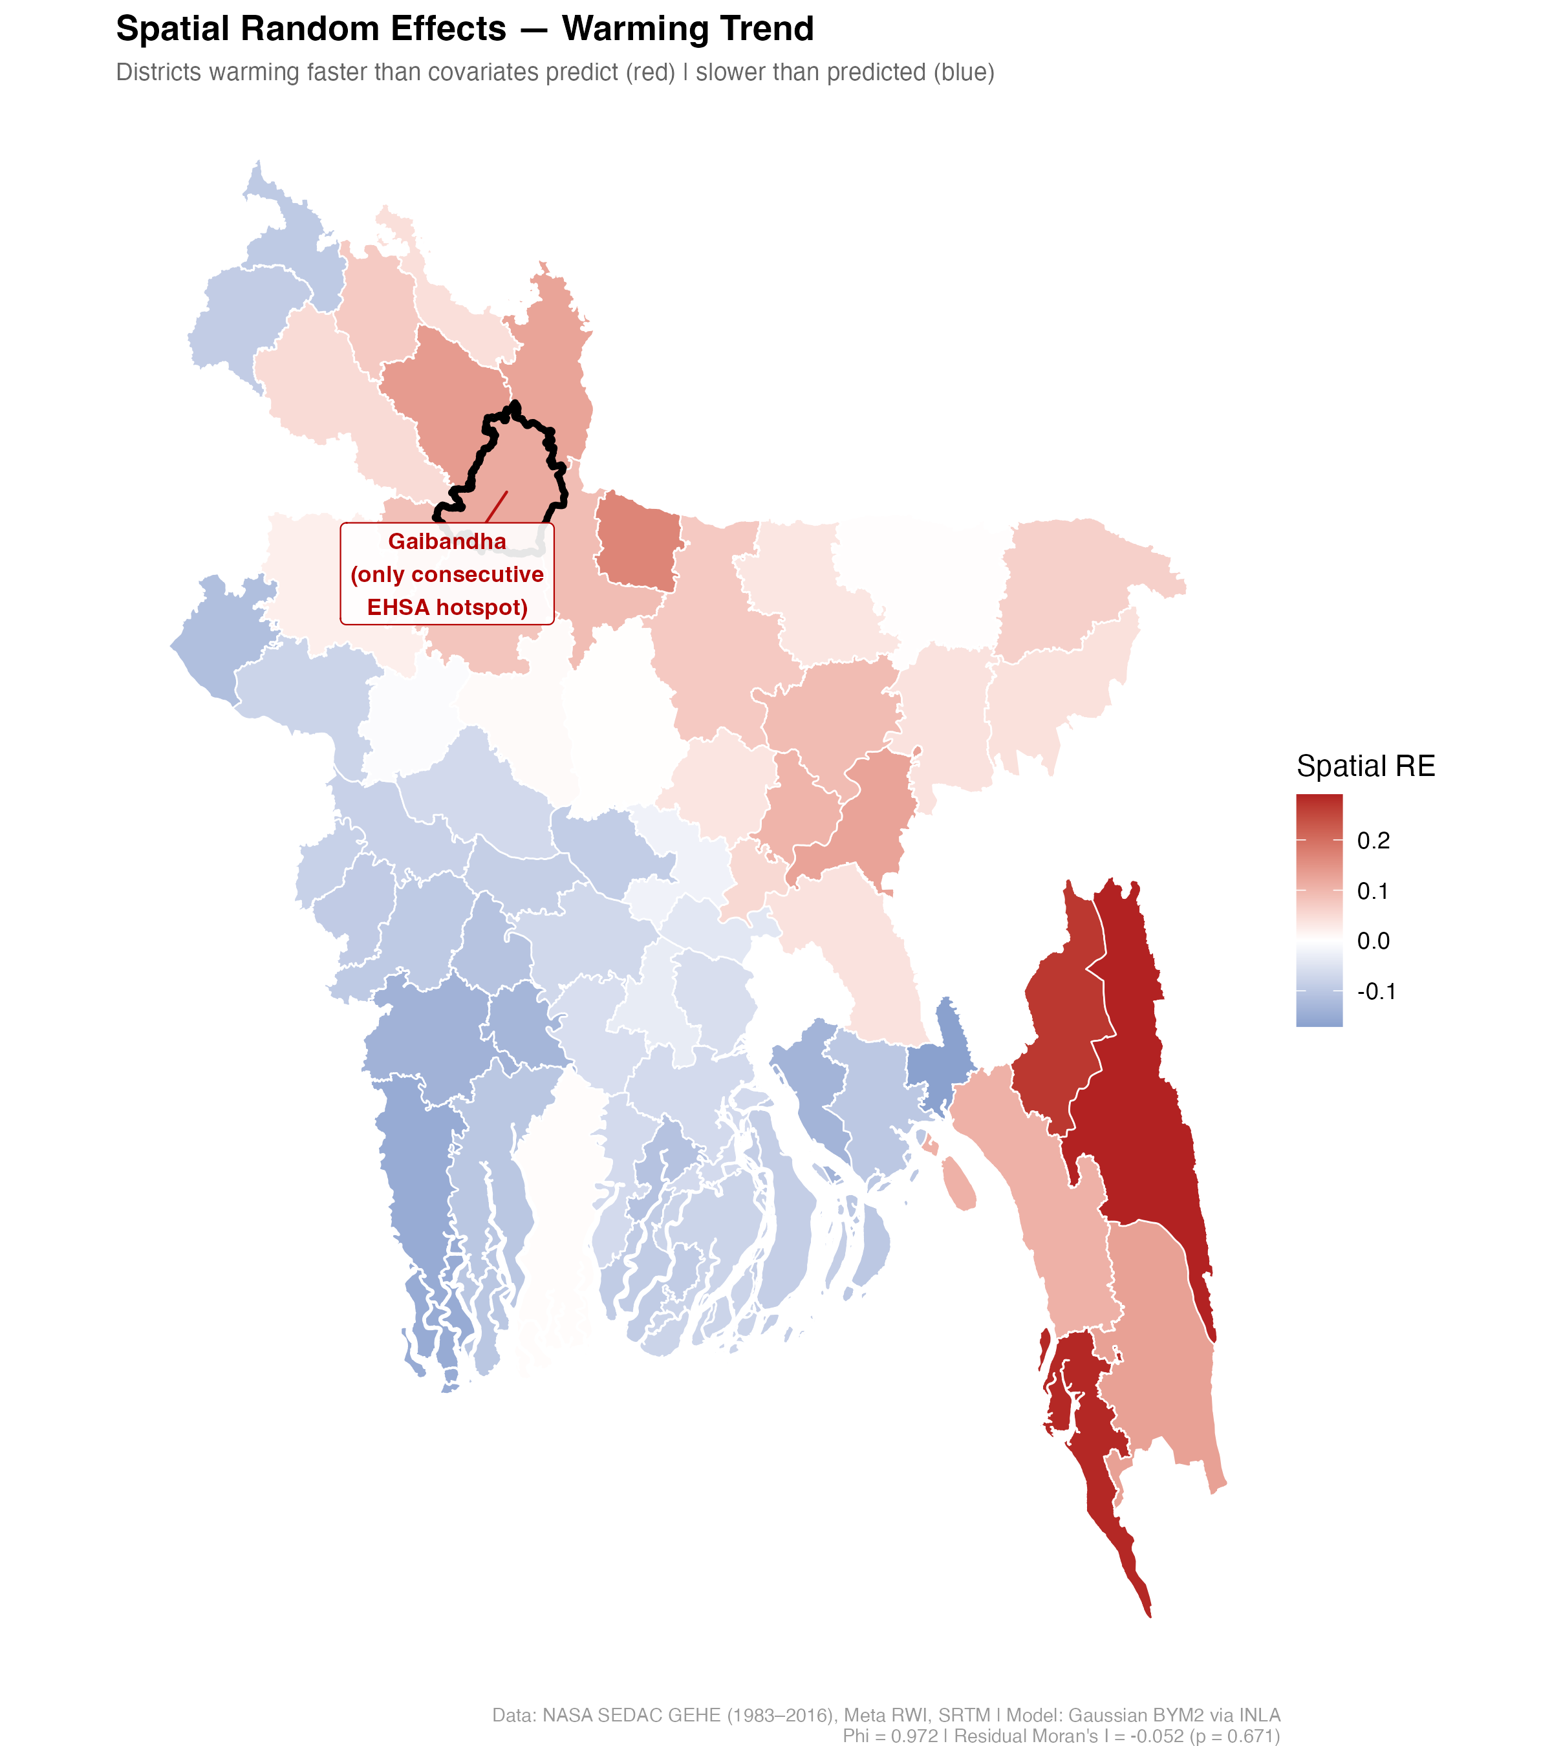
Results: Statistical Models
Section IV | What the Model Cannot Explain is Still Spatial
Key Findings
Gaibandha remains red here, showing that it is warming faster than its wealth, elevation, coastal distance, and population density would predict
Worth noting that the Southeastern districts also show elevated residuals, suggesting that there are additional unmeasured spatial factors influencing this pattern in this region
Figure 9. Spatial random effects for warming trend model. Model: Gaussian BYM2 via INLA.
Phi = 0.972 | Residual Moran’s I = -0.052 (p = 0.671) Data: NASA SEDAC GEHE (1983-2016) & Meta RWI. Created in R.
P9380: Advanced Public Health GIS | Columbia University Mailman School of Public Health | Spring 2026
10/12

Slide 11
Conclusions & Implications
Section V
Finding 1
Finding 2
Finding 3
Spatial analysis reveals that the districts warming the fastest are concentrated in the north. Four independent methods indicate the Gaibandha district as the most critical emerging risk zone.
Although the current (as of 2016) exposure levels would place the regions of Gaibandha, Jamalpur, and Dinajpur below standard intervention thresholds, they are projected to reach crisis-level heat exposure within a decade of the study period’s end.
Wealth drives where heat will be worse in the future, with poorer districts accumulating heat days significantly faster, controlling for other physical characteristics.
Public Health Implications
Limitations
Temporal mismatch among covariates, assuming that socioeconomic and demographic conditions were stable
The linear crisis timeline projection assumes a constant linear warming rate
Small sample size limits the precision of fixed effects coefficients
• Indicates an early intervention window and an opportunity for preventive action before emergencies
• Can help with heat-health early warning systems and green infrastructure investments
• Key actors: Ministry of Health and Family Welfare Bangladesh and World Health Organization
Future Directions
This work could be used to create a district-level heat vulnerability index, integrating exposure, sensitivity, and adaptive capacity
P9380: Advanced Public Health GIS | Columbia University Mailman School of Public Health | Spring 2026
11/12

Slide 12
References
[1] Cai, J., Maxwell, A. & Zhou, B. Disease burden attributable to high temperature between 1990 and 2021 in South Asia and Southeast Asia, with projections to 2045. (2025). Trop Med Health 53(146) https://doi.org/10.1186/s41182-025-00823-4
[2] World Meteorological Organization. (2025). State of climate in Asia 2024. https://wmo.int
[3] Romanello, M., Walawender, M., Hsu, S. C., Moskeland, A., Palmeiro-Silva, Y., Scamman, D., Ali, Z., Ameli, N., Angelova, D., Ayeb-Karlsson, S., Basart, S., Beagley, J., Beggs, P. J., Blanco-Villafuerte, L., Cai, W., Callaghan, M., Campbell-Lendrum, D., Chambers, J. D., Chicmana-Zapata, V., Chu, L., … Costello, A. The 2024 report of the Lancet Countdown on health and climate change: facing record-breaking threats from delayed action. (2024). Lancet (London, England), 404(10465), 1847–1896. https://doi.org/10.1016/S0140-6736(24)01822-1 .
[4] N.S. Diffenbaugh, & M. Burke, Global warming has increased global economic inequality. (2019). Proc. Natl. Acad. Sci. U.S.A. 116 (20) 9808-9813, https://doi.org/10.1073/pnas.1816020116 (2019).
[5] Mani Z, Ranse J, Goniewicz K. Why extreme heat weather is a global health emergency: a retrospective analysis. Int J Emerg Med. (2025) 18(1):255. doi: 10.1186/s12245-025-01062. [6] Debasish Roy Raja, Md Shah Naim Hredoy, Md. Kamrul Islam, K.M. Ashraful Islam, Mohammed Sarfaraz Gani Adnan, Spatial distribution of heatwave vulnerability in a coastal city of Bangladesh. (2021). Environmental Challenges, Volume 4, 100122, ISSN 2667-0100, https://doi.org/10.1016/j.envc.2021.100122.
[7] Tuholske, C., Peterson, P., Funk, C., & Caylor, K. (2023). Annual global high-resolution extreme heat estimates (GEHE), 1983–2016 (Version 1.00) [Data set]. NASA Socioeconomic Data and Applications Center (SEDAC). https://doi.org/10.7927/hff0-k565
[8] Tuholske, C., Caylor, K., Funk, C., Verdin, A., Sweeney, S., Grace, K., Peterson, P., & Evans, T. (2021). Global urban population exposure to extreme heat. Proceedings of the National Academy of Sciences, 118(41), e2024792118. https://doi.org/10.1073/pnas.2024792118
[9] Chi, G., Fang, H., Chatterjee, S., & Blumenstock, J. E. (2022). Microestimates of wealth for all low- and middle-income countries. Proceedings of the National Academy of Sciences, 119(3), e2113658119. https://doi.org/10.1073/pnas.2113658119
[10] NASA JPL. (2013). NASA shuttle radar topography mission global 1 arc second (Version 3) [Data set]. NASA Land Processes Distributed Active Archive Center. https://doi.org/10.5067/MEASURES/SRTM/SRTMGL1.003
[11] Center For International Earth Science Information Network-CIESIN-Columbia University. (2017). Gridded Population of the World, Version 4 (GPWv4): Population Density, Revision 11 (Version 4.11) [Data set]. Palisades, NY: NASA Socioeconomic Data and Applications Center (SEDAC). https://doi.org/10.7927/H49C6VHW
[12] GADM. (2022). Database of global administrative areas, version 4.1 [Data set]. University of California, Berkeley. https://gadm.org
[13] Massicotte P, South A (2026). rnaturalearth: World Map Data from Natural Earth. R package version 1.2.0.9000, https://docs.ropensci.org/rnaturalearth/.
[14] Arel-Bundock, V. (2023). WDI: World Development Indicators (World Bank). R package.
P9380: Advanced Public Health GIS | Columbia University Mailman School of Public Health | Spring 2026
12/12

