Slide 1

Weather Prediction
By
Maya Babu
Anjana Vattakuzhiyil Chacko
Olusegun Samuel Agboola

Slide 2

Business Understanding
The goal of this project is to predict Seattle weather conditions using historical data, benefiting various stakeholders. Accurate forecasts help businesses plan better, farmers optimize crop schedules, and transportation services ensure safety and efficiency. Public safety is also enhanced through timely weather warnings. By leveraging machine learning models on data such as precipitation, temperature, and wind speed, we aim to provide precise weather predictions, driving informed decision-making and operational efficiency.

Slide 3
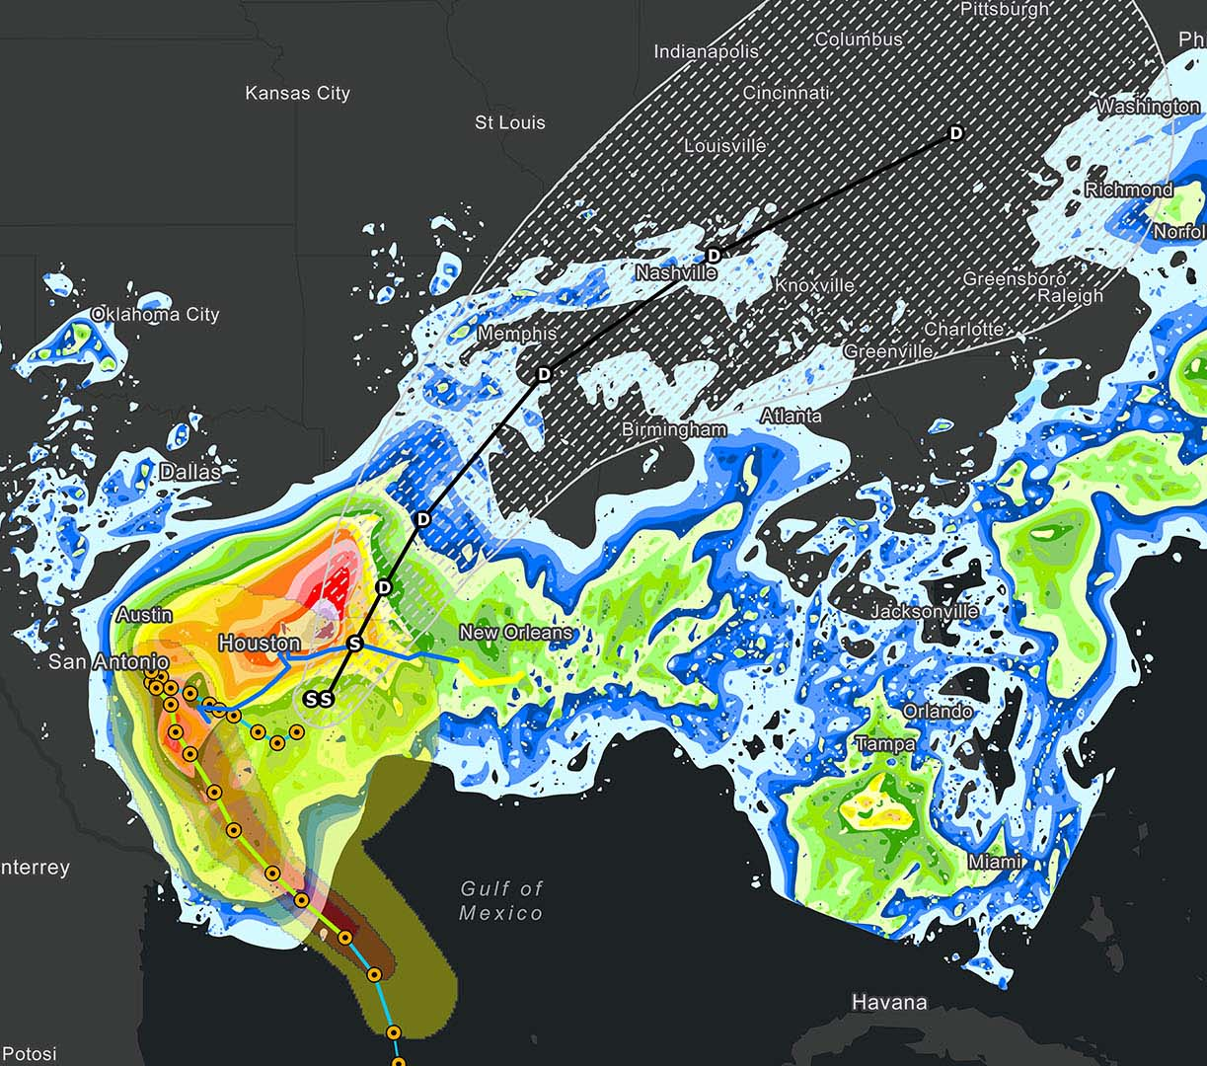
Data Understanding
This dataset is the weather report of Seattle city between 2012 to 2015.
Data source: Seattle weather prediction dataset | Kaggle

Slide 4

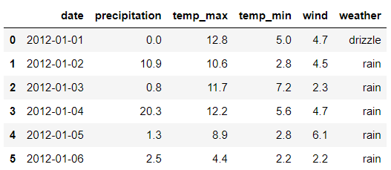
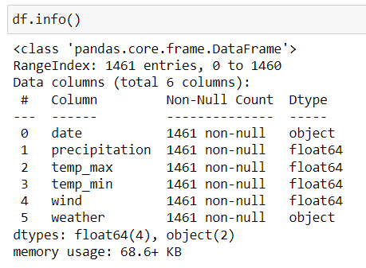
Dataset Description
date: The date of the weather observation.
precipitation: The amount of precipitation in millimeters.
temp_max: The maximum temperature of the day in degrees Celsius.
temp_min: The minimum temperature of the day in degrees Celsius.
wind: The wind speed in kilometers per hour.
weather: The weather condition, categorized into five labels: drizzle, fog, rain, snow, and sun.

Slide 5
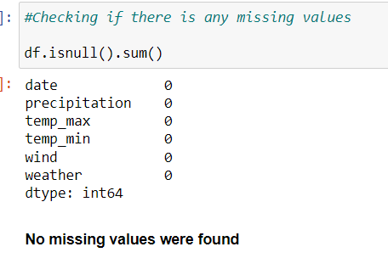
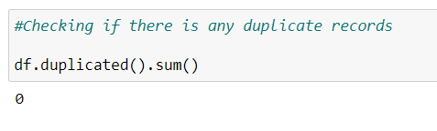
Data Cleaning

Slide 6
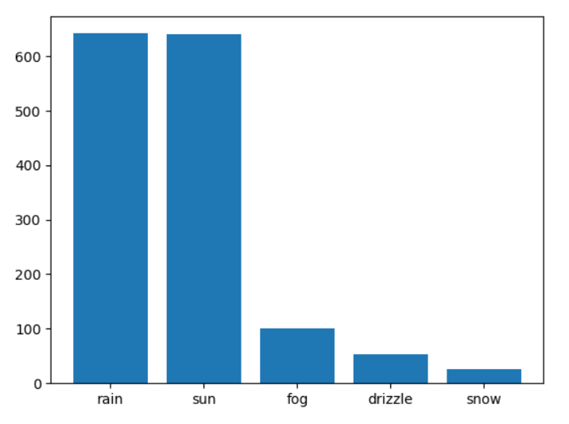
Exploratory Data Analysis
We can see here that Seattle gets maximum amount of rainy and sunny weather than any other categories

Slide 7
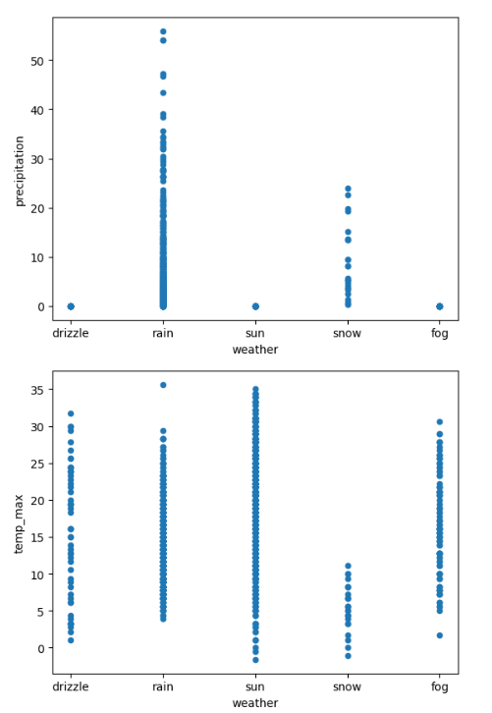
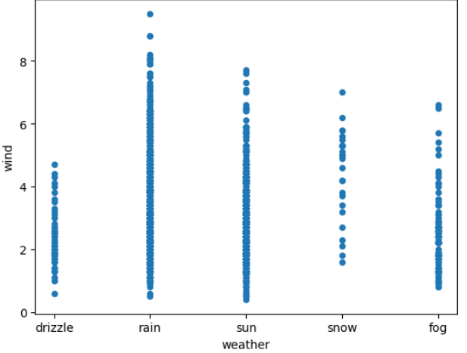
We can conclude that temperature fluctuates more during snowy conditions.
Wind is the highest maximum during rainy weather.
Precipitation is more during rainy and snowy weather.

Slide 8
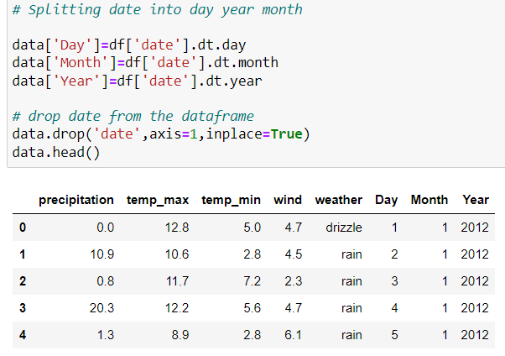
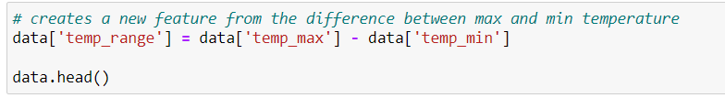
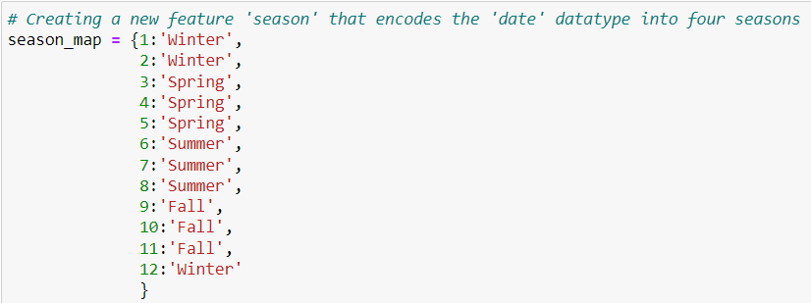
Feature Engineering

Slide 9
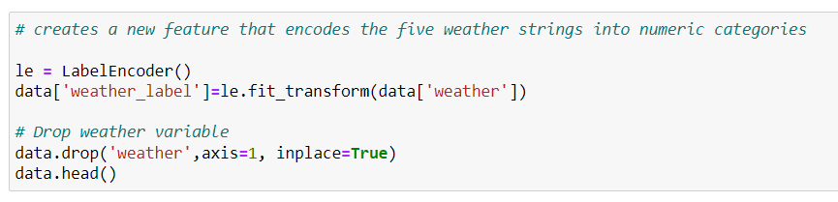
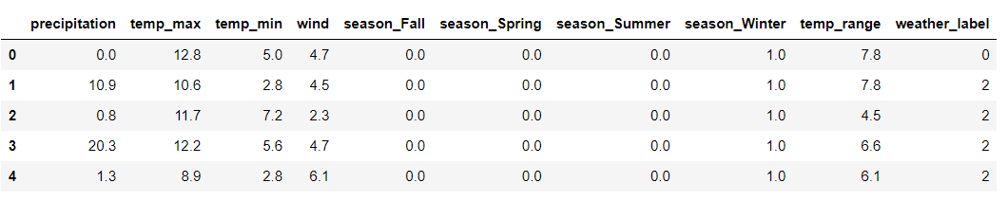
Data Transformation
Label Encoding
Transformed Data

Slide 10
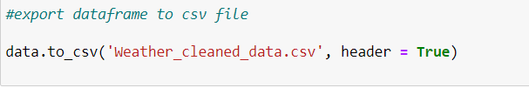
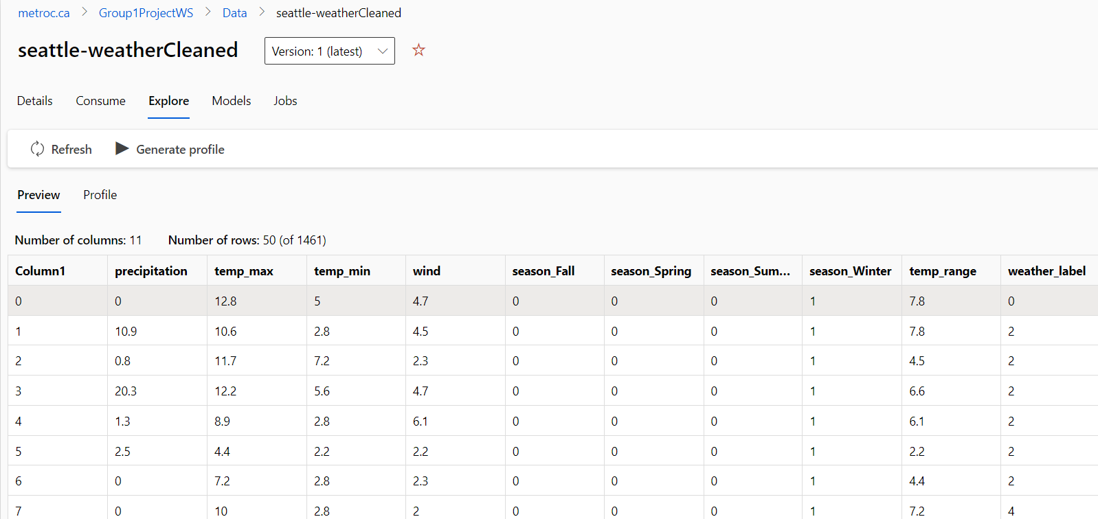
Exported the cleaned data to CSV file and then uploaded that CSV file to Data asset to create an automated ML pipeline.

Slide 11
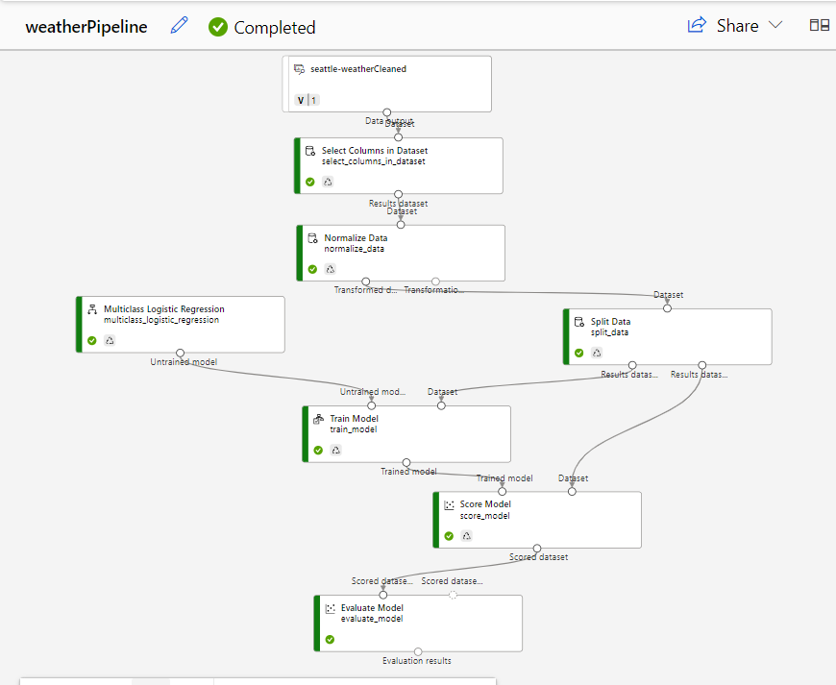
Creating Pipeline
Notes:
The pipeline job was completed successfully

Slide 12
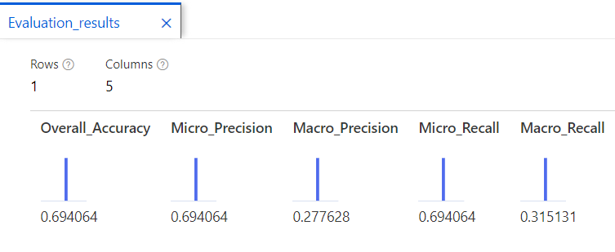
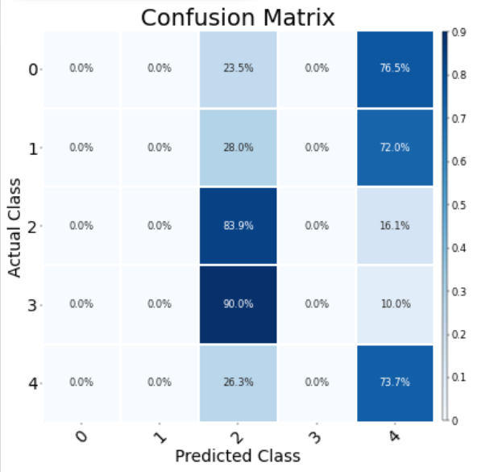
Model Evaluation
Model accuracy score was 69.40% which indicates the model has performed well.
Model predicted class 2 at 83.9% accuracy and class 4 at 73.7% accuracy. Other classes were not predicted well.
We should experiment with parameter tunings and different models to improve the accuracy core.
Notes:
Overall accuracy is a measure of how well a classification model matches the true labels of the data
Precision is a metric that quantifies the number of correct positive predictions made

Slide 13
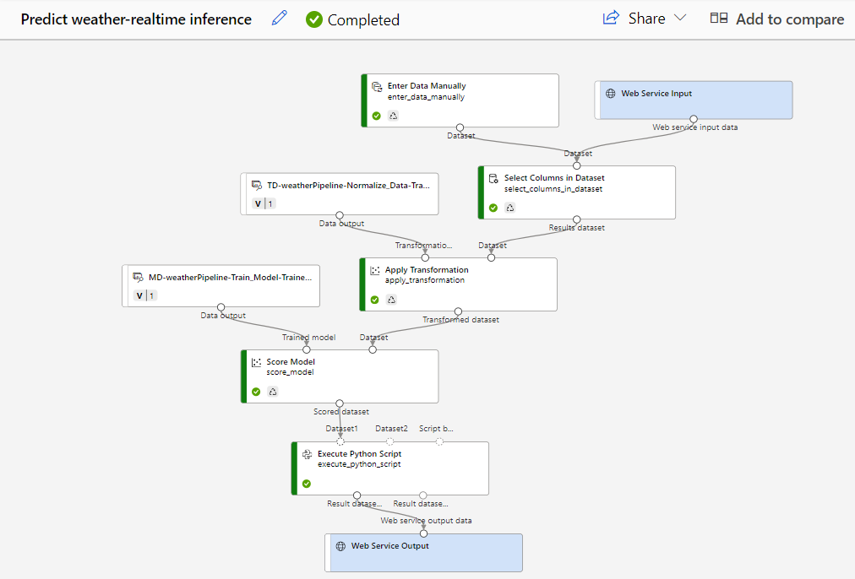
Successfully submitted job at real time inference

Slide 14
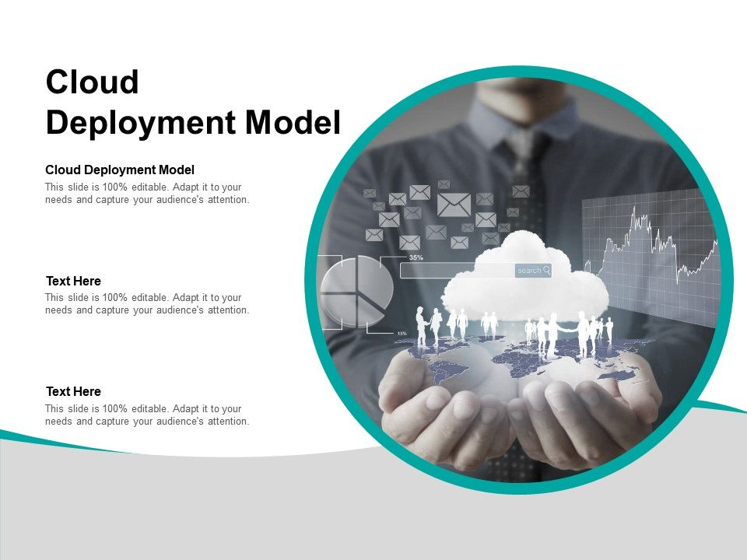
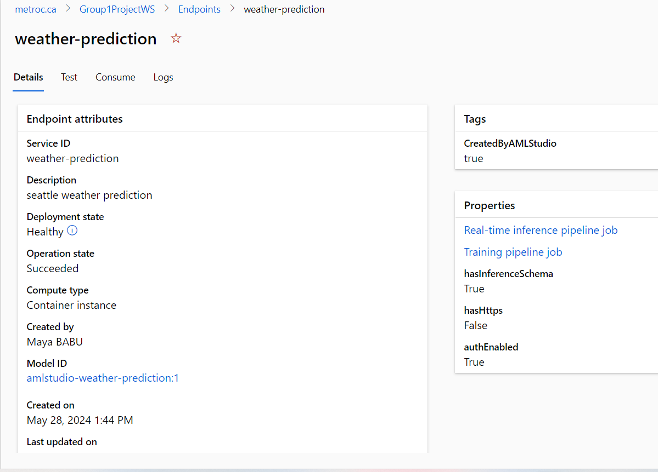
Deploy
Deployment was successful

Slide 15
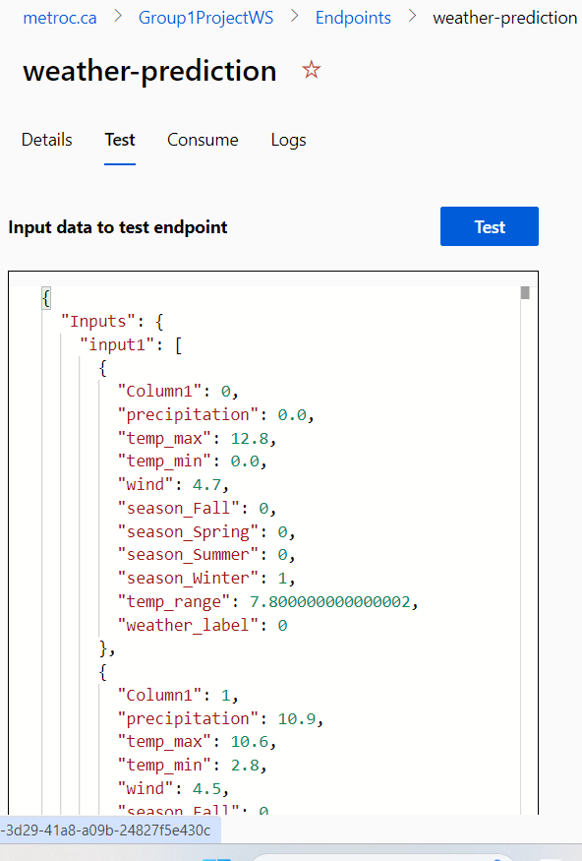
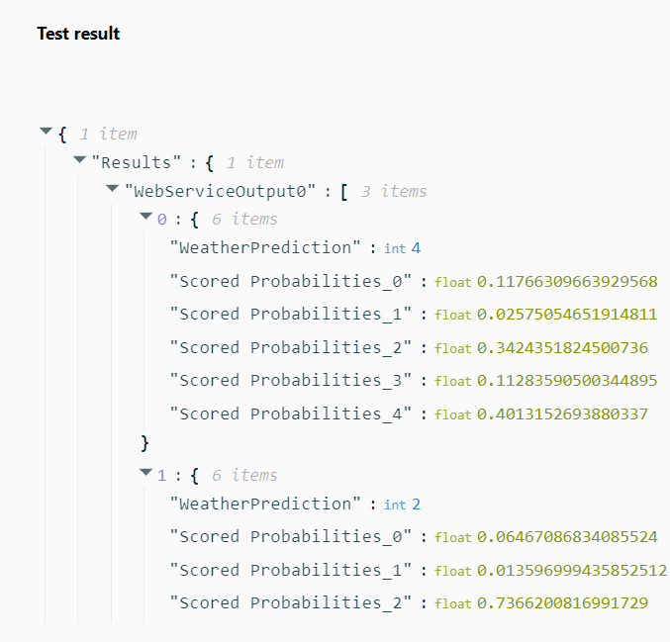
Test at endpoints was successful

Slide 16
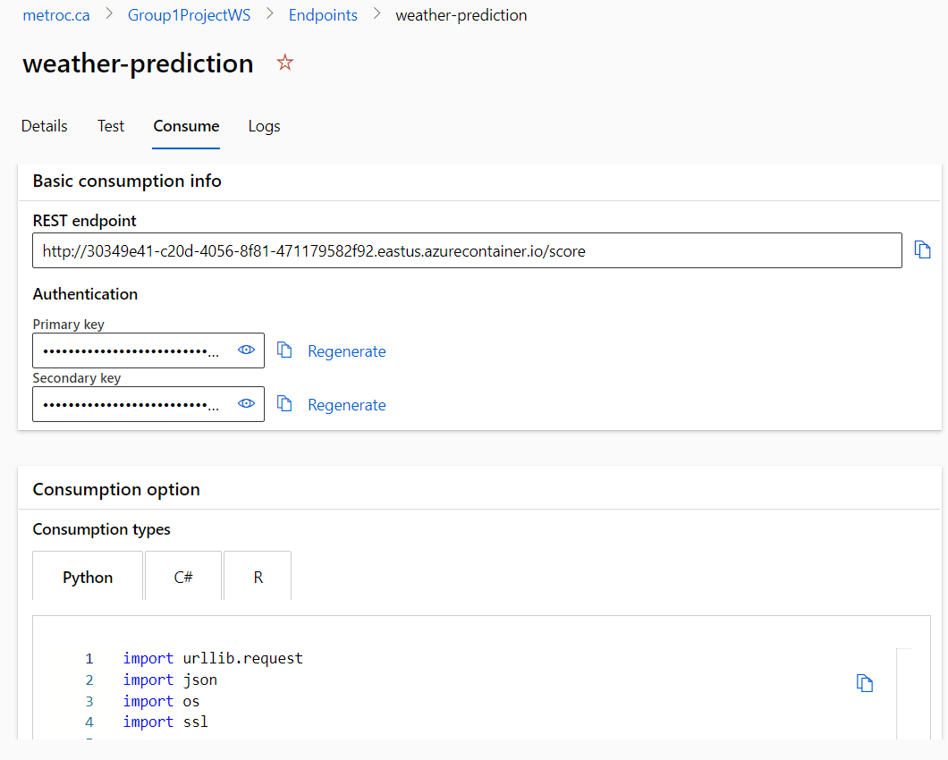
Notes:
We generated rest end points and Authentication keys.

Slide 17
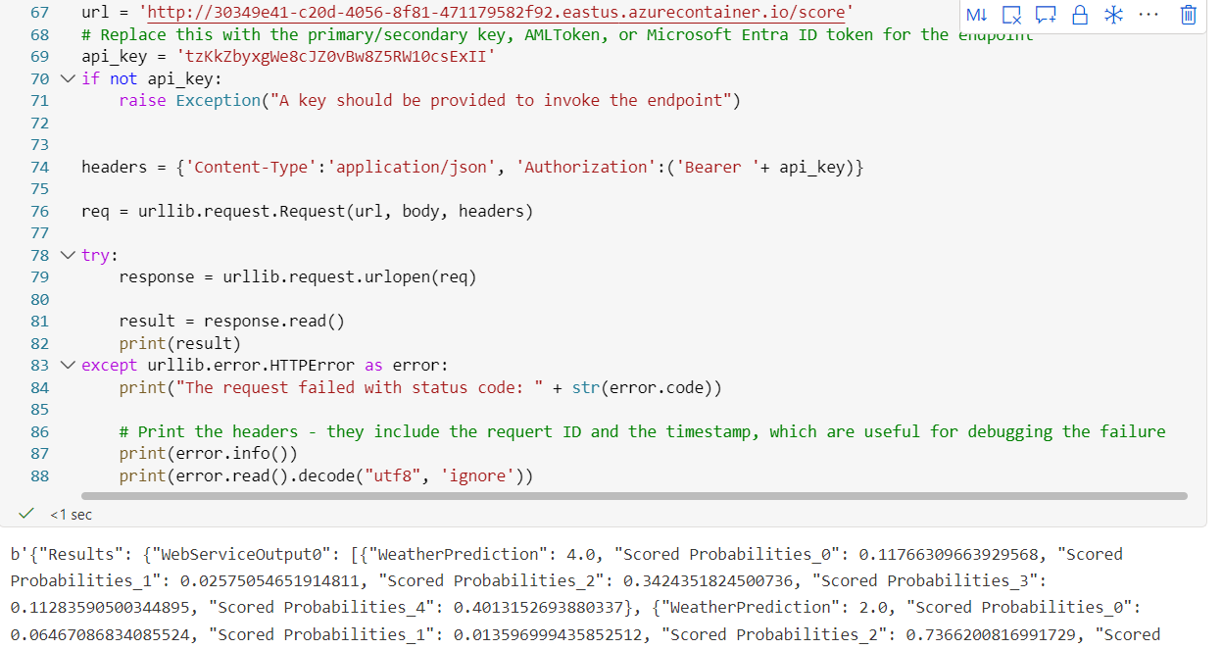
After changing the API key, we ran the python code in a new notebook. The predictions are same as was generated in endpoints test results.

Slide 18
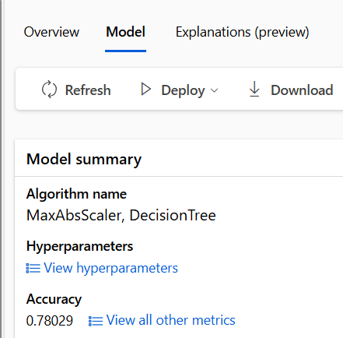
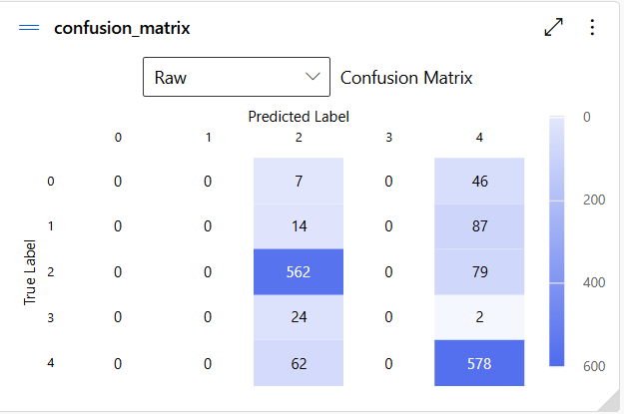
This is the Decision tree Model we created in Automated ML.
This model performed better with an accuracy score of 78%.

Slide 19
Thank You

