Slide 1

Machine Learning Project
Mobile Price Range Prediction
Project Type: Classification
Submitted By : Maya Babu

Slide 2

Introduction
In the competitive mobile phone market, companies want to understand sales data of mobile phones and factors which drive the prices. The objective is to find out some relation between features of a mobile phone (e.g.:- RAM, Internal Memory, etc) and its selling price. In this problem, we do not have to predict the actual price but a price range indicating how high the price is.
The main objective of this project is to build a model which will classify the price range of mobile phones based on the specifications of mobile phones.

Slide 3
Methodology
1. Problem Statement
2. Dataset Description
3. Outliers Handling &
Data Manipulation
4. Exploratory Data Analysis & Conclusion
5.Hypothesis Testing & Conclusion
6.Feature Selection, Transformation % Data Scaling
7. ML Model implementation & Conclusion
8.Model Deployment
2
999
6+

Slide 4


Problem Statement
The problem statement is to predict the price range of mobile phones based on
the features available (price range indicating how high the price is).
Here is the description of target classes:
0 - Low cost phones
1 - Medium cost phones
2 - High cost phones
3 - Very high cost phones
This will basically help companies to estimate price of mobiles to give tough competition to other mobile manufacturer. Also, it will be useful for consumers to verify that they are paying best price for a mobile.

Slide 5

A Quick Data Summary
The dataset has a record of 2000 mobile phones with 20 features.
The dataset is perfectly balanced with 500 observations for each class. Each column represents the feature of the mobile.
Interestingly, there is zero null values.
Started with importing all the required python libraries.
Implemented different model to find out best model to predict the mobile price range with respect to the mobile features. I have applied – Decision Tree, Random Forest, KNN, Logistic Regression and XG Boost.
At last it is concluded that Logistic Regression is performing better than any other model.

Slide 6
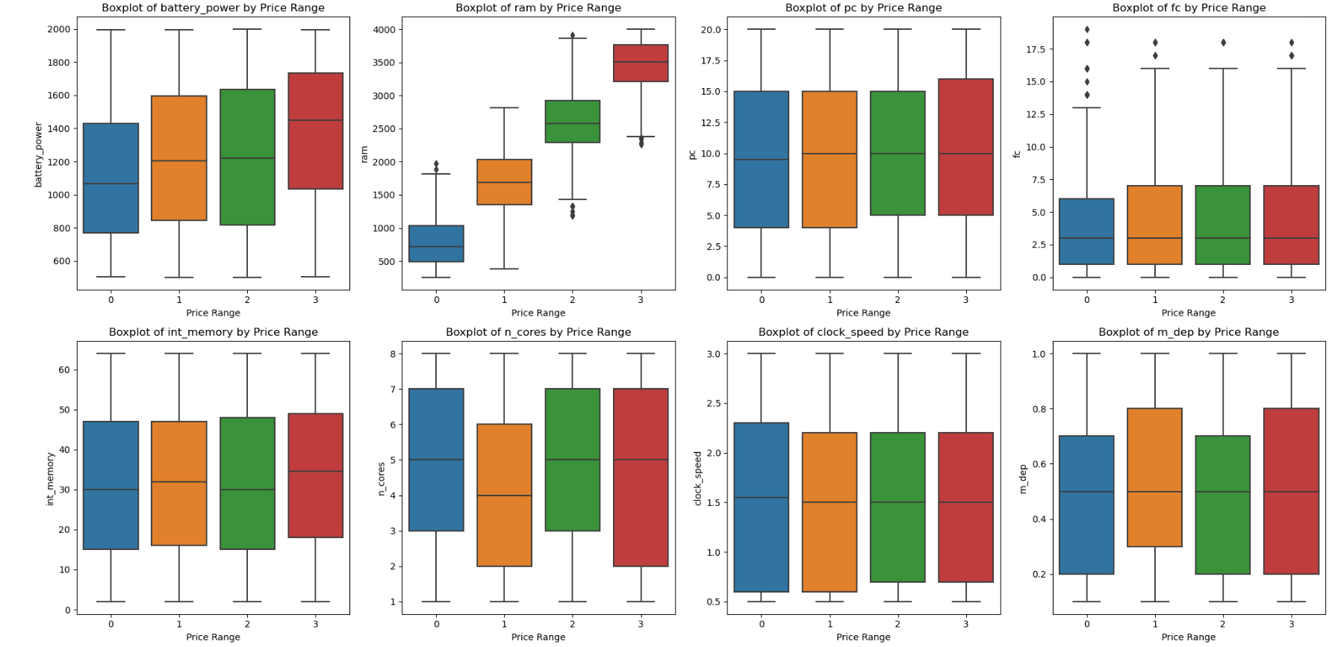
Checking for Outliers
There are very few outliers present in the dataset which can be ignored as dataset is very small.

Slide 7
Data Wrangling/Manipulations
2 values in 'Pixel_height' are 0 which are outliers, so it is replaced with mean value.
There are 180 values in 'Screen_width' are 0 which are outliers, and is replaced with mean value.
Created a new feature 'Pixel_area' by multiplying 'Pixel_height' & 'Pixel_width’.
Created a new feature 'Screen_area' by multiplying 'Screen_height' & 'Screen_width’.
Created new features for front & primary cam for indicating presence of camera by taking all the values above 0 as 1.
Created 4 rambins ranging from 1GB to 4GB to check the distribution of ram in different price range.

Slide 8
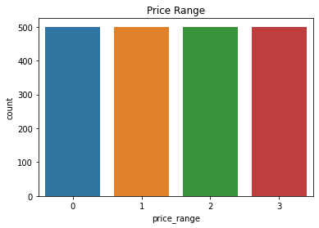
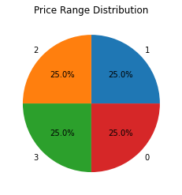
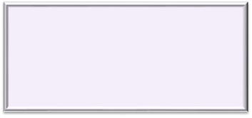
Exploratory Data Analysis
The data is equally distributed. Price
range are as follows:
0 - Low cost phones
1 - Medium cost phones
2 - High cost phones
3 - Very high cost phones

Slide 9
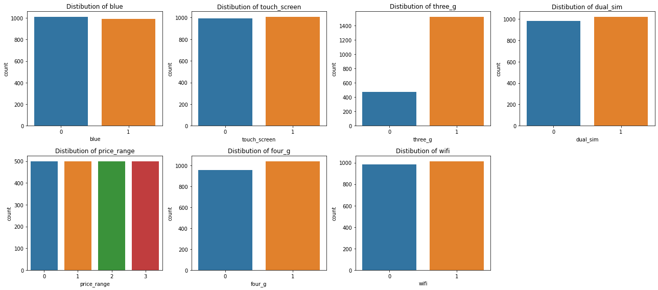
Almost 50% phones are having bluetooth connectivity.
Almost 50% phones are having dual sim.
Almost 48% phones lack 4G connectivity and 23% phones lack 3G connectivity. Phones lacking 3G are not having 4G connectivity as well.
Almost 50% phones lack wifi connectivity.
Almost 50% phones does not have touch screen.

Slide 10
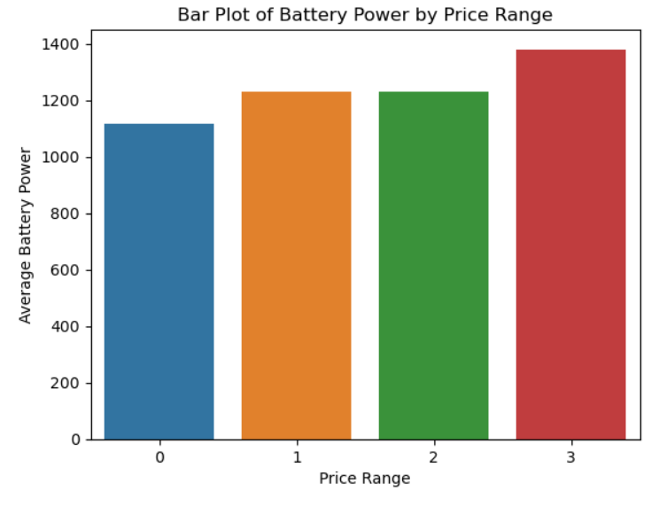
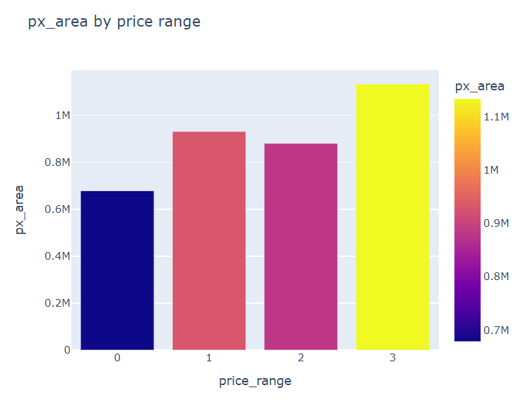
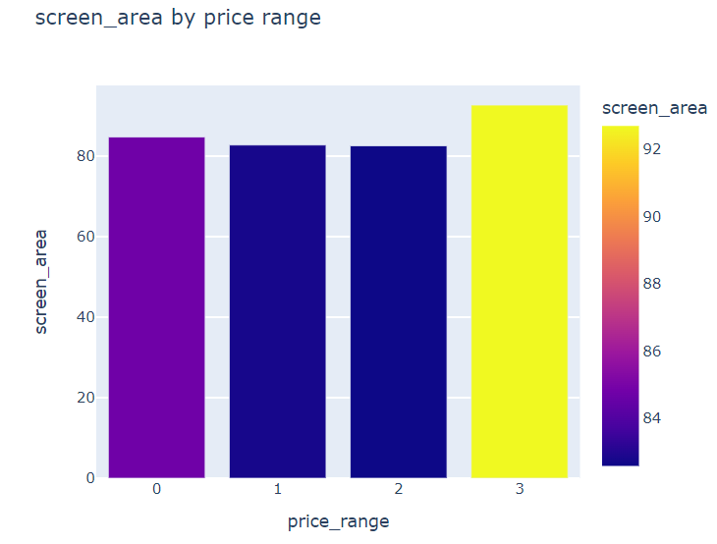
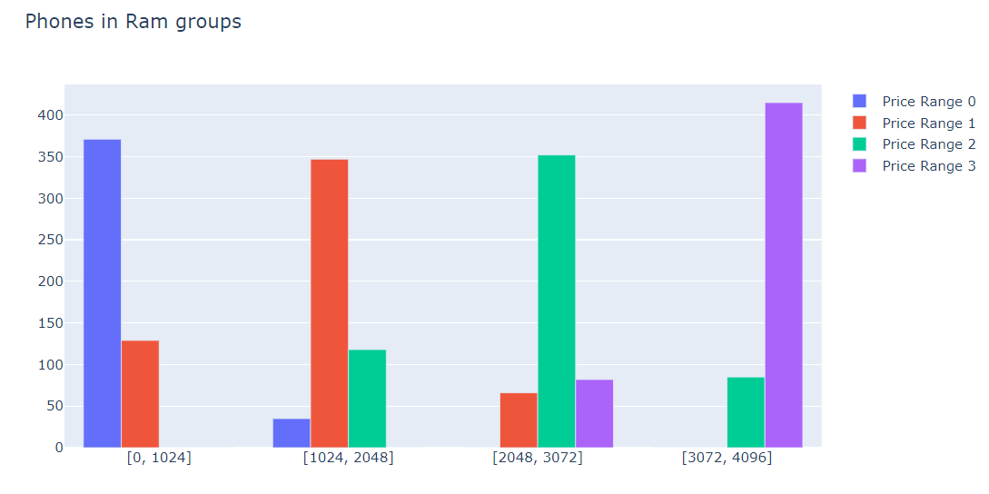
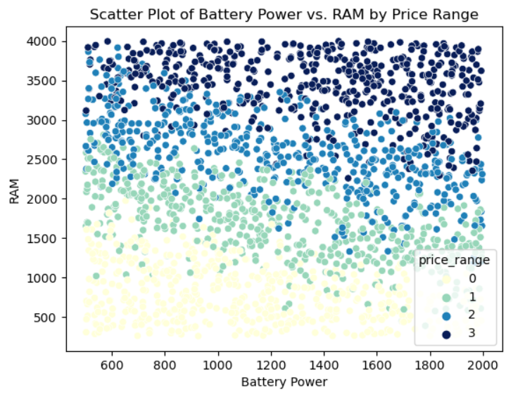
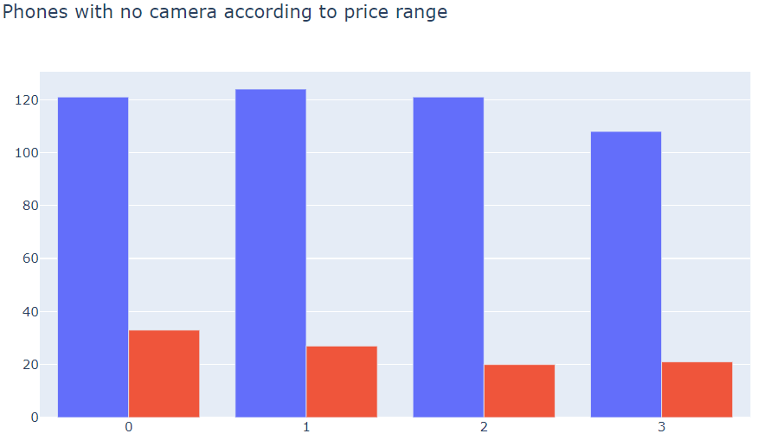
Higher price phones have larger screen & larger pixels resulting in better screen quality.
Prices are directly proportional to the battery power provided in the phone.
There are more phones with no front cam than no primary cam through all price ranges.
Phones which are not having primary cam are also not having front cam.
Lower price range phones mostly fall under 1GB RAM bin.
Higher price range phones mostly fall under 3GB to 4GB RAM bin.
Battery power & RAM is higher in case of expensive phones.

Slide 11
Key Findings from EDA
Phones which are not having 3G don't have 4G connectivity as well.
Phones which are not having Primary cam don't have front cam as well.
Low price phones mostly fall under Rambin 1GB & very high cost phones fall under rambin of 3GB to 4GB.
Adequate amount of ram should be in lower range phones too for stabilized performance of phone which can effect the brand image in a positive way.
Very high cost phones have larger screen area & pixel area as well, resulting in better screen quality.
Very high cost phones have larger battery size & mobile weight is lowest.
There are many phones with no front cam through out all price ranges, atleast it should be present in all very high cost phones.

Slide 12
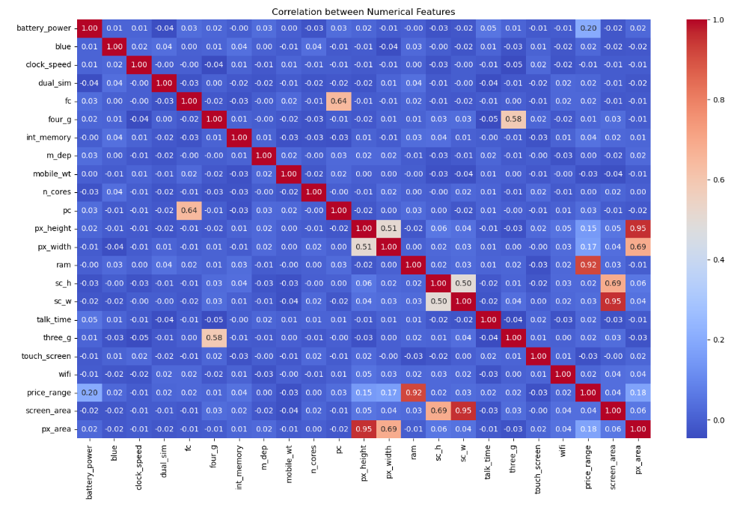
Correlation Heatmap
RAM & Price range are highly correlated with each other.
Primary cam & Front cam are highly correlated with each other.
Pixel height & width are correlated with each other.
Screen height & width are correlated with each other.

Slide 13
Hypothesis Testing
Internal memory, Ram are normally distributed so I have applied 2 sample T-Test to check if there is significant difference with respect to price range.
Screen area column is not normally distributed so cannot use population variable that’s why I have applied Mann-Whitney U Test to check if there is significant difference with respect to price range.
Mobile 4G connectivity is categorical Hence I have used chi-square test to check dependency with price range.
Conclusions from Hypothesis Testing
There is significant difference in the mobile price range with respect to average ram .
There is significant difference in mobile price range with respect to average int_memory.
There is significant dependency between the mobile price range and 4G connectivity.
There is significant difference in price range with respect to screen area.

Slide 14
Feature Engineering & selection
I have used sklearn.feature_selection module for feature selection/dimensionality reduction on dataset, to improve estimators accuracy scores and to boost their performance on very high-dimensional datasets.
I have checked p-value for all independent variables and removed features which are having confidence interval below 90%.

Slide 15

Model Selection and Evaluation
Before building models, I performed the train test split. I kept 25% of the data for test and remaining 75% of the data for training the model.
We compared 6 algorithms and evaluated them based on the overall accuracy score and the recall of the individual classes.
Accuracy is the ratio of the total number of correct predictions and the total number of predictions.
The recall is the measure of our model correctly identifying True Positives.
1. Decision Tree.
2. Random Forest classifier.
3. Decision Tree Classifier
4. K-nearest Neighbor classifier
5. XG Boost Classifier
6. Support Vector Machine(SVM)

Slide 16
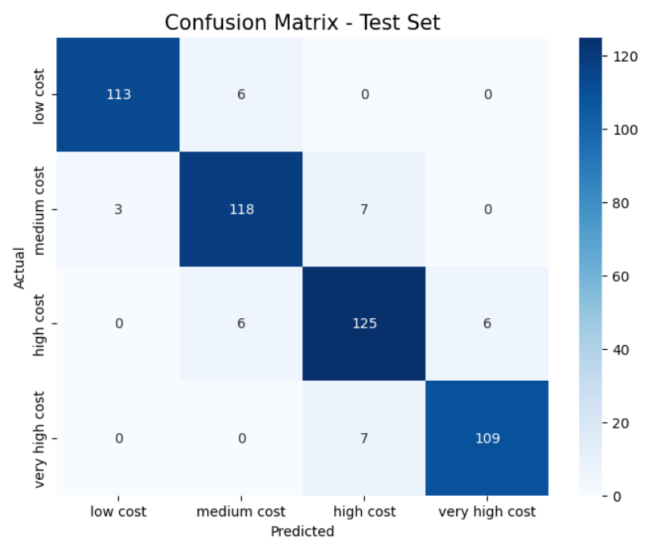
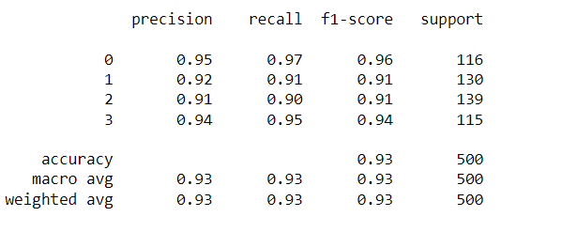
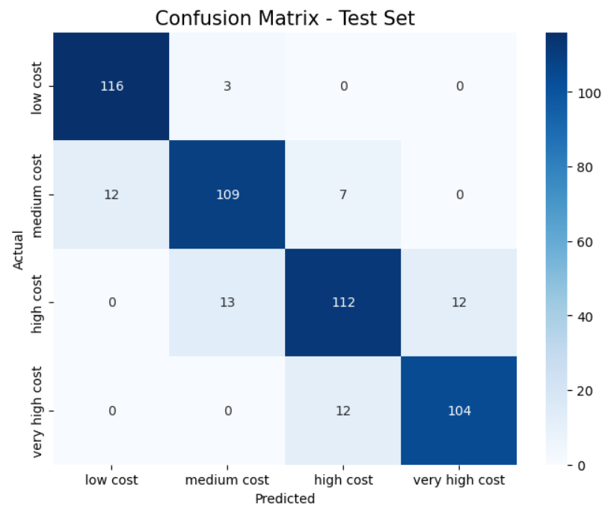
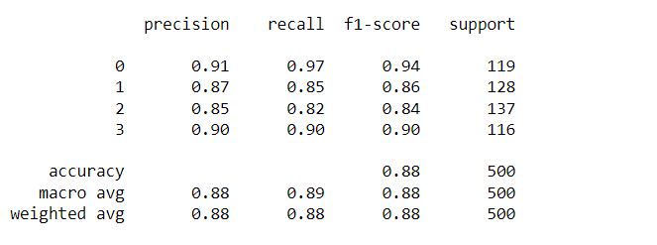
1.Logistic Regression
2. Random Forest Classifier

Slide 17
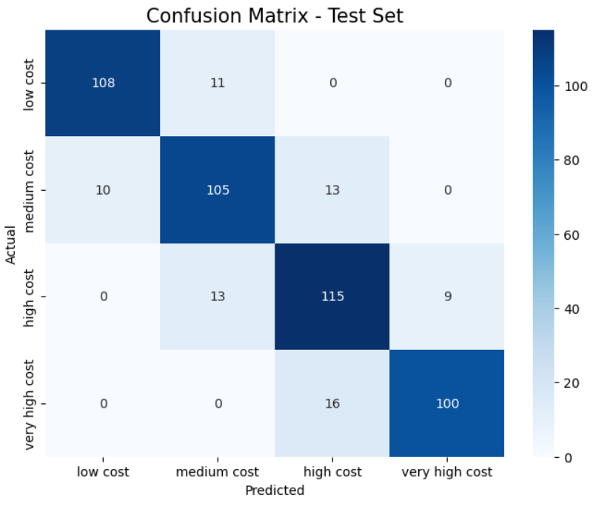
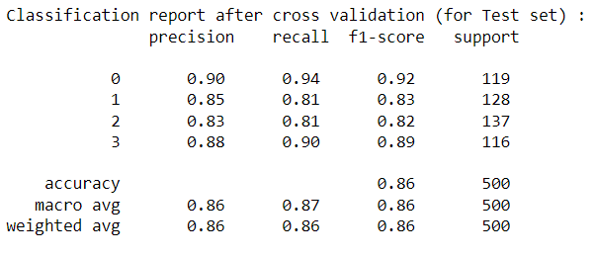
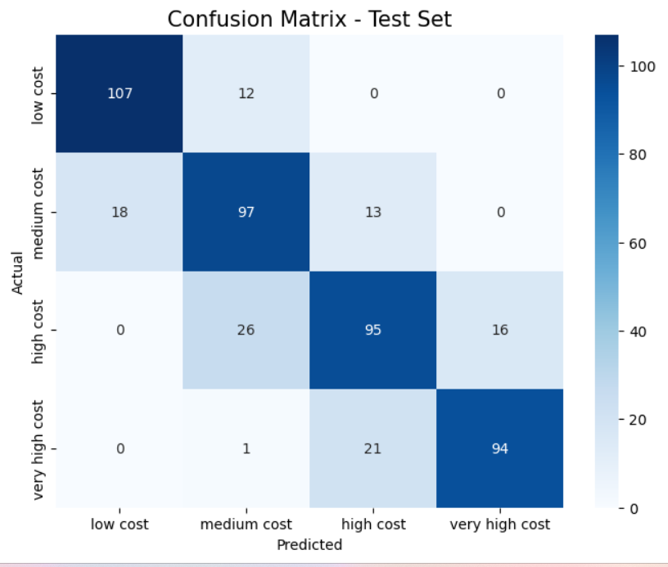
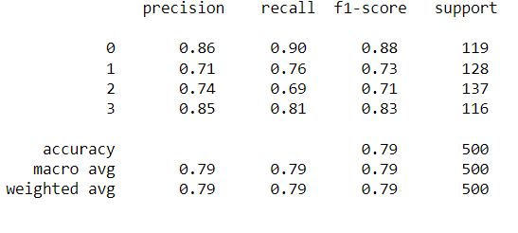
3. Decision Tree Classifier
4. K-Nearest Neighbour Classifier

Slide 18
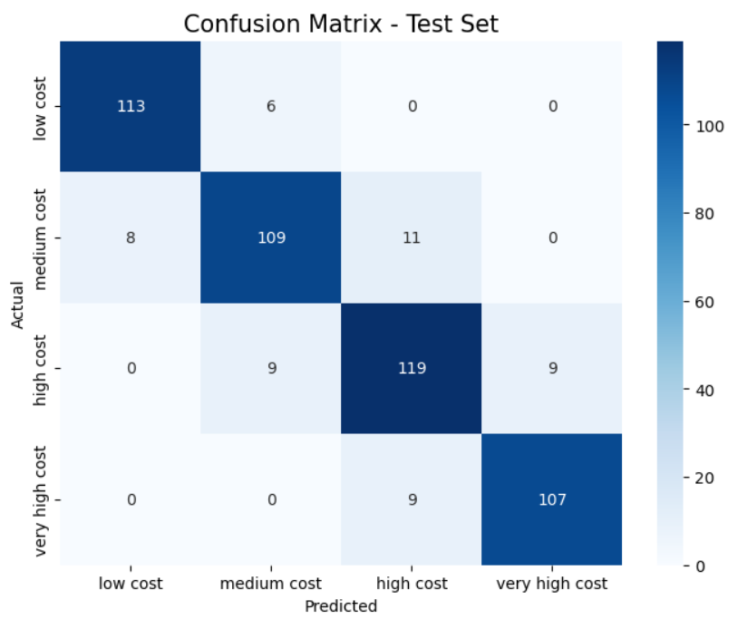
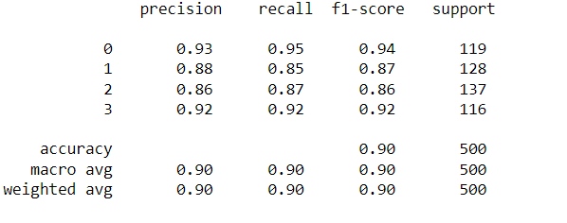

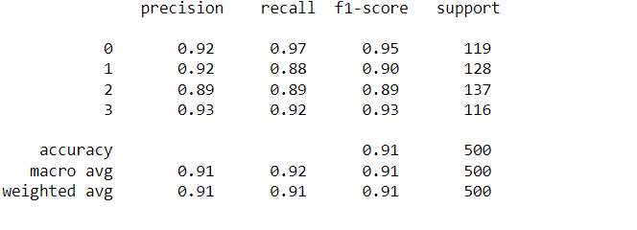
5. XG Boost Classifier
ML Model selected for deployment: Logistic Regression
The obvious choice would be the tuned 'Logistic Regression' model after cross validation and hyperparameter optimization, as this model yielded the highest accuracy result of about 93% among various models trained, making it a suitable model for prediction.
6. Support Vector Machine Classifier

Slide 19
Conclusions from Model
Simple and easy to implement: Logistic regression is a relatively simple statistical method that does not require much mathematical or statistical knowledge to use.
Works well with small datasets: Logistic regression can work well with small datasets, which is often the case in many practical applications.
Interpretable results: Logistic regression provides coefficients for each independent variable that can be interpreted as the change in the log odds of the dependent variable for a one-unit change in the independent variable.
Can handle both categorical and continuous variables: Logistic regression can handle both categorical and continuous independent variables, making it a versatile method for modeling binary outcomes.

Slide 20
Thank You

