Slide 1
Mushroom Classification
Edible or Poisonous

Slide 2
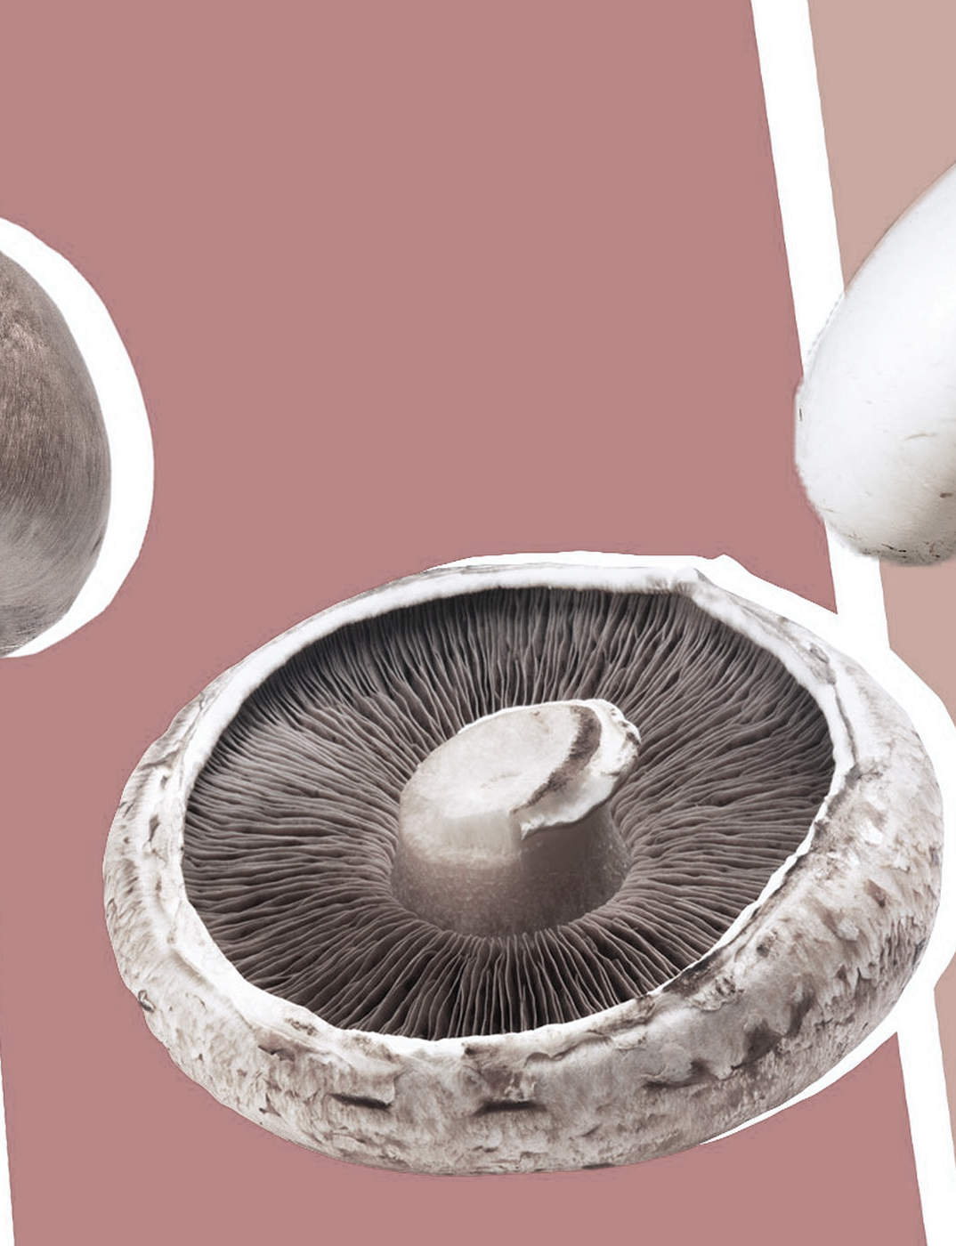
Introduction
Mushrooms exists naturally in different types in diverse environments and different shapes, it can be recognized with some common features. Mushrooms are common for their vast usages medical, nutritional and therapeutical properties. However, some types are known for their toxicity. Which causes huge number of fatal accidents yearly, because of misidentification. Creating a model that recognizes the edible types of mushrooms can safe many precious lives.

Slide 3
Methodology
Problem Understanding
Load Data
EDA
Feature Engineering
Classification
Results & Insights

Slide 4
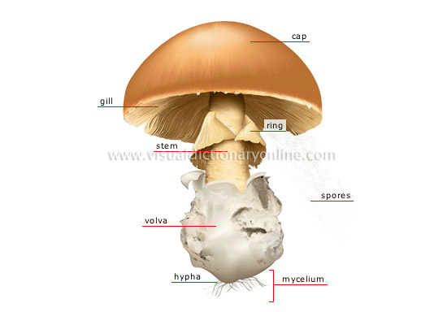
Problem Understanding
To detect if the mushroom is edible or poisonous by its specifications like cap shape, cap color, gill color, etc. using different classifiers.
This dataset which we used includes descriptions of hypothetical samples corresponding to 23 species of gilled mushrooms. Each species is identified as definitely edible, definitely poisonous, or of unknown edibility and not recommended.

Slide 5
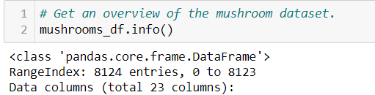
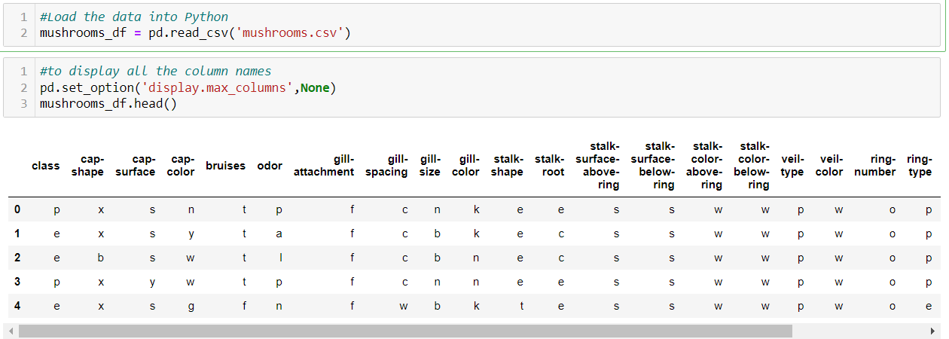
Load Mushroom Data into Python
There are no duplicated values nor missing values.

Slide 6
Data Dictionary
Attribute Information: (classes: edible=e, poisonous=p)
cap-shape: bell=b, conical=c, convex=x, flat=f, knobbed=k, sunken=s (6 distinct values)
cap-surface: fibrous=f, grooves=g, scaly=y, smooth=s (4 distinct values)
cap-color: brown=n, buff=b, cinnamon=c, gray=g, green=r, pink=p, purple=u,red=e, white=w, yellow=y (10 distinct values)
bruises: bruises=t, no=f (2 distinct values)
odor: almond=a, anise=l, creosote=c, fishy=y, foul=f, musty=m, none=n,pungent=p, spicy=s (9 distinct values)
gill-attachment: attached=a, descending=d, free=f, notched=n (4 distinct values)
gill-spacing: close=c, crowded=w, distant=d (3 distinct values)
gill-size: broad=b, narrow=n (2 distinct values)
gill-color: black=k, brown=n, buff=b, chocolate=h, gray=g, green=r, orange=o, pink=p, purple=u, red=e, white=w, yellow=y (12 distinct values)
stalk-shape: enlarging=e, tapering=t (2 distinct values)
stalk-root: bulbous=b, club=c, cup=u, equal=e, rhizomorphs=z, rooted=r, missing=? (7 distinct values)
stalk-surface-above-ring: fibrous=f, scaly=y, silky=k, smooth=s (4 distinct values)
stalk-surface-below-ring: fibrous=f, scaly=y, silky=k, smooth=s (4 distinct values)
stalk-color-above-ring: brown=n, buff=b, cinnamon=c, gray=g, orange=o, pink=p, red=e, white=w, yellow=y (9 distinct values)
stalk-color-below-ring: brown=n, buff=b, cinnamon=c, gray=g, orange=o, pink=p, red=e, white=w, yellow=y (9 distinct values)
veil-type: partial=p, universal=u (2 distinct values)
veil-color: brown=n, orange=o, white=w, yellow=y (4 distinct values)
ring-number: none=n, one=o, two=t (3 distinct values)
ring-type: cobwebby=c, evanescent=e, flaring=f, large=l, none=n, pendant=p,sheathing=s, zone=z (8 distinct values)
spore-print-color: black=k, brown=n, buff=b, chocolate=h, green=r, orange=o,purple=u, white=w, yellow=y (9 distinct values)
population: abundant=a, clustered=c, numerous=n, scattered=s, several=v, solitary=y (6 distinct values)
habitat: grasses=g, leaves=l, meadows=m, paths=p, urban=u, waste=w, woods=d (7 distinct values)

Slide 7
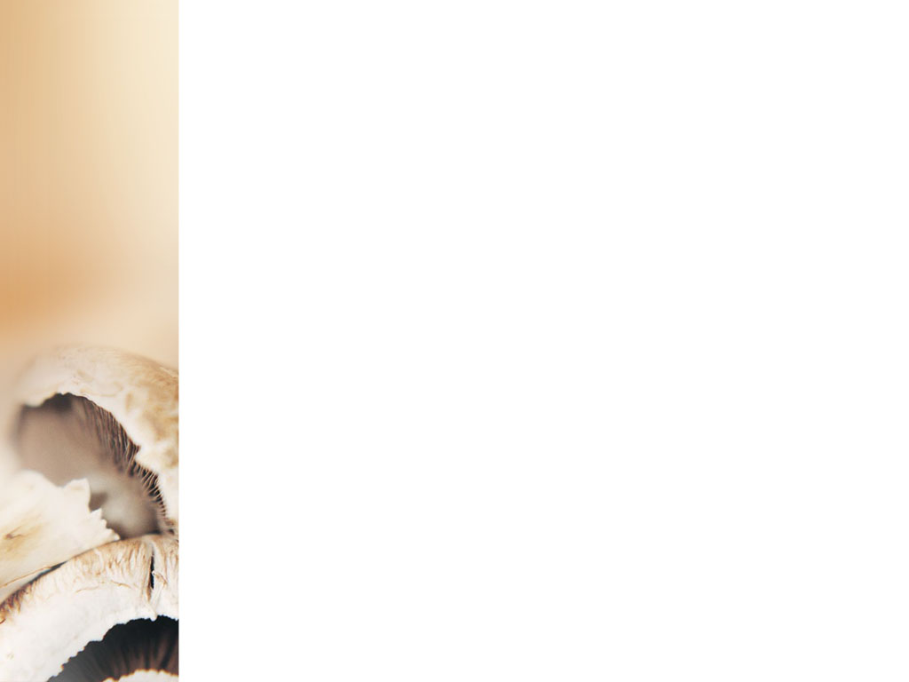
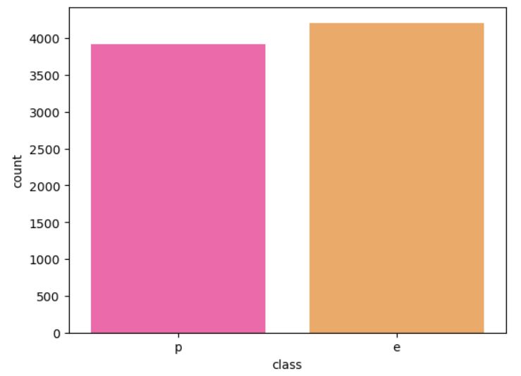
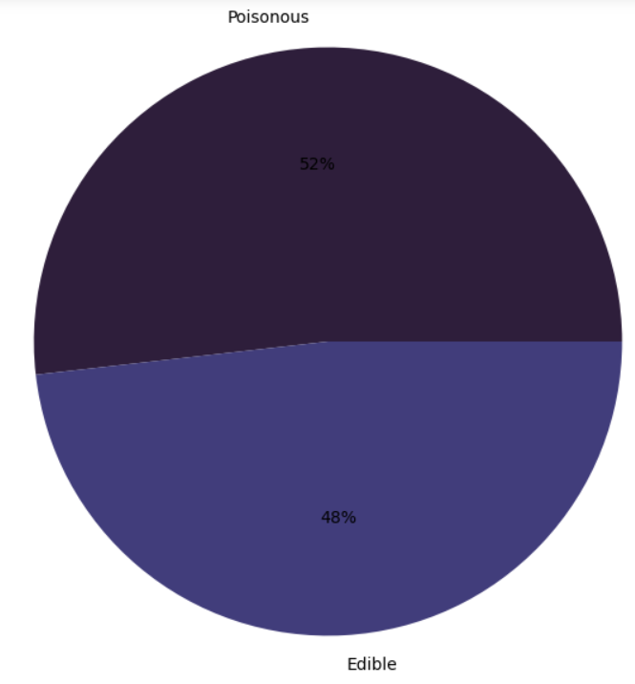
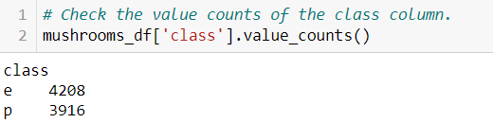
Exploratory Data Analysis
How many poisonous and edible mushrooms?

Slide 8
Data Analysis
Identify weather mushrooms are edible or poisonous based on
Cap-shape
Stalk-root
Gill-color
Gill-attachment
Odor
Ring-type
Stalk-color-
below-ring
Stalk-color-
above-ring

Slide 9
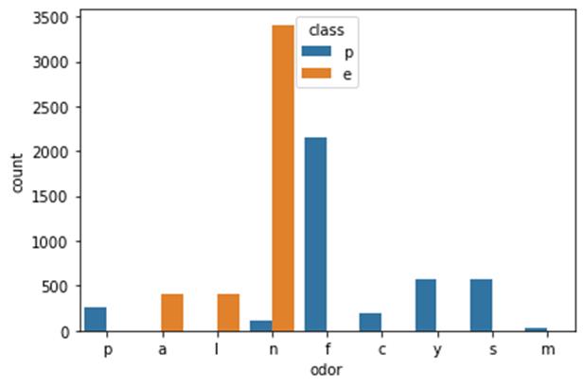
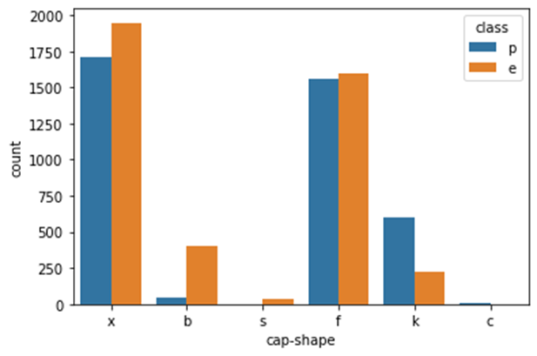
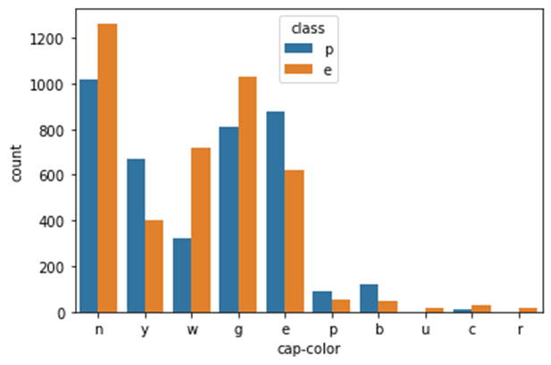
Edible mushrooms mostly have a broad gill size and do not have conical caps.
Edible mushrooms do not have any kind of bad like foul, fishy, pungent odor.
Every red and orange colored cap of a mushroom is edible

Slide 10
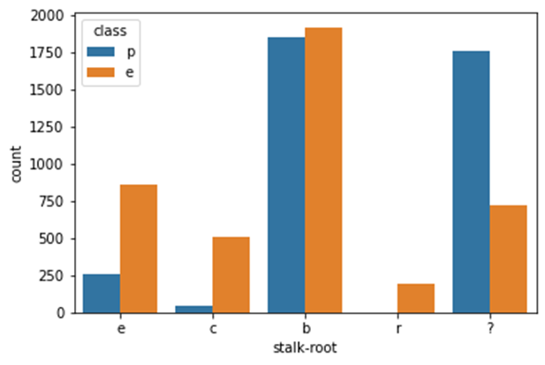
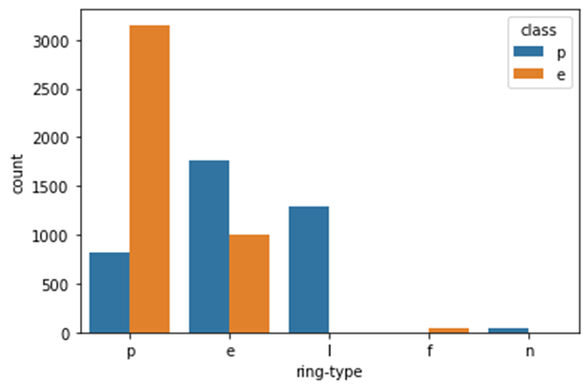
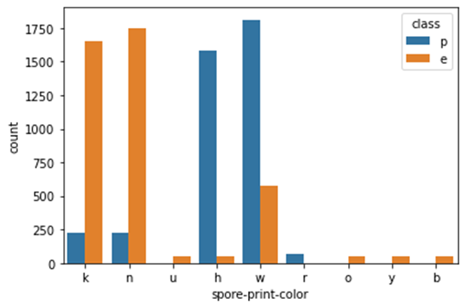
The stalk roots of edible mushrooms don't look like rhizomorphs
All flaring ring types are edible and large and none ring types are definitely poisonous.
Mushrooms with the spore print buff, yellow, orange, and purple are always edible in nature. While green is for poisonous

Slide 11
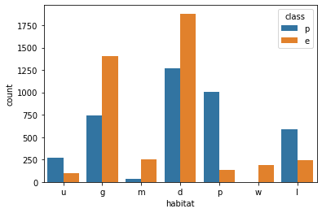
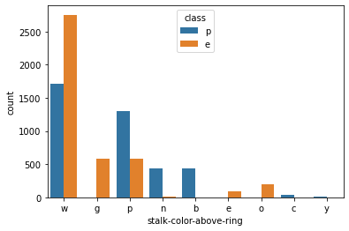
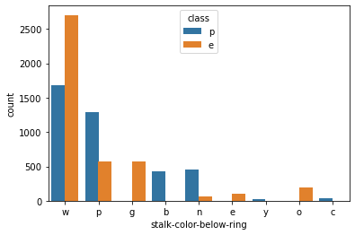
Edible mushrooms can grow in all population types where as poisonous cannot grow in waste
If the stalk color above or below the ring is red, orange or grey it is definitely an edible mushroom. With stalk color cinnamon, yellow, buff it has to a poisonous mushroom.

Slide 12
Other Key Findings from EDA
If the cap shape is sunken then its surface is always fibrous.
The mushrooms with conical-shaped caps with surface of cap as grooves are poisonous in nature.
Conical cap-shaped mushrooms are only white and yellow, and Mushrooms whose cap surface is groove are only white in color.
The large ring type has only a foul odor and the Flaring ring type does not have an odor.
Mushrooms which having large rings have a spore print color of chocolate. When there are no rings then the spore print color is white
If the mushroom has a spicy and fishy odor then it will have an evanescent ring type. Whereas, almond, creosote, anise, and pungent odor have a pendant ring type.
Poisonous mushrooms aren't rooted.

Slide 13
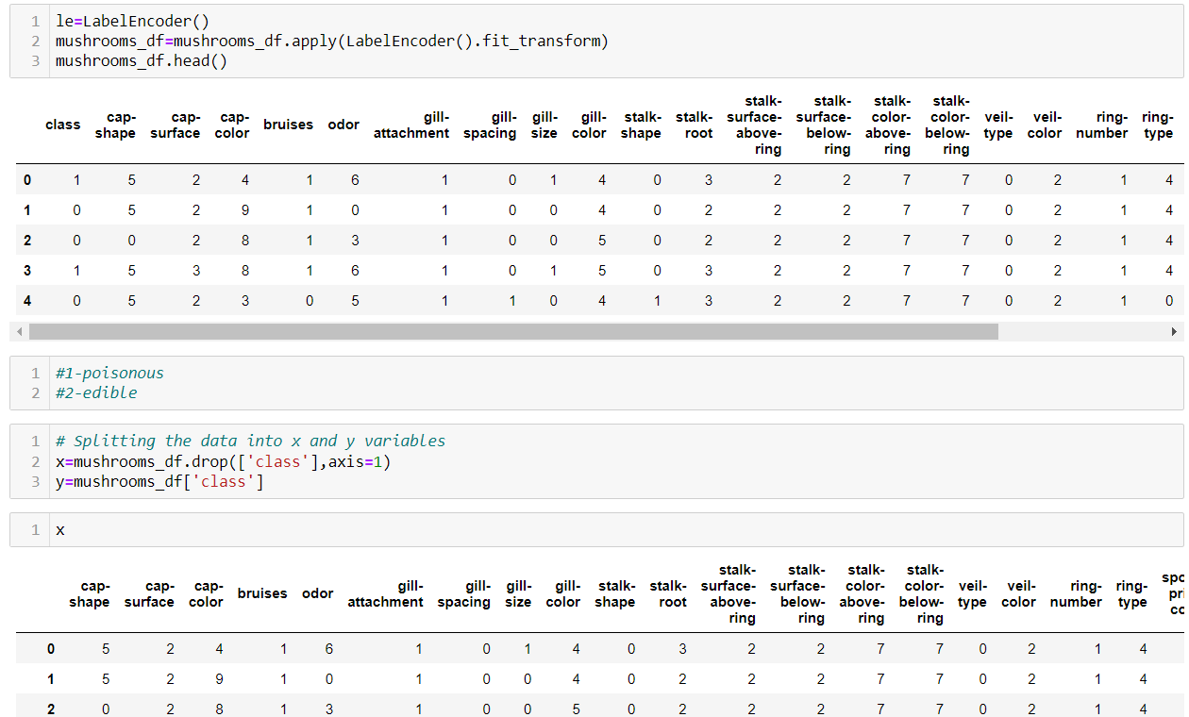
Feature Engineering
Converted all the columns into integer format to feed the data into model using LabelEncoder
Splitted the dataset into a set of features (X) and variable (Y)
Used 70% of dataset for training and remaining 30% for testing.

Slide 14
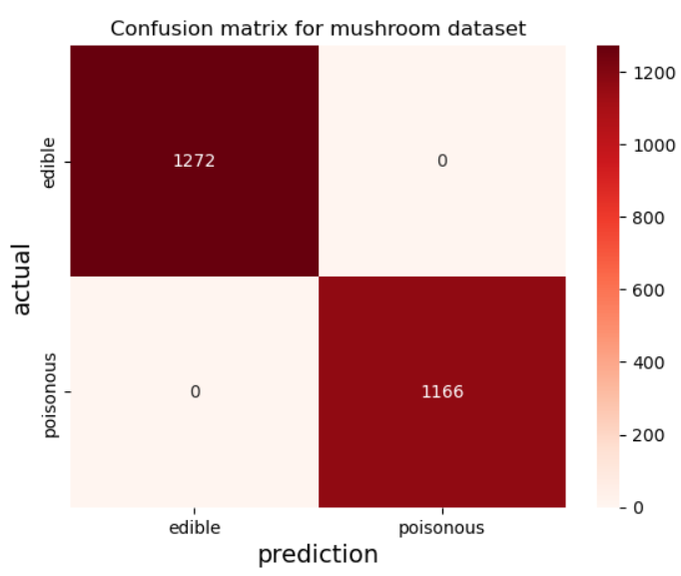
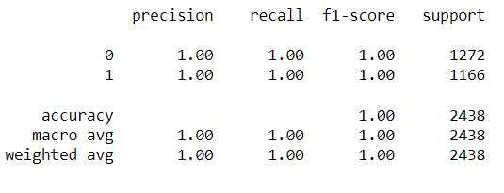
Model Selection & Evaluation
1. Decision Tree

Slide 15
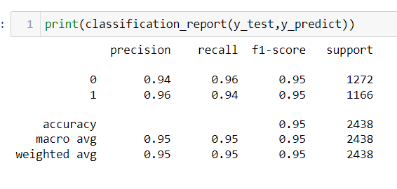
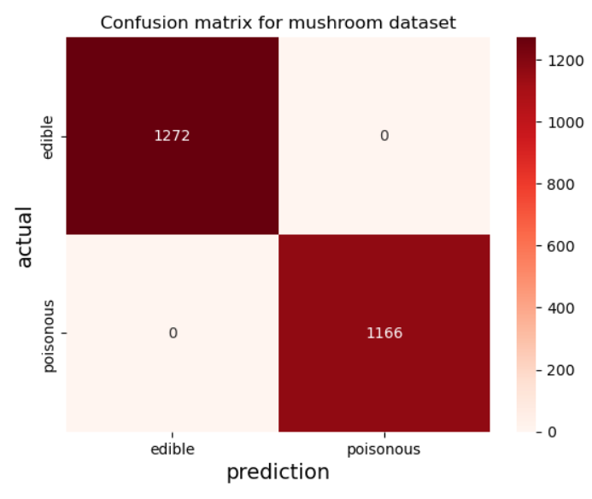
2. Logistic regression

Slide 16
Conclusion
Since both the models performed so well, it was clear to me that they were able to identify specific traits that greatly influenced the classification of an edible versus poisonous mushroom.Still, we can choose Decision Tree model as it has an accuracy of 100%
a few simple rules to identify a poisonous mushroos:
Odor: If the Mushroom has an odor, especially if the odor is not pleasant, it is likely to be poisonous.
Gill Size: If the gills are narrow, it is likely to be poisonous.
Spore Print Color: White, red, ‘chocolate’ are likely to be poisonous.
Bruises: If the mushroom does not have bruises, it is likely to be poisonous.
Stalk Surface Above Ring: If it appears silky, it is likely to be poisonous.

Slide 17
Thank You

