Slide 1
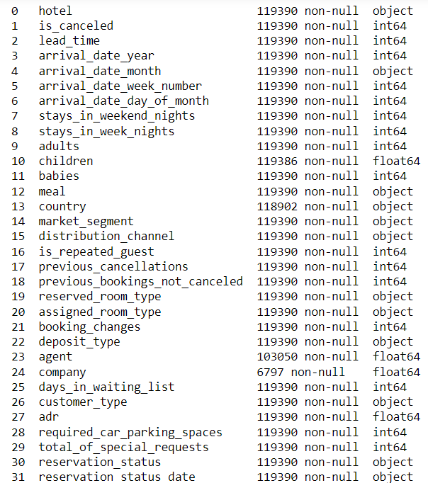
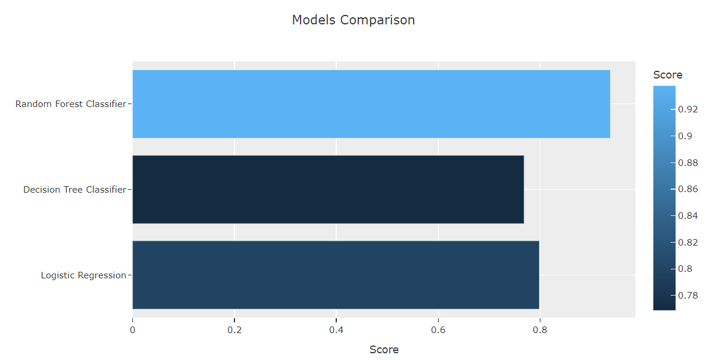
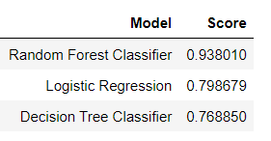
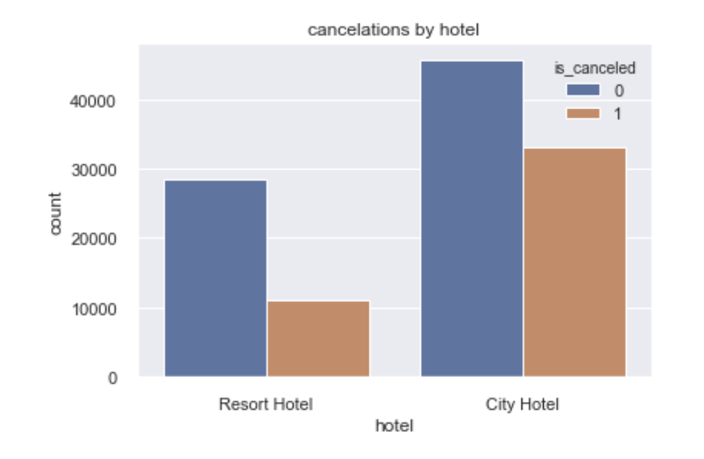
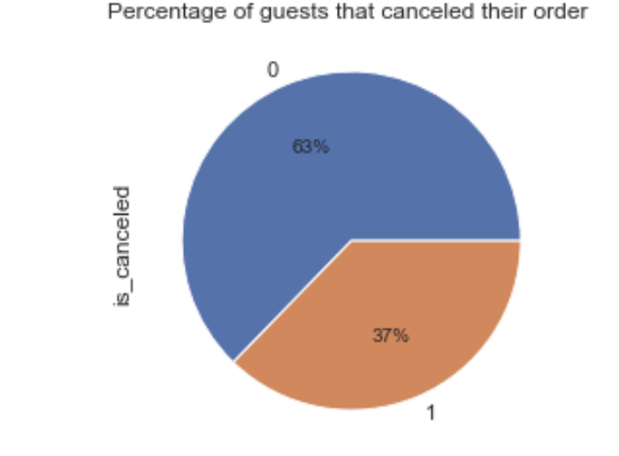
Hotel Booking Cancellation Prediction
By : Maya Babu
Variables
Model Evaluation
Business Problem
The Goal of this project is to Predict the Guests who are likely to Cancel the Hotel Booking using Machine Learning with Python.
Data Source
Data Source is from Kaggle and contains 119,390 observations and 32 variables
Feature Engineering & selection
Visualisation
Conclusion
Calculated mean of agents, company, children and filled the 'nan' values.
there are zero and nan values for the 'no nights' columns.
The same manipulations I did for 'guests_total' and 'children'.
Booking cancellation model will help to Identify the likelihood of bookings being cancelled and makes it possible for hotel managers to take measures to avoid these potential cancellations, such as offering services, discounts, or other perks.

