Slide 1

Online Shoppers Purchase Intention

Slide 2
CONTENTS
EXECUTIVE SUMMARY, BUSINESS PROBLEMS & OBJECTIVES
CONCLUSIONS & RECOMMENDATIONS
PREDICTIVE ANALYTICS
METHODOLOGY
HYPOTHESIS TESTING & CORRELATION
DESCRIPTIVE ANALYTICS

Slide 3
EXECUTIVE SUMMARY
Analysis of Online Shopper’s Purchase Intention Dataset Using Machine Learning Algorithm
Classification Project using Logistic Regression
The dataset used in this project is retrieved from the UCI website.
The dataset consists of 12,330 entries, 18 variables, and 1 class label called Revenue which contains either a True or False value.

Slide 4

INTRODUCTION
The use of online stores has grown significantly around the world in recent years.
The ability to automatically determine a user's purpose is one of the essential elements in helping real-time decision-making for products and enterprises.
Our project is focused on applying a Machine Learning classification model to e-commerce website data.
We analyze if machine learning is an effective method in predicting whether or not a visitor to an e-commerce website will make a purchase or not.
BUSINESS PROBLEM
Given the clickstream and session data of a user who visits an e-commerce website, can we predict whether or not that visitor will make a purchase?
Answering this question is critical for these types of companies to ensure that they can remain profitable.

Slide 5
METHODOLOGY
Data Collection
Data Preprocessing
Handled duplicate values and Outliers.
No missing values
Performed exploratory data analysis to visually analyze our data to identify any patterns or trends.
Statistical techniques used were chi-Square and t-test.
Feature Engineering
Reduced the number of categories of some categorical variables by combining categories
Created a new variable Quarter from the Month feature
Model Selection
Logistic Regression Model to predict the Revenue class
Model Training
Split the data into 70:30
Evaluation
Evaluated the model’s performance using the testing data.
Each row in the dataset contains data corresponding to a visit “session” (period of time spent) of a user on an e-commerce website.
Each session would belong to a unique user over a 1-year period.
The total number of sessions in the dataset is 12,330.
Univariate/
Bivariate Analysis
Log Transformation
Trained the model using the training data.

Slide 6
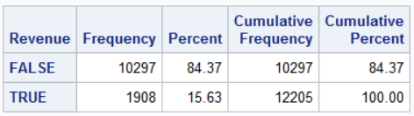
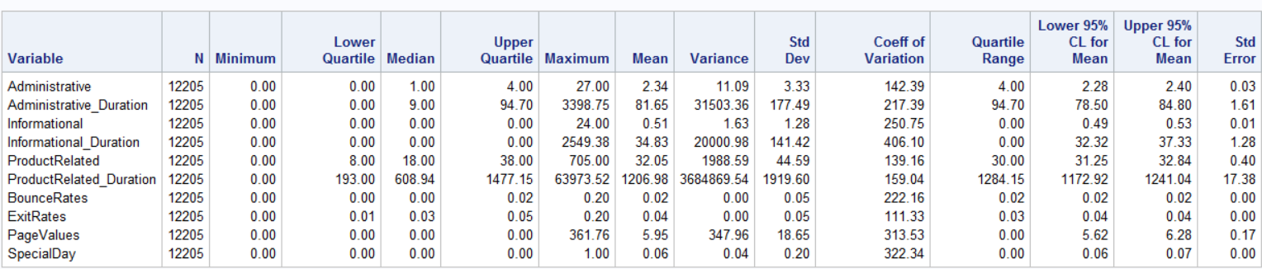
VARIABLES OF THE DATASET
INDEPENDENT VARIABLES
DEPENDENT VARIABLE
Duration (time) spent on Administrative, Informational, or Product related sections of the website.
Data from Google Analytics such as bounce rate, exit rate, and page values.
What month the session took place and whether or not the day of the session falls on a weekend?
The operating system and browser used by the website visitor.
Other categorical variables are VisitorType, region, and traffic type.
The dataset consists of 10 numerical and 8 categorical variables
Descriptive statistics for numerical variables
Notes:
Page Value feature represents the average value of a web page that a user visited before completing an e-commerce transaction.
The bounce rate is the percentage of visitors who navigate away from the site after viewing only one page.
The exit rate is the percentage of visitors who leave the website from a specific page.

Slide 7
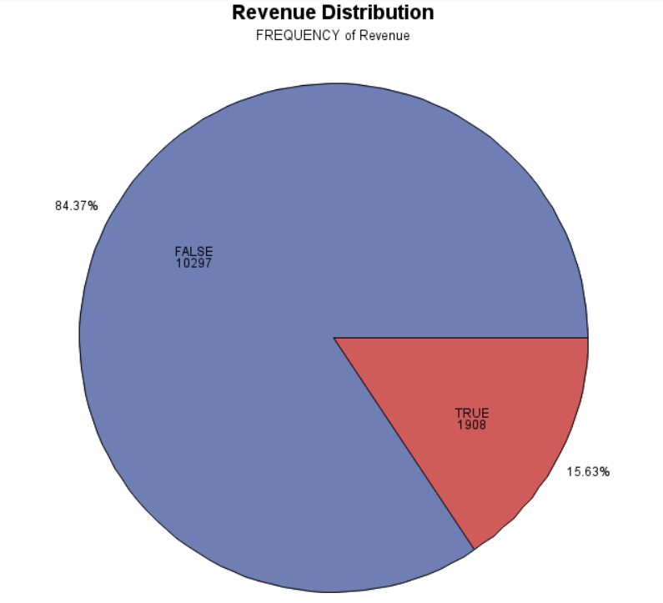
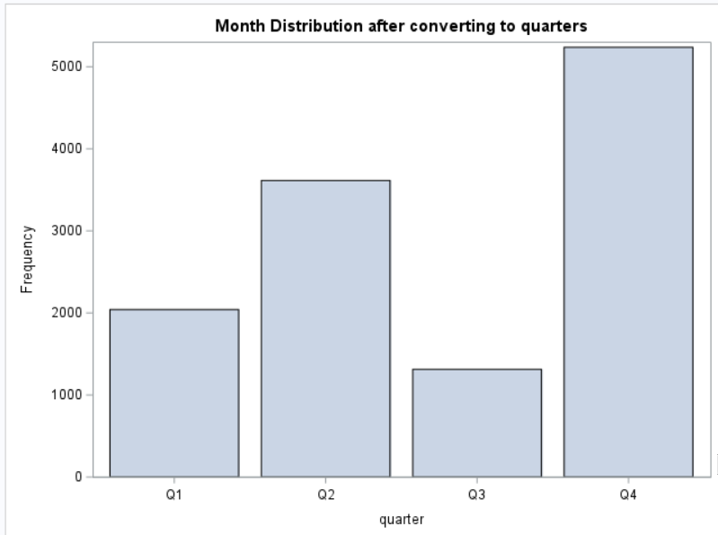
UNIVARIATE ANALYSIS - CATEGORICAL
Target class Revenue is highly imbalanced where only 15% of sessions ended in a purchase
Most of the online purchases occurred in the last quarter.

Slide 8
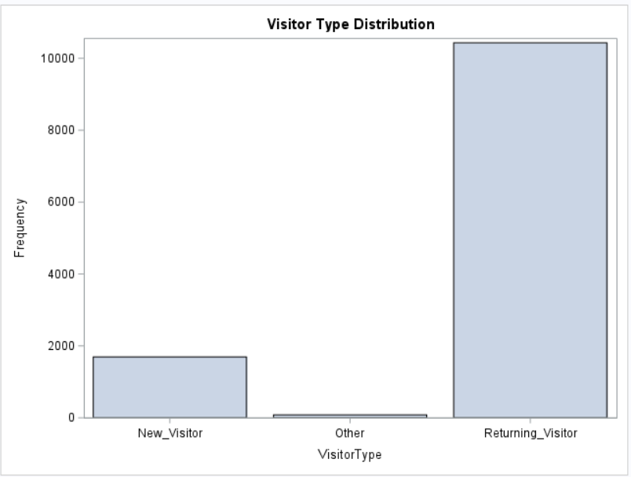
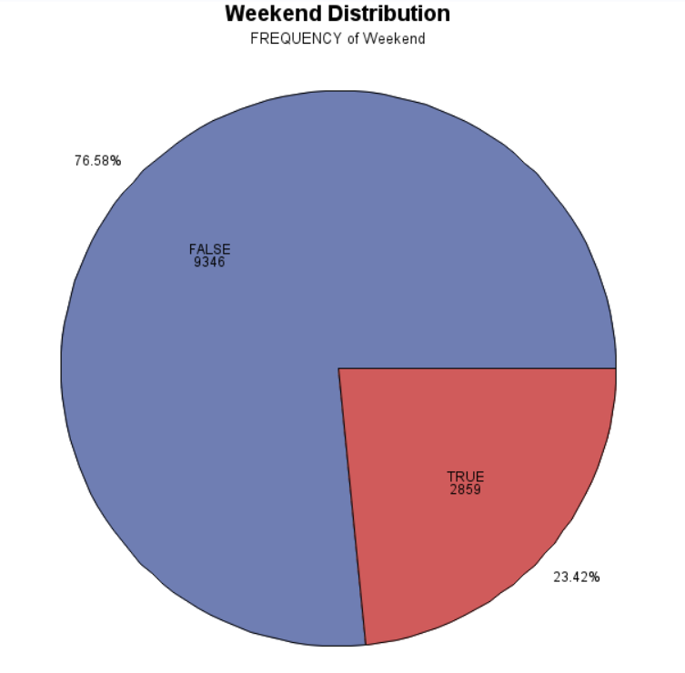
UNIVARIATE ANALYSIS - CATEGORICAL
The majority of the sessions are for returning users
Most of the online purchases are happening on weekdays.

Slide 9
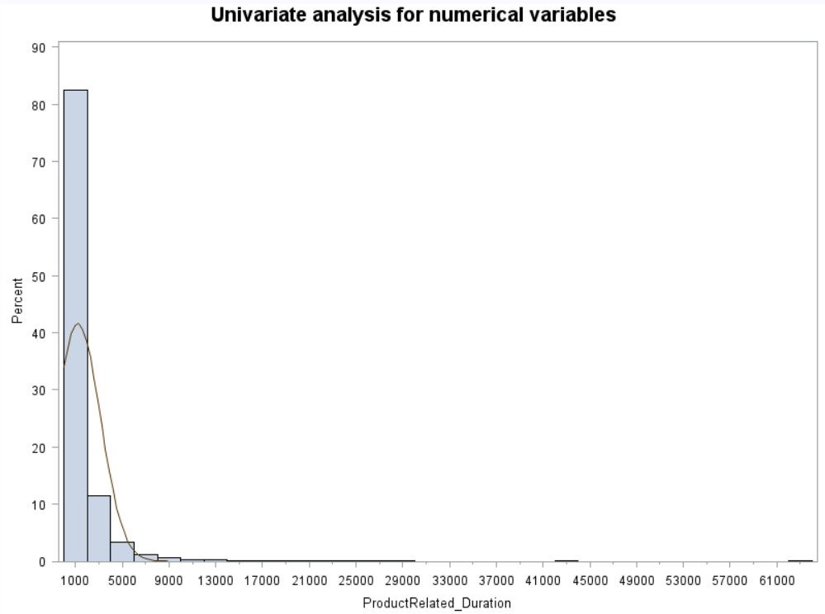
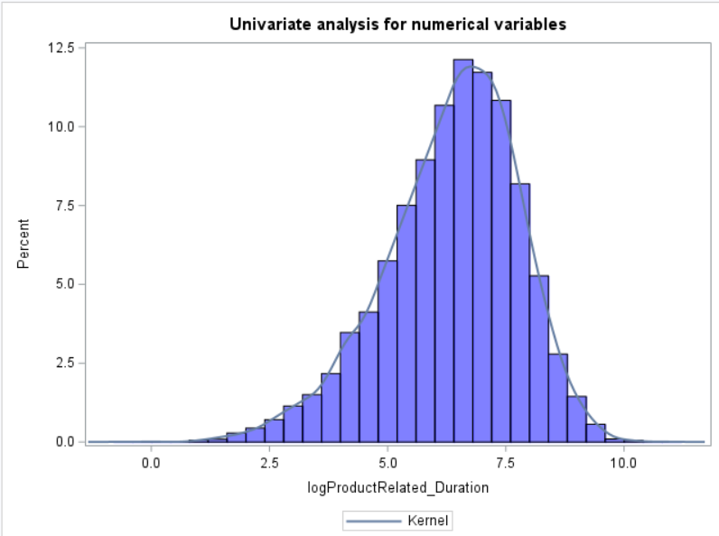
UNIVARIATE ANALYSIS - NUMERICAL
Log transformation
Many numeric features are right-skewed with long tails.
This is common in e-commerce settings, where some users have extremely high usage statistics.

Slide 10
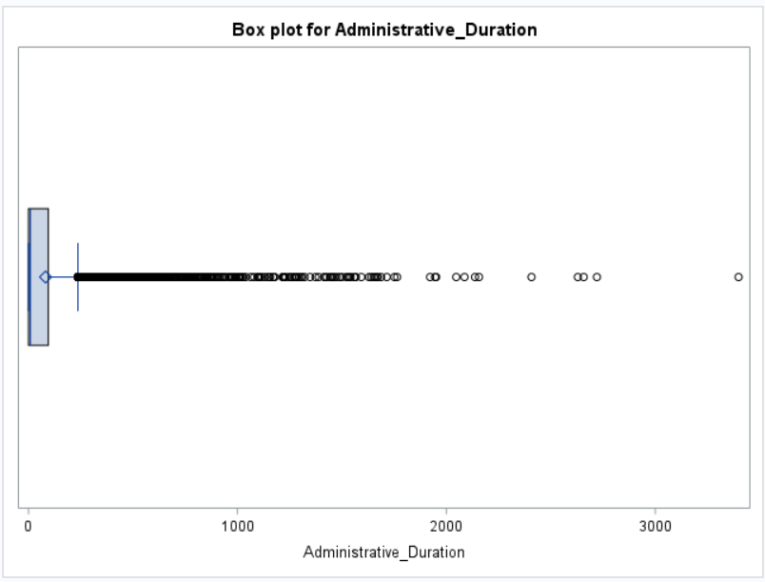
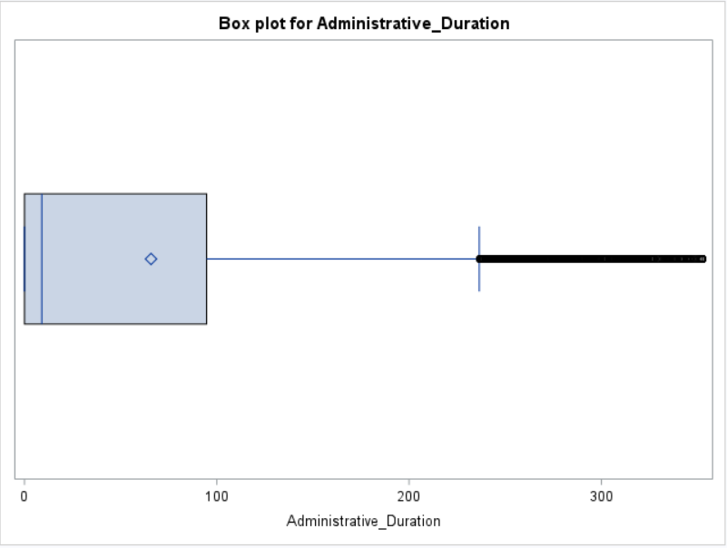
UNIVARIATE ANALYSIS - NUMERICAL
After Capping
Most of the numeric features have outliers.
We didn’t completely remove the outliers instead capped the outliers at the 5th and 95th percentiles, where values below the 5th percentile are replaced with the 5th percentile value, and values above the 95th percentile are replaced with the 95th percentile value.

Slide 11
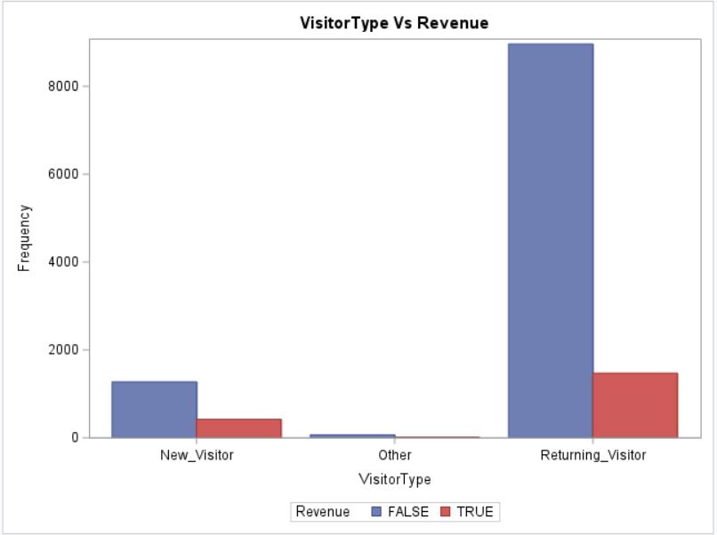
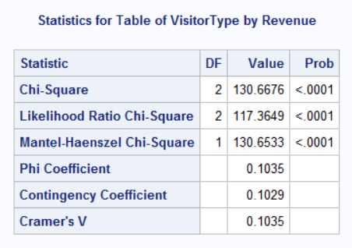


BIVARIATE ANALYSIS – Chi-Square
Based on the p value of the chi-square test, there is a statistically significant association between VisitorType and Revenue
Returning visitors are more likely to make a purchase compared to new visitors and other visitors.
This suggests that website owners could consider targeting returning visitors with special promotions or personalized content to encourage them to make more purchases.

Slide 12
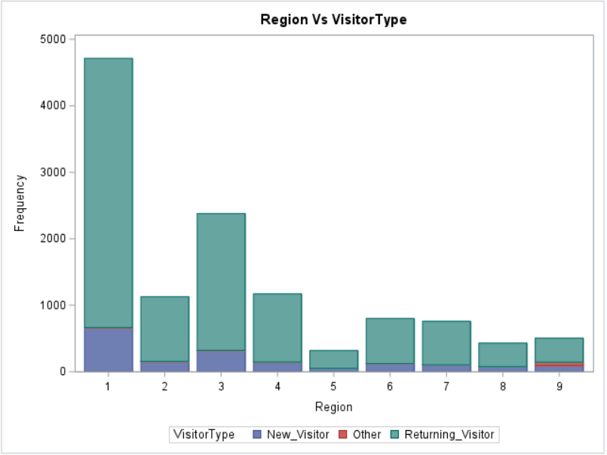
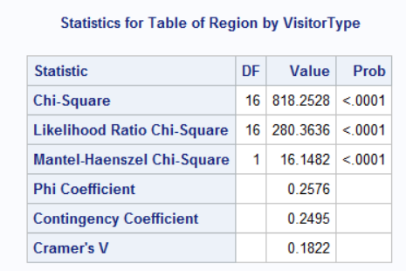

BIVARIATE ANALYSIS – Chi-Square
The chi-square test statistic is 818.2528, which has a probability of <0.0001, indicating that there is a significant association between region and visitor type.
Most of the visitors are from Region1.

Slide 13
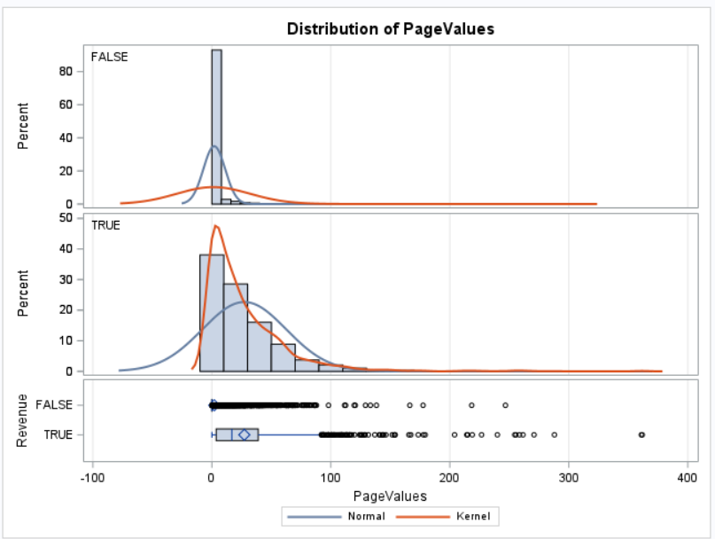
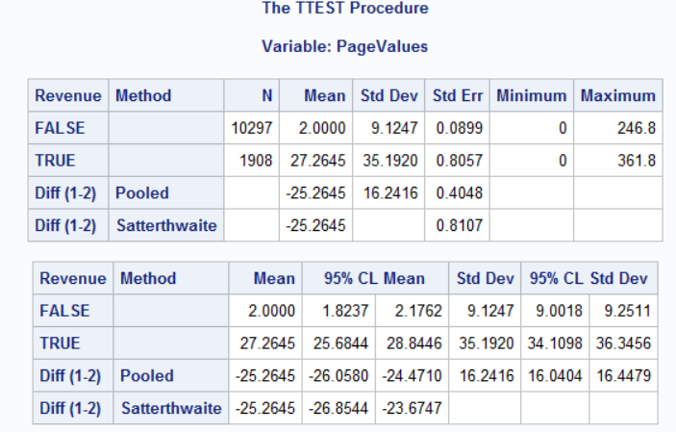
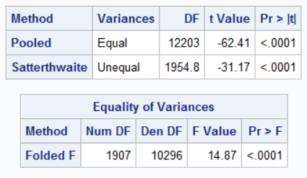
BIVARIATE ANALYSIS - Ttest
PageValues Vs Revenue
The p value less than 0.05 indicates that there is statistically significant difference in mean pageValues between users who made a purchase and who didn’t.
The users who visited more pages are more likely to make a purchase than those who visited fewer pages.

Slide 14
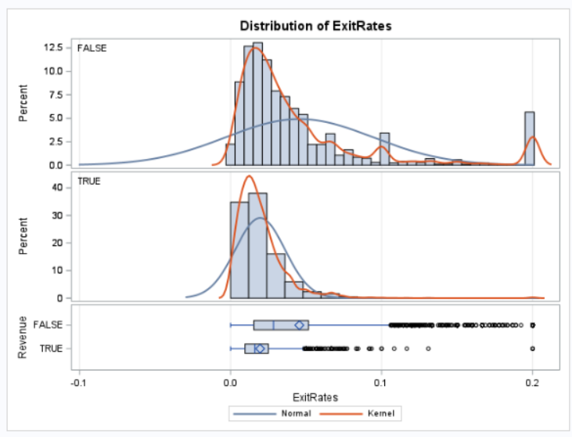
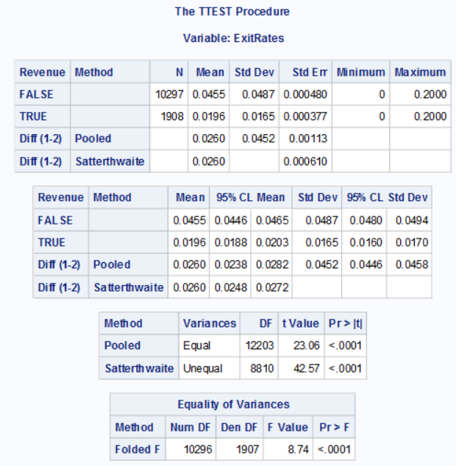
BIVARIATE ANALYSIS - Ttest
ExitRates Vs Revenue
The p-value less than 0.05 indicates that there is a statistically significant difference in mean ExitRates between users who made a purchase and those who didn’t.
The users who had high ExitRates are more likely to not purchase.

Slide 15
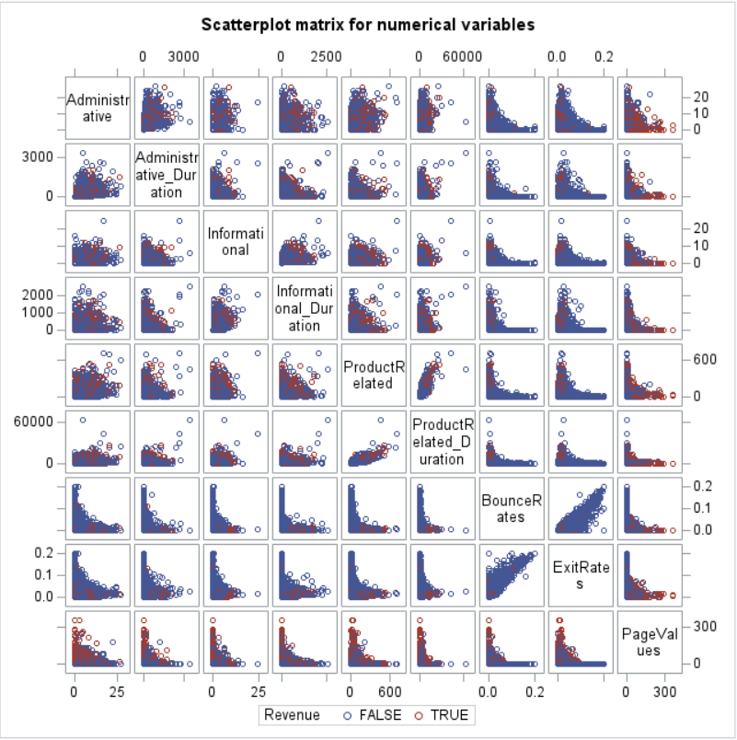
SCATTERPLOT

Slide 16
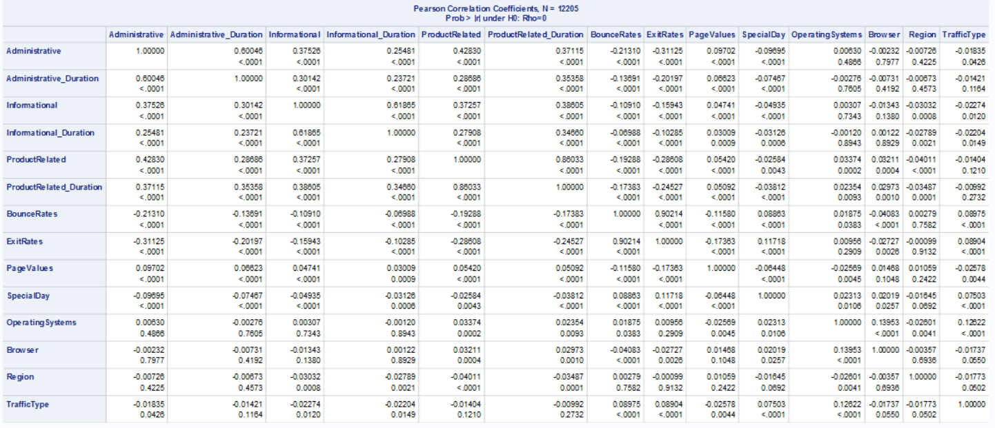




CORRELATION MATRIX
From the result we can see that ProductRelated and ProductRelated_Duration are highly correlated
Also ExitRates and BounceRates are highly correlated

Slide 17
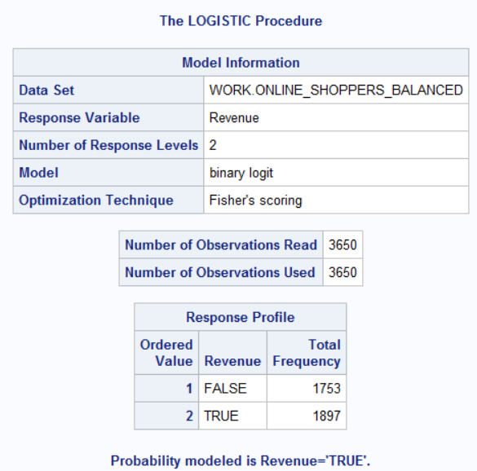
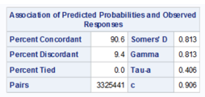
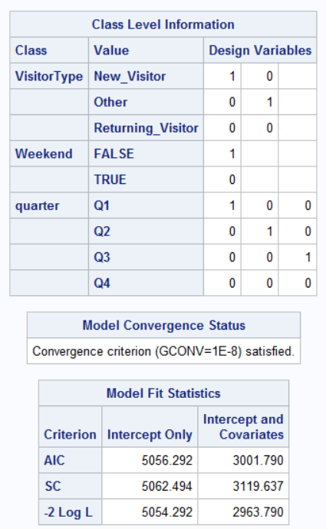
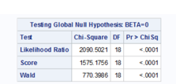

PREDICTIVE MODELING – LOGISTIC REGRESSION
The c statistic value is 0.91 which indicates the model is good

Slide 18
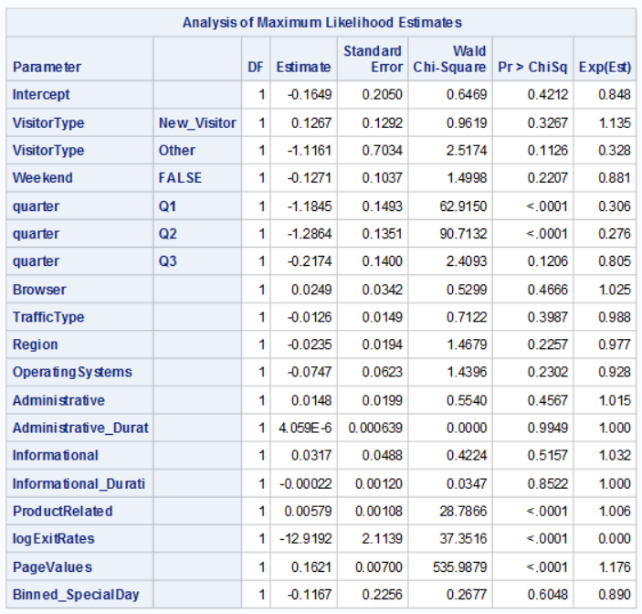
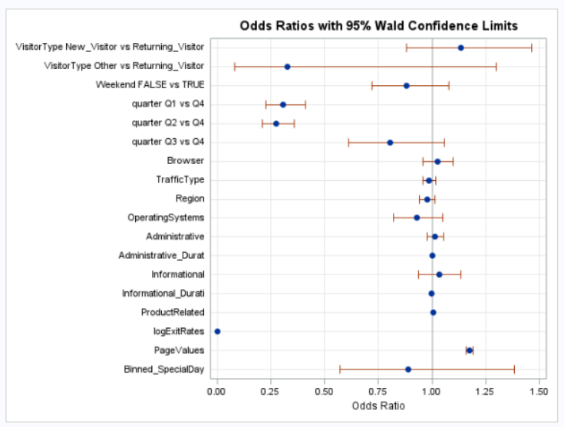





PREDICTIVE MODELING – LOGISTIC REGRESSION

Slide 19
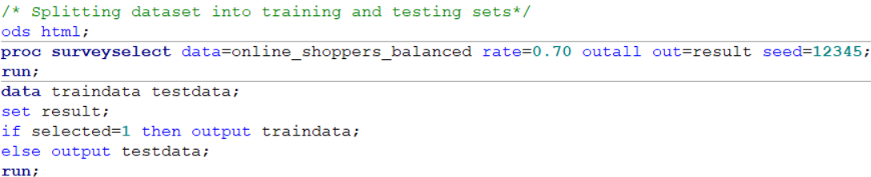
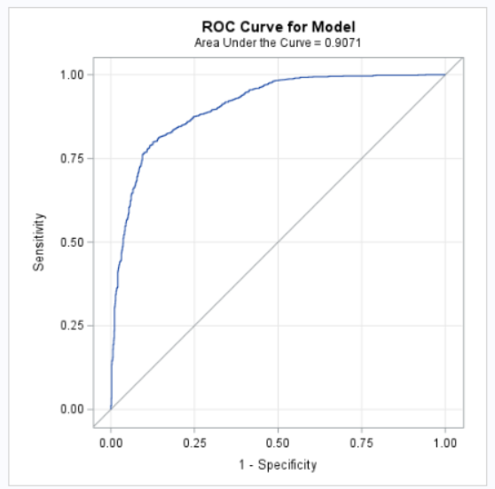
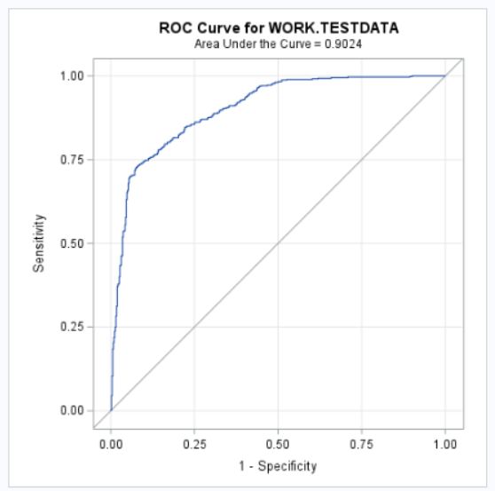
LOGISTIC REGRESSION – SPLITTING THE DATA
The ROC curve shows the model is working well with test data

Slide 20
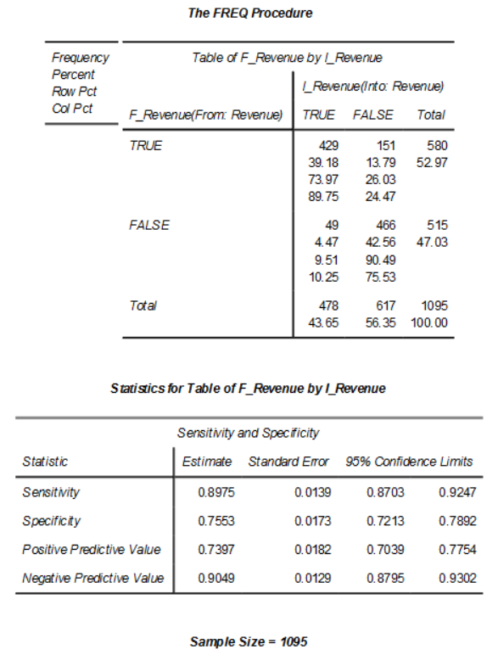




LOGISTIC REGRESSION – PERFORMANCE METRIC
Sensitivity or Recall for test data (True positive rate TPR): The proportion of true positive responders (Response=‘TRUE’ ) with true positive results is 89.75%.
Specificity (TNR rate): True Negative Responders (Response=‘FALSE”) with negative Test Results is 75.53%.

Slide 21
CONCLUSIONS
The logistic regression model is a good fit for predicting online shoppers' intention to make a purchase.
Features such as PageValues, VisitorType, and ExitRates, are significant predictors of online shoppers' intention to make a purchase.
Online shoppers are more likely to make a purchase if they have higher PageValues, access the website for the first time and have lower ExitRates.
Other predictor variables such as Quarter, Weekend, SpecialDay, and Browser also affect shoppers' intentions but are not as strong as other variables.
RECOMMENDATIONS
Businesses should focus on improving website content, particularly product-related content, to increase the likelihood of purchase.
Offer discounts and promotions on high-traffic days like holidays or weekends to increase purchases.
Reduce ExitRates and BounceRates by optimizing website design, navigation, and search functionality.

Slide 22
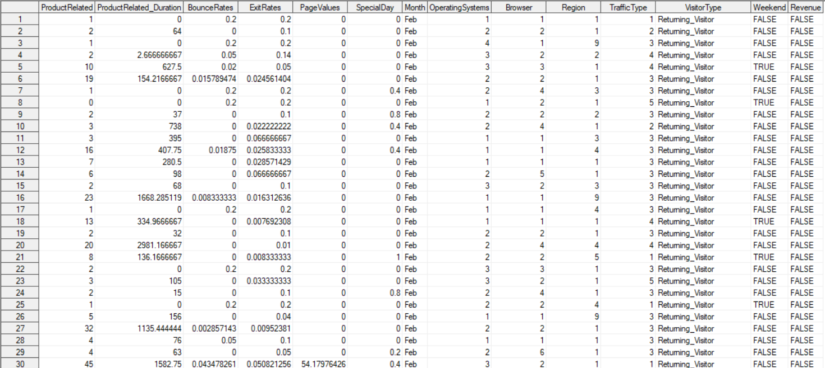
APPENDIX
DATASET

Slide 23


