Slide 1

Mini Project – Advanced SAS
Telecom Company Customer Distribution & Deactivation Analysis
By : Maya Babu

Slide 2
Agenda
Objective
Background
Key Findings
Recommendations
Appendix

Slide 3

Objective
Gain insightful understanding about the customers behavior and the reason why customer’s attritions.
Uncover the customer distribution by status, tenure, credit, residential region, channels and all other related factors.
Provide early recommendations to our marketing and operations teams

Slide 4

Background
Based on the wireless company's CRM data for the past two years to investigate customer distribution and behavior. The company aimed to gain insight into its customers and predict deactivation trends over the next six months.

Slide 5
Dataset variables
acctno
ActDT
deact_dt
deactreason
Age
DealerType
RatePlan
goodcredit
Province
Sales

Slide 6

Data Analysis

Slide 7
Key Findings
#1.
Deactivated account: 19635
Remained account: 82620
Activated account: 102255
The earliest activating date is: 1999-01-20
The latest activating date is : 2001-01-20
The earliest deactivating date is: 1999-01-25
The latest deactivating date is : 2001-01-20

Slide 8
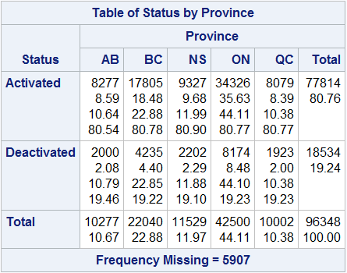

#2
The percentage of active accounts to total accounts in each province is 81%.
A consistent ratio may be an indication of corporate practices or trends.Business actions may result in a uniform ratio of activated and deactivated accounts if market dynamics, consumer demographics, or industry trends are similar across provinces.

Slide 9
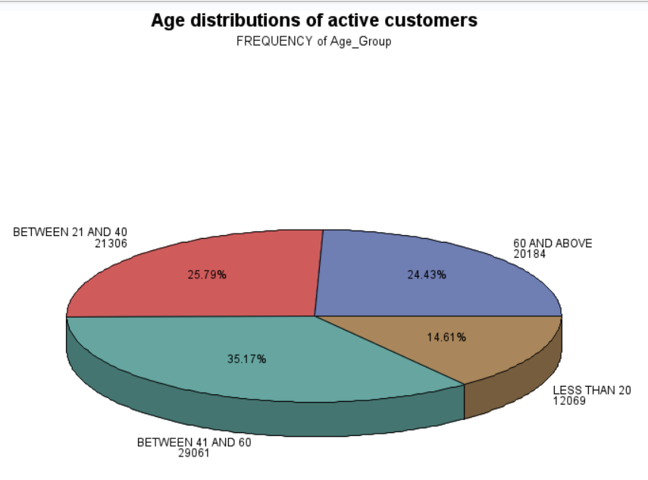
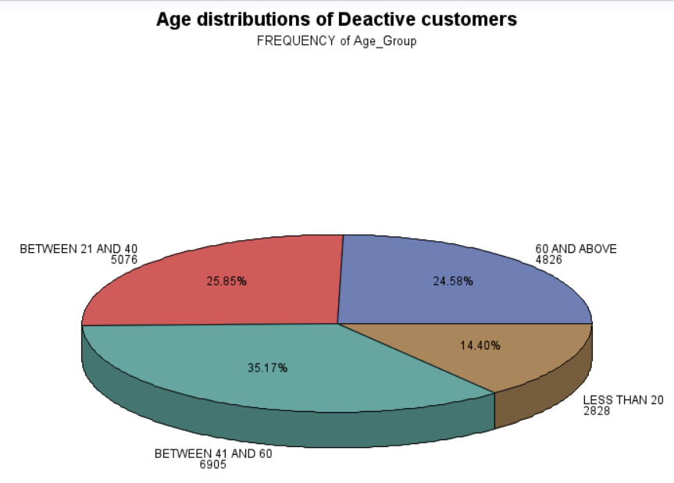
#3.
The people whose age at range 41-60 is the biggest section(36%). It is found that the population is in the 21 to 40, 41-60, and 60+ age groups are very substantial sales and are markets we can sustain. We should strengthen our sales strategy for the under 20s. In addition, people in those age range are having more money to support them to have activated account.

Slide 10
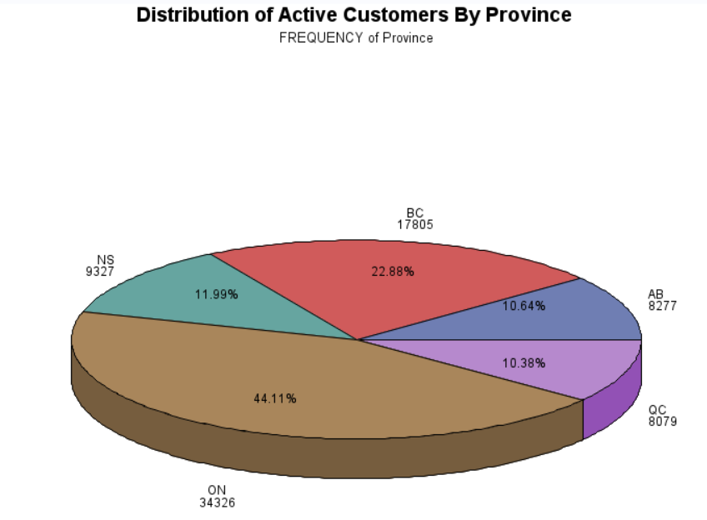
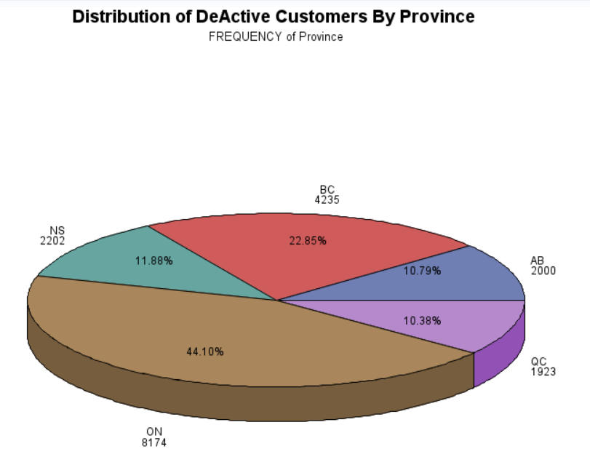
#4.
Active accounts and deactivate accounts are mainly concentrated in the ON province.
Among the provinces, the QC is the province with the smallest proportion of active accounts and deactivate accounts

Slide 11
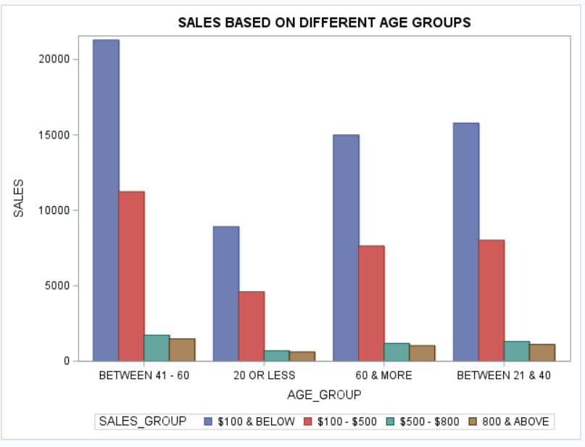
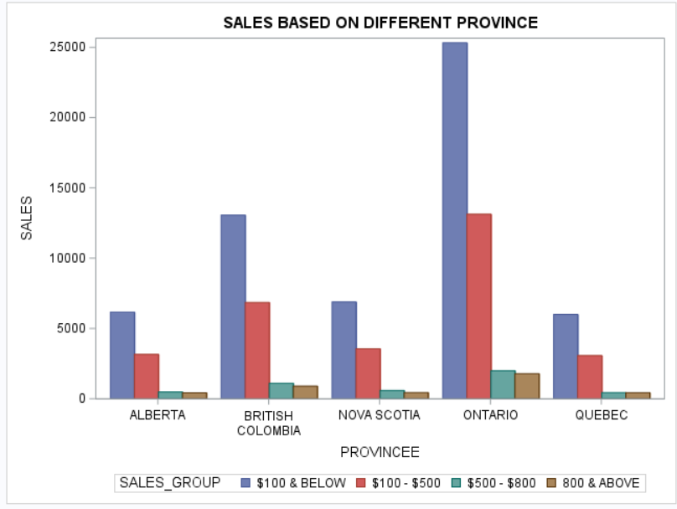
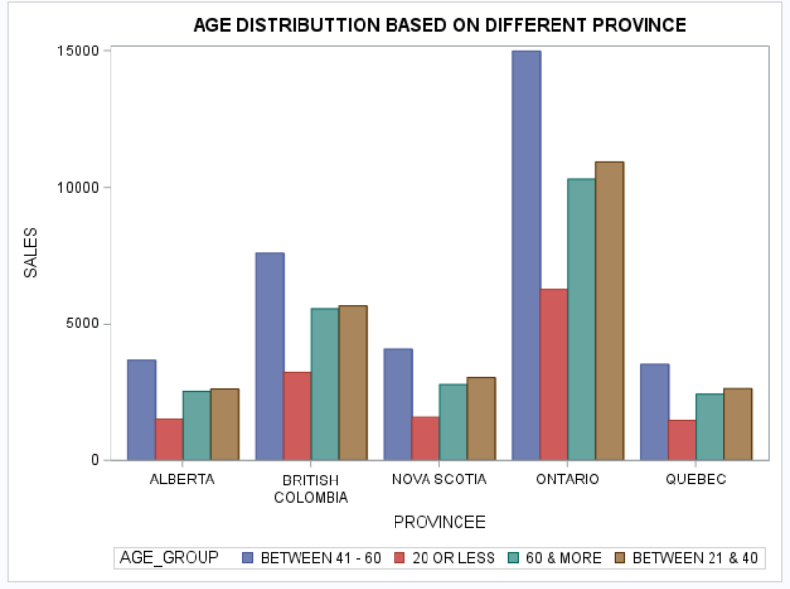
#5.
Sales based on Age Group
Sales based on Province
Age distribution in Provinces
Irrespective of age the sales is highest for the category $100 and below
Irrespective of location/province the sales is highest for the category $100 and below
In each province maximum number of customers belong to the age group between 41 and 60
Here from chi-square test we can see the p value >0.05 in all three cases As p value is more than 5% ,we fail to reject null hypothesis and can say that there is no statistical association between the variables

Slide 12
#6.
The majority of sales are quite tiny, but there are a few larger sales figures as well, which could indicate the presence of outliers or a few noteworthy transactions.
A right-skewed sales distribution is indicated by a positive skewness score. This could mean that while the majority of transactions have lesser amounts, the distribution is affected overall by a small number of transactions with larger amounts.
With a score of 5.28, the Kurtosis is much higher than 3. A high kurtosis value may suggest that there is a significant and relatively sharp peak in the sales amount distribution. It could indicate that specific transaction quantities are comparatively concentrated, or that there are huge orders or outliers among the sales amounts.

Slide 13
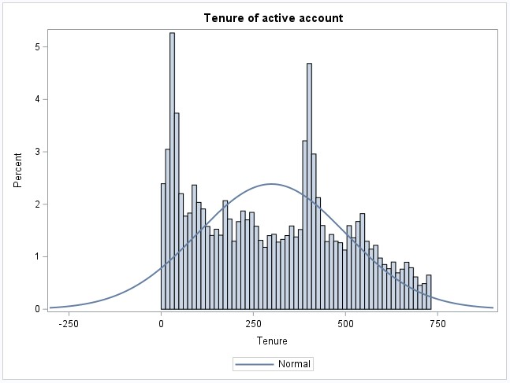
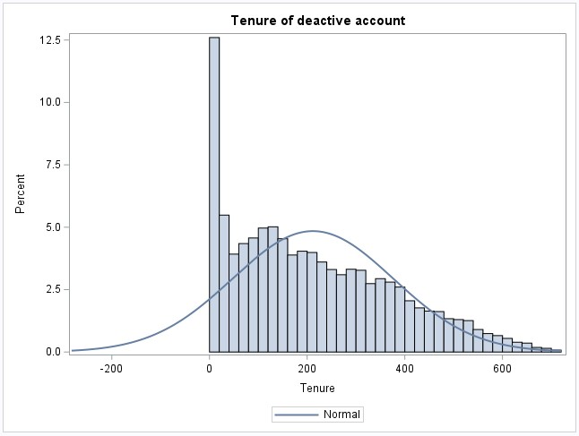
#7.
To see the distribution of tenure, we use Proc Sgplot.
The downward trends in these two charts could be due to the following factors:
Duration of Account: The chart's downward trend may indicate that most accounts are used for comparatively short periods of time.
Client Loyalty: Account tenures under one year may indicate a decline in client loyalty.
Market Dynamics: The level of market competition may occasionally be reflected in the temporary account deactivations.

Slide 14
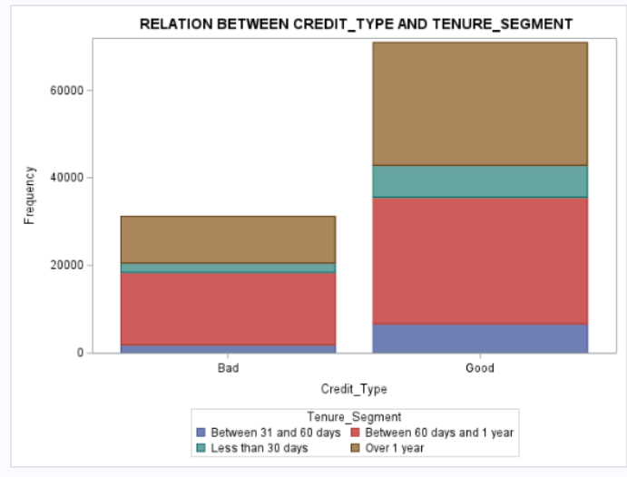
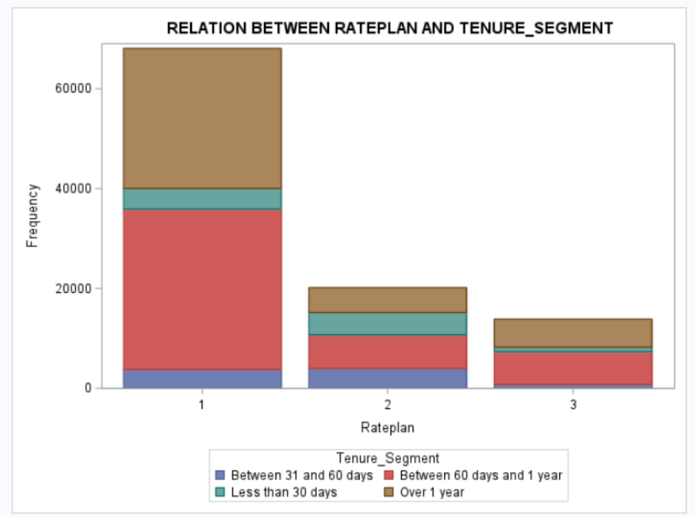
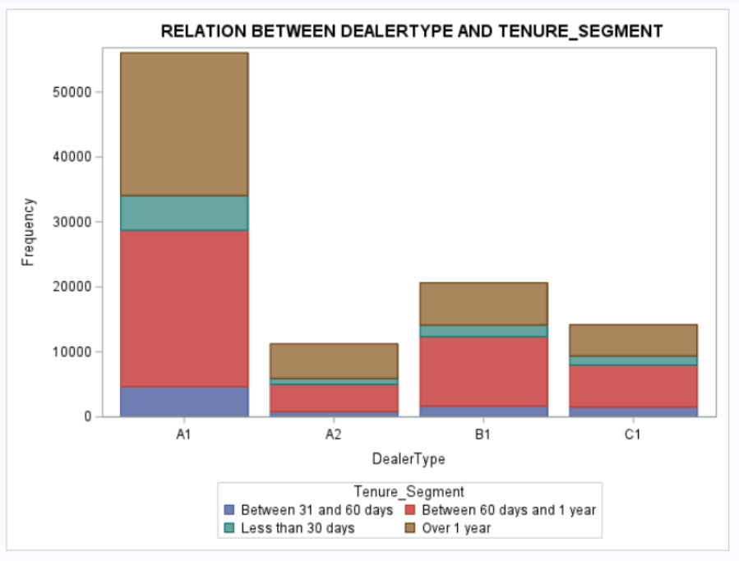
#8.
Tenure VS. GoodCredit / RatePlan / DealerType
Majority of the customers are between the tenure of 60 days and 1 year, and over 1 year, and they all have good credit.
Majority of the customers are between the tenure of 60 days and 1 year, and over 1 year, and they are all with rate plan 1.
Majority of the customers are between the tenure of 60 days and 1 year, and over 1 year, and they are all with dealer A1.

Slide 15
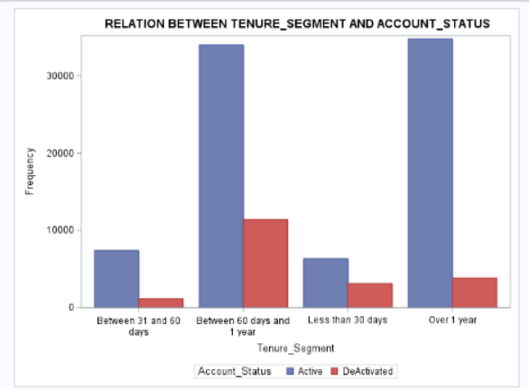
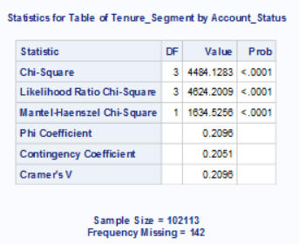
#9.
Is there any association between the account status and the tenure segments？
Number of customers de-activated is highest between tenure of 60 days and 1 year. Deactivated accounts are lower when the tenure is over 1 year.
H0: There is no significant association between the account status and Tenure segments.
All the Chi-Square Probability are <.0001, which indicates that we can reject this null hypothesis, and conclude that there is an ASSOCIATION between the account status and Tenure segments, rather than just random differences.

Slide 16
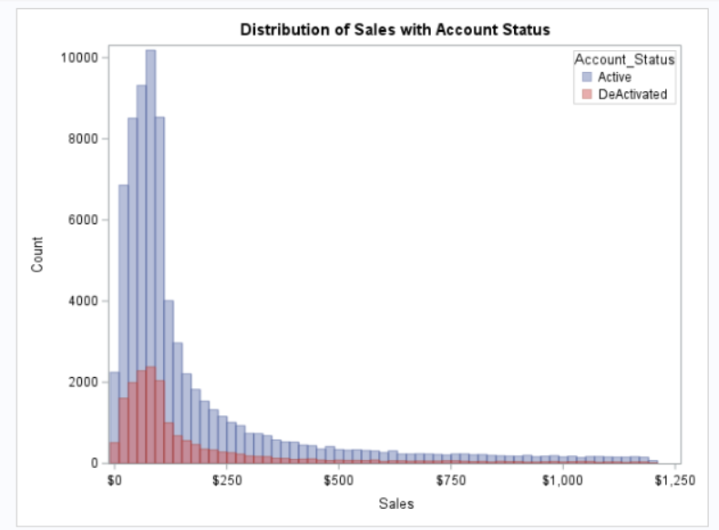
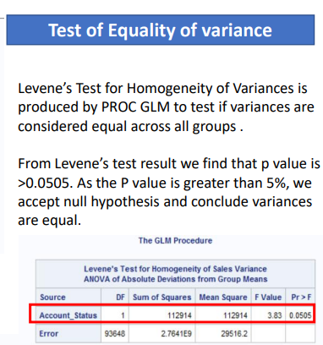
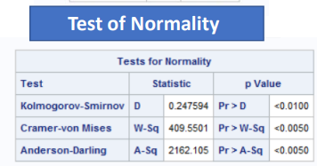
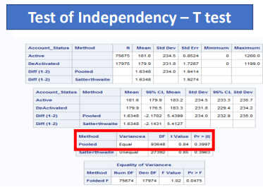
#10.
Does Sales amount differ among different account status?
Since p value <0.05. As the p value is less than 5% we conclude that data is not normally distributed
A grouped histogram is used for visualization. The sales pattern for both active and deactivated accounts is similar, with the majority of sales occurring under $250.
As our categorical variable Account status has 2 levels ,we perform T test for test of independency. Since the Levene’s test p-value > 0.05 and variance are found to be equal pooled T test is appropriate for testing independency
Based on the result from pooled T test , the p value >0.05, hence we fail to reject null hypothesis and find that there is no statistical relationship between sales and Account status.

Slide 17
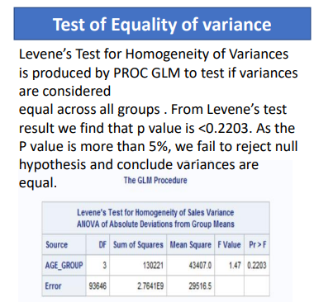
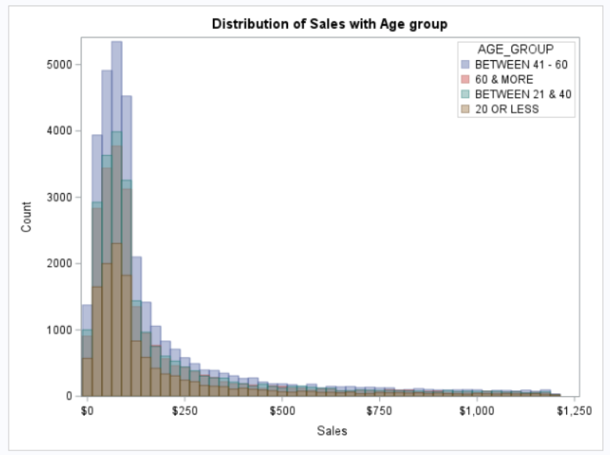
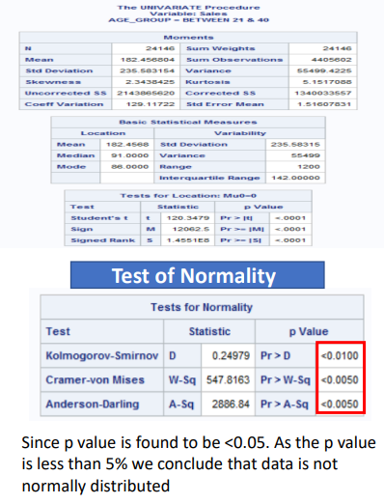
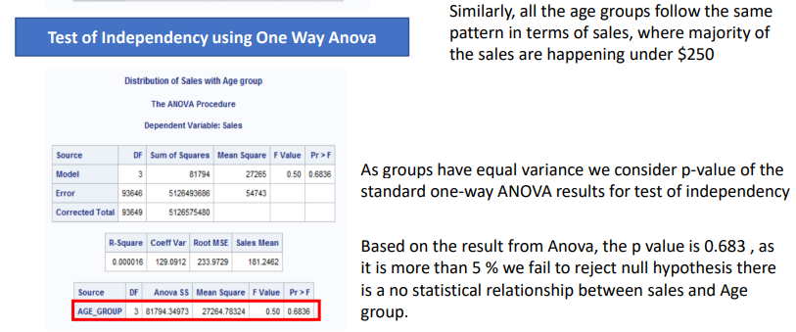

#11.
Does Sales amount differ among age group?

Slide 18
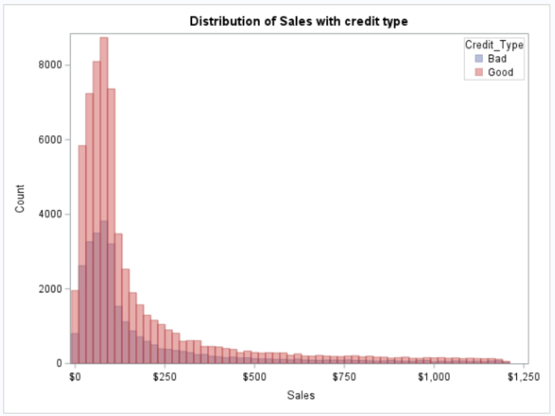
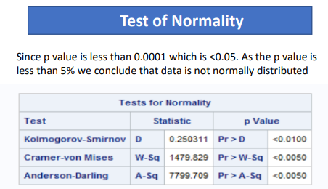
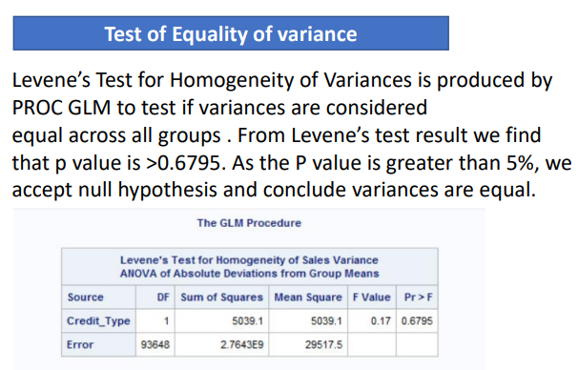
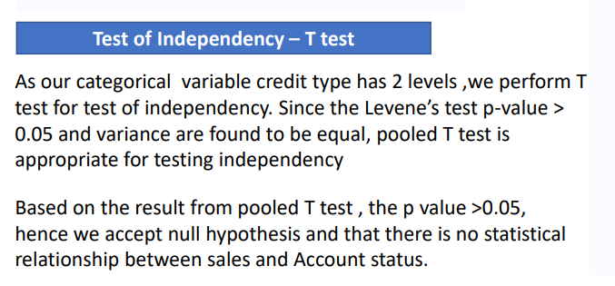
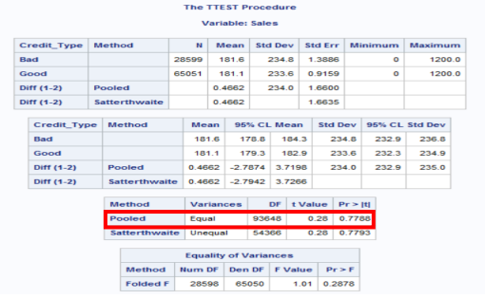





#12.
Does Sales amount differ among credit type
both bad and good credit types follow the same pattern in terms of sales, where majority of the sales are happening under $250

Slide 19

Recommendation
The middle-aged population makes up the majority of the population overall. Once the middle-aged group has stabilized, we can cultivate new users within the 20–40 year old demographic.
30.56% of accounts have bad credit, while 69.44% of accounts have good credit. Too many people have bad credit accounts. In the future, a thorough credit check should be performed on the customer when opening an account.
RatePlan #1's percentage of the total data is twice the total of RatePlans #2 and #3. This indicates that RatePlan#1 is more well-liked, so we might think about releasing additional plans similar to it in the future.
Number of deactivated accounts can be reduced by offering promotions and discounts for customers who are less than 6 months tenure.
By providing continued excellent customer service, it may possible to retain the active customers.

Slide 20
Appendix
SAS Code – refer the Project Report

Slide 21

Thank You

