Slide 1

Database Systems
Final Project
Matan Lieber, Itai Yifrach, Shawn Molga, Maya Cahana

Slide 2
API’s
LastFm – Chart.getTopArtists
Artist Name
Number of Listeners
Playcount

Slide 3
API’s
MusicGraph –
Search for Artist (by name)
Genre
Country
Artist ID
Get all the albums by artist (using Artist ID)
Album Name
Album ID
Release Year
Number of Tracks
Get all the tracks by album (using Album ID)
Track ID
Track Name
Track Duration

Slide 4
API’s
Lyrics.ovh – Search for Lyrics (by Artist Name and Track Title)
Track Lyrics

Slide 5
API’s
Bandsintown – Get Upcoming Artist Events (using Aritst Name)
Event ID
Date of Event
On Sale Date
Venue
City
Country

Slide 6
Our Databases
Artists –
Artist ID
Artist Name
Country
Genre
Playcount
Listeners

Slide 7
Our Databases
Tracks –
Track ID
Track title
Lyrics
Duration

Slide 8
Our Databases
Albums –
Album ID
Album Title
Release Year
Number of Tracks

Slide 9
Our Databases
Events –
Event ID
Date of Event
On Sale Date
Venue
City
Country

Slide 10
Work Plan
Create back-end :
Create python script to build our schema
Create python script to insert data from CSV files
Create python script for interacting with front-end
Create front-end :
Create login page
Create admin page
Create query page
Create update/insert page

Slide 11
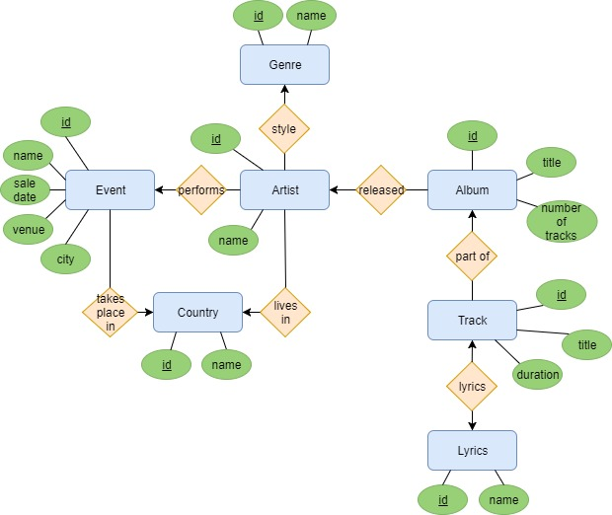
E/R Diagram

