Slide 1
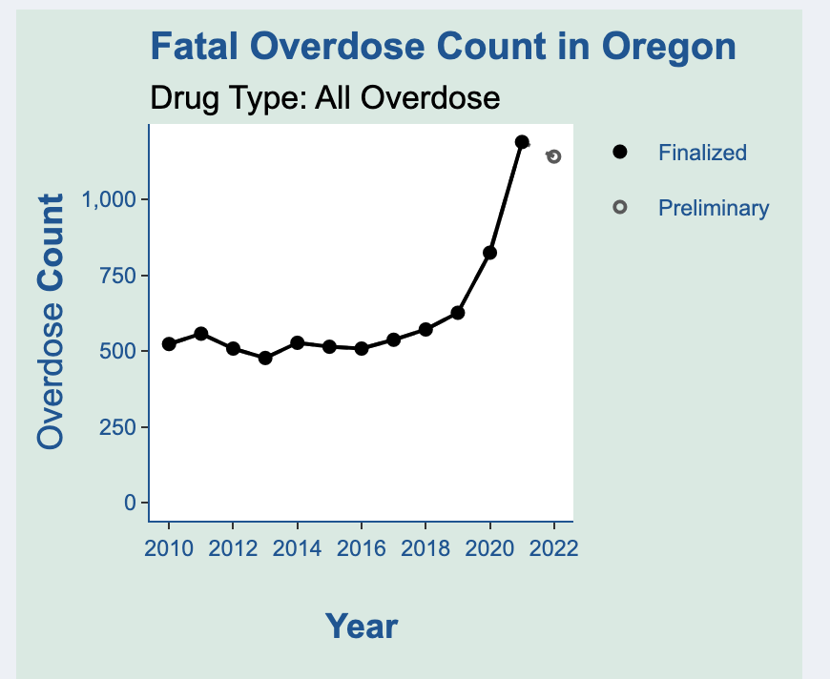
Overarching Questions
How have overdose rates changed over time?
How do overdose rates vary by Oregon counties?
Over time and in 2022
What substance has been the main driver of drug overdose deaths?
Oregon Prescribing Data Dashboard

Slide 2
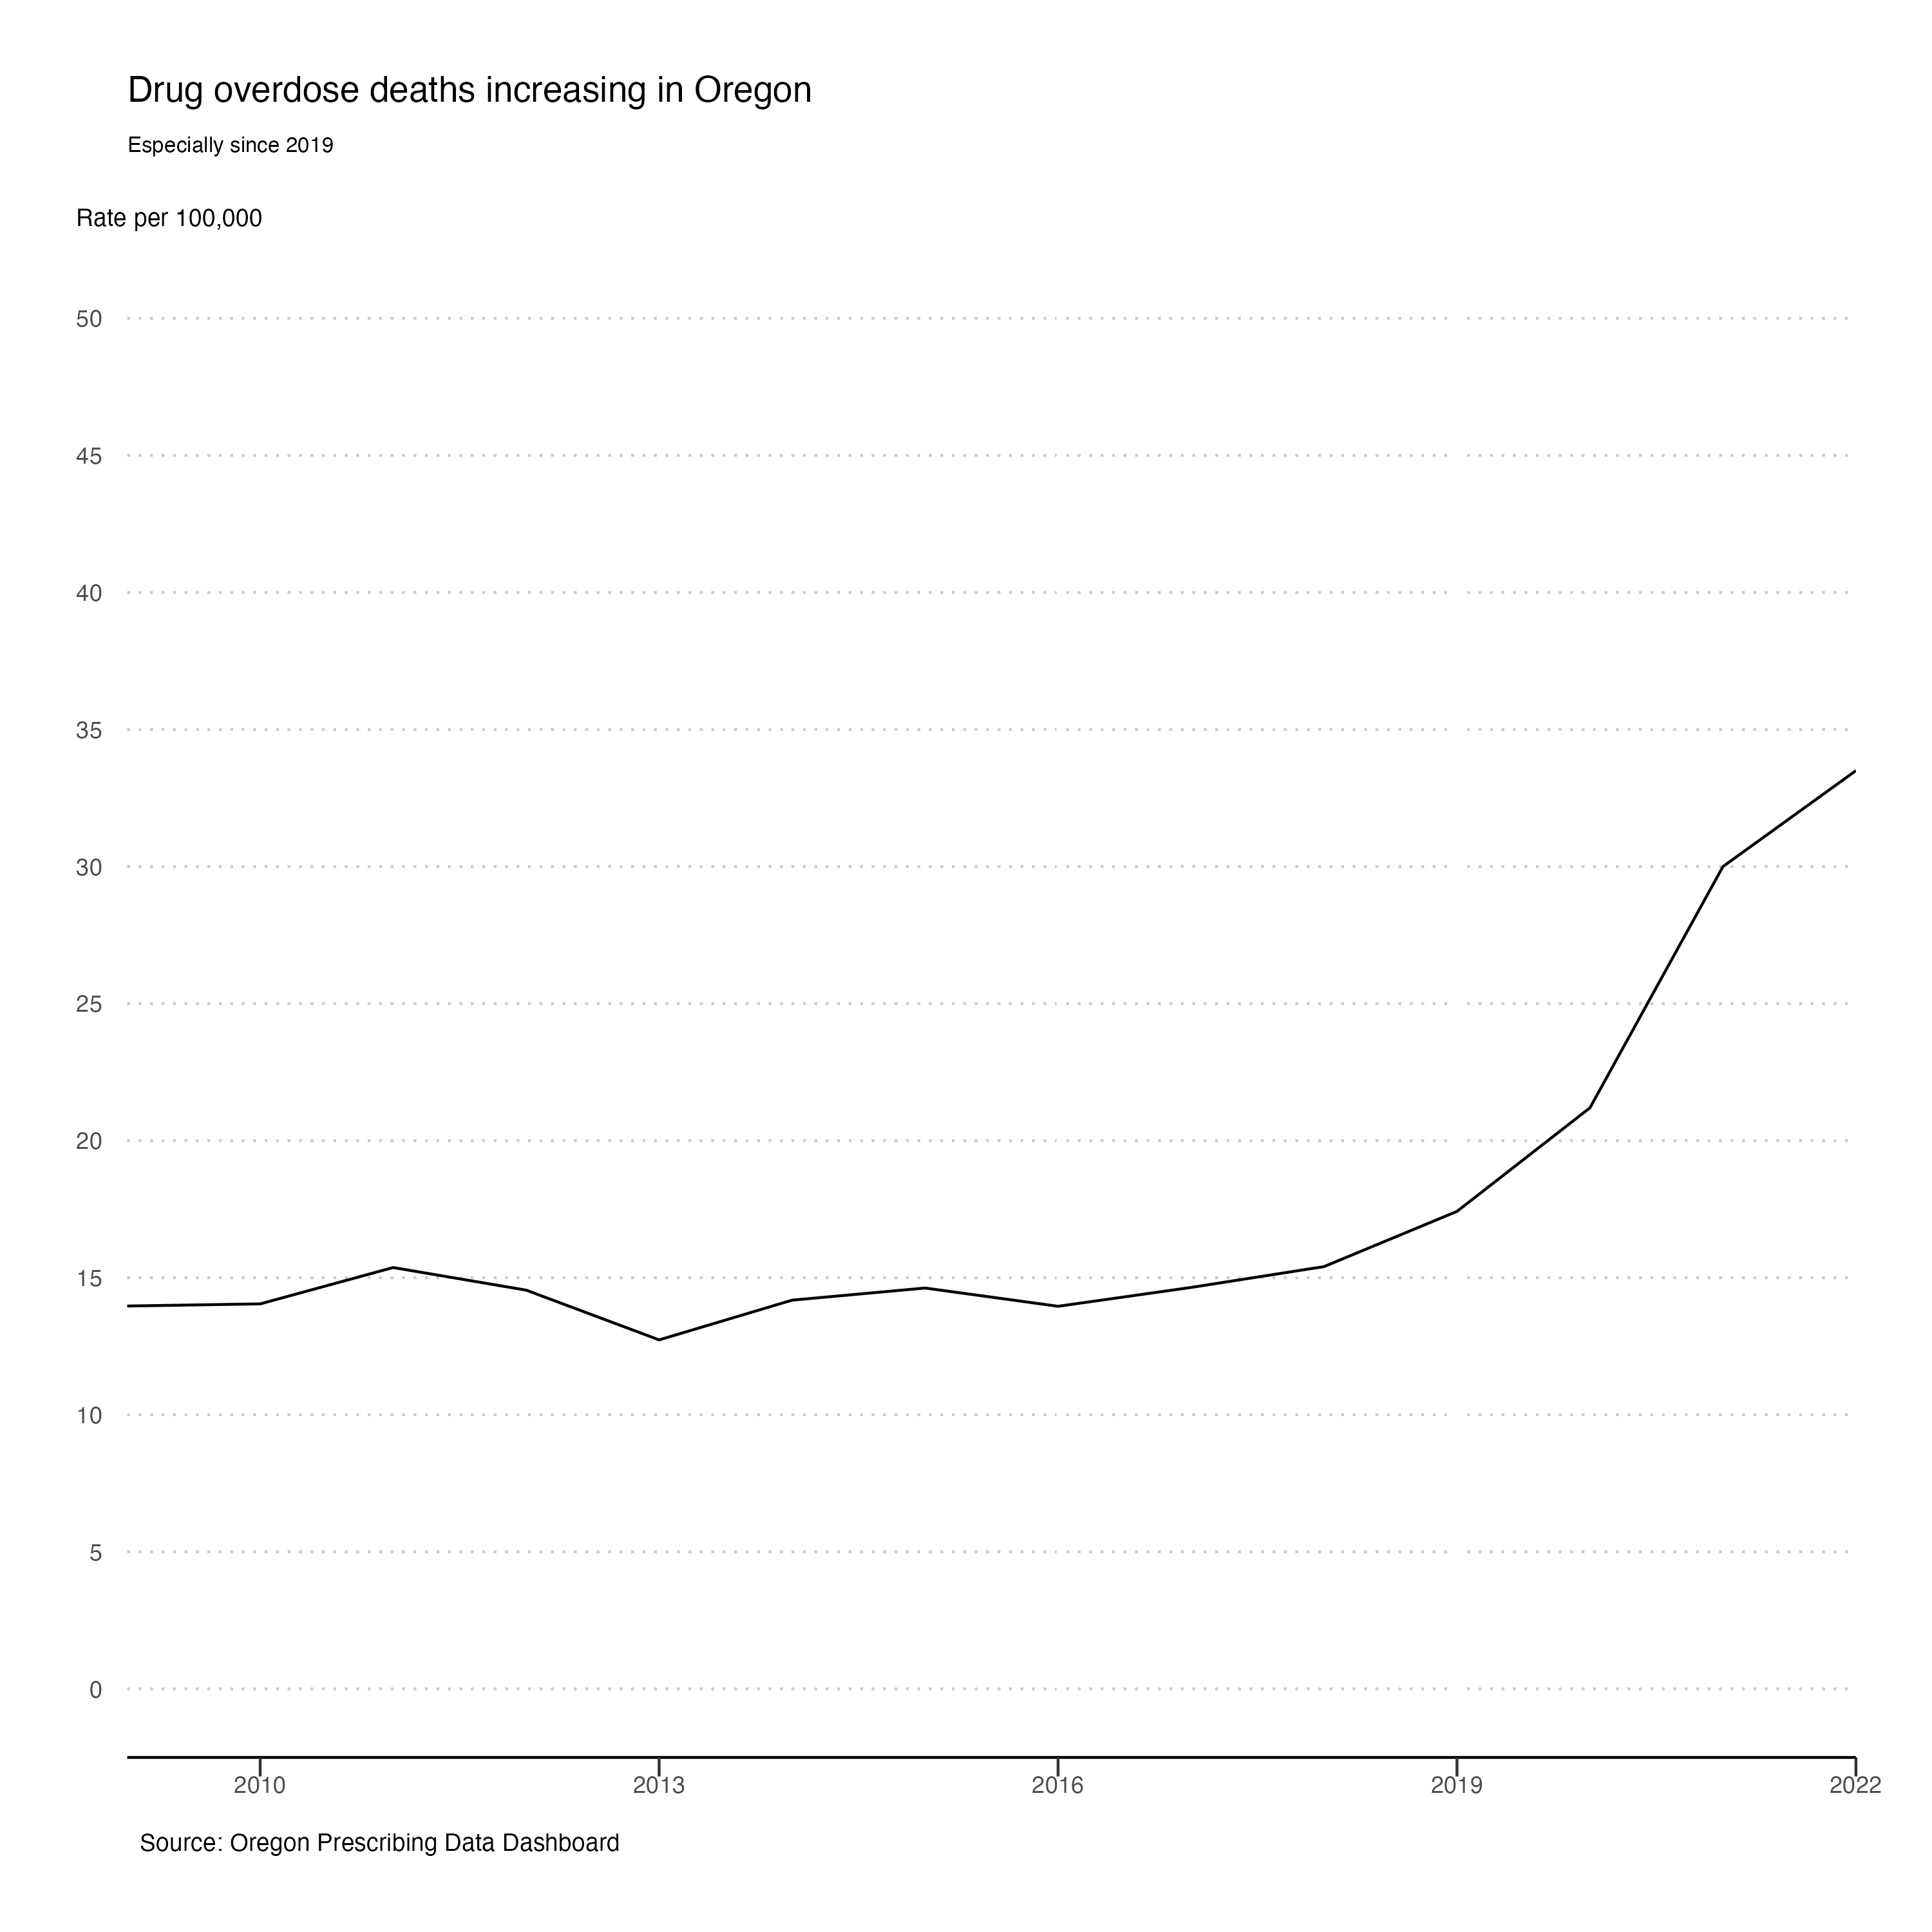

Slide 3
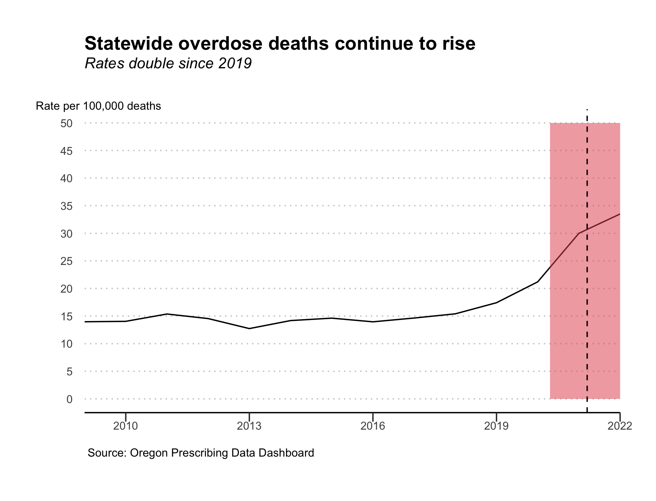

Slide 4
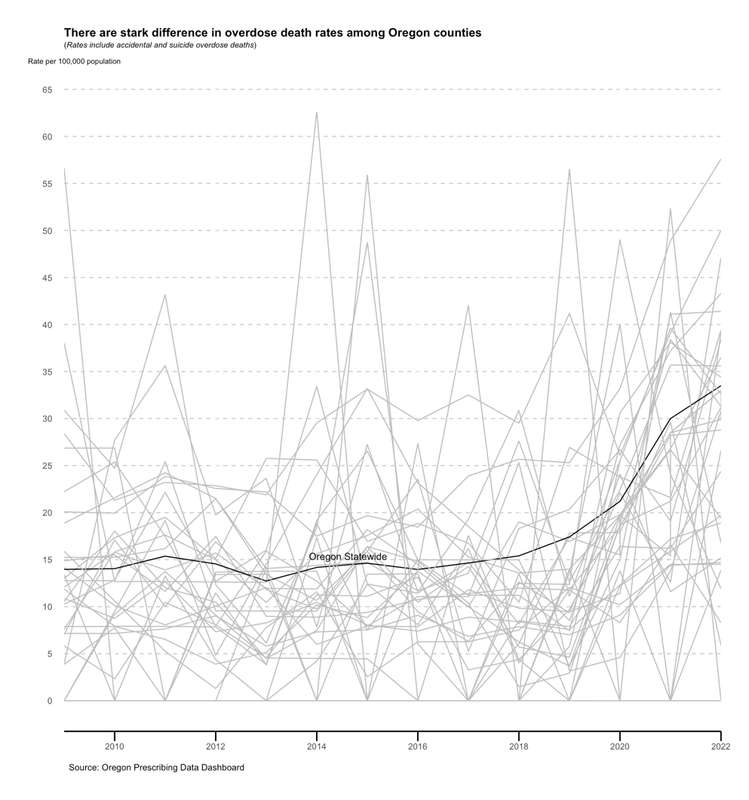

Slide 5
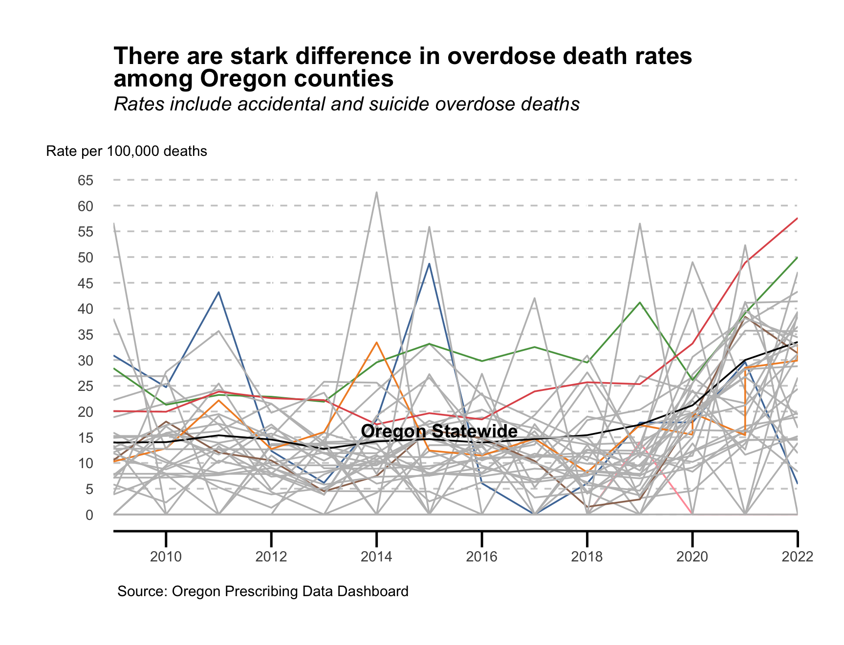

Slide 6
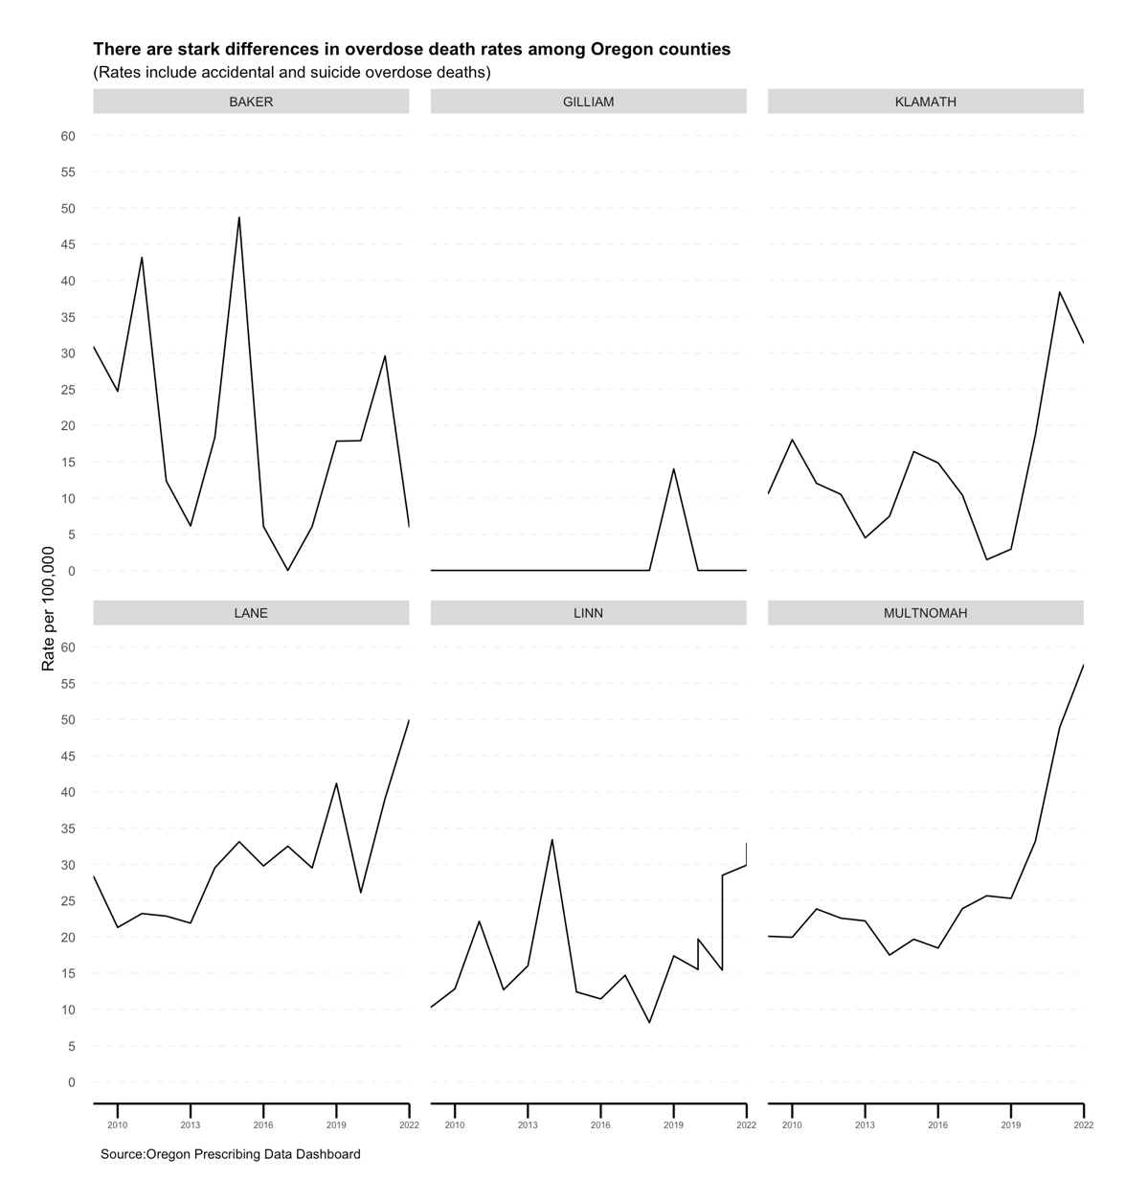

Slide 7
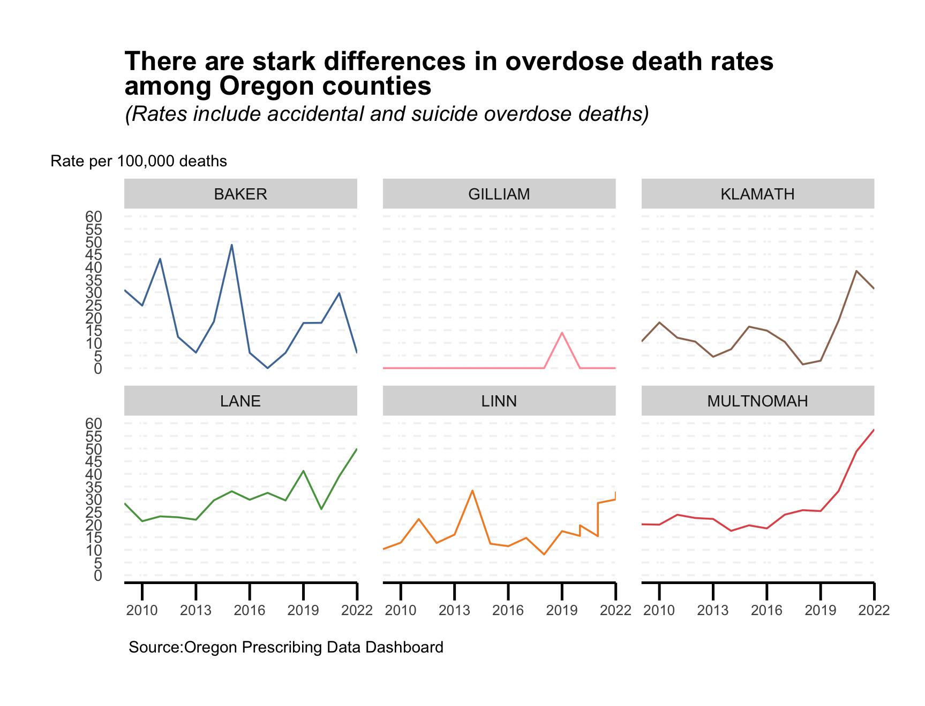

Slide 8
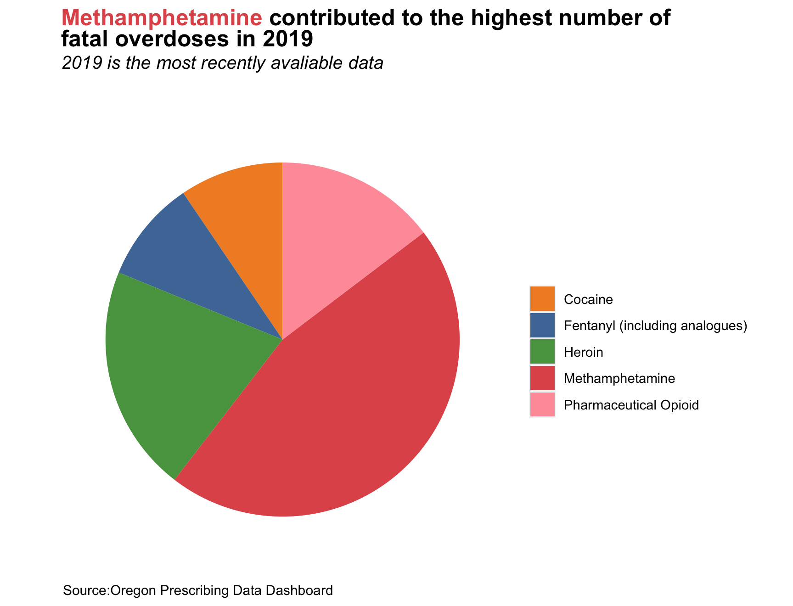

Slide 9
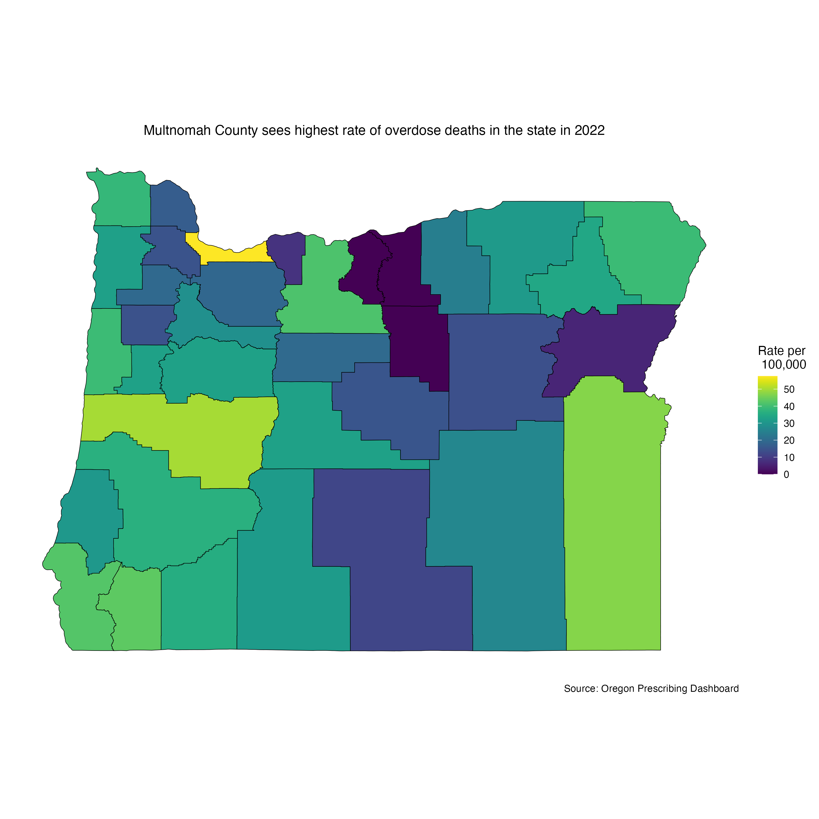

Slide 10
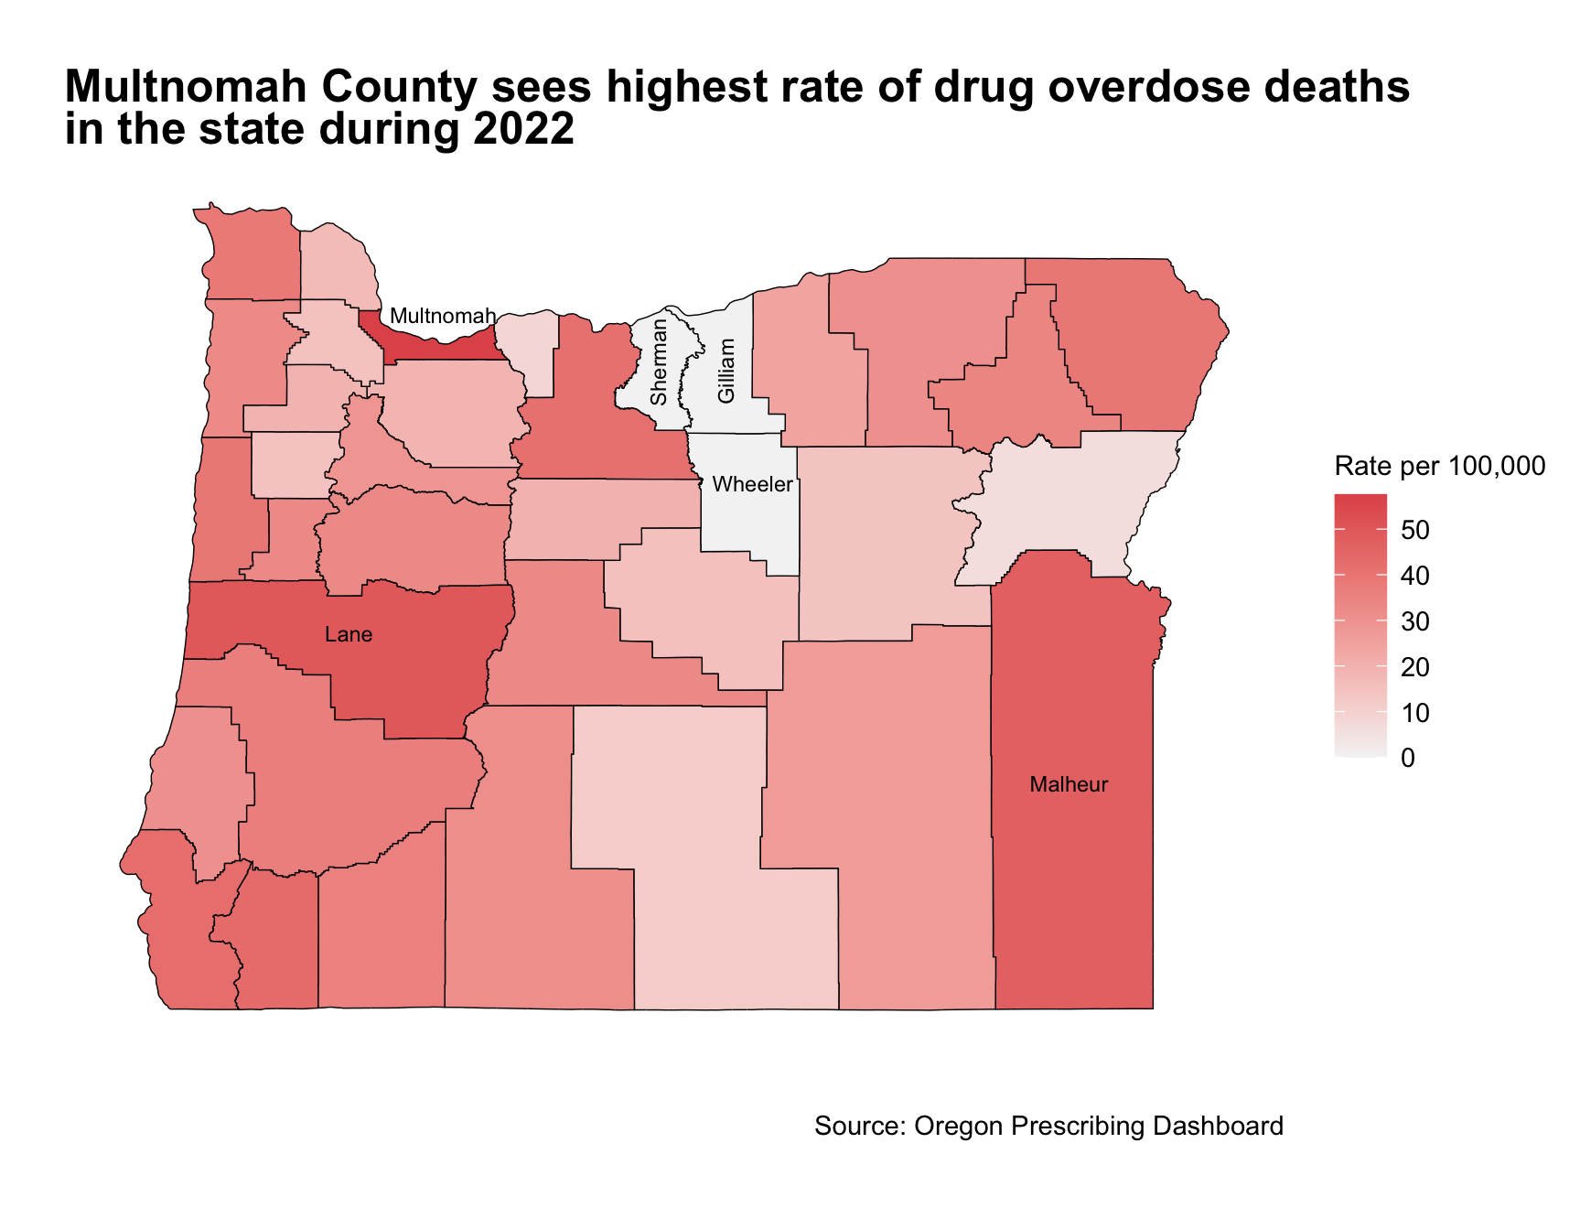

Slide 11
