Slide 1
Advanced Security
Maya OConnell, D20125203

Slide 2
Miller-Rabin Algorithm
Algorithm to test if a number is or is not prime
Prime number can only be divided by 1 and itself
Probabilistic algorithm – there is a low chance the number is not prime

Slide 3
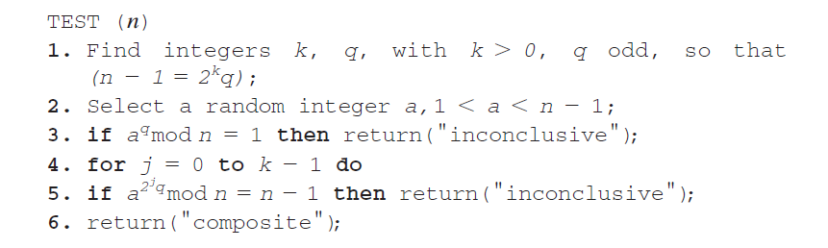
Miller-Rabin Algorithm

Slide 4
AES – Key expansion
Advanced Encryption Standard
Specification for electronic data encryption
AES Key expansion algorithm produces a linear array of 44 words (176 bytes) from a four word (16 byte) key.
Provides four word round key for AddRoundKey stage and each of the AES ciphers 10 rounds
First four words of expanded key are filled with the key, the rest is filled four words at a time
Each word added, depends on the word before it, and the word four places behind

Slide 5
Encrypted Mail
Implemented using Enigmail in Postbox
Enigmail allows users to encrypt emails using GPG and digital signatures
GPG uses a combination of asymmetric and symmetric encryption
Digital signatures are used to prove the email has not been modified since it was signed, by generating a unique hash of the email and encrypting it using the private key of the sender.

Slide 6
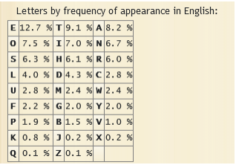
Letter Frequency Attack
Cipher text attack
Focuses on decoding using frequency of letters or groups of letters
Frequency of letters in English alphabet

Slide 7
Thanks!

