Slide 1

Plant rekognition
DTS personal project
Maya O’Connell, Cloud Support Associate Intern

Slide 2
Project Objectives
Build a project using AWS services
Utilise DTS services
Integrate cross profile services

Slide 3
Concepts
Maya O’Connell, Cloud Support Associate Intern

Slide 4
Original Concept
Web application to analyze face for various skin problems, and return products to target them.
Use Rekognition Custom Labels to detect various skin problems, e.g. dry skin, oily skin, blackheads etc.

Slide 5
FINAL concept
Web application to analyze plant type in image, and return care tips.
Use Rekognition Custom Labels to train model to detect various plant types.

Slide 6
Services
Maya O’Connell, Cloud Support Associate Intern

Slide 7

Compute services
Providing a highly available, scalable web server and to deploy code using event triggers on a serverless platform.
EC2
Amazon EC2 Autoscaling
Elastic Load Balancer
AWS Lambda

Slide 8
NETWORKING & CONTENT DELIVERY services
Quickly and reliably delivering the web page and it’s resources to the end user
Amazon Route 53
Amazon CloudFront
API Gateway

Slide 9

database services
SECURITY, IDENTITY AND COMPLIANCE services
Management & governance services
DynamoDB
AWS IAM
Cloudwatch
Securely stores data in NoSQL database
Provides required access controls for various services
Monitors Lambda code when it runs

Slide 10

Storage services
MACHINE LEARNING services
Securely storing web pages, user uploads and the training dataset
Trained to analyse images of plants and return data it determines
S3
Rekognition

Slide 11
architecture
Maya O’Connell, Cloud Support Associate Intern

Slide 12
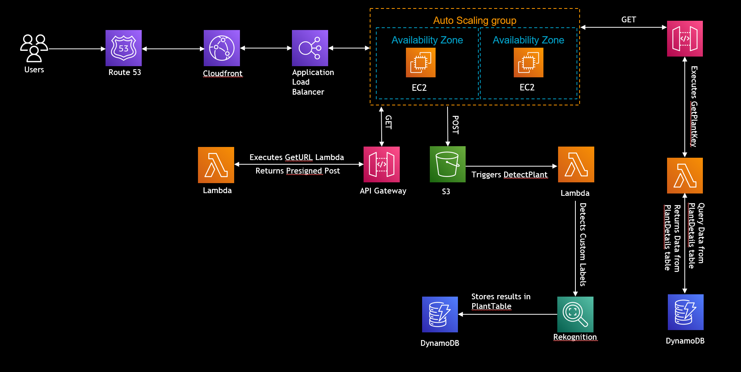
ARCHITECTURE
3.
1.
2.

Slide 13
DEMO
Maya O’Connell, Cloud Support Associate Intern

Slide 14

Any Questions?

Slide 15
Thank you!
Maya O’Connell, Cloud Support Associate Intern

