Slide 1

Mastering Power BI: Data Transformation
Welcome to a deep dive into Power BI's data transformation capabilities. We'll explore powerful features to cleanse, reshape, and integrate your data effectively.

Slide 2
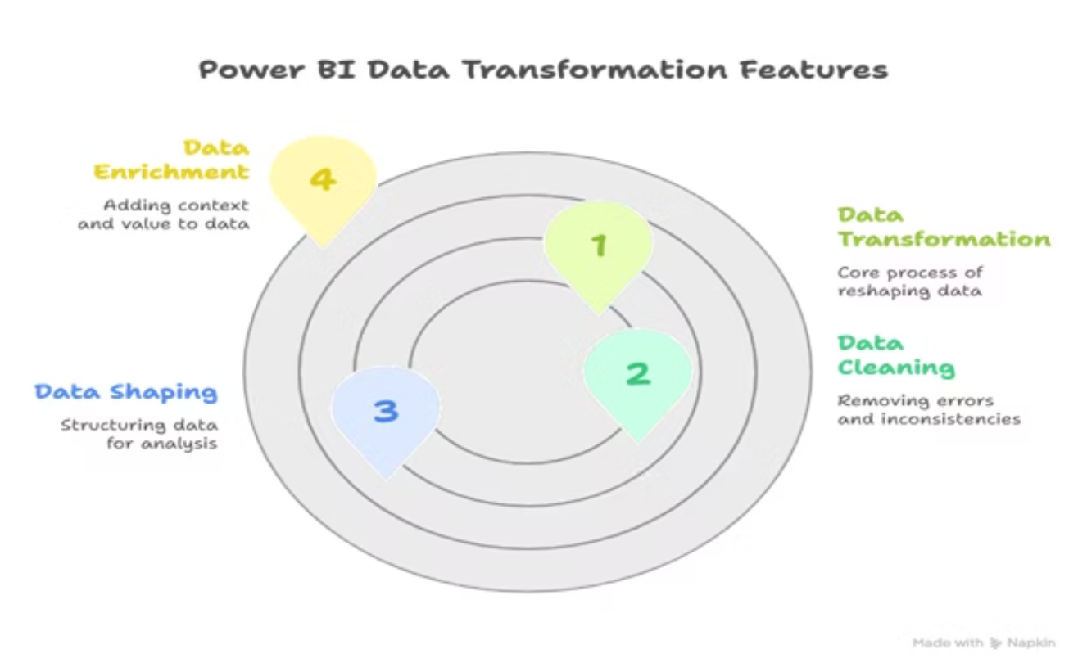


Slide 3




Accessing Data Transformation
Home Tab
Transform Data
Power Query
Locate the 'Home' tab in Power BI Desktop.
Click 'Transform Data' to open Power Query Editor.
The Power Query Editor window will launch.
The Power Query Editor is your hub for all data preparation tasks, offering a comprehensive set of tools.

Slide 4
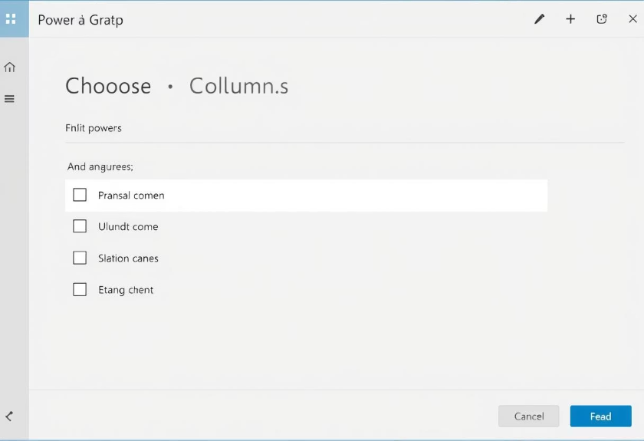
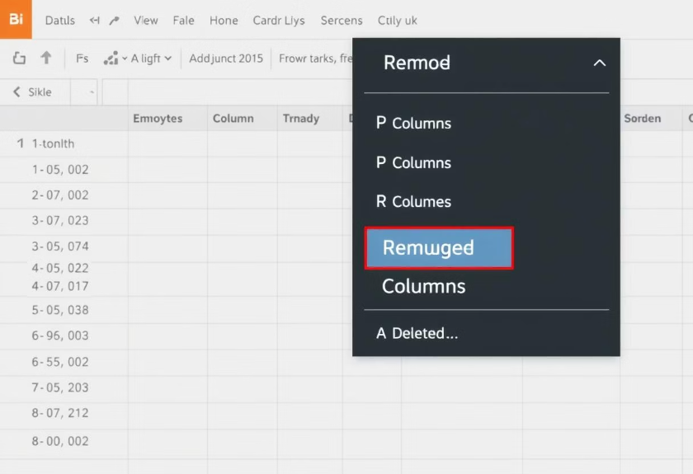
Column Management: Choose & Remove
Choose Columns
Remove Columns
Select specific columns to keep from your dataset. This optimizes data size.
Eliminate unnecessary columns from your dataset. This streamlines your view.
Efficient column management ensures your data is concise and relevant for analysis.

Slide 5
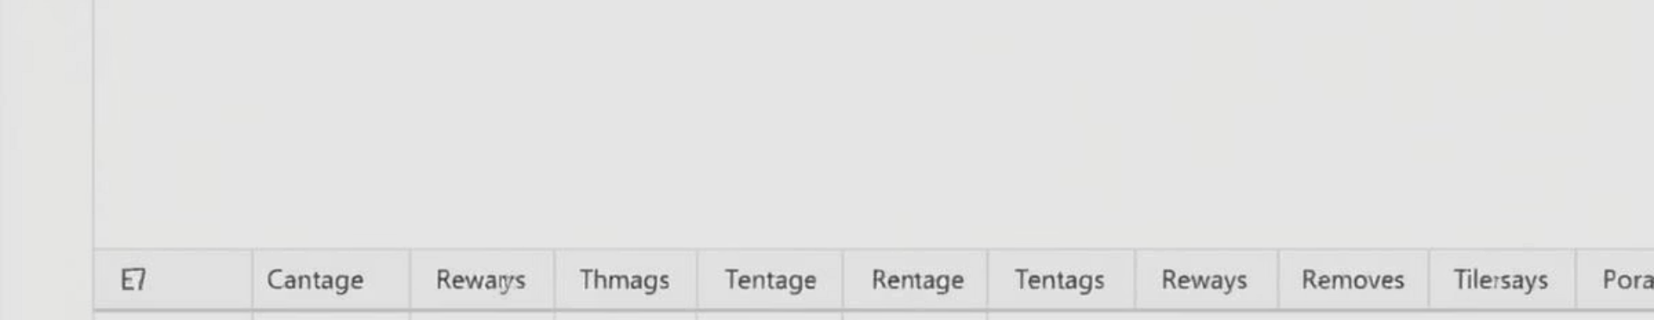


Row Management: Keep & Remove
Keep Rows
Remove Rows
Specify criteria to retain only relevant rows. Isolate key data points.
Delete rows based on specific conditions. Cleanse your dataset of anomalies.
Precise row management helps you focus on the most impactful data for your reports.

Slide 6



Column Operations: Split & Group
Split Column
Divide a single column into multiple columns. Use delimiters like commas or spaces.
Group By
Aggregate data based on common values. Create summarized views like totals or averages.
These features enable granular control over your data structure and powerful aggregation capabilities.

Slide 7
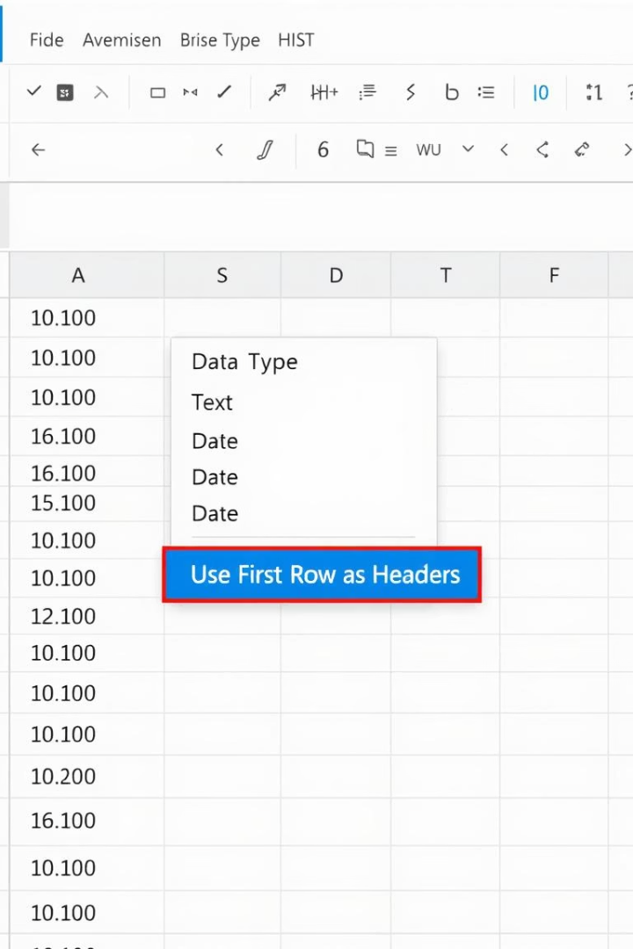
Data Type & Header Transformation
Data Types
Assign appropriate data types to columns. Ensure accurate calculations and sorting.
Use First Row as Headers
Promote your first data row to serve as column headers. This is crucial for proper data recognition.
Correct data typing and header assignment are foundational for reliable data models in Power BI.

Slide 8



Data Correction: Replace Values
Identify Values
Find specific values to be changed.
Specify Replacement
Define the new value to insert.
Apply Changes
Execute the replacement across the column.
The 'Replace Values' feature is essential for data cleansing and standardizing entries within your datasets.

Slide 9
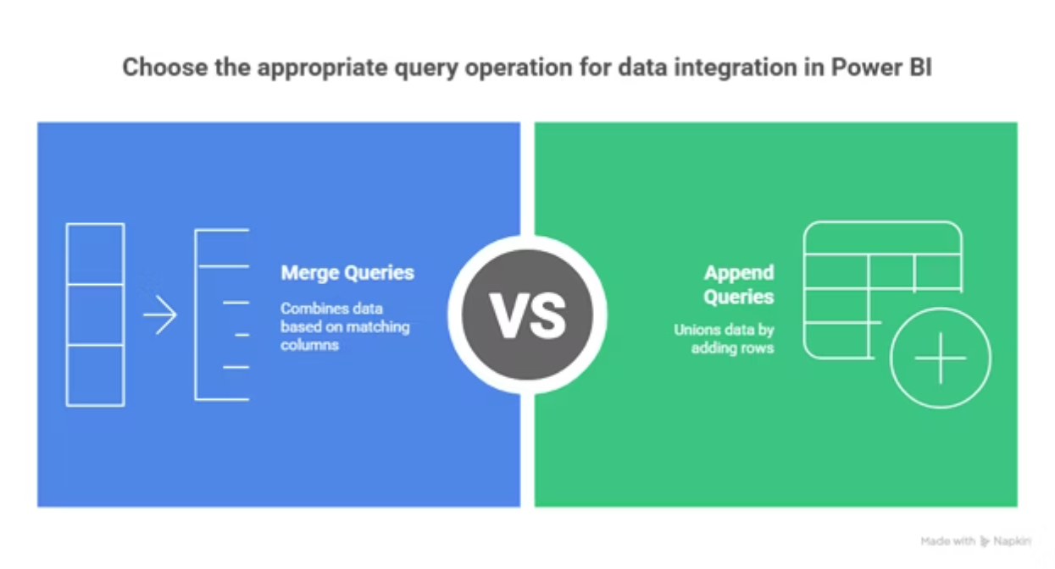
Combining Datasets: Merge & Append

Slide 10
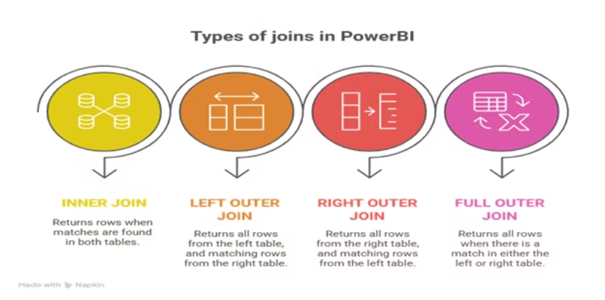
Merge Queries
Append Queries
Combine two datasets using joins.
Stack two or more datasets vertically. Use for union operations.
Inner Join
Example: Sales 2022 + Sales 2023
Left Outer Join
Right Outer Join
Full Outer Join
Merging and appending are crucial for integrating disparate data sources into a unified model for comprehensive analysis.

