Slide 1
Friend Function and Inline Function in C++
Definition, Syntax, and Examples

Slide 2
Friend Function - Definition
• A friend function is a function that is not a member of a class but has access to the class's private and protected members.
• Declared using the keyword 'friend' inside the class.

Slide 3
Friend Function - Syntax
class ClassName {
friend returnType functionName(arguments);
};
returnType functionName(arguments) {
// Function definition
}

Slide 4
Friend Function - Example
#include <iostream>
using namespace std;
class Sample {
int x;
public:
Sample(int val) { x = val; }
friend void showValue(Sample obj);
};
void showValue(Sample obj) {
cout << "Value: " << obj.x << endl;
}
int main() {
Sample s(10);
showValue(s);
return 0;
}

Slide 5
Inline Function - Definition
• An inline function is a function in which the compiler places a copy of the function's code at each point the function is called.
• Declared using the keyword 'inline'.
• It reduces function call overhead but may increase code size.

Slide 6
Inline Function - Syntax
inline returnType functionName(arguments) {
// Function body
}

Slide 7
Inline Function - Example
#include <iostream>
using namespace std;
inline int square(int x) {
return x * x;
}
int main() {
cout << "Square of 5: " << square(5) << endl;
return 0;
}

Slide 8
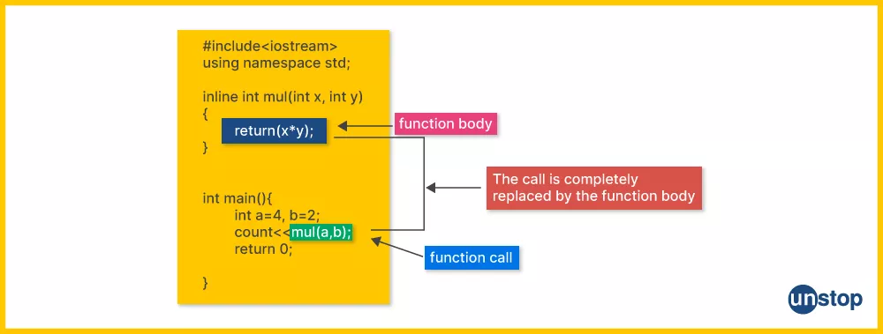

Slide 9
Key Difference Between Friend and Inline Functions:
Feature | Friend Function | Inline Function
Purpose | To access private/protected members externally | To reduce function call overhead
Declaration keyword | friend | inline
Location | Declared inside class, defined outside | Defined normally (inside/outside class)
Access level | Can access private/protected data | Same as normal function

