Slide 1
Decision Statement
Decision making statement is depending on the condition block need to be executed or not which is decided by condition.
If the condition is "true" statement block will be executed, if condition is "false" then statement block will not be executed.
    • if
    • if-else
    • else if statement
    Switch Case

Slide 2
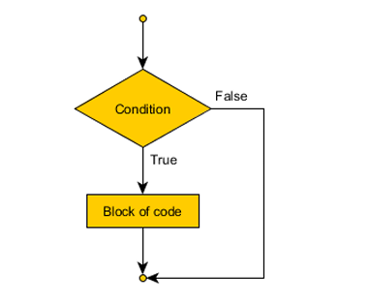
1.if statement:
Executes a block of code only if a specified condition is true.
Syntax:
if (condition) {
// code to execute if condition is true
}

Slide 3
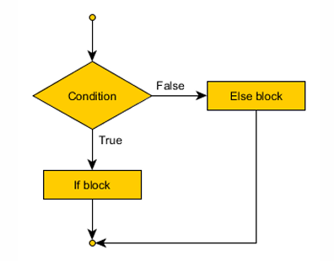
if-else statement:
Executes one block of code if a condition is true, and another block if the condition is false.
Syntax:
if (condition) {
// true block
} else {
// false block
}

Slide 4
3. Nested if Statement(if...else if....else Statement):
The if...else statement executes two different codes depending upon whether the test expression is true or false. Sometimes, a choice has to be made from more than 2 possibilities. The nested if...else statement allows you to check for multiple test expressions and execute different codes for more than two conditions..
Syntax of nested if...else statement:
if (testExpression1)
{
// statements to be executed if testExpression1 is true
}
else if(testExpression2)
{
// statements to be executed if testExpression1 is false and testExpression2 is true
}
else if (test Expression 3)
{
// statements to be executed if testExpression1 and testExpression2 is false and testExpression3 is true
}

Slide 5
if...else if...else Ladder
Checks multiple conditions one by one.
if (condition1) {
// block 1
} else if (condition2) {
// block 2
} else if (condition3) {
// block 3
} else {
// default block
}

Slide 6
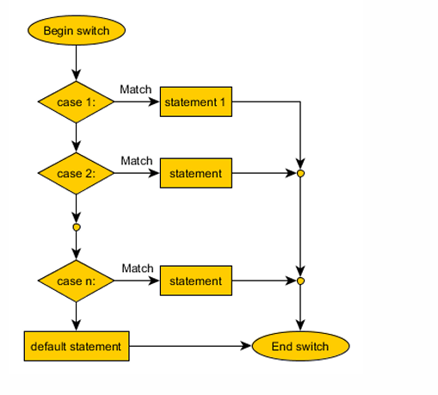
5. switch Statement
The nested if...else statement allows you to execute a block code among many alternatives. If you are checking on the value of a single variable in nested if...else statement, it is better to use switch statement. The switch statement is often faster than nested if...else (not always).
Also, the syntax of switch

Slide 7
switch (expression) {
case value1:
// code
break;
case value2:
// code
break;
default:
// code
}

