Slide 1
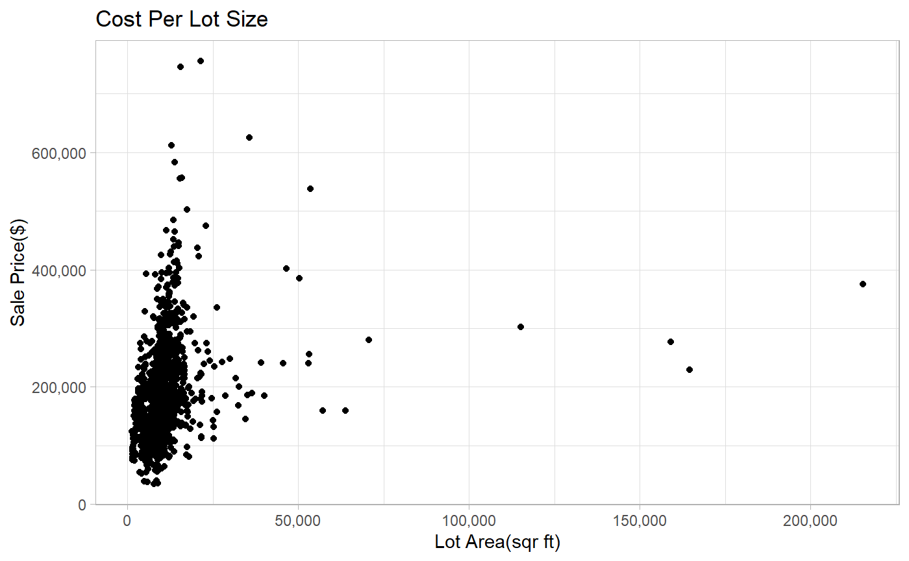

Slide 2
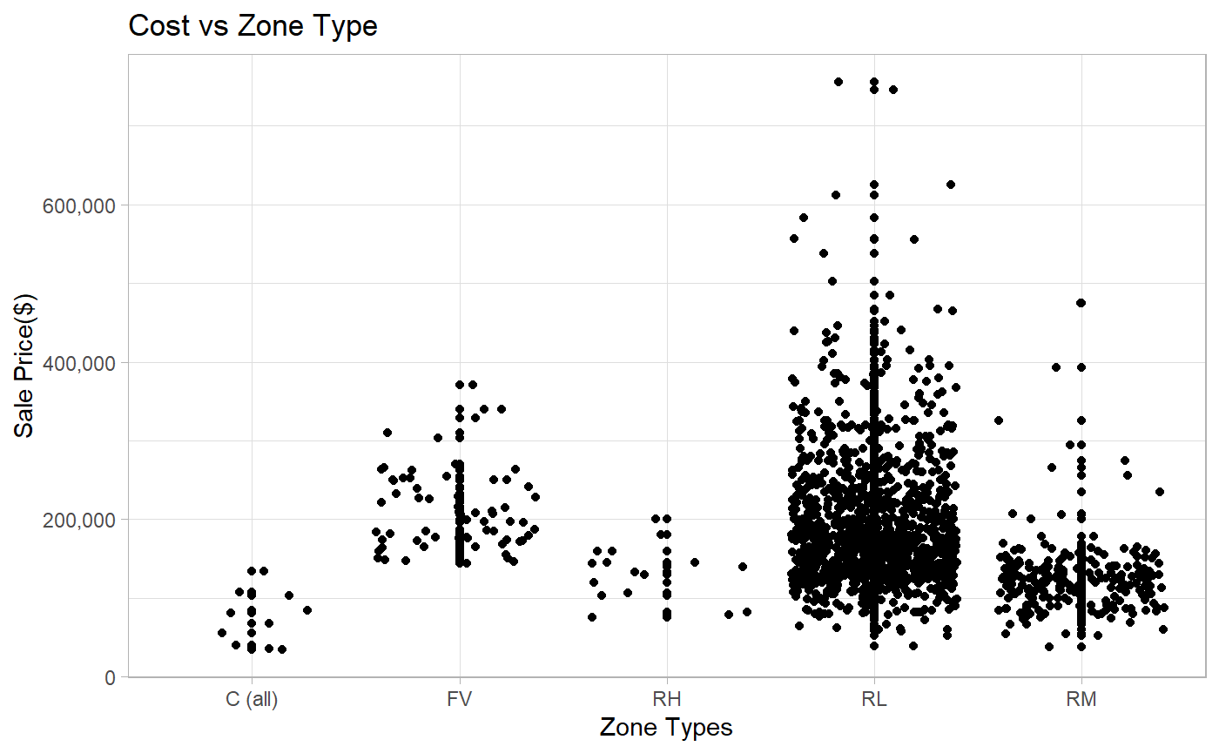

Slide 3
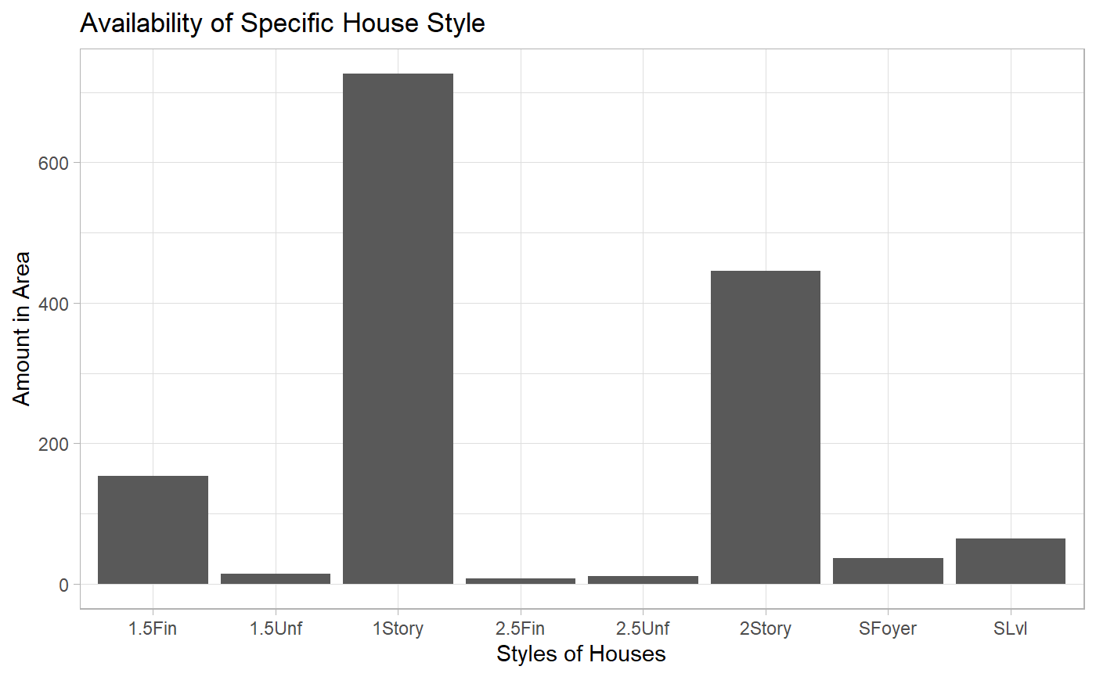

Slide 4
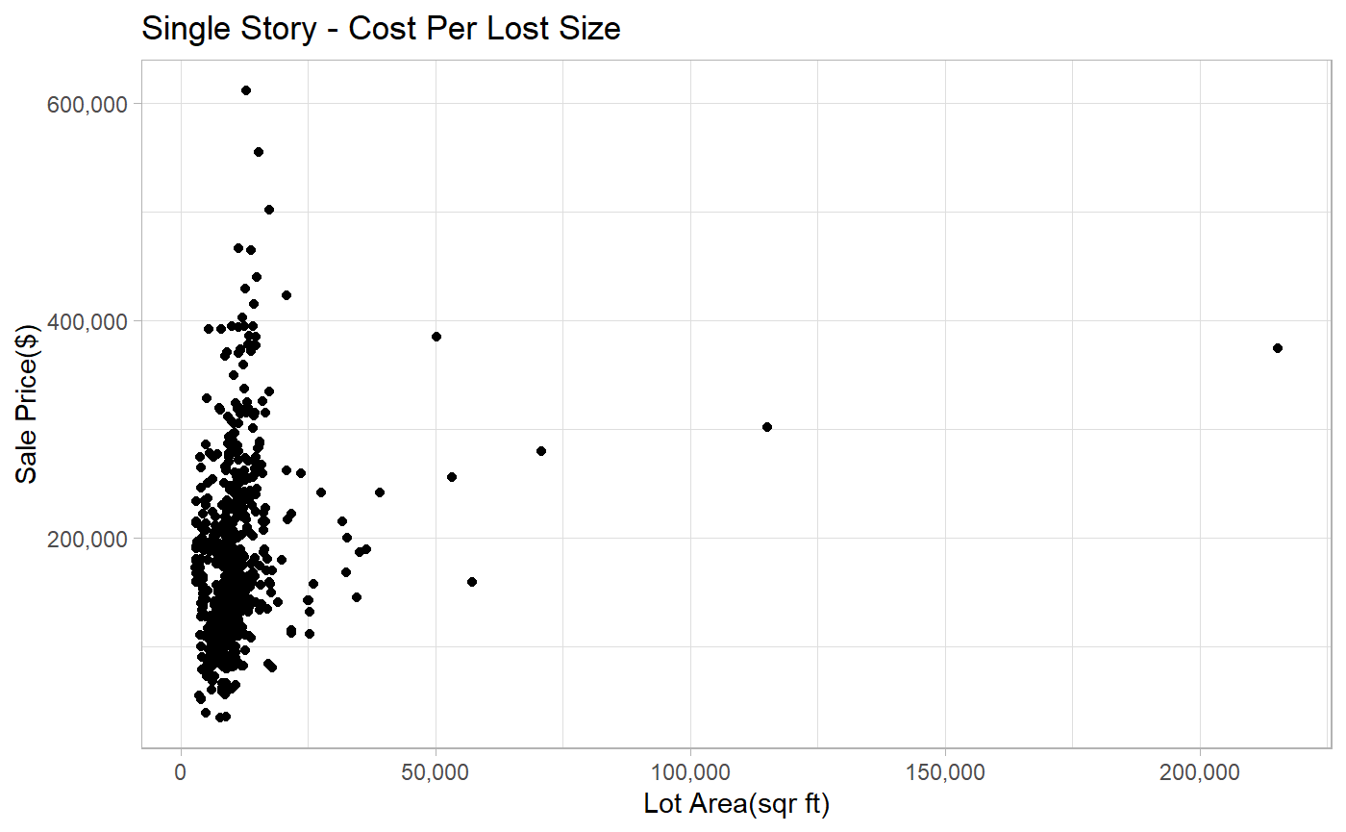

Slide 5
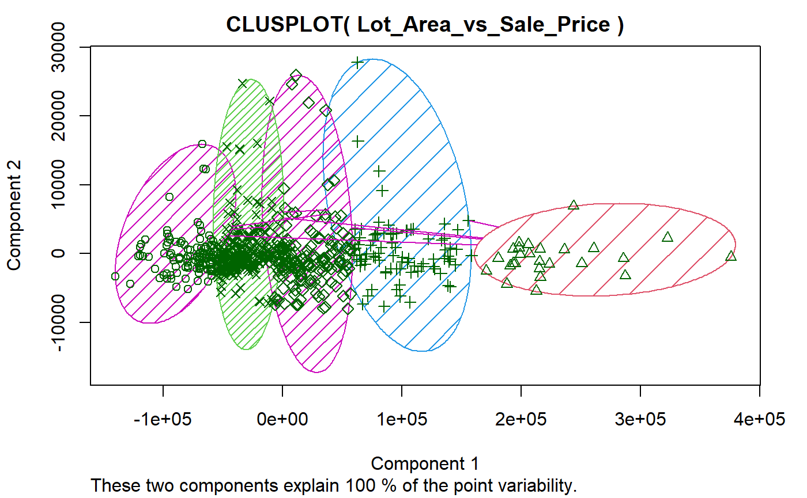

Slide 6
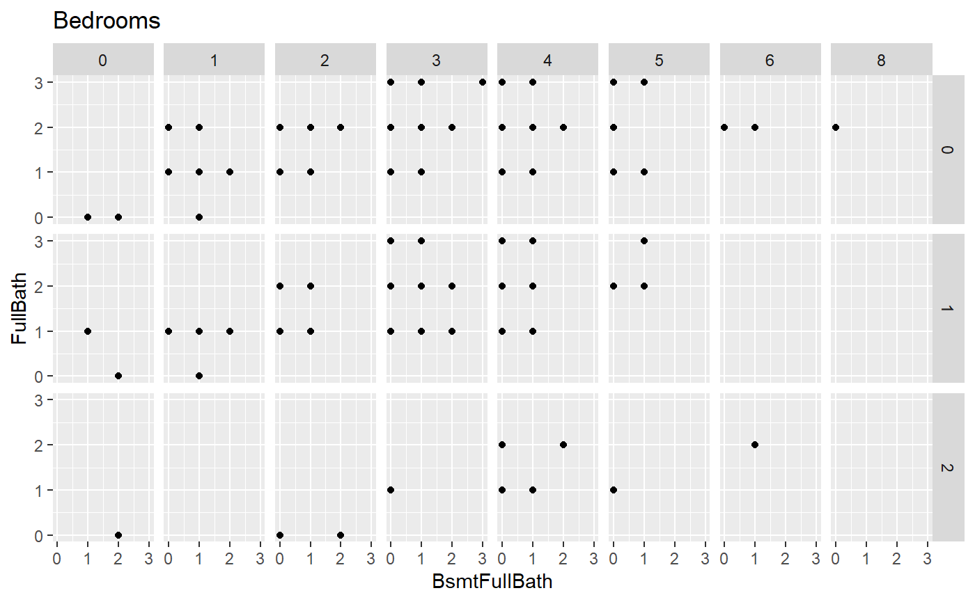
HalfBath

Slide 7
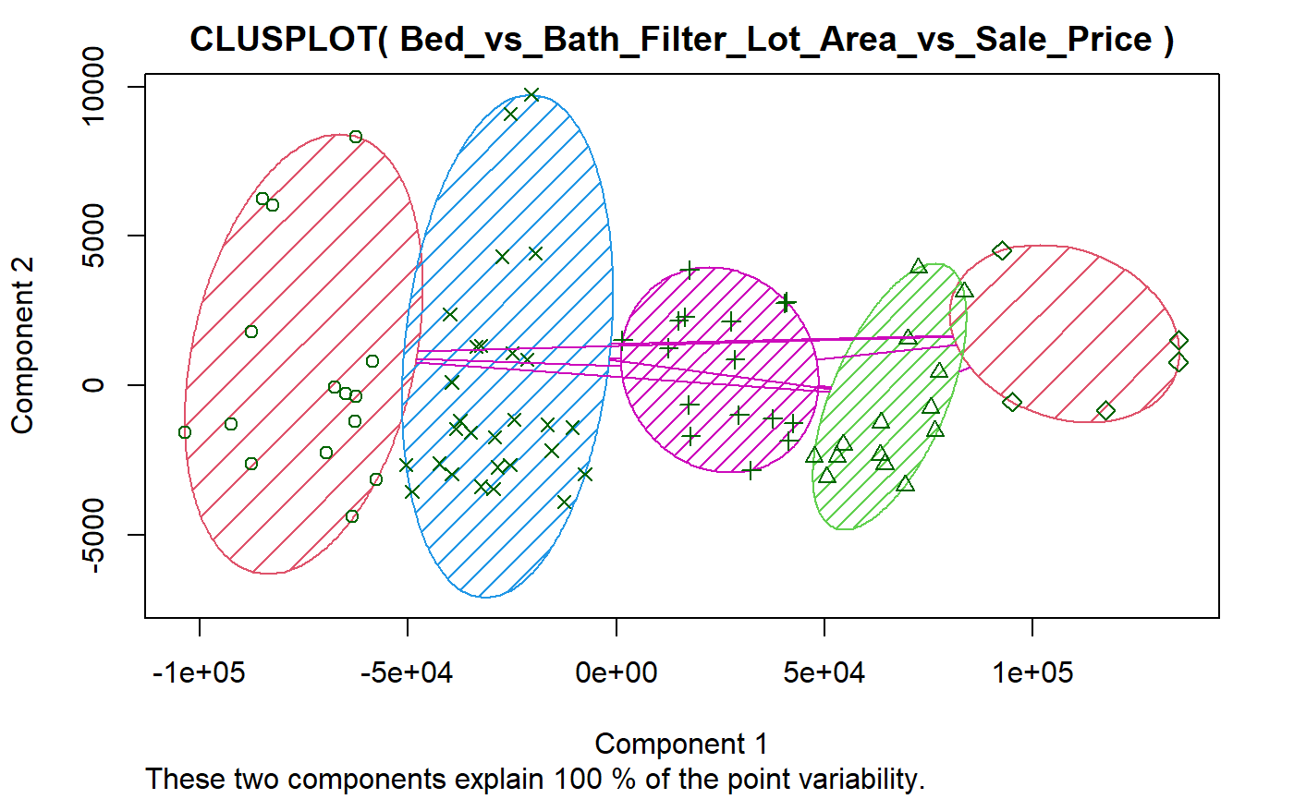

Slide 8
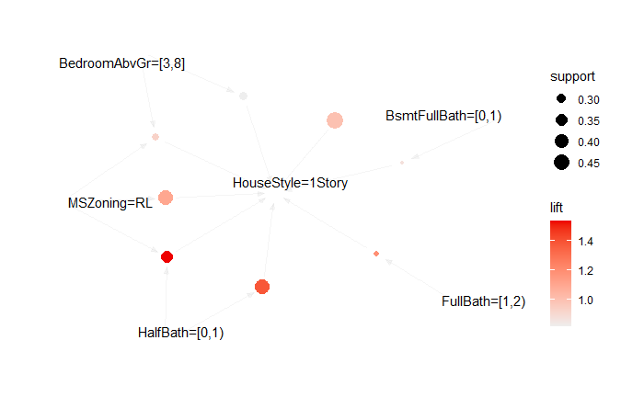
8 Rules from Machine Learned Data (25% Support)
It is determined that all previous information gathered is proven by the rules that the machine learning algorithm created for us.

Slide 9
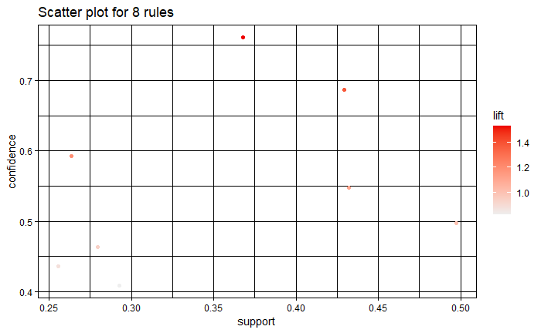
8 Rules from Machine Learned Data (25% Support)

Slide 10
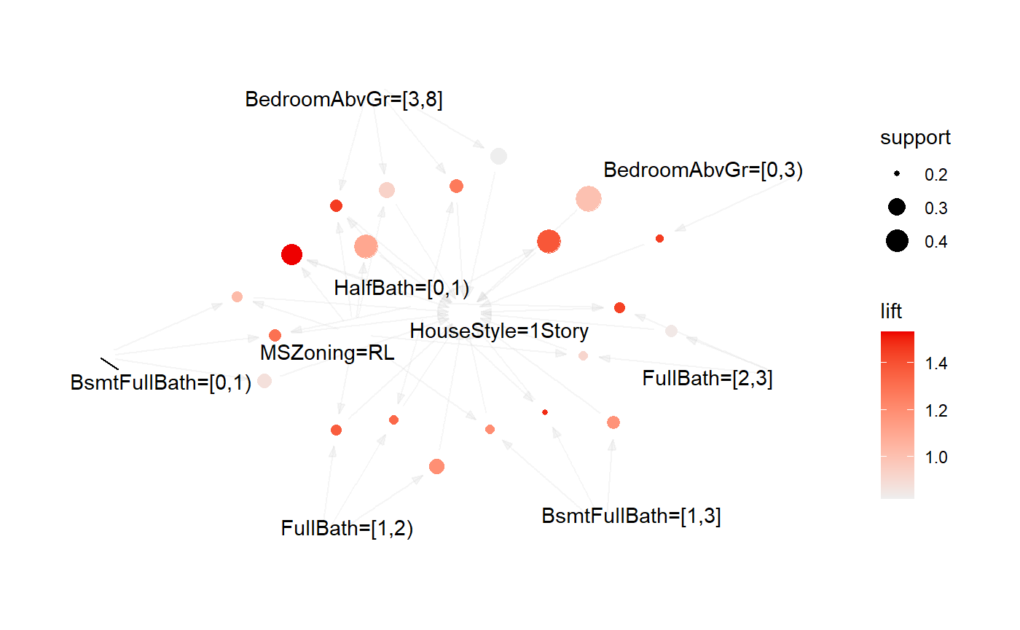
21 Rules from Machine Learned Data (20% Support)
It is determined that all previous information gathered is proven by the rules that the machine learning algorithm created for us.

Slide 11
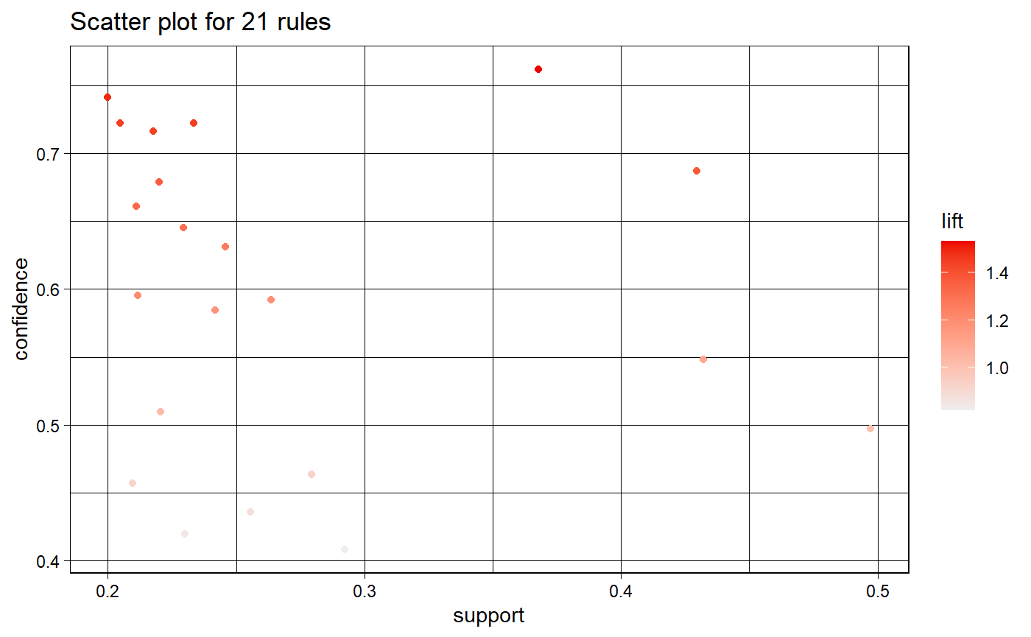
21 Rules from Machine Learned Data (20% Support)

