Slide 1
Housing Data
The Question:
If given housing parameters in a dataset from a city in the state of Iowa, can we determine what is the most abundant and affordable housing based on the type and layout of the house?
Final Project
Michael Ayala
INFO 523

Slide 2
Parameters
LotArea – Lot Area (Sqr Feet)
FullBath – Full Bathrooms
HalfBath – Half Bathrooms
BsmtFullBath – Basement Bathrooms
HouseStyle – House Style
BedroomAbvGr – Bedrooms Above Ground
MSZoning – The type of Zoning the house is in
SalePrice – Sale Price of the Property

Slide 3
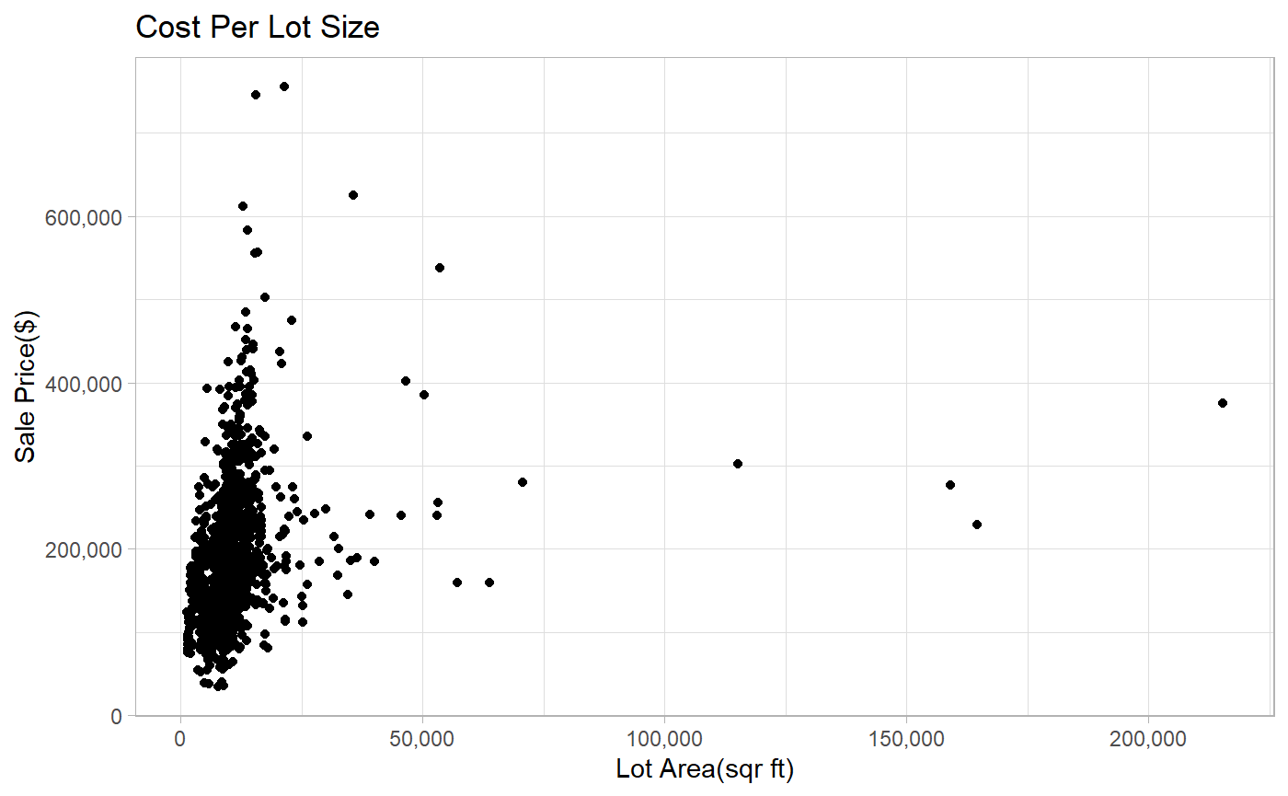

Slide 4
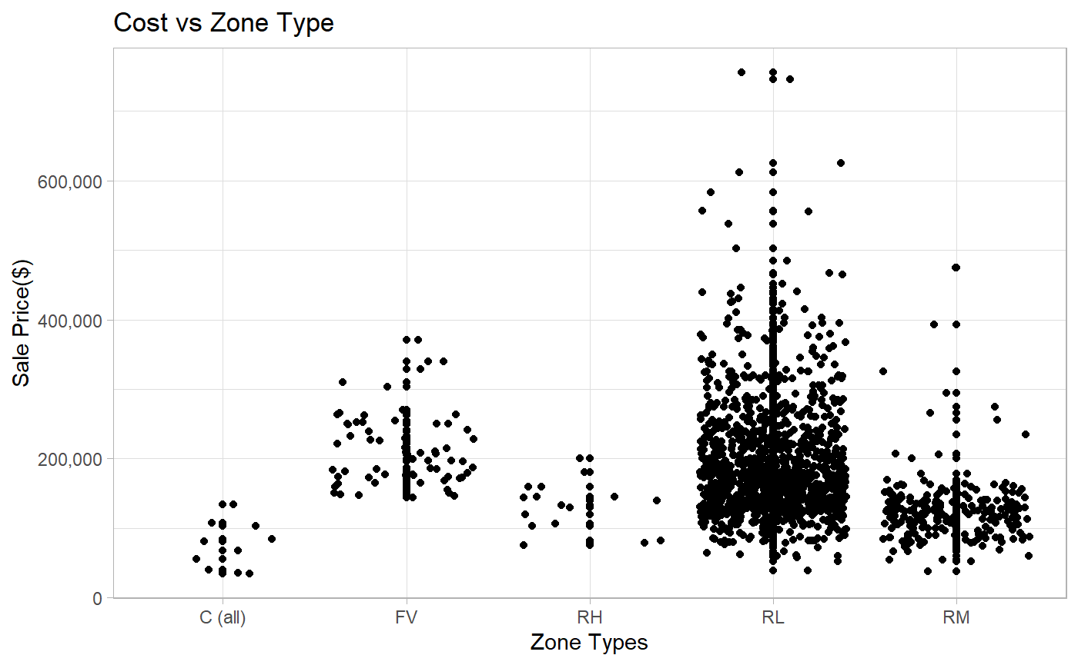

Slide 5
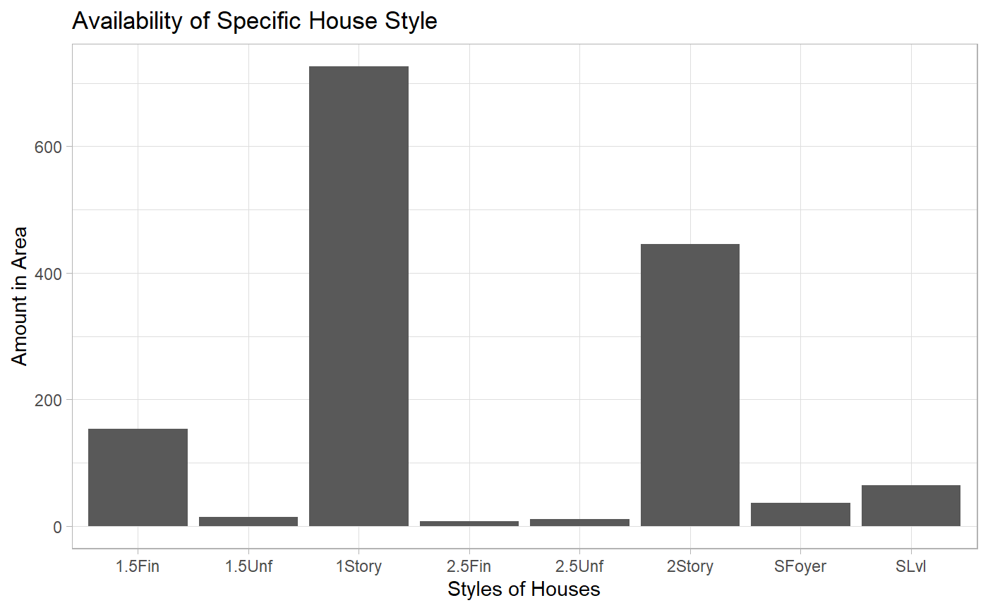

Slide 6
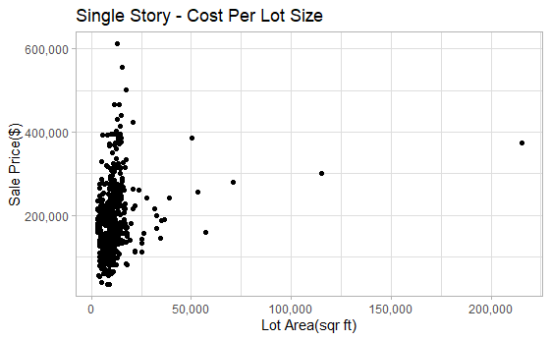

Slide 7
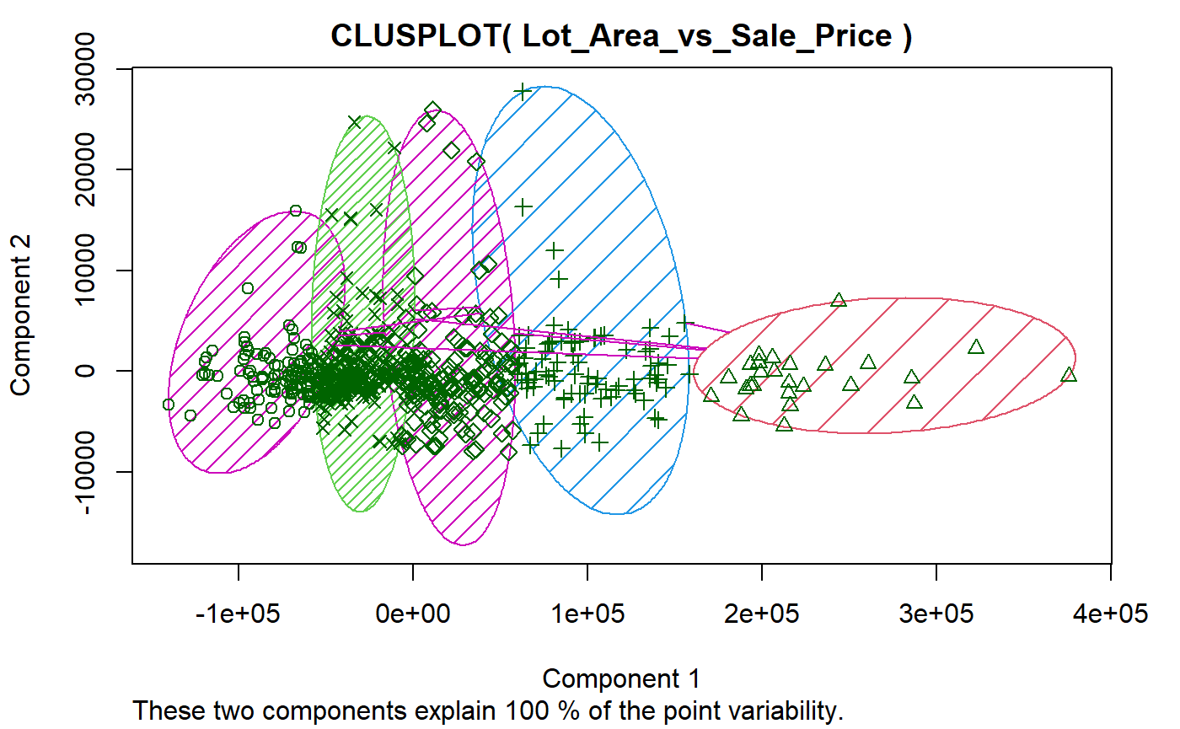

Slide 8
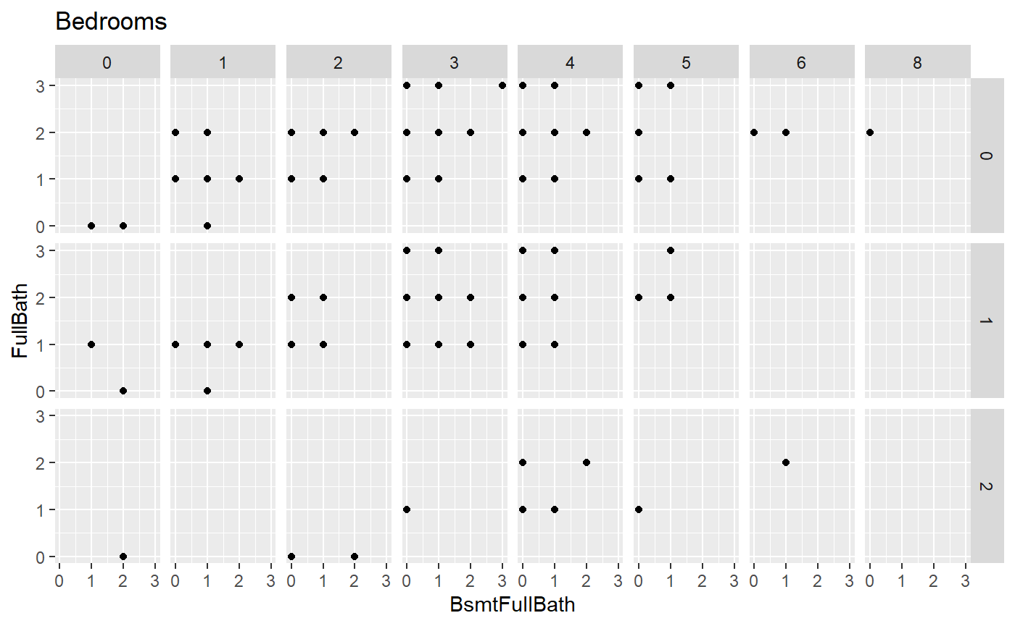
HalfBath

Slide 9
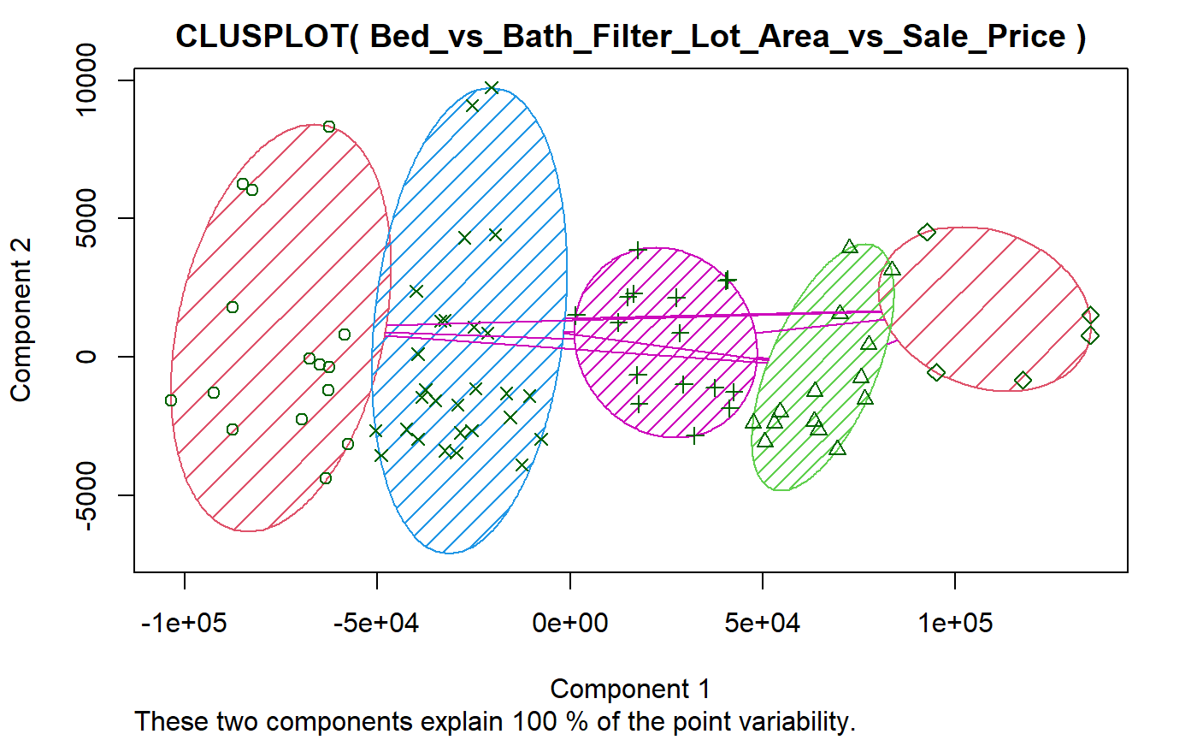

Slide 10
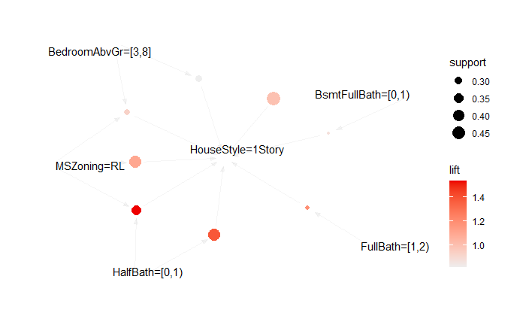
8 Rules from Machine Learned Data (25% Support)
It is determined that all previous information gathered is proven by the rules that the machine learning algorithm created for us.

Slide 11
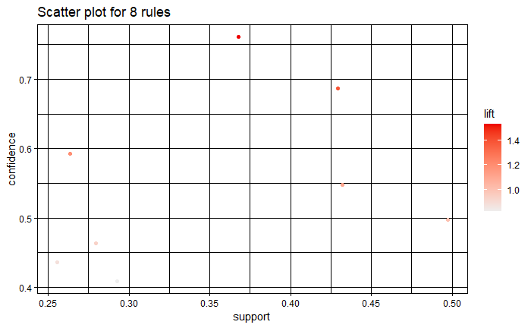
8 Rules from Machine Learned Data (25% Support)

Slide 12
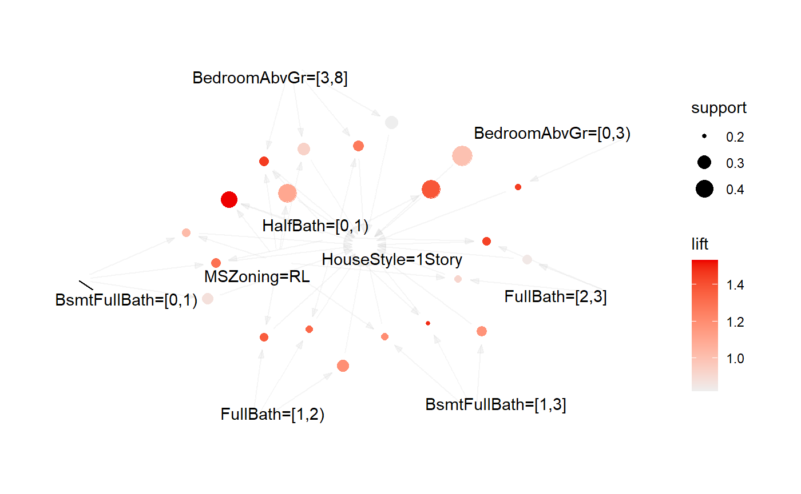
21 Rules from Machine Learned Data (20% Support)
It is determined that all previous information gathered is proven by the rules that the machine learning algorithm created for us.

Slide 13
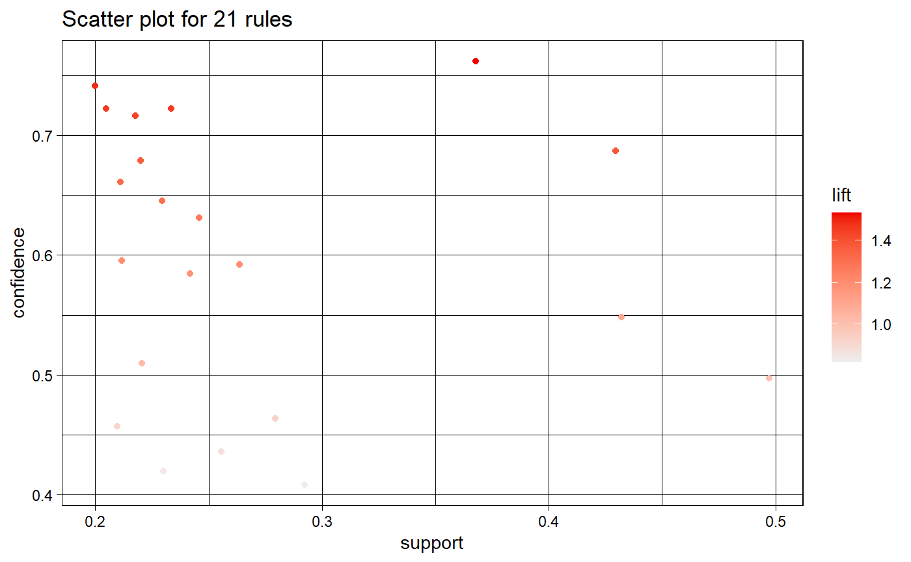
21 Rules from Machine Learned Data (20% Support)

Slide 14
Conclusion
The analysis done initially to determine the abundance of specific housing matched the Machine Learning Algorithm and based on the support level of 25% it matched all the selected filtering done for the clustering.
This proved that the machine learning can be trusted to make the decision completely from the correlation of the data given the parameters of interest.

