Slide 1
Fenty beauty analysis
Maya Madhavan

Slide 2
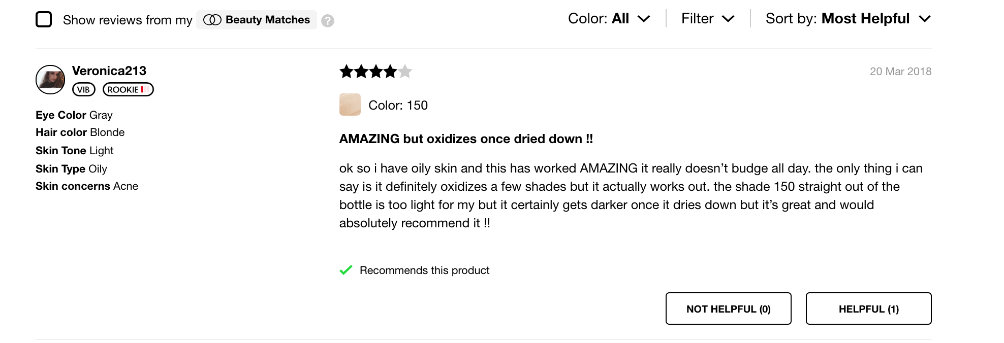
Background
Notes:
Fenty
New Brand, lots of Hype
Dataset= Scraped Until Kicked Out
2,657/10000 Reviews
Unsorted (Unidentifiable Sorting)
Rows:
User Info; Name, Physical Attributes
Review Content
Rating
How many people found it helpful

Slide 3
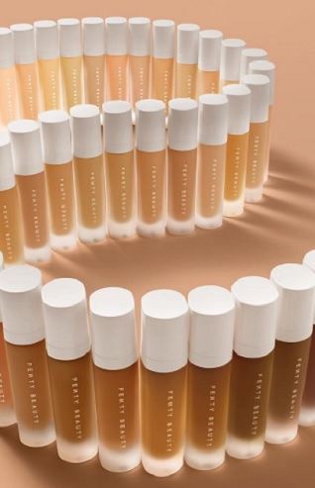
What are reviewers generally saying?
LDA: Unmeaningful Topics
NMF: A little harder to read than LSA
LSA CV With TruncatedSVD (Human Interpretation):
General Foundation Descriptors
Dry Skin and Patchiness
Lots of love from both dry and oily skin types
Oily Skin and Wear
Application methods
Notes:
Count vectorizer= only used
Changed stop words
Internal tokenization
Fit transform/fit to data
Corpus
Lda
LSA
Number of topics
What are reviewers saying?
Tuning:
Stop Words
Number of Topics
Final Choice
NMF Using Count Vectorizer with Truncated SVD
Results
Want topics you can describe to other people= number of topics will be small
Dimensional reductions= large number of topics is fine, do that so the number of clusters look okay

Slide 4
Analysis: Rating
Prep Data
Oversample
Compare Accuracy
Naïve Bayes Bernoulli
Vectorize
Split
Notes:
Clustering Problem
Vectorize Data
Train/Test Split
Fix imbalances with oversampling
Comparisons using accuracy score on a single train test split
‘Best Model’= Naïve Bayes Bernoulli
What Can we do with this= Autofill stars for people

Slide 5
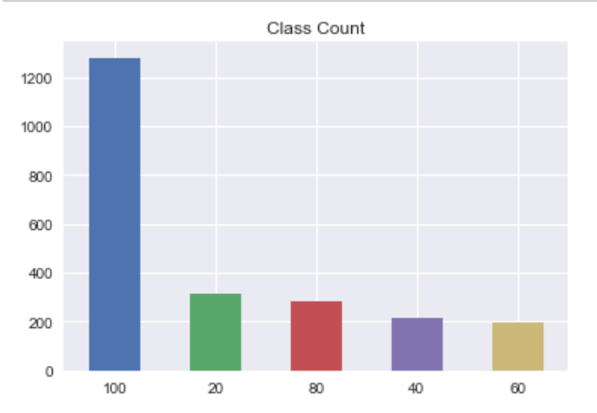
Class Imbalances: Oversampled

Slide 6
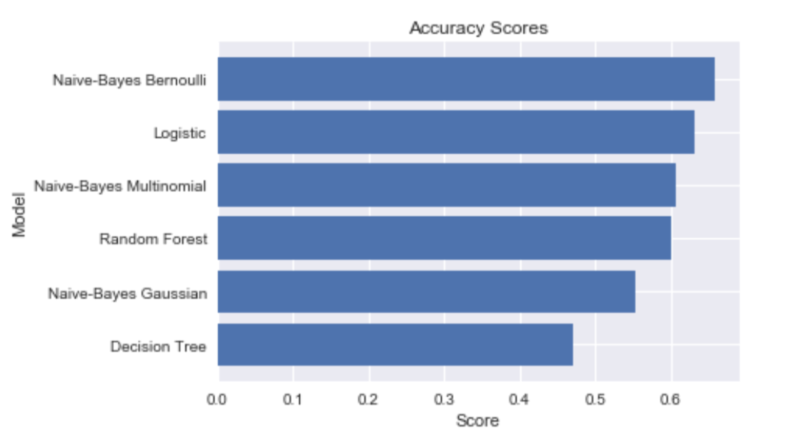
Results: Accuracy Scores
Notes:
Test scores
In multilabel classification, this function computes subset accuracy: the set of labels predicted for a sample must exactly match the corresponding set of labels in y-true.

Slide 7
Analysis: Helpfulness
Train/Test Split
Compare MSE
Ridge
Notes:
Regression problem
Comparison using mean squared error
Prediction function to tell you how many people find the review helpful
Use case= Want more meaningful conversation around their reviews
Promote those reviews that they think will be more helpful

Slide 8
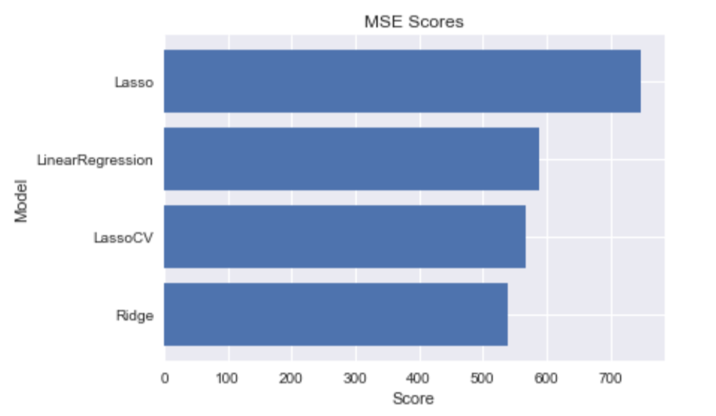
Results: MSE

Slide 9
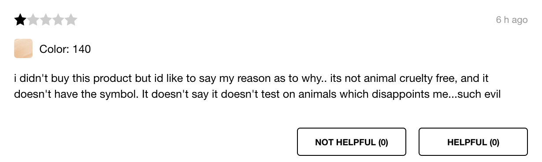
Predicting Helpfulness
Prediction: 7 People Find This Unhelpful

Slide 10

Topic Model on Negative
You Throwing Shade
LSA CV With TruncatedSVD (Human Interpretation):
General Thoughts About Product
Shade matching
Blending
Dry skin
Oily skin
At My Foundation Shades??

Slide 11
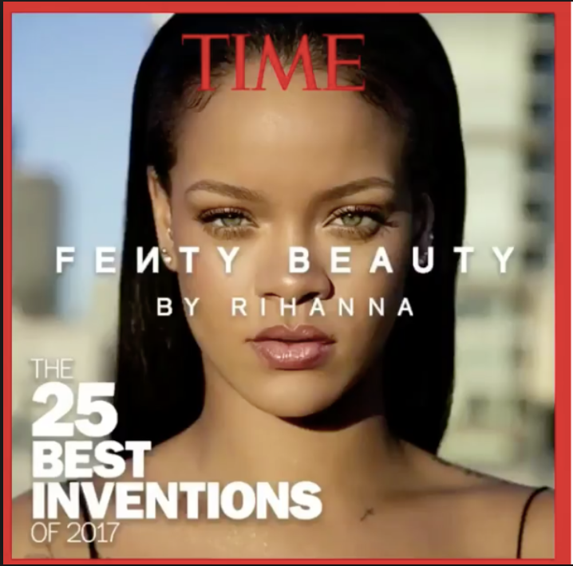
Going Forward
More Data
Including image and video reviews
Spammy Reviews

Slide 12


Questions

Slide 13
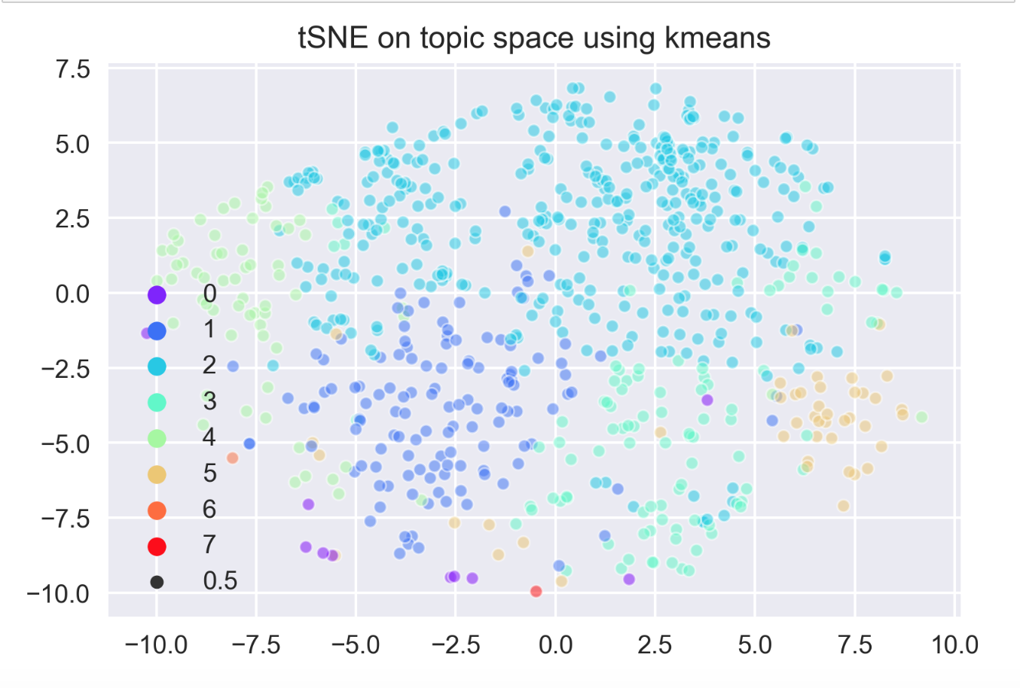
Clustering on Negative Reviews: Dimension
Notes:
Perplexity= how big is the neighborhood in the high dimensional space in a low dimensional space

Slide 14
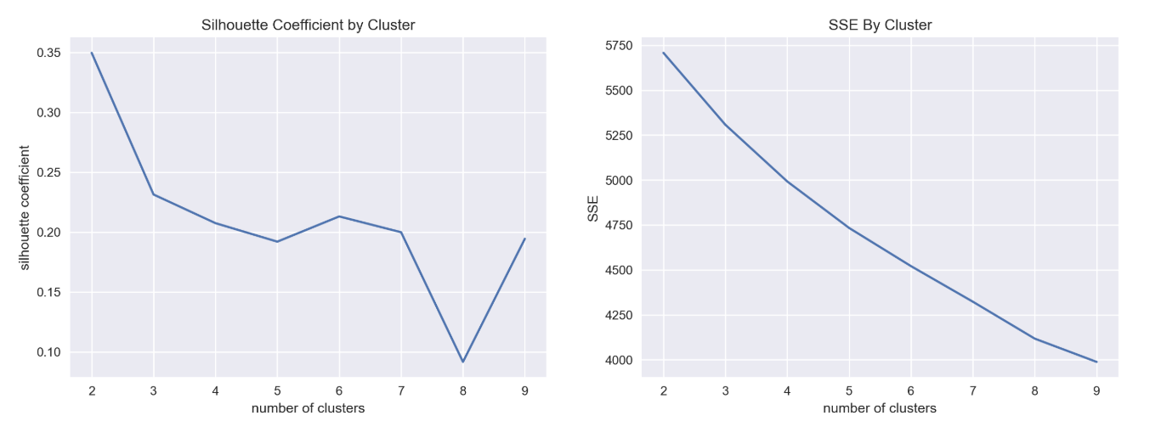
Clustering on Negative Reviews: N Clusters
Notes:
Were found to be best as 6 clusters

Slide 15
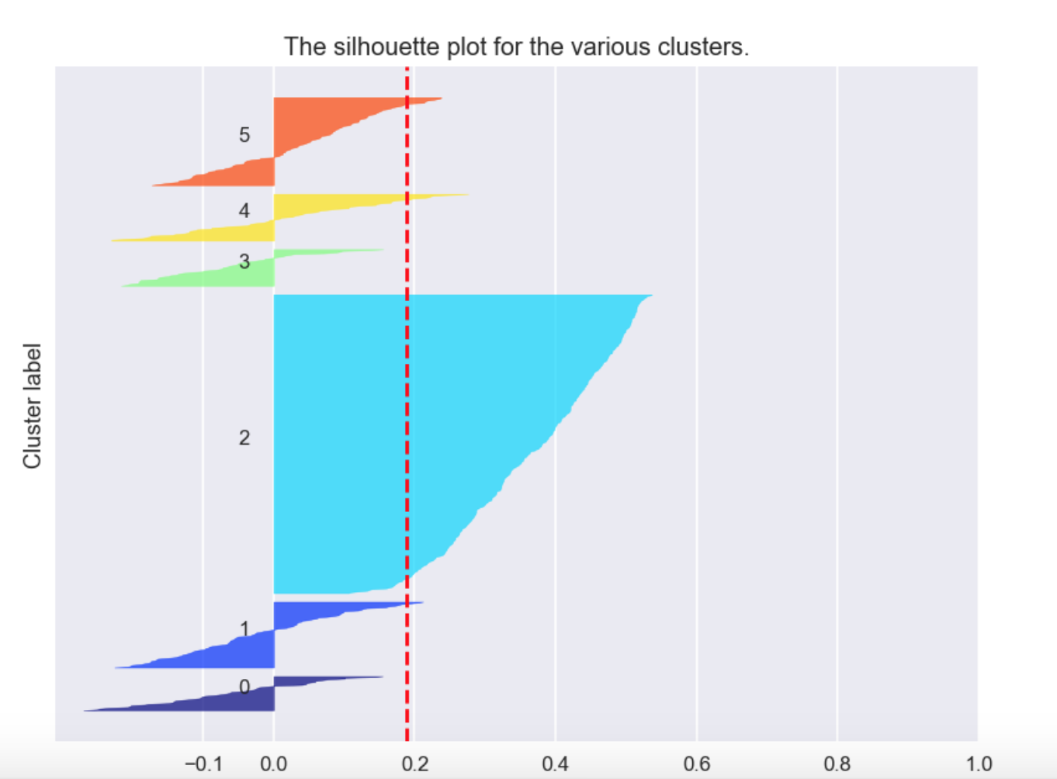
Clustering on Negative Reviews: not great
Notes:
One very large amourphous cluster, and other clusters that aren’t closely related
This was backed up by manually reading the reviews

Slide 16
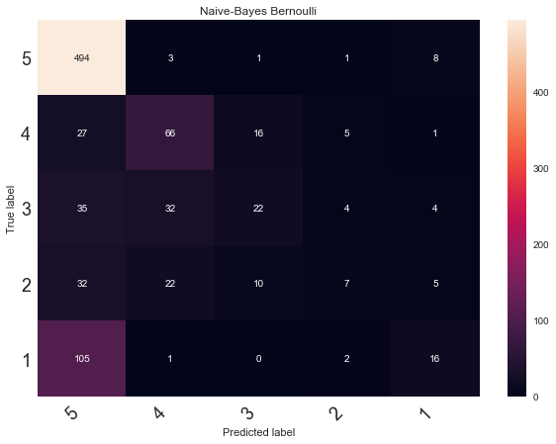
Confusion Matrix

Slide 17
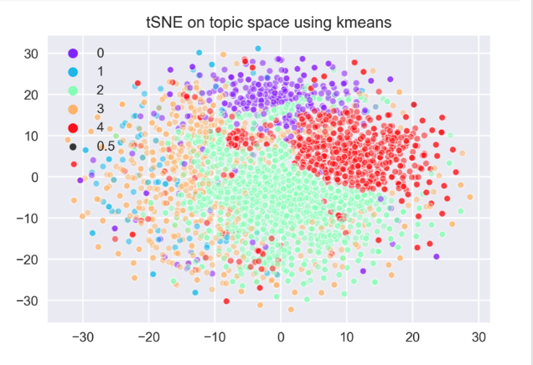
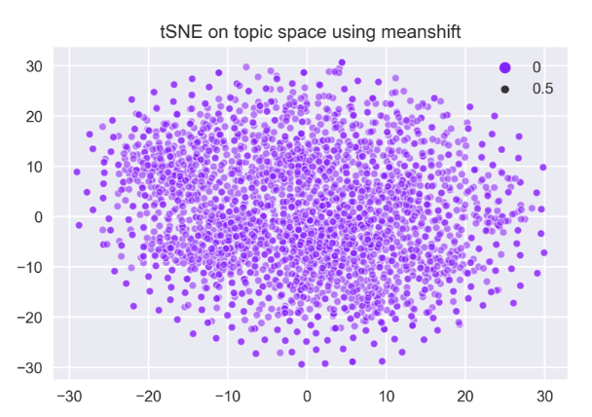
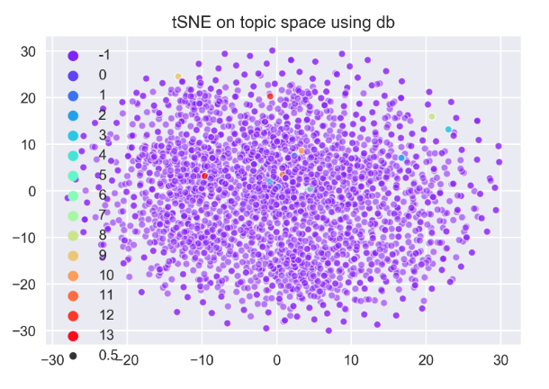
Clustering On Whole Dataset
Model | Kmeans | DBSCAN | Meanshift | Spectral
N Clusters | 5 | 14 | 1
TSNE
Notes:
Checking Dimensions
Checking for number of clusters
Kmeans
Run check tsne and print results
Dbscan
Run check tsne and print results
meanshift
Run check tsne and print results
Final= Kmeans, cv
why
Intra Cluster Variation
Tuning
Checking Dimensions
N Clusters KNN

Slide 18
Meaning in Clusters?
Same Proportions Across Clusters For:
Star Rating
Helpfulness
Ans: Not Yet Identified
Notes:
Want to see what it clustered on
Using labels from data
Star
Helpfulness
Idea: See how they compare, on average, in each of these clusters
If cluster has disproportionate value, that’s what it’s clustered on
Ans: Neither of these have discernable relation to end clusters

