Slide 1
(An attempt at) Predicting Steam Game Reviews
Maya Madhavan

Slide 2



Research Question
Purpose: Can we maximize user engagement with games on Steam, as measured by the number of reviews the game has?
Steam is the largest online digital distribution platform for games
Gaining 1.7 million users per month in late 2017

Slide 3
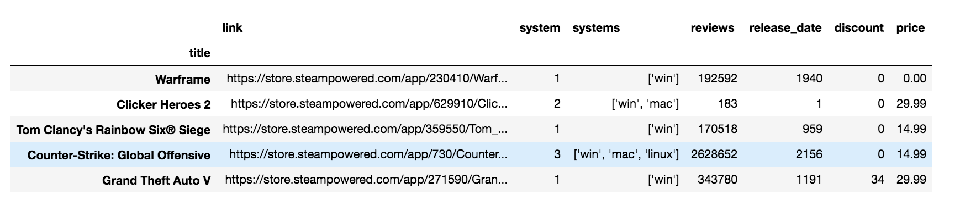
Dataset
Scrape Until Kicked Out
10475 of ~ 49,050 Games
Random Arrangement on Steam Search Page
=> Representative Sample

Slide 4
General Format of Regression Analysis
EDA
Regress
OLS on Full Training
10-Fold Validation
Analyze
Modify Variables as Needed

Slide 5
Attempted Modifications
Log Dependent Variable
1
Drop Windows
2
Drop Games with 0 Reviews
3
Add Polynomial Features on Price and Release Date
4

Slide 6
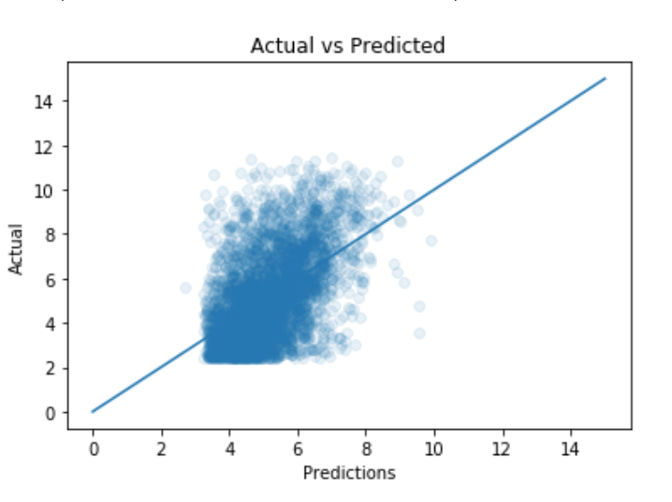
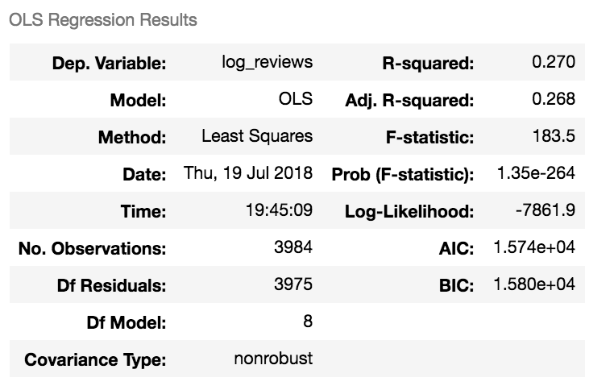
Best Model
Polynomial Degree 2
Logged Y Values
Dropped Windows and Reviews

Slide 7
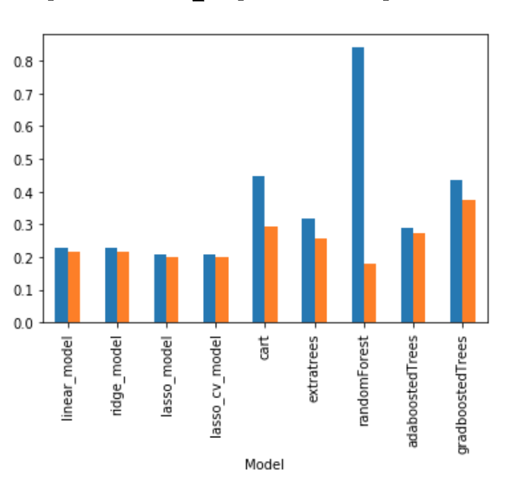
more Models
Compare R2 scored
“Best” Model= Gradient Boosted Trees on Logged Reviews
Best in terms of R2, not overfitting

Slide 8
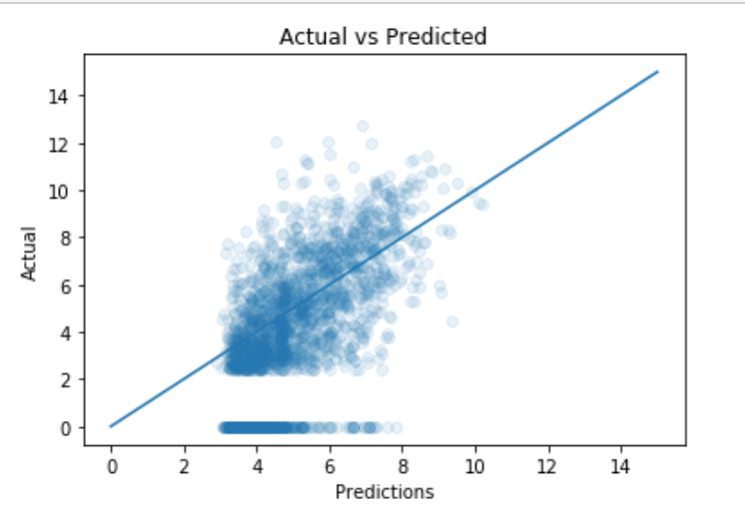
Final Model + Results
Final Score on Full Train: 0.4818365496905238
Final Score on Test: 0.2066513992465474
This is a Bad Model
Overfitted
High Bias

Slide 9
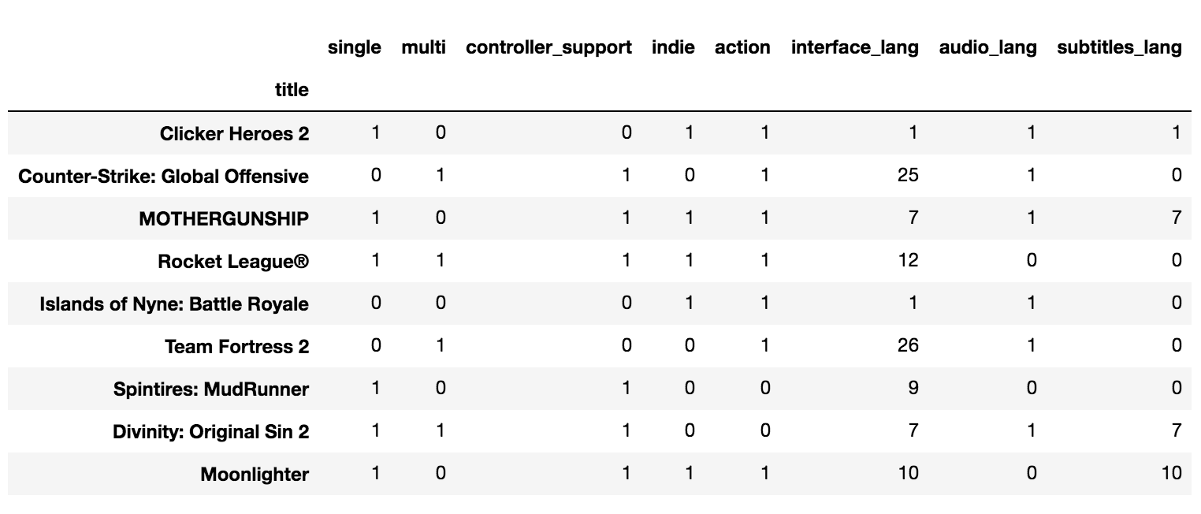
So what now
⏰ → More Polynomial Features
⏰ → Other Features
Other Models
Notes:
R2 is fitting the best fit line- how well your best fit line is fitting

Slide 10
Questions???

