Slide 1
Police use of force and right wing extremist violence in the US
Maya Van Nuys
PLSC 31101

Slide 2
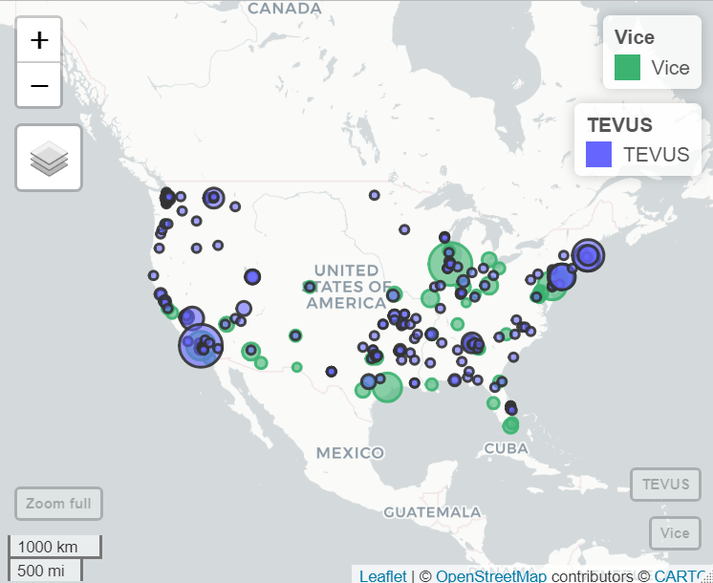
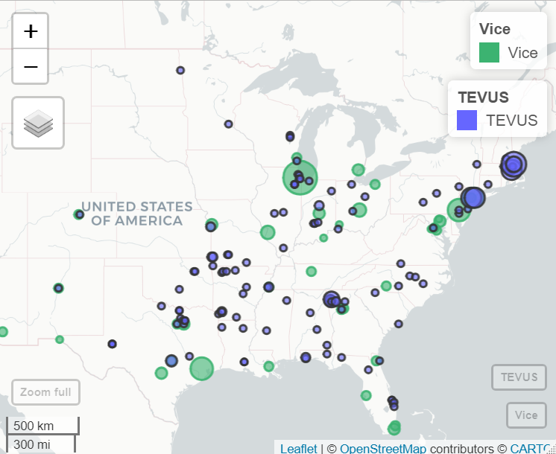
Mapping
Needed coordinates
Google API

Slide 3
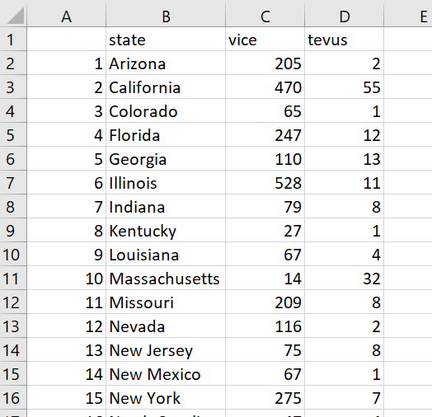
Merging
Required changing coordinates to other locational data
Merge by:
Zip code
City
State (*)

Slide 4
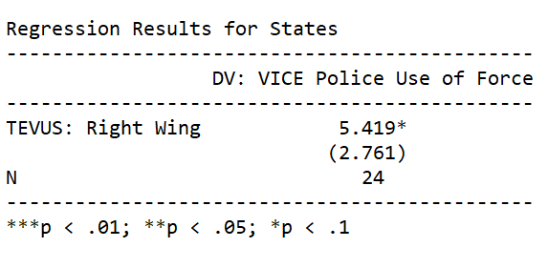
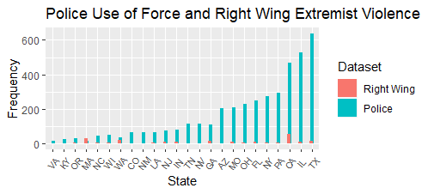
Analysis
Bar plot of data merged by state
Linear regression

Slide 5
Thank you!

