Slide 1
Development And Optimization Of A Two-view Model For Anamorphic Projections On Planar Surfaces
Van Mai Nguyen Thi
Joint Senior Project: Mathematics & Computer Science
Advisers: Keith O’Hara and Jim Belk

Slide 2
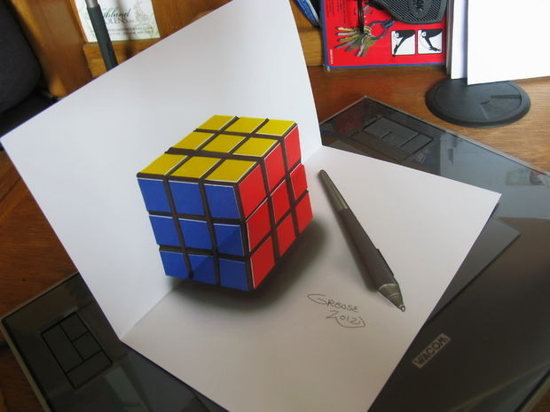
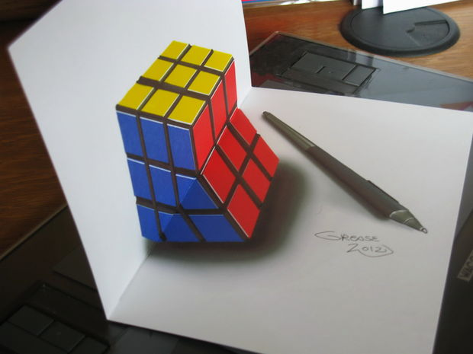
Notes:
In short: Looks correctly from 1 perspective, and distorted from other perspectives.

Slide 3
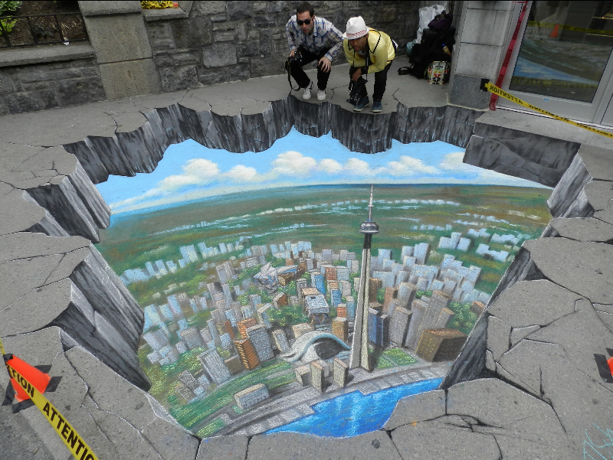

Slide 4
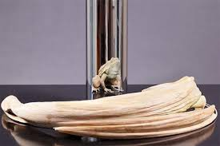
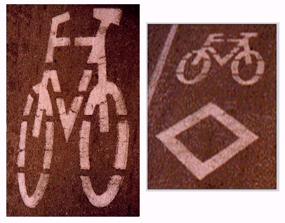
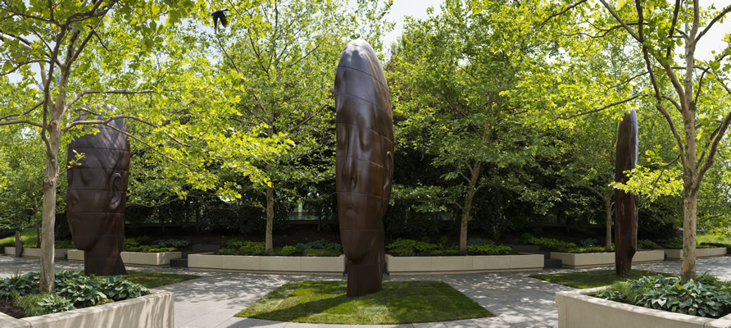

Slide 5
Previous Work
Keystone correction
Principles of planar, conical, cylindrical anamorphosis
Dynamic anamorphosis
Reconstructing the 3D scene using the Kinect
Notes:
+ motivation:
+ single and two view geome- tries, both of which have potential applications in visual and performance arts.
+ This project, however, takes a different approach in that it not only uses the cameras to recon- struct the information about the scene, but also optimizes the projections for the camera views.
we use simple proj/camera system

Slide 6
Summary of Project
Single View Models
Basic Model
Improved Model
Two View Model
Notes:
GOAL: develop software that generates anamorphic img for specific viewer
Basic: e.g. minimum # point correspondences to generate an anamorphic images - limitations
Improved: propose some improvements minimize the limitations
2-View: rather than anamorphic img -> optimize for 2 viewers; THIS is for performance and optimizing for a large audience

Slide 7
Basic Setup
Projection surface (S)
Camera image (C)
Projector image (P)

Slide 8
Homogeneous coordinates

Slide 9
Homography

