Slide 1

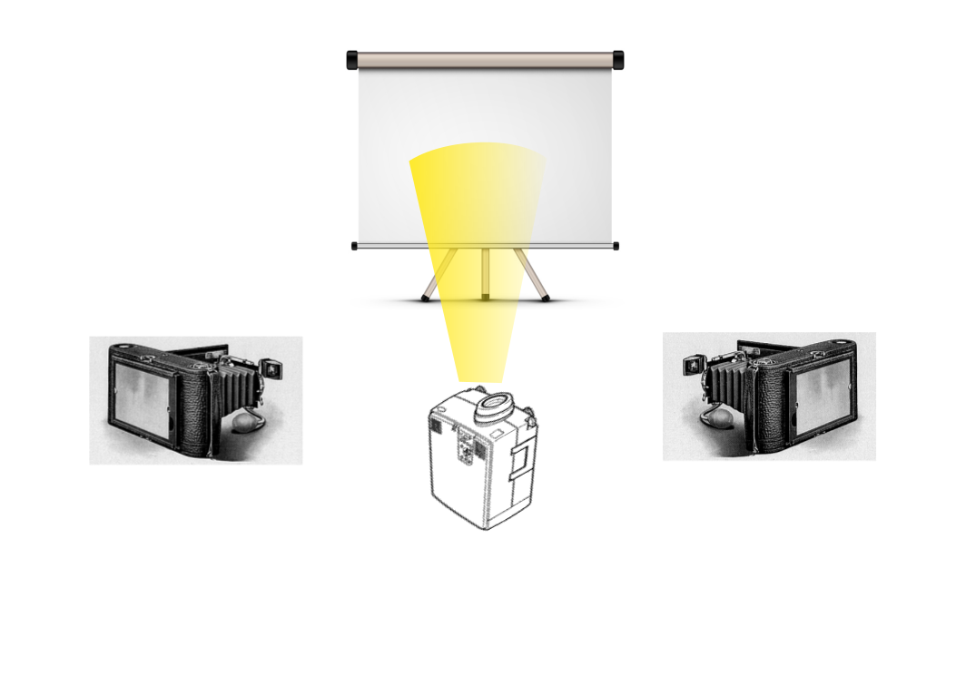
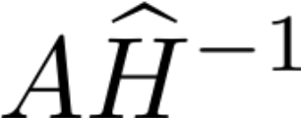
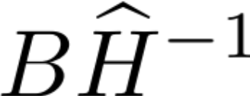


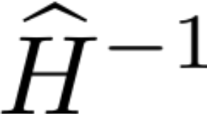
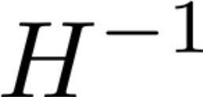


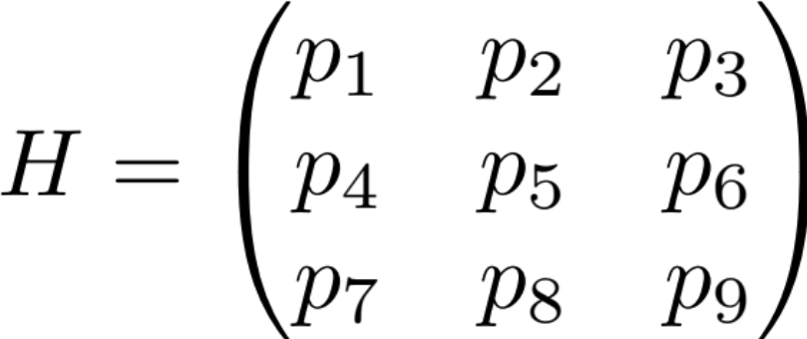
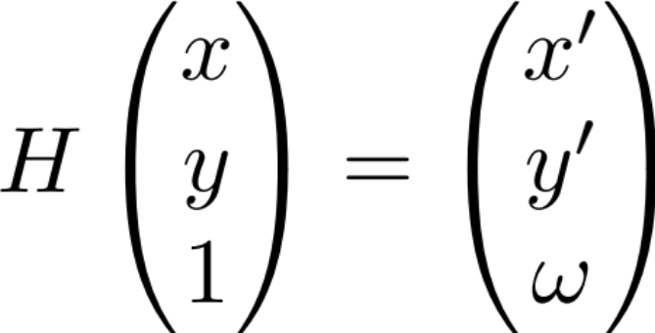



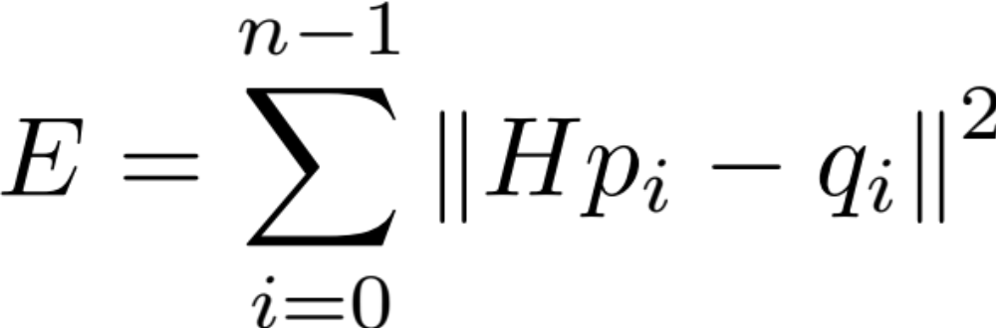
Automated Anamorphic Projections on Planar Surfaces
Van Mai Nguyen Thi, Keith O’Hara*, and James Belk§
*Computer Science Department, Bard College, Annandale-on-Hudson NY 12504
§Mathematics Department, Bard College, Annandale-on-Hudson NY 12504
Introduction
Experimental Setup
Two-View Model
Homography
Projection Screen
Camera 1 image
Original image
Camera 2 image
Projector Image
Camera Image
Camera 1
Projector
Camera 2
Projector image
Camera 1 image
Original image
Camera 2 image
Projection surface (S)
Projector image
Camera image (C)
Projector image (P)
A homography, or projective transformation, is a transformation of a two-dimensional image I to another two-dimensional image I′ (called the anamorphic image), such that all lines in I are preserved in I′.
The error function:
n – number of point correspondences
H – projector-camera homography
p_{i} – original chessboard corners
q_{i} – chessboard corners detected in the camera image
Future Work
Generate anamorphic images that can be projected on more complex surfaces such as multi-planar and curved surfaces.
Improve the optimization for multiple-viewer system.
Explore other types of anamorphosis such as mirror anamorphosis.
Sukthankar, R., et al. Smarter Presentations: Exploiting Homography in Camera-Projector Systems. International Conference on Computer Vision, 2001.

