Slide 1

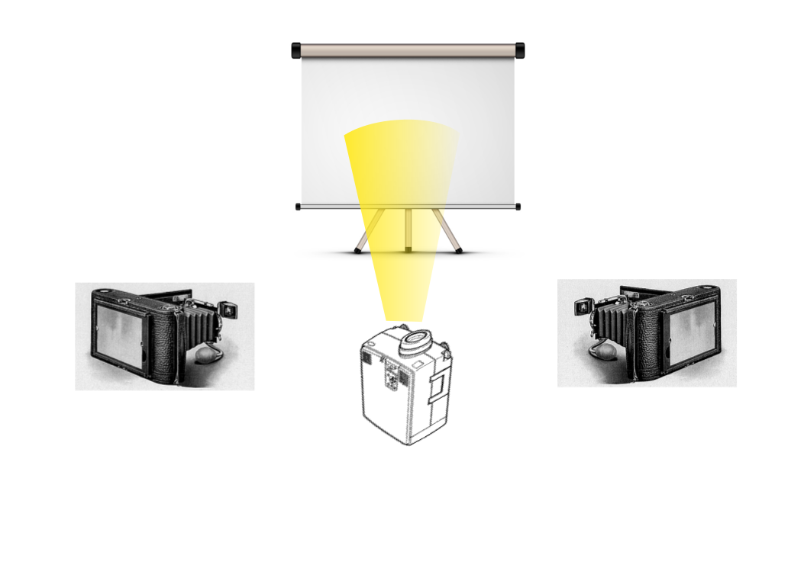
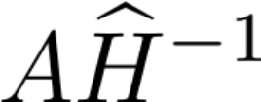
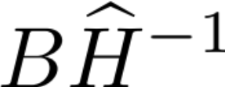
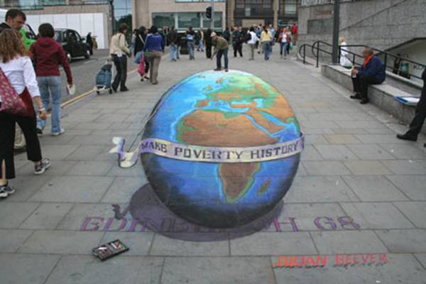
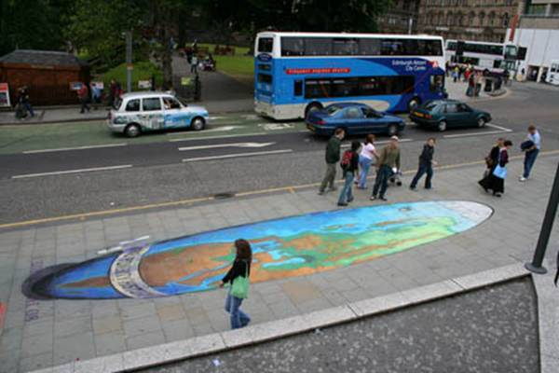

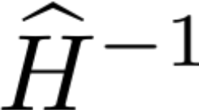


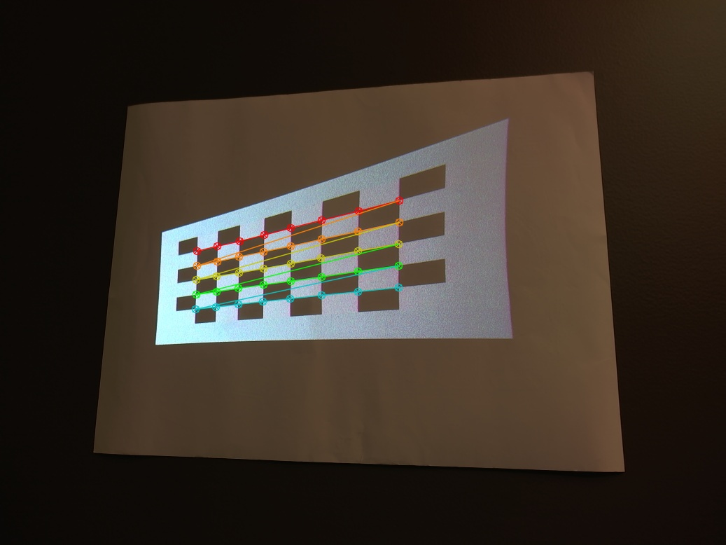
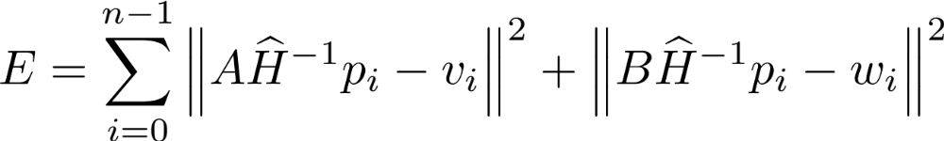
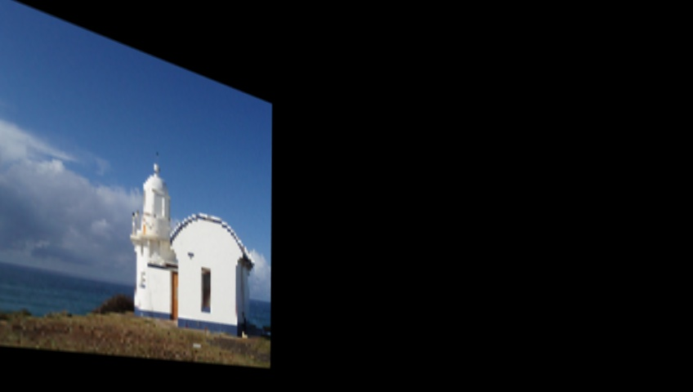
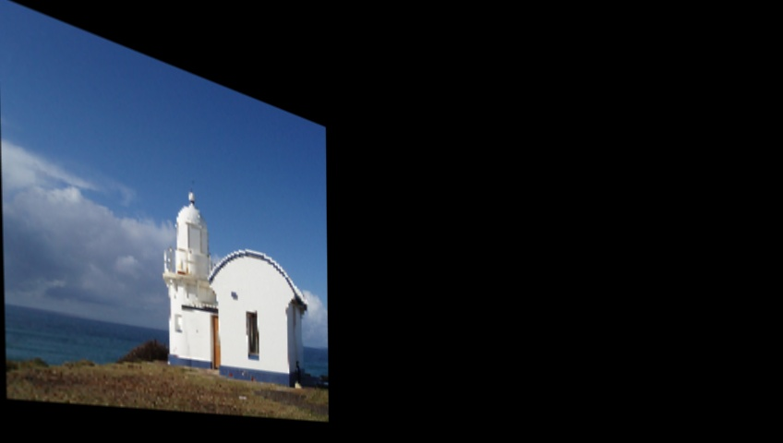

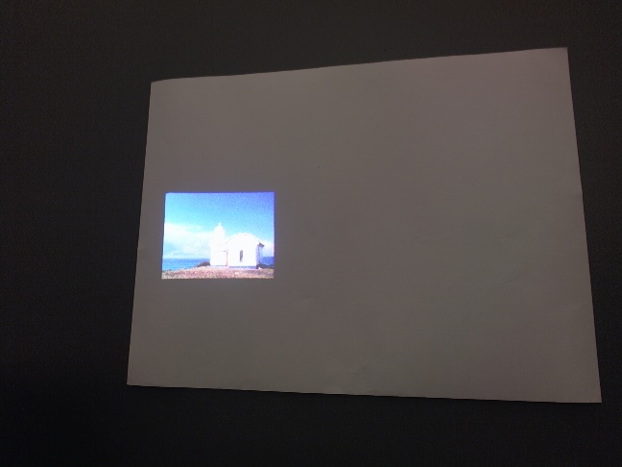
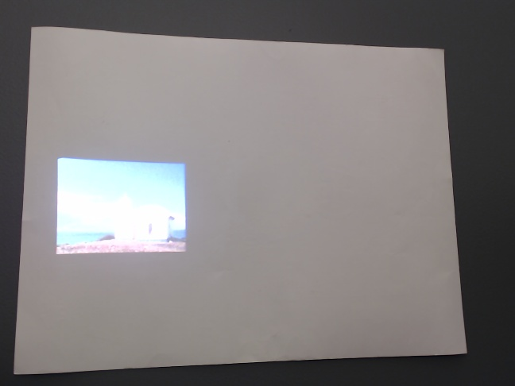
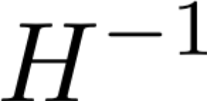
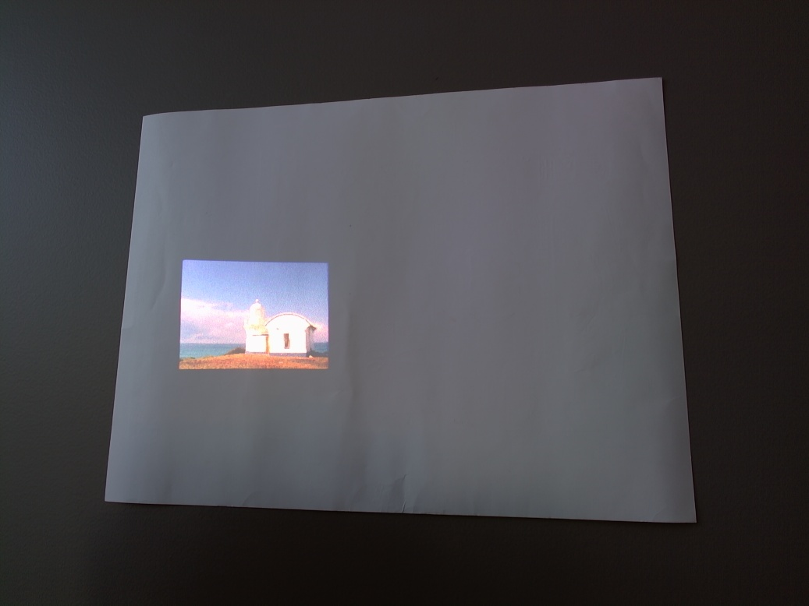
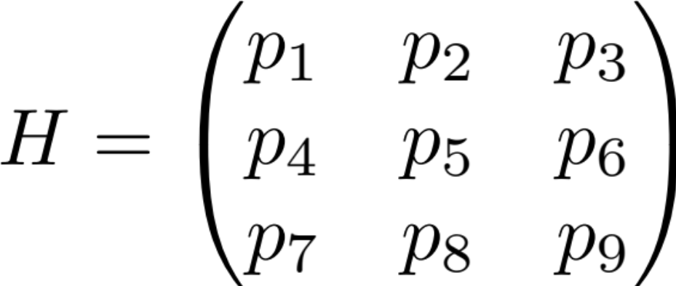
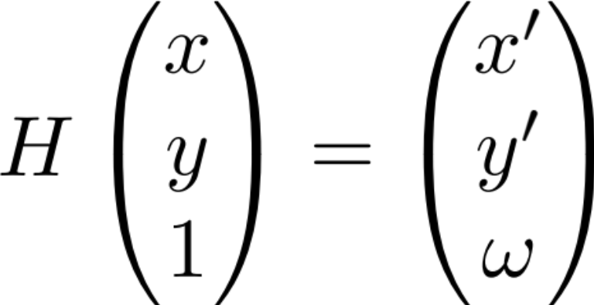
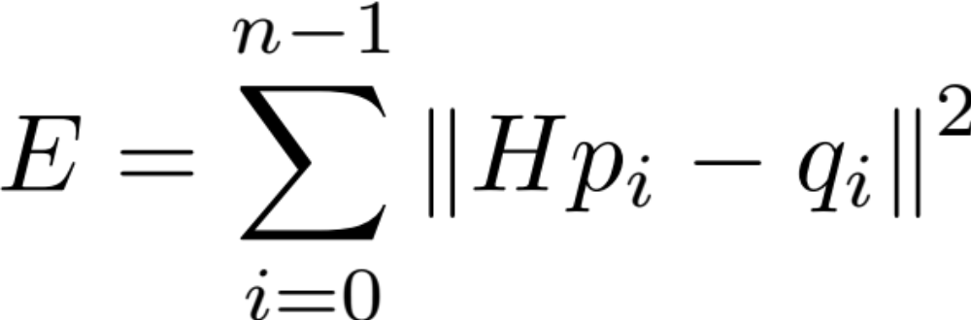
Automated Anamorphic Projections on Planar Surfaces
Van Mai Nguyen Thi, Keith O’Hara*, and James Belk§
*Computer Science Department, Bard College, Annandale-on-Hudson NY 12504
§Mathematics Department, Bard College, Annandale-on-Hudson NY 12504
Introduction
Experimental Setup
Two-View Model
An anamorphic projection is an image that is intentionally distorted so that the original image can be seen only from a certain perspective, or using a special device, for example a mirror. The origins of anamorphosis can be traced back to the 16th century art, but beyond the aesthetic values, anamorphosis has found its uses in many practical settings, such as road signs and keystone correction.
Projection Screen
Camera 1 image
Original image
Camera 2 image
Example of anamorphosis in street art:
Camera 1
Camera 2
Projector
Make Poverty History by Julian Beever
Planar Anamorphosis Model
Projector image
This project applies computer vision techniques to create a program that automates the process of generating anamorphic projections. We use a projector­camera system to derive homography mappings between the projector image and the projection surface, and propose a method for generating an optimal anamorphic image for multiple viewers using the least­squares estimation.
The error function:
Project a chessboard pattern.
Find the chessboard corners in the camera image.
Preliminary Results:
Homography
Projector Image
Camera Image
Estimate homography H using the least squares method.
Apply H⁻¹ to the original image to warp it.
Warped image
Project the warped image. Now the camera should see it correctly.
Result in Camera 1
Result in Camera 2
A homography, or projective transformation, is a transformation of a two-dimensional image I to another two-dimensional image I′ (called the anamorphic image), such that all lines in I are preserved in I′.
The error function:
n – number of point correspondences
H – projector-camera homography
p_{i} – original chessboard corners
q_{i} – chessboard corners detected in the camera image
Future Work
Generate anamorphic images that can be projected on more complex surfaces such as multi-planar and curved surfaces.
Improve the optimization for multiple-viewer system.
Explore other types of anamorphosis such as mirror anamorphosis.
Sukthankar, R., et al. Smarter Presentations: Exploiting Homography in Camera-Projector Systems. International Conference on Computer Vision, 2001.

