Slide 1

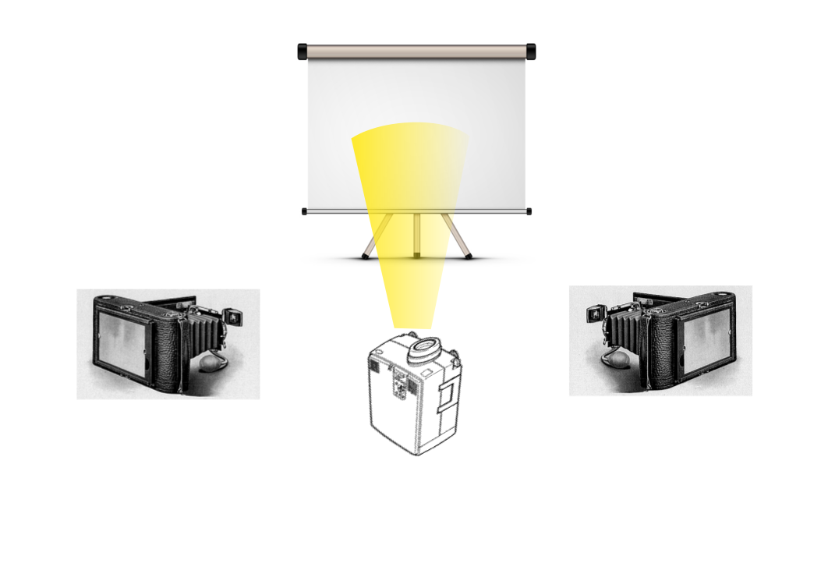




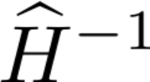

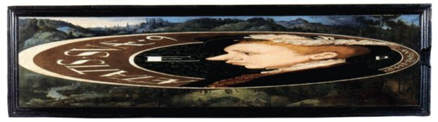


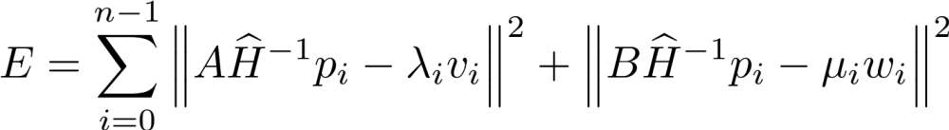

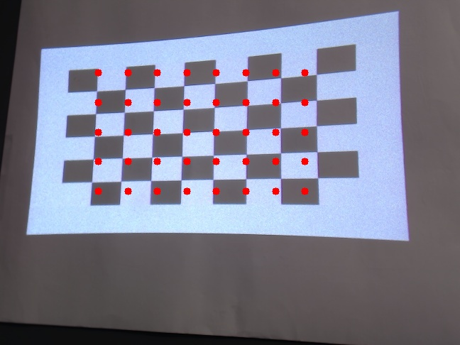
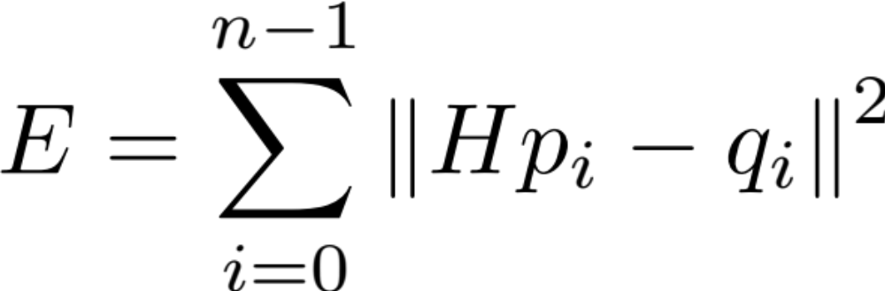
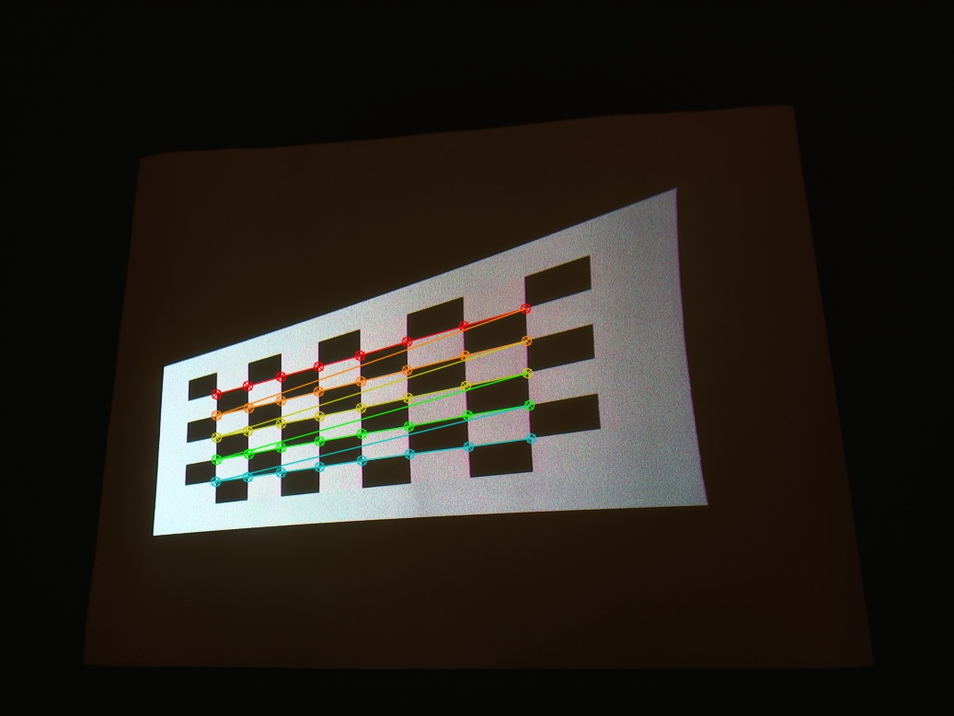
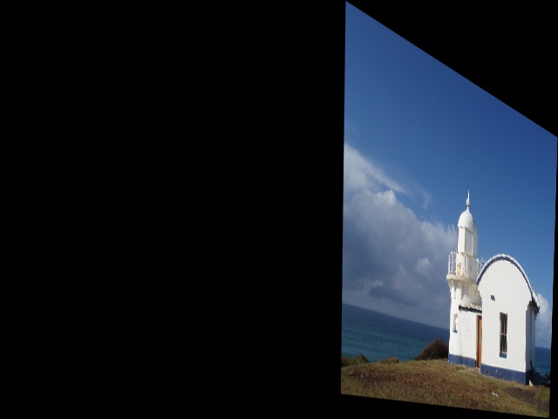

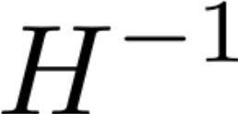
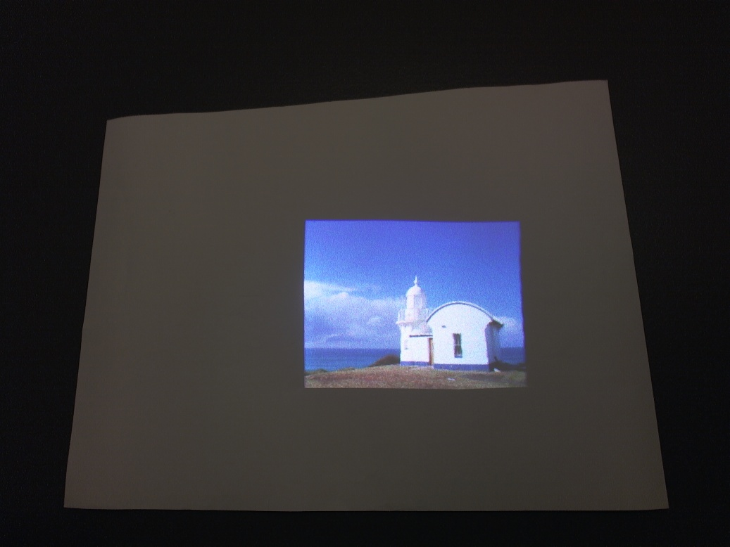
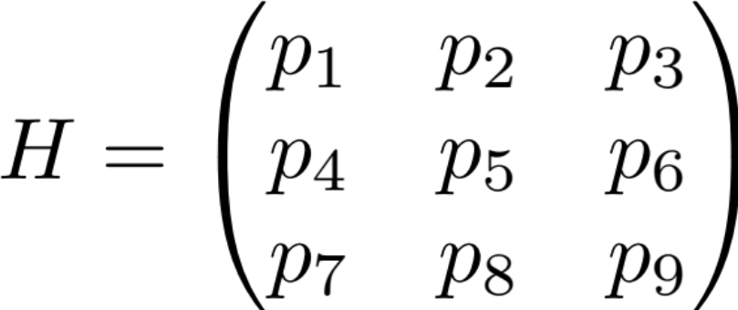
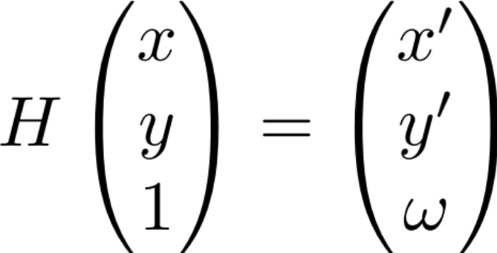

Development and Optimization of a Two-View Model for
Anamorphic Projections on Planar Surfaces
Van Mai Nguyen Thi, Keith O’Hara*, and James Belk§
*Computer Science Department, Bard College, Annandale-on-Hudson NY 12504
§Mathematics Department, Bard College, Annandale-on-Hudson NY 12504
Introduction
Experimental Setup
Two View Model
An anamorphic projection is an image that is intentionally distorted so that the original image can be seen only from a certain perspective, or using a special device, for example a mirror. The origins of anamorphosis can be traced back to the 16th century art, but beyond the aesthetic values, anamorphosis has found its uses in many practical settings, such as road signs and keystone correction.
Projection Screen
Camera 1 image
Original image
Camera 2 image
Example of anamorphosis:
Camera 1
Projector
Camera 2
(2-View Model)
Single View Model
Projector image
p_{i} – original chessboard corners
v_{i} – chessboard corners in camera 1
w_{i} – chessboard corners in camera 2
λ_{i}, μ_{i} – scaling factors
Projection surface (S)
The error function:
Anamorphic portrait of Edward VI by William Scrots
To view this correctly, stand close and look from the right-hand side.
This project applies computer vision techniques to create a program that automates the process of generating anamorphic projections. We use a projector­camera system to derive homography mappings between the projector image and the projection surface, and propose a method for generating an optimal anamorphic image for multiple viewers using the least­squares estimation.
Outline of the algorithm
Project a chessboard pattern.
Find the corners of the chessboard in Camera 1 and Camera 2 images.
Estimate the projector-camera homography (A and B) for each camera, using the same method as in the Single View Model.
Camera image (C)
Projector image (P)
Homography
The error function:
n – number of point correspondences
H – projector-camera homography
p_{i} – original chessboard corners
q_{i} – chessboard corners detected in the camera image
Definition. (Homogeneous point) Let P be a finite point in n dimensions, and (x₁, x₂, ..., x_{n}) be its representation in Cartesian coordinates. A homogeneous representation of point P is any (n + 1)-tuple (ωx₁, ωx₂, ..., ωx_{n}, ω), where ω ≠ 0.
The last coordinate ω is called the homogeneous coordinate. A homogeneous representation of a finite point has a non-zero homogeneous coordinate, and a point at infinity has a zero homogeneous coordinate.
Definition. A homography is a transformation of a two-dimensional image I to another two-dimensional image I′ such that all straight lines in I are preserved in I′. It can be represented as a 3 × 3 matrix.
Choose a target chessboard pattern for each camera.
Estimate the homography H and its inverse H􏰐⁻¹ that map between the original image and the projector image, and minimize the difference in the observed chessboard corners and the target chessboard corners for each camera.
Prepare (resize and reposition) the pre-anamorph.
Generate the anamorph by warping the pre-anamorph with the homography H􏰐⁻¹.
In this step we encountered an issue, possibly due to ill-conditioned matrices.
Outline of the algorithm
Project a chessboard pattern.
Find the chessboard corners in the camera image.
Projector Image
Camera Image
Estimate homography H using the least squares method.
Apply H⁻¹ to the original image to warp it.
Future Work
Improve the optimization for multiple-viewer system.
Generate anamorphic images that can be projected on more complex surfaces such as multi-planar and curved surfaces.
Introduce a method for measuring the accuracy of the resulting anamorphic image, for example by applying the estimated homography on a chessboard pattern. This is especially relevant in the two view model.
Explore other types of anamorphosis such as mirror anamorphosis.
Result:
Project the warped image.
Now the camera should see it correctly.
Acknowledgement
Bard College, Department of Mathematics and Computer Science

