Slide 1
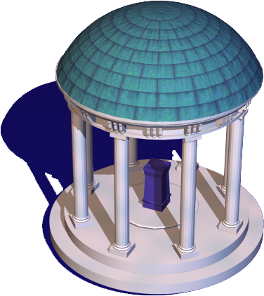
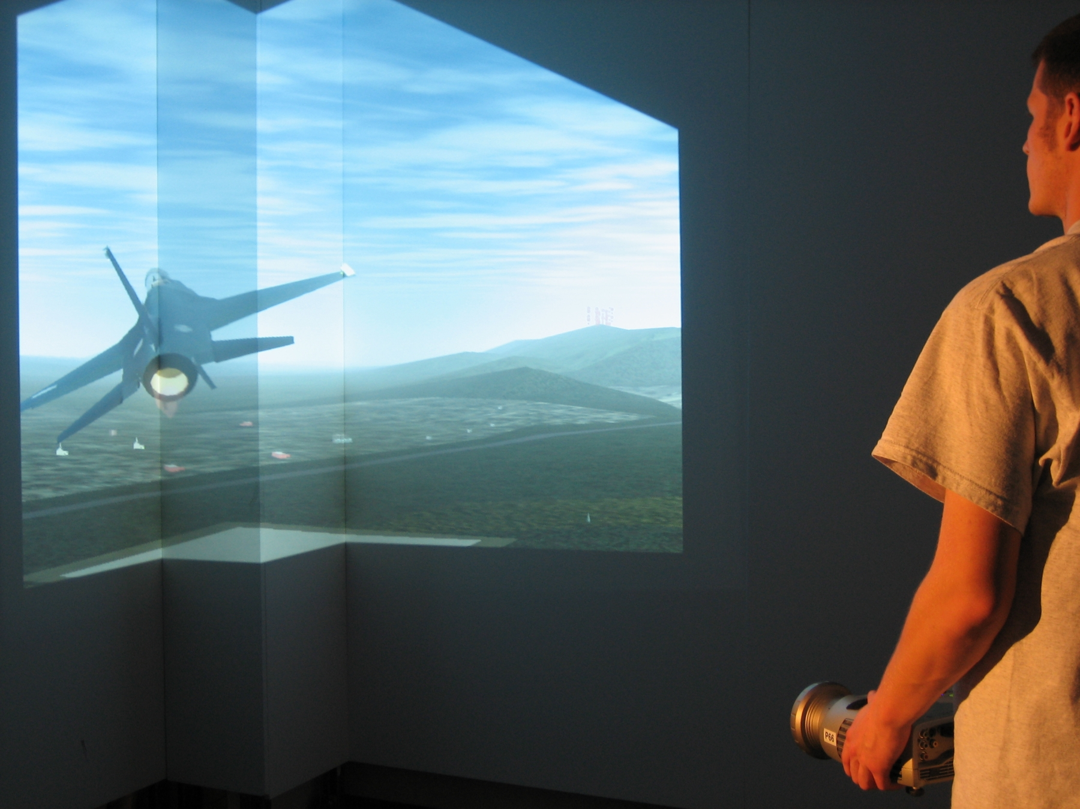
Real-Time Projector Tracking on Complex Geometry Using Ordinary Imagery
Tyler Johnson and Henry Fuchs
University of North Carolina – Chapel Hill
ProCams June 18, 2007 - Minneapolis, MN

Slide 2
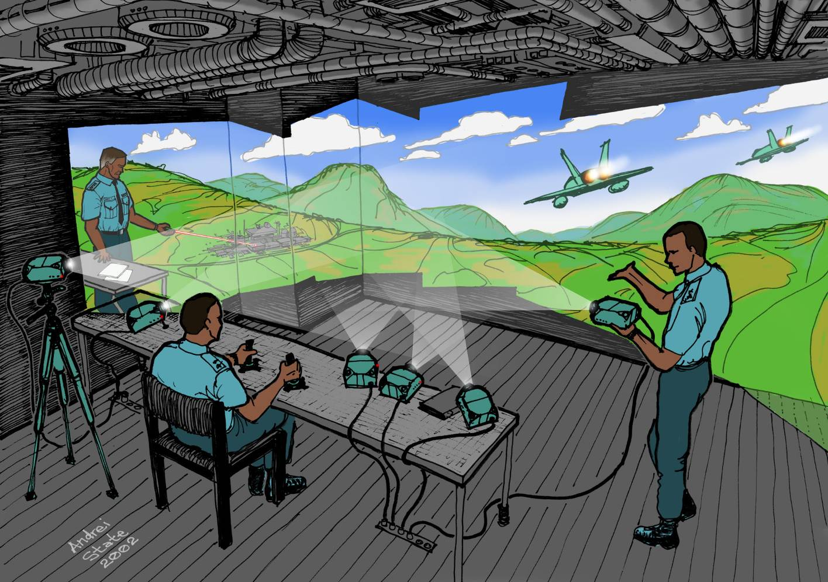
Multi-Projector Display

Slide 3
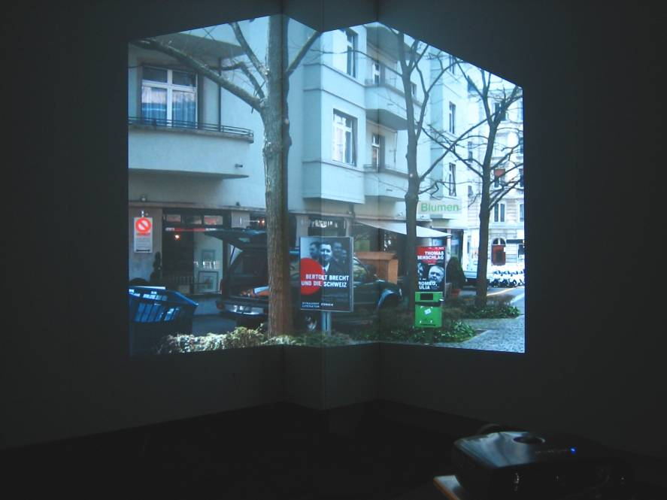
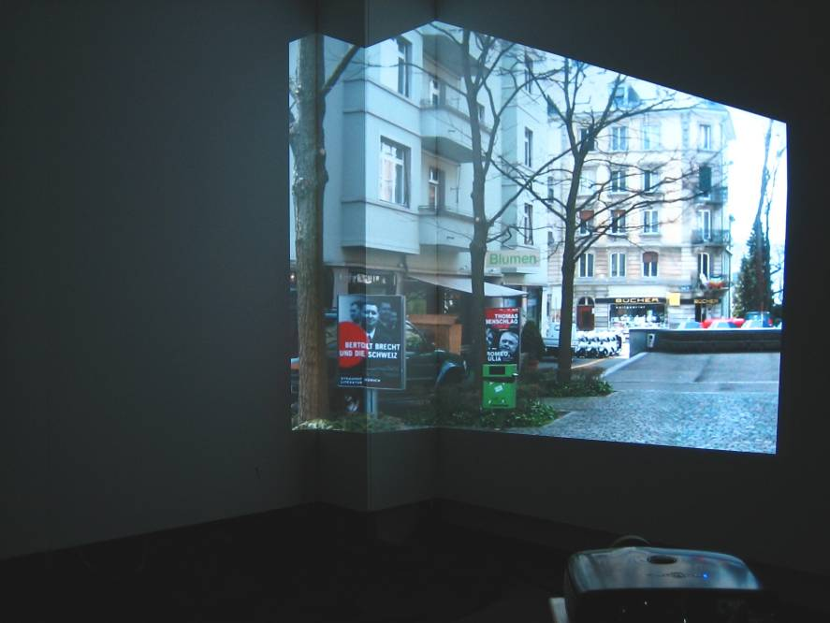

Dynamic Projector Repositioning
Make new portions of the scene visible

Slide 4
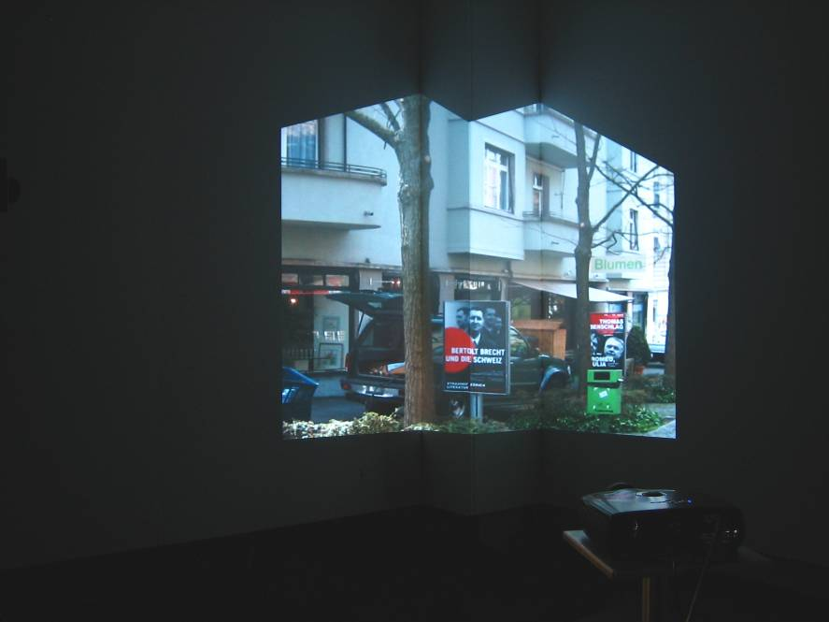
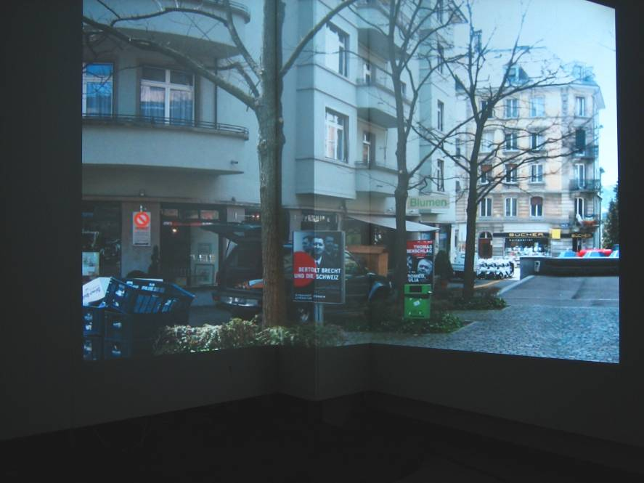
Dynamic Projector Repositioning (2)
Increase spatial resolution or field-of-view

Slide 5
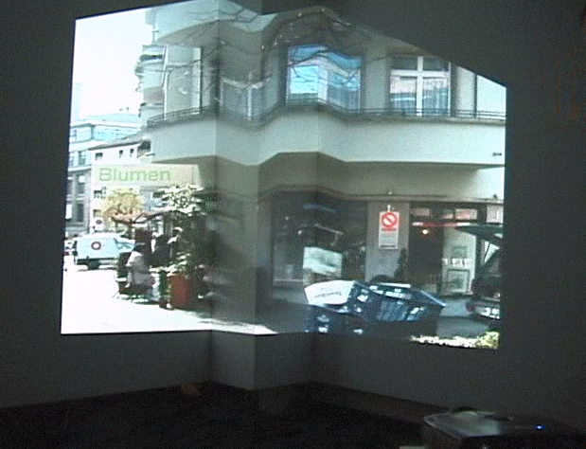
Dynamic Projector Repositioning
Accidental projector bumping

Slide 6
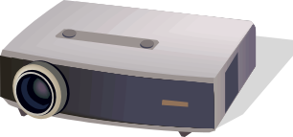
Goal
Given a pre-calibrated projector display, automatically compensate for changes in projector pose while the system is being used

Slide 7
Previous Work
Online Projector Display Calibration Techniques
Class | Active | Passive
Technique | Embedded Imperceptible Structured Light | Unmodified Imagery, Fixed Fiducials
References | Cotting04-05 | Raskar03, Yang01

Slide 8

Our Approach
Projector pose on complex geometry from unmodified user imagery without fixed fiducials
  Rely on feature matches between projector and stationary camera.

Slide 9


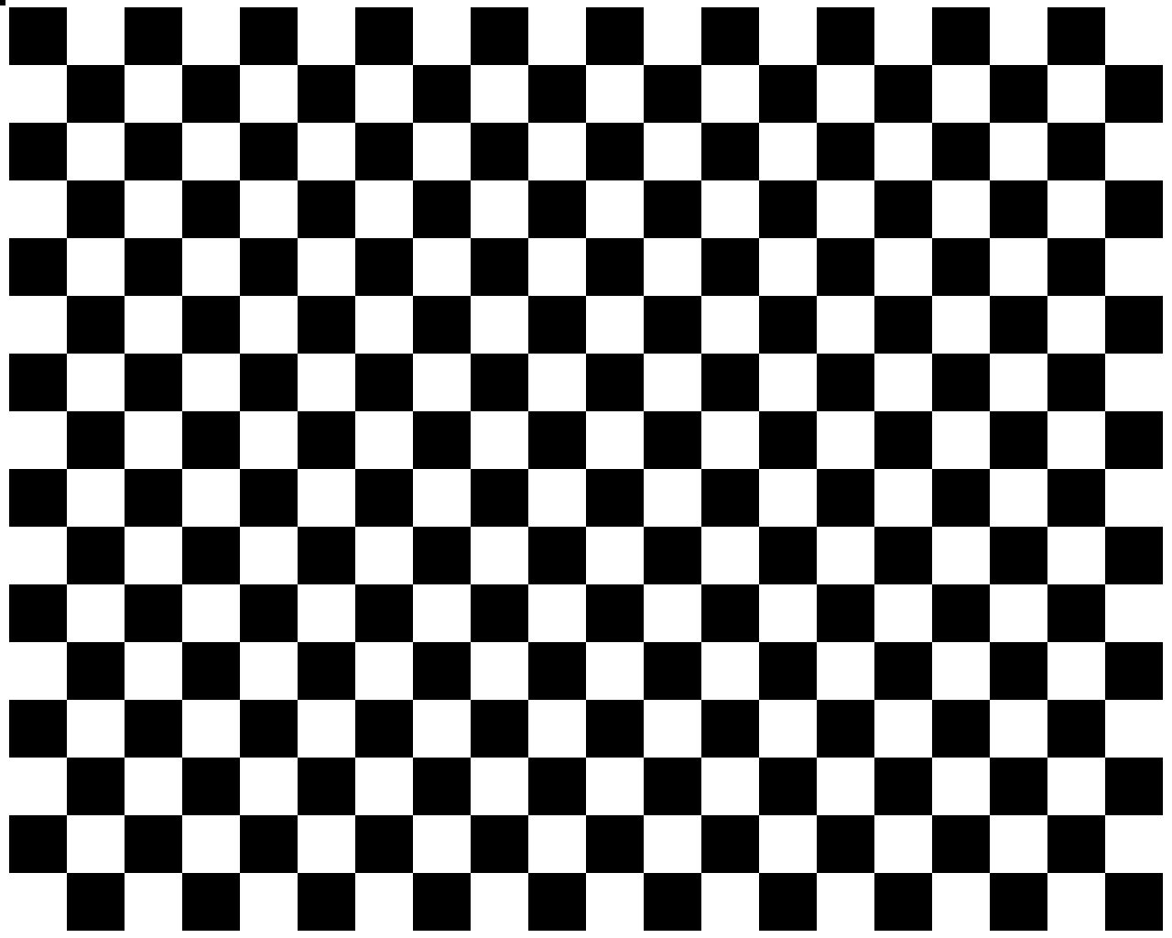
Overview
Upfront
  Camera/projector calibration
  Display surface estimation
At run-time in independent thread
  Match features between projector and camera
  Use RANSAC to identify false correspondences
  Use feature matches to compute projector pose
  Propagate new pose to the rendering

Slide 10
Projector Pose Computation
Display Surface
Camera
Projector

Slide 11
Difficulties
Projector and camera images are difficult to match
  Radiometric differences, large baselines etc.
No guarantee of correct matches
No guarantee of numerous strong features

Slide 12
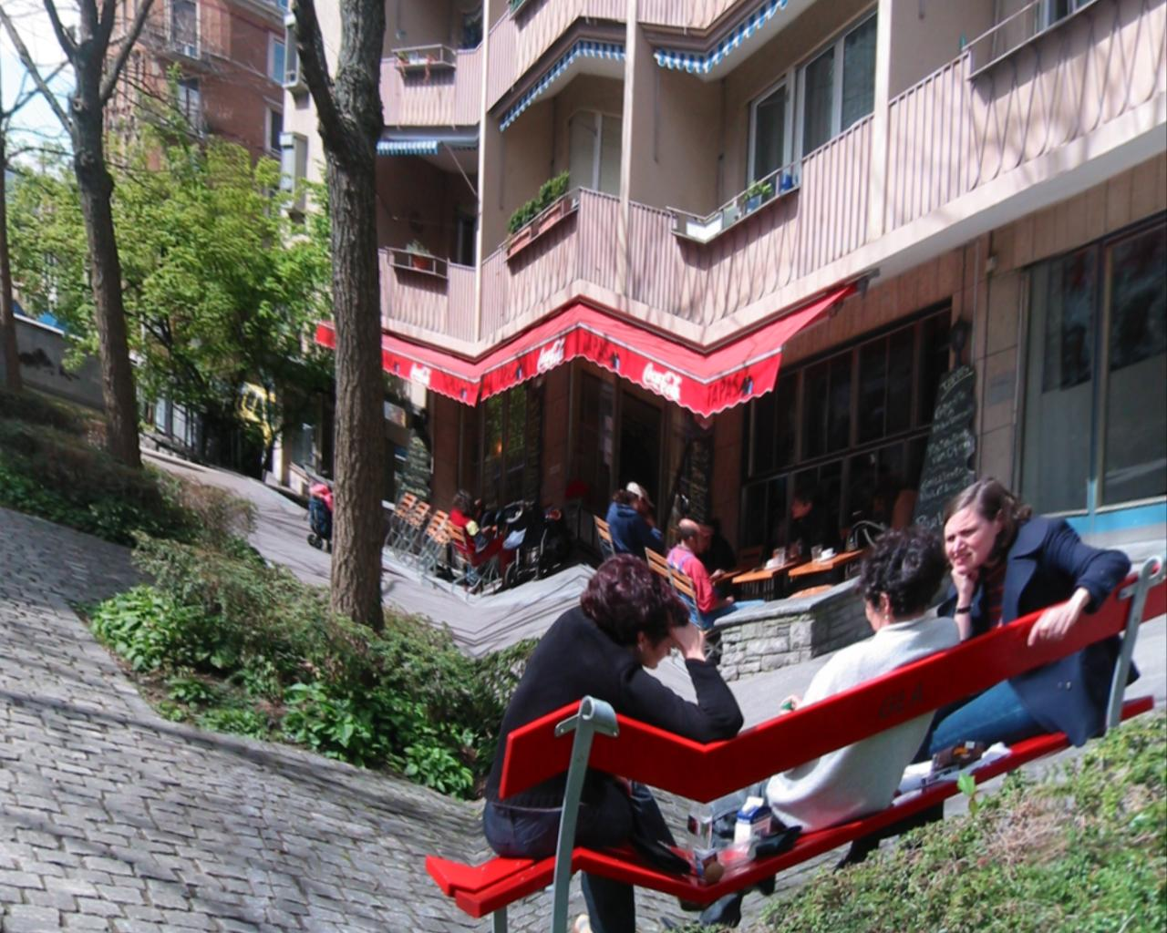
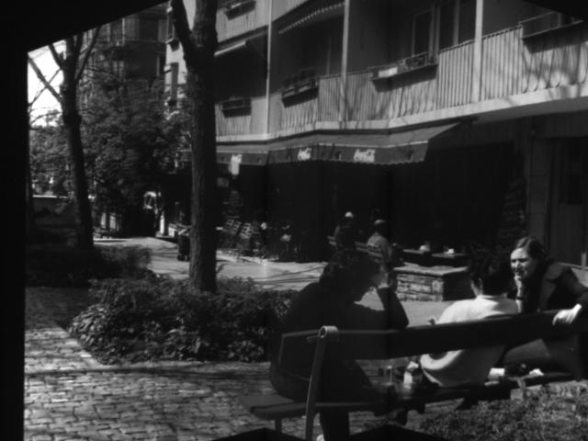
Feature Matching
P
Projector Image
Camera Image

Slide 13

Feature Matching Solution
Predictive Rendering
Projector Image
Camera Image
Prediction Image

Slide 14






Predictive Rendering
Account for the following
  Projector transfer function
  Camera transfer function
  Projector spatial intensity variation
    How the brightness of the projector varies with FOV
  Camera response to the three projector primaries
Calibration
  Project a number of uniform white/color images
    see paper for details

Slide 15
Predictive Rendering Steps
Two steps:
  Geometric Prediction
    Warp projector image to correspond with the camera’s view of the imagery
  Radiometric Prediction
    Calculate the intensity that the camera will observe at each pixel

Slide 16
Step 1: Geometric Prediction
Two-Pass Rendering
  Camera takes place of viewer
Display Surface
Camera
Projector

Slide 17
Step 2: Radiometric Prediction
Pixels of the projector image have been warped to their corresponding location in the camera image.
Now, transform the corresponding projected intensity at each camera pixel to take into account radiometry.

Slide 18

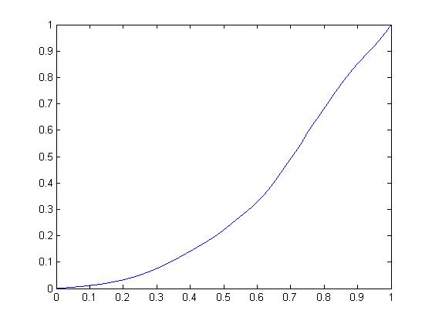

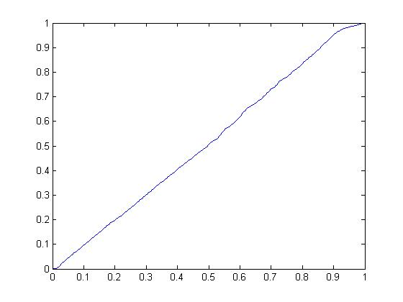
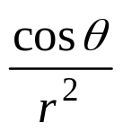
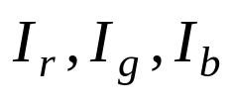
Radiometric Prediction (2)
Predicted Camera Intensity
(i)
Projector Intensity
(r,g,b)
Projector Image
Prediction Image
Projector Response
Projector Intensity
Spatial Intensity Scaling
Surface Orientation/Distance
Camera Response
r
θ
Proj. COP

Slide 19
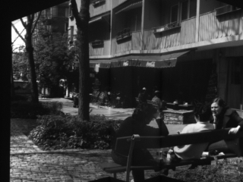
Prediction Results
Captured Camera Image
Predicted Camera Image

Slide 20
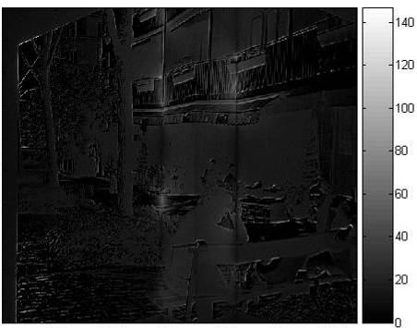
Prediction Results (2)
Error
  mean - 15.1 intensity levels
  std - 3.3 intensity levels
Contrast Enhanced Difference Image

Slide 21
Video

Slide 22
Implementation
Predictive Rendering
  GPU pixel shader
Feature detection
  OpenCV
Feature matching
  OpenCV implementation of Pyramidal KLT Tracking
Pose calculation
  Non-linear least-squares
    [Haralick and Shapiro, Computer and Robot Vision, Vol. 2]
    Strictly co-planar correspondences are not degenerate

Slide 23
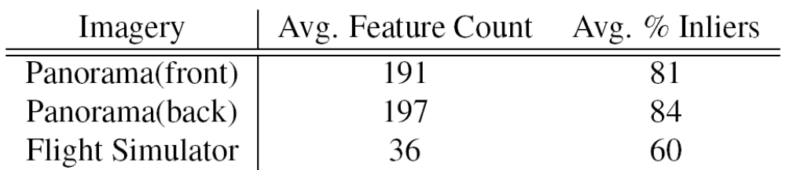
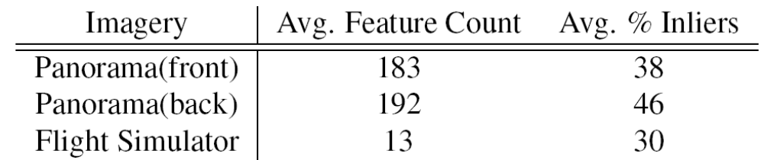
Matching Performance
Matching performance over 1000 frames for different types of imagery
  Max. 200 feature detected per frame
  Performance using geometric and radiometric prediction
  Performance using only geometric prediction

Slide 24
Tracking Performance
Pose estimation at 27 Hz
  Commodity laptop
    2.13 GHz Pentium M
    NVidia GeForce 7800 GTX GO
  640x480 greyscale camera
  Max. 75 feature matches/frame
Implement in separate thread to guarantee rendering performance

Slide 25
Contribution
New projector display technique allowing rapid and automatic compensation for changes in projector pose
  Does not rely on fixed fiducials or modifications to user imagery
  Feature-based, with predictive rendering used to improve matching reliability
  Robust against false stereo correspondences
  Applicable to synthetic imagery with fewer strong features

Slide 26
Limitations
Camera cannot be moved
Tracking can be lost due to
  Insufficient features
  Rapid projector motion
Affected by changes in environmental lighting conditions
Requires uniform surface

Slide 27
Future Work
Extension to multi-projector display
  Which features belong to which projector?
Extension to intelligent projector modules
  Cameras move with projector
Benefits of global illumination simulation in predictive rendering
  [Bimber VR 2006]

Slide 28
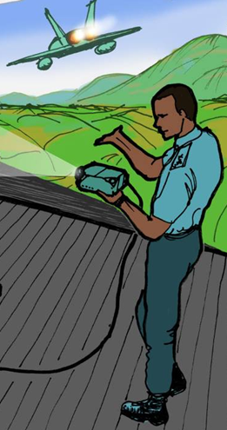
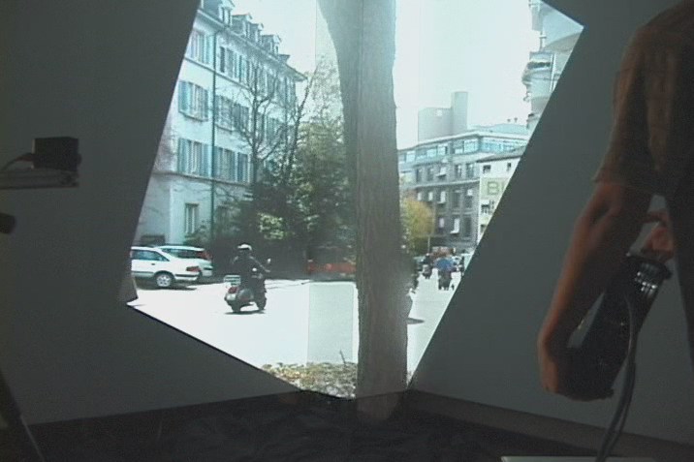
Thank You
Funding support: ONR N00014-03-1-0589
  DARWARS Training Superiority program
  VIRTE – Virtual Technologies and Environments program

