Slide 1
HACKATHON TECH ADRISHTA
Check & Mate
Team Number : 29

Slide 2
Team Members
Mayank Sunil Pagar
Annirudh VSP
Harsh Kumar Pandey

Slide 3
Introduction
We chose the problem Check & Mate due to our shared enthusiasm for chess as we have also started playing a lot of chess this lockdown. We also were thrilled to make an application that would help us get better at the game.
For this application we used the Flask Framework as it is a very lightweight and powerful tool for building web apps and we could also integrate the python backend, a language with which we are very comfortable with.

Slide 4
Project Overview
We have tried to create an application that helps chess players newbies and seasoned veterans alike to improve their game.
We have created a web app that allows the users to play against a bot and analyse their every move to get better.

Slide 5
Solution Description
We use the Stockfish Chess engine to provide the user with a bot with difficulty levels ranging from a 1200 rating bot to a Grandmaster Level bot.
The Web App shows various information regarding the game as it progresses like the current winning probability, Mistakes, Inaccuracies, Blunders and Also an option to get the best possible move at the given Board State.

Slide 6
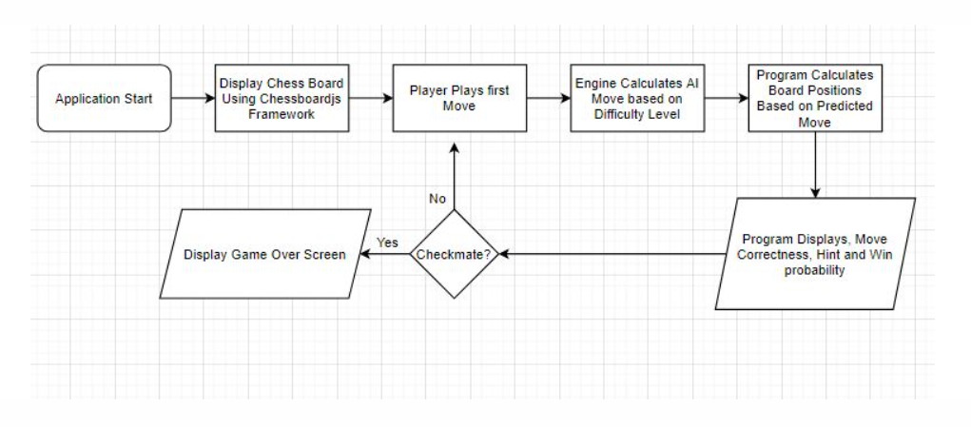
Architecture Diagram

Slide 7
Technical Description
Frontend
The frontend of this application is built with HTML, CSS and JavaScript. Integrating seamlessly with a very popular framework for drawing Chess boards, Chessboardjs (http://chessboardjs.com/)
The Web App shows various information regarding the game as it progresses like the current winning probability, Mistakes, Inaccuracies, Blunders and Also an option to get the best possible move at the given Board State.

Slide 8
Technical Description
Backend
For the backend, Flask was our best option as it allowed us to integrate a really powerful chess engine that is Stockfish
The Python Chess library was a cherry on top as it allowed us to manipulate the board and convert it into a FEN(Forsyth–Edwards Notation ).
After all the information is calculated it is then communicated through the flask framework to the frontend JavaScript and then displayed on the Page for the user to disseminate.

Slide 9
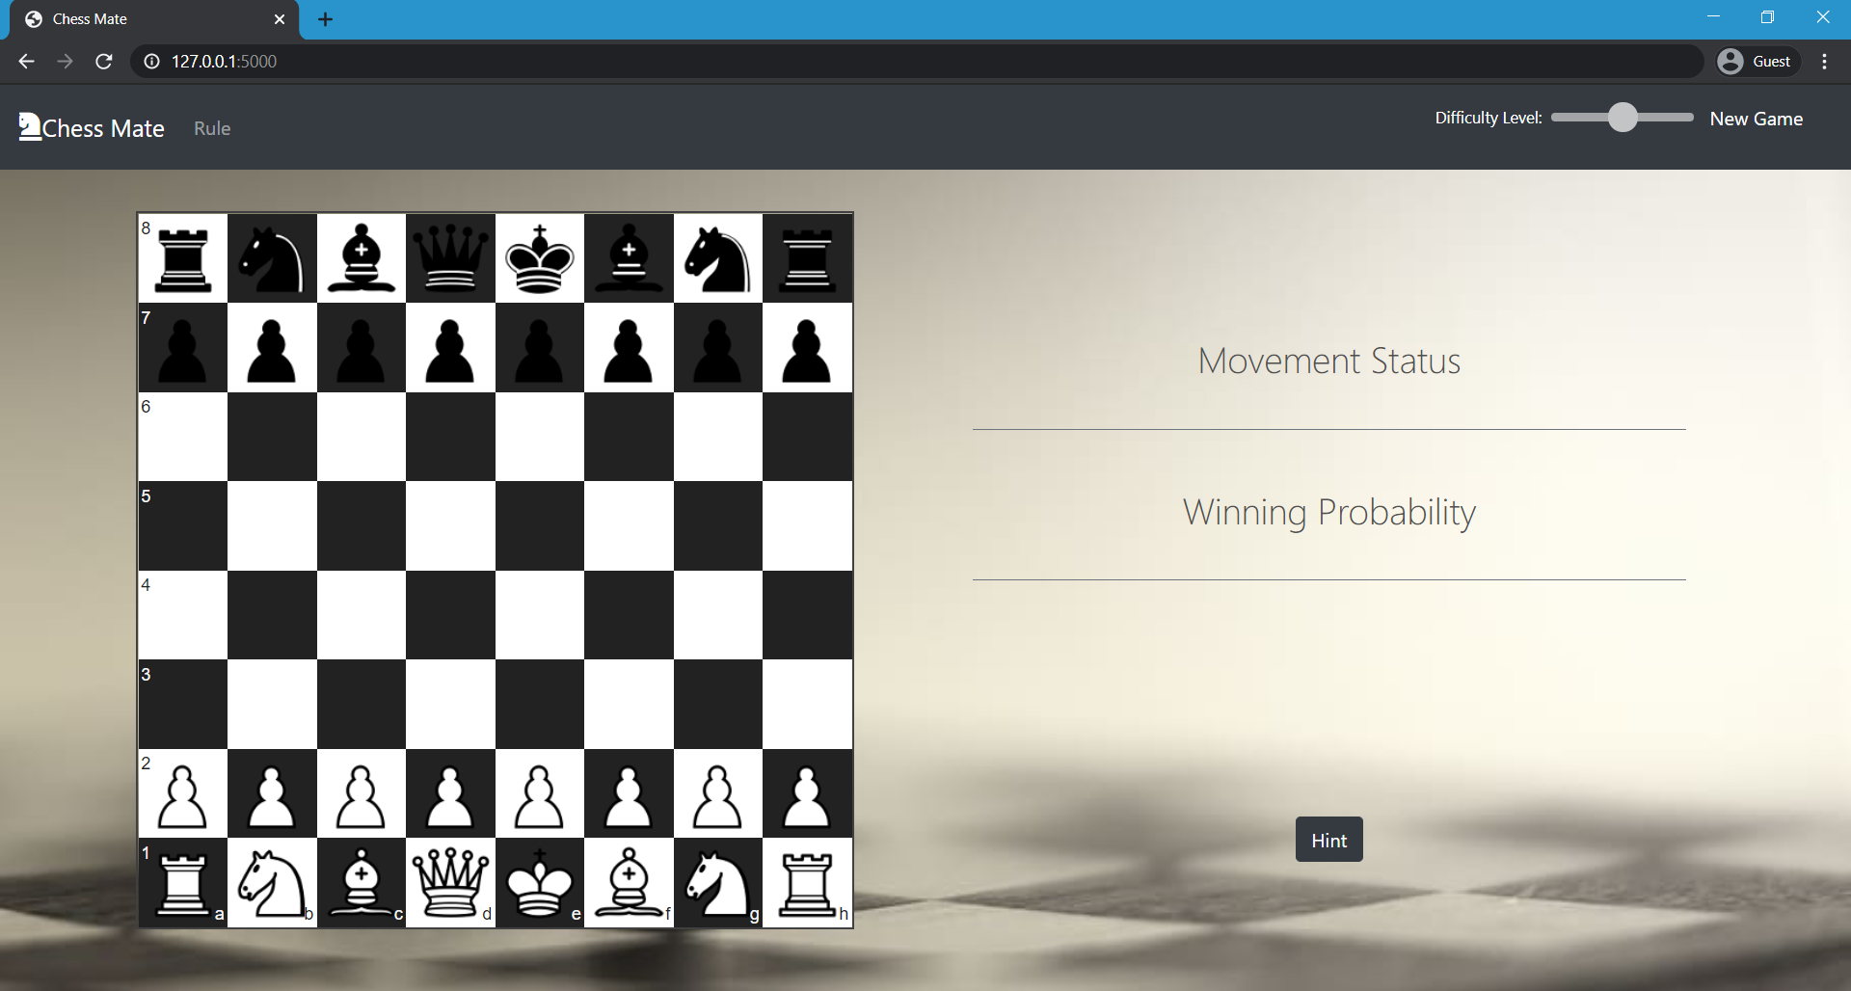
Screenshot

Slide 10
References
https://chessboardjs.com/ - for drawing the board
https://pypi.org/project/stockfish/ - for calculating and evaluating moves
https://pypi.org/project/chess/ - for Board Parsing and manipulation
https://www.chessprogramming.org/Pawn_Advantage,_Win_Percentage,_and_Elo - for providing very useful insights on calculating Win probability and Pawn Advantage

Slide 11
Thank You !

