Slide 1
ADHIVE
BY :- 21IT003 Mayank Asodariya

Slide 2
Agenda
Topics to be covered :-
Title
Definition
Technology Used
Roles and Responsibilities
Screenshots
Advantages

Slide 3
Definition
Adhive is an ad managing web application which provides ad analysis and other related services.
Our project aims to create a user-friendly web application that connects publishers, who have ad spaces available, with advertisers, who want to display their ads. The application allows publishers to manage their ad spaces and provides advertisers with tools to create and track ad campaigns. Additionally, the application offers analytics and reporting features to help both publishers and advertisers understand the performance of their ads.

Slide 4
Technology Description
The technology used is MERN stack which includes MongoDB , Express.js , React.js and Node.js
MongoDB :- Stores the data in BSON form so that it needs less space in compare to other DB services.
Express.js :- Helps to create strong and secure apps and server to communicate with databases.
React.js :- To create interactive front end and html components through which we can make Single page websites.
Node.js :- JavaScript runtime environment for server-side execution

Slide 5
Roles And Responsibilities
Patel Manav Jayeshbhai | Front End Team
Harsh Chandrakant Rana
Mayank Asodariya
Rabara Aryaan Jagdishkumar | Back End and Databse Team
Patel Aryan SaurabhKumar
Bodana Yuvrajsinh Dilipsinh

Slide 6
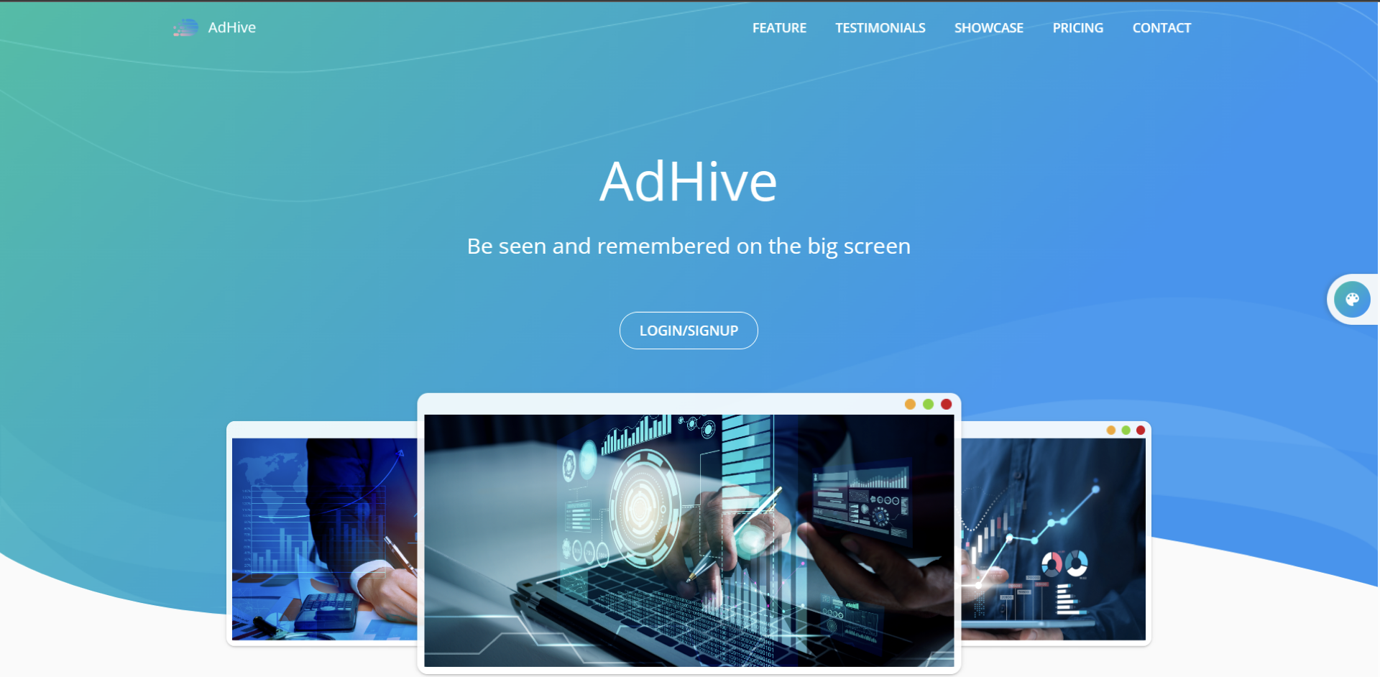
Screenshots of work done

Slide 7
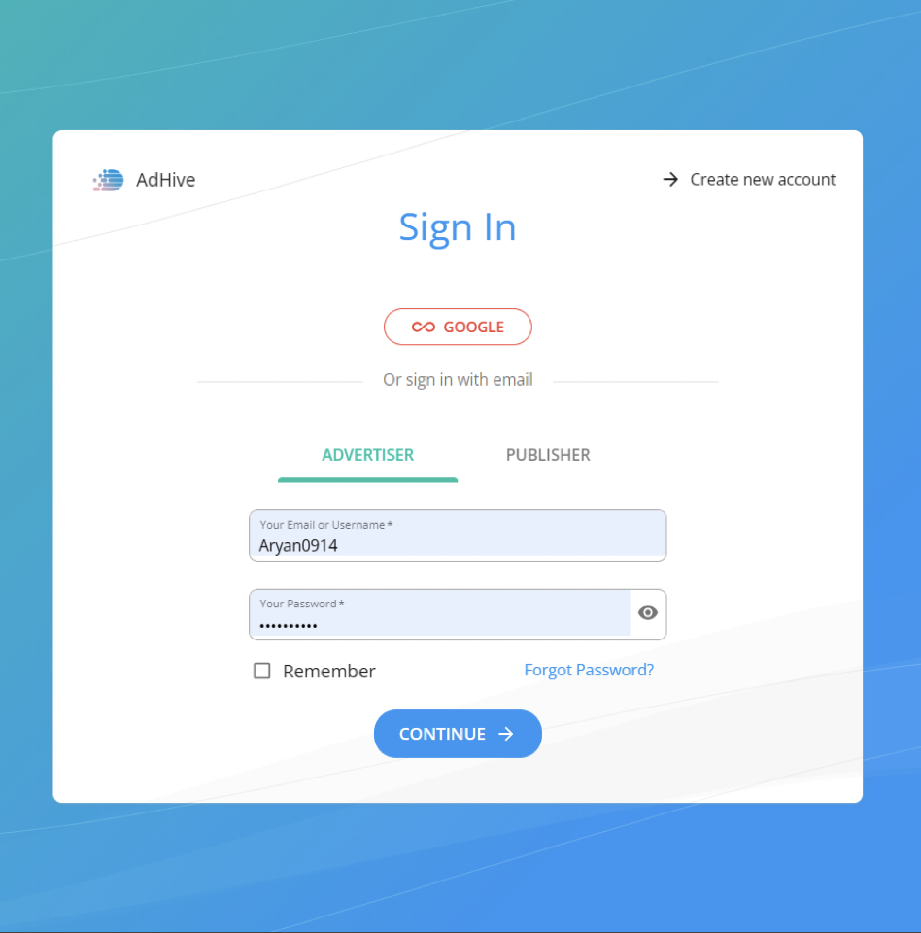

Slide 8
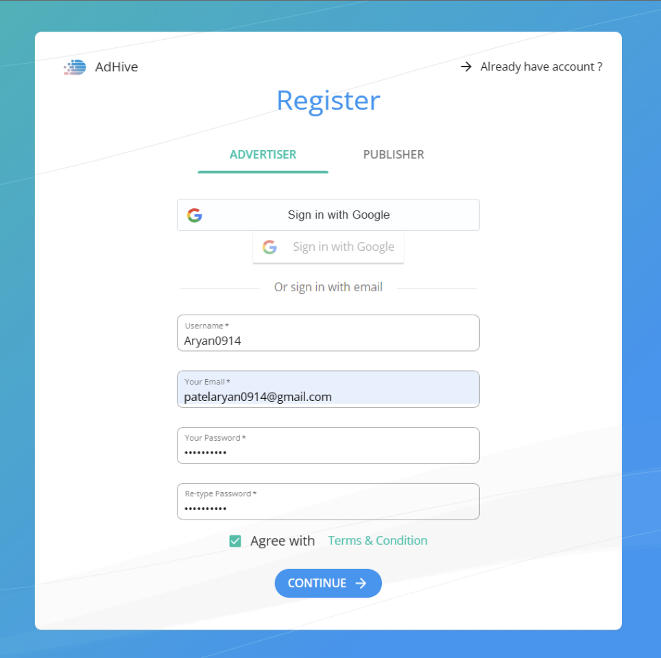

Slide 9
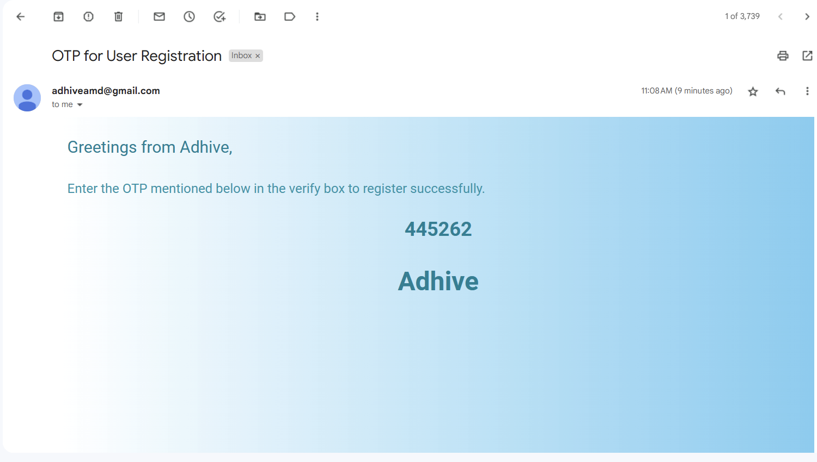

Slide 10
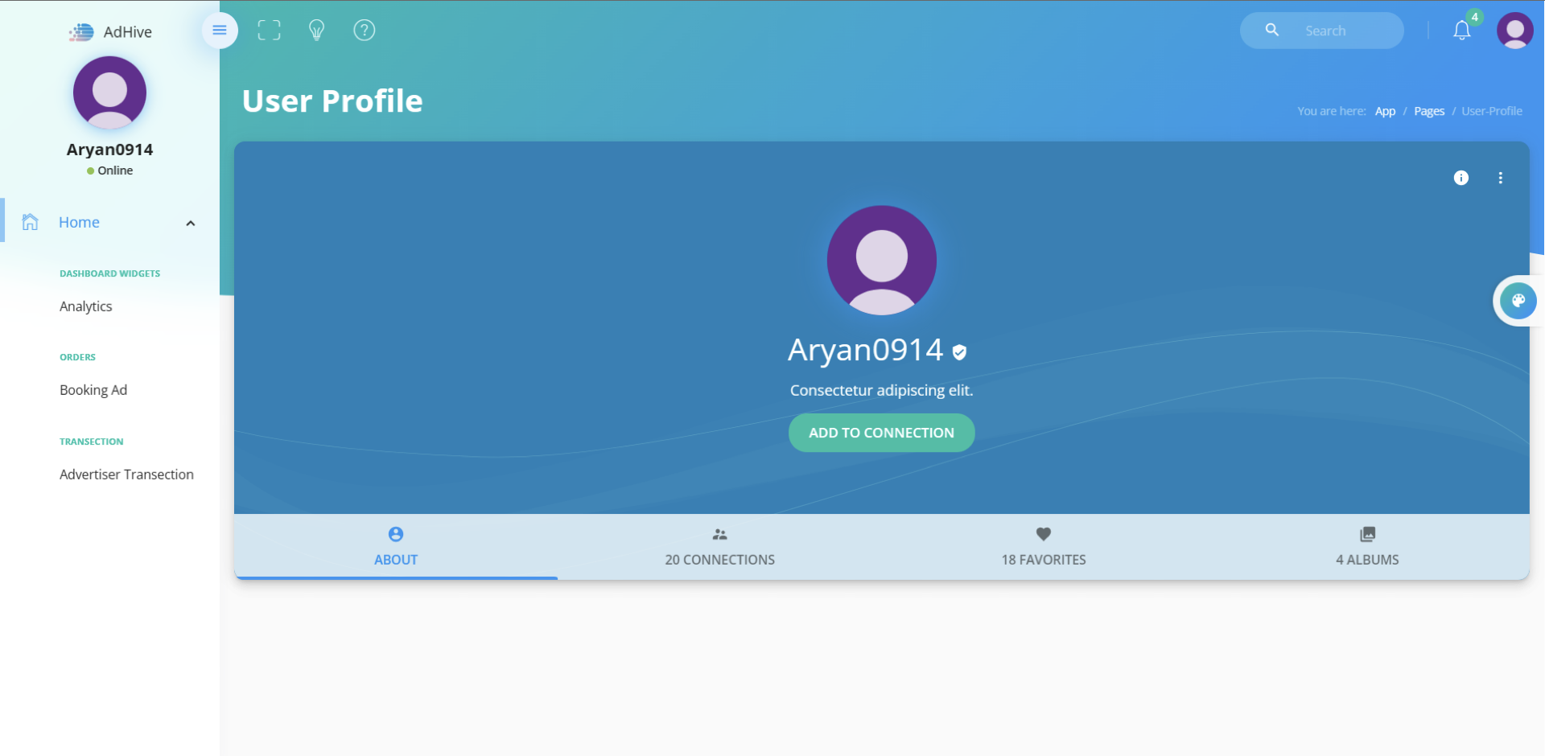

Slide 11
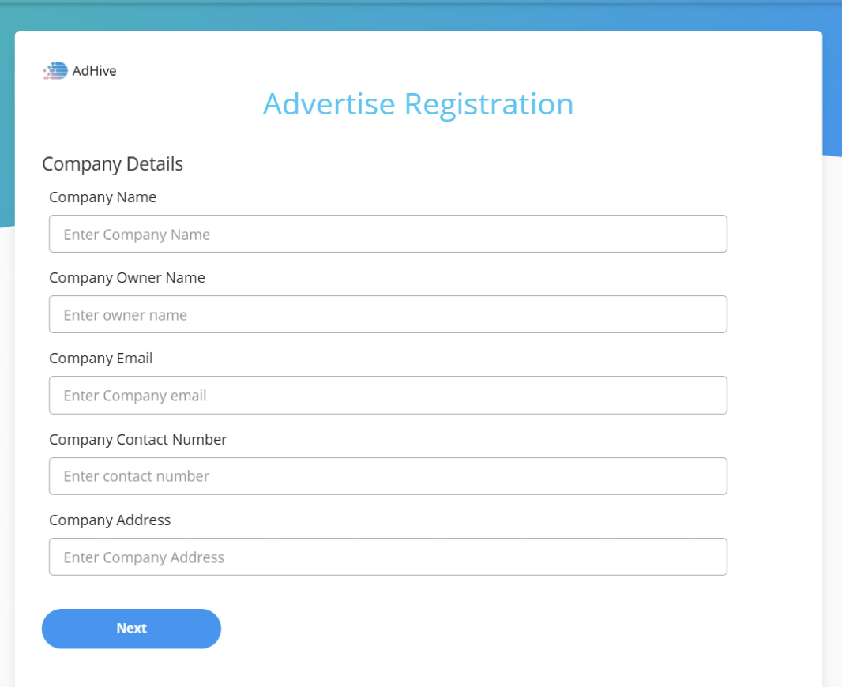
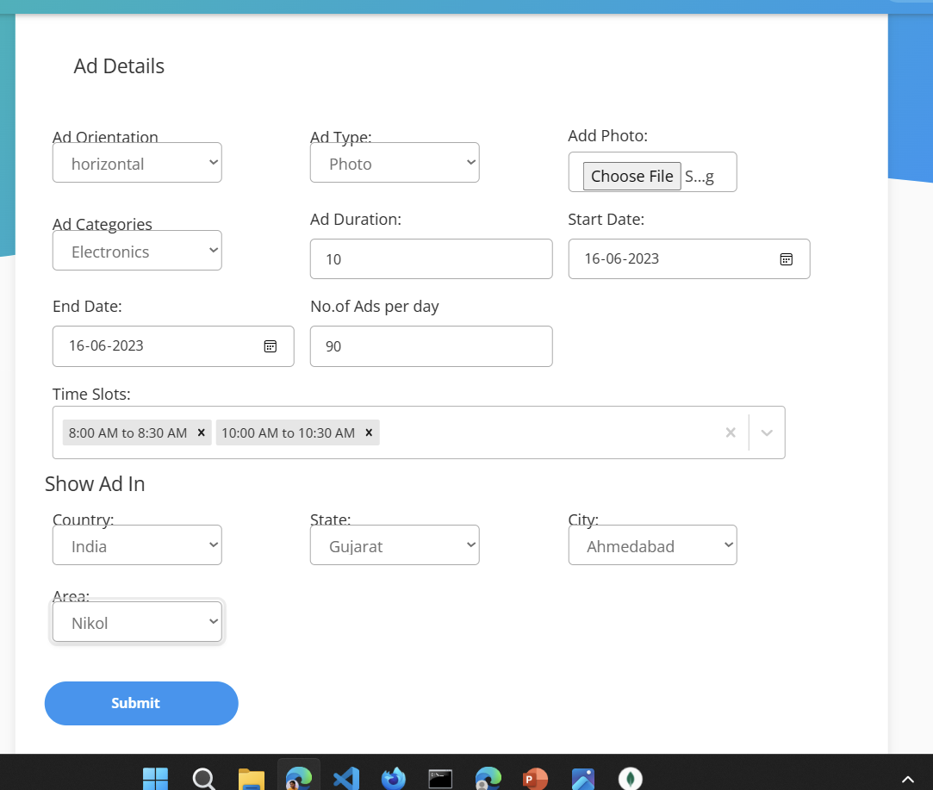

Slide 12
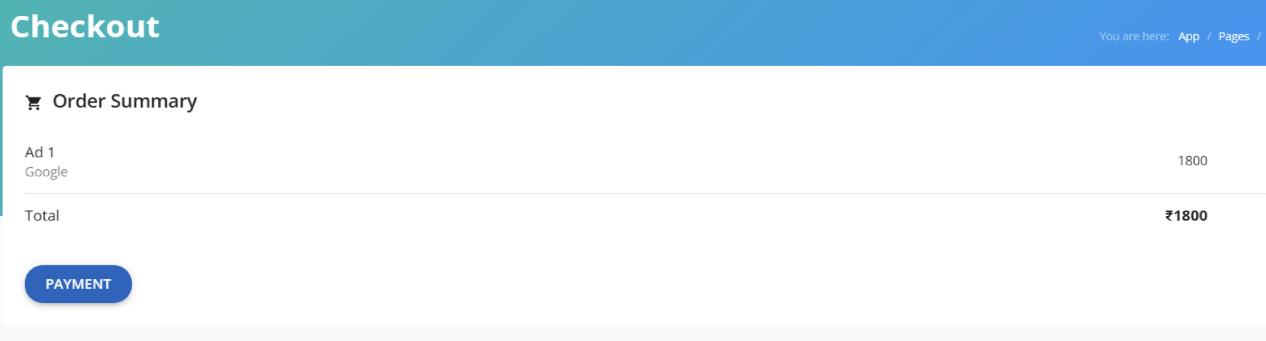

Slide 13
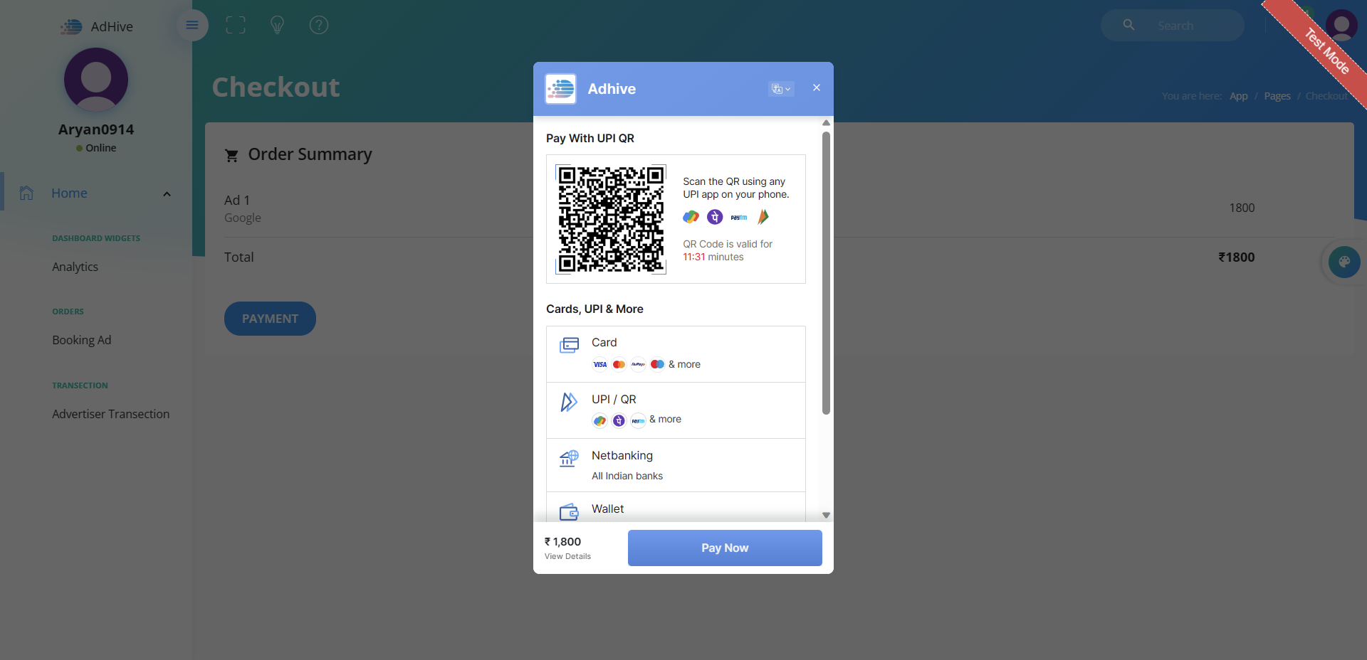

Slide 14
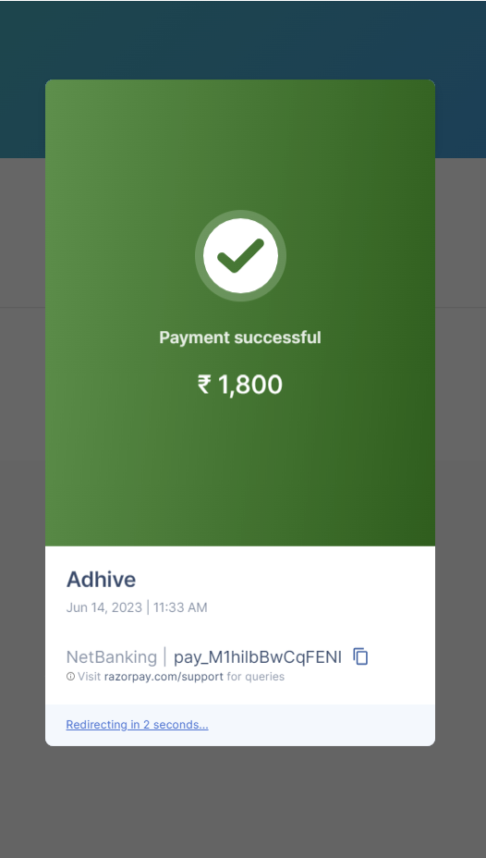
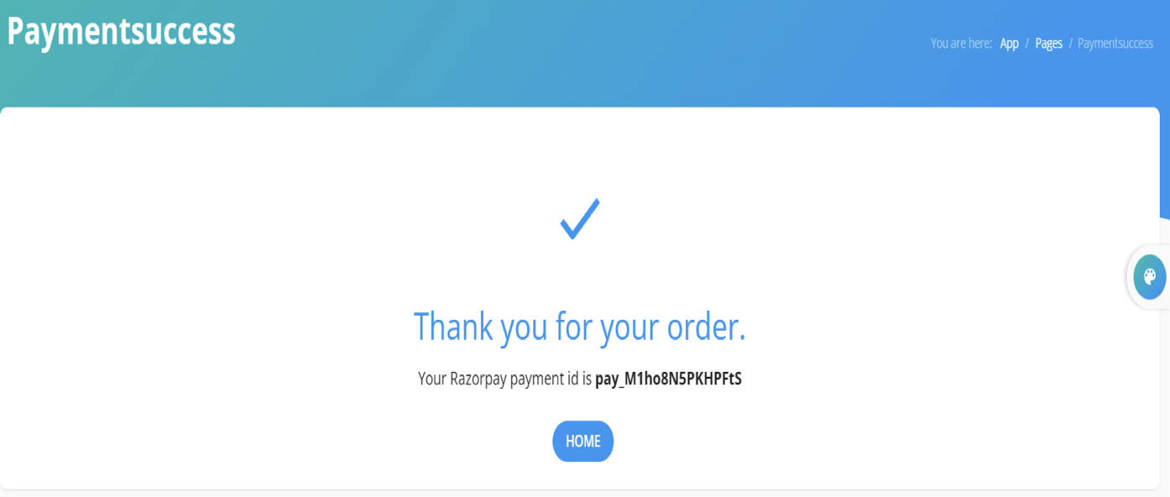

Slide 15
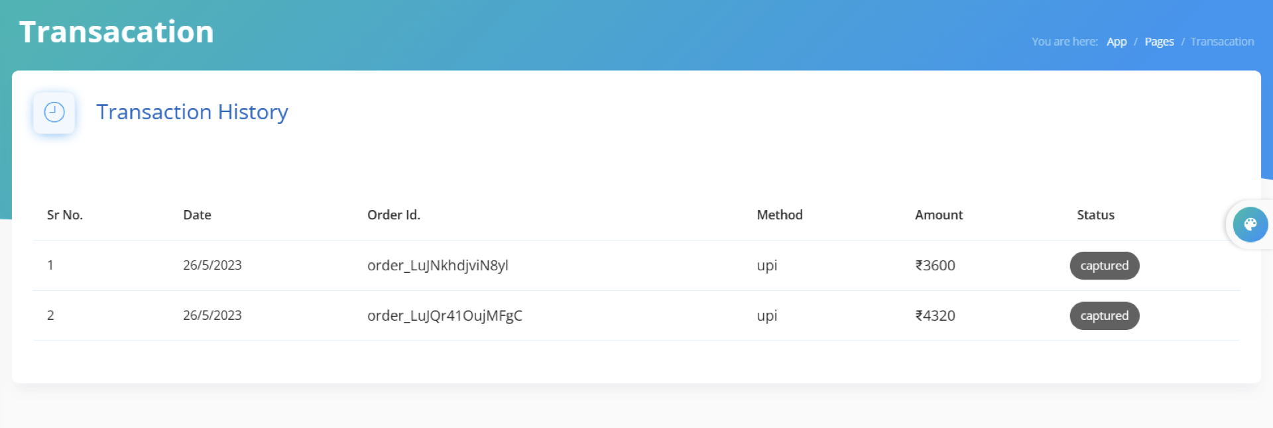

Slide 16
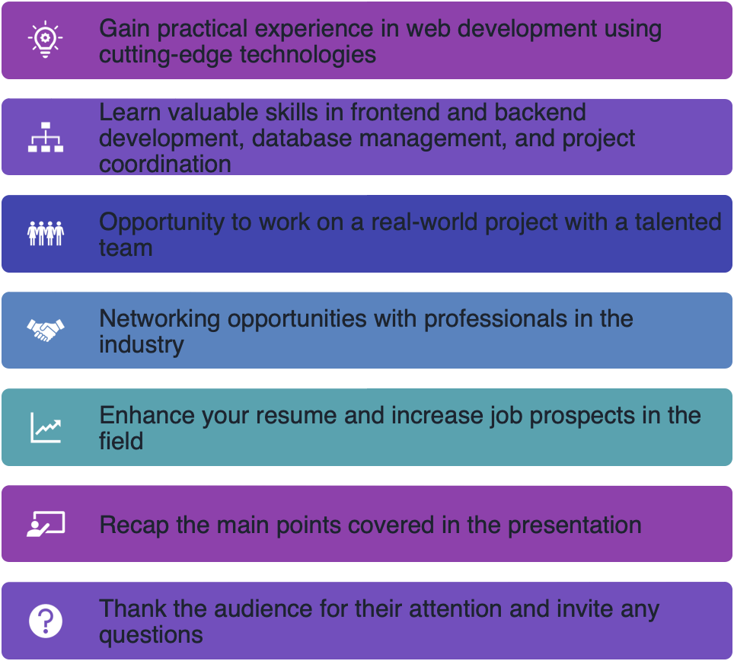
Advantages of
Taking an Internship

Slide 17


