Slide 1
DR Screening District Capacity Model
SimEvents operational capacity model for rural screening deployment
SIH 2026 demo package

Slide 2
Operational model architecture
Patient flow models capture, quality recapture, AI routing, review capacity, and deferred image sync.
Clinical performance remains external telemetry. The model evaluates operational queues and capacity only.
Patient arrivals
Camera queue
Quality recapture
AI routing
Review / auto-clear
Processed image copy
Local sync queue
Connectivity gate
Bandwidth server
District server

Slide 3
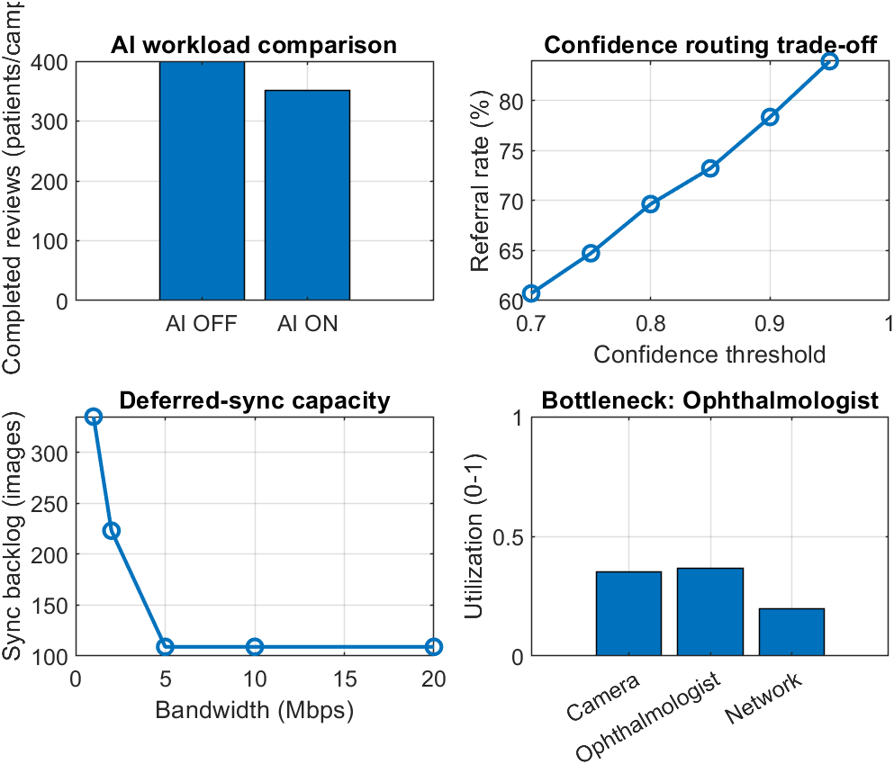
Current simulation summary

Slide 4
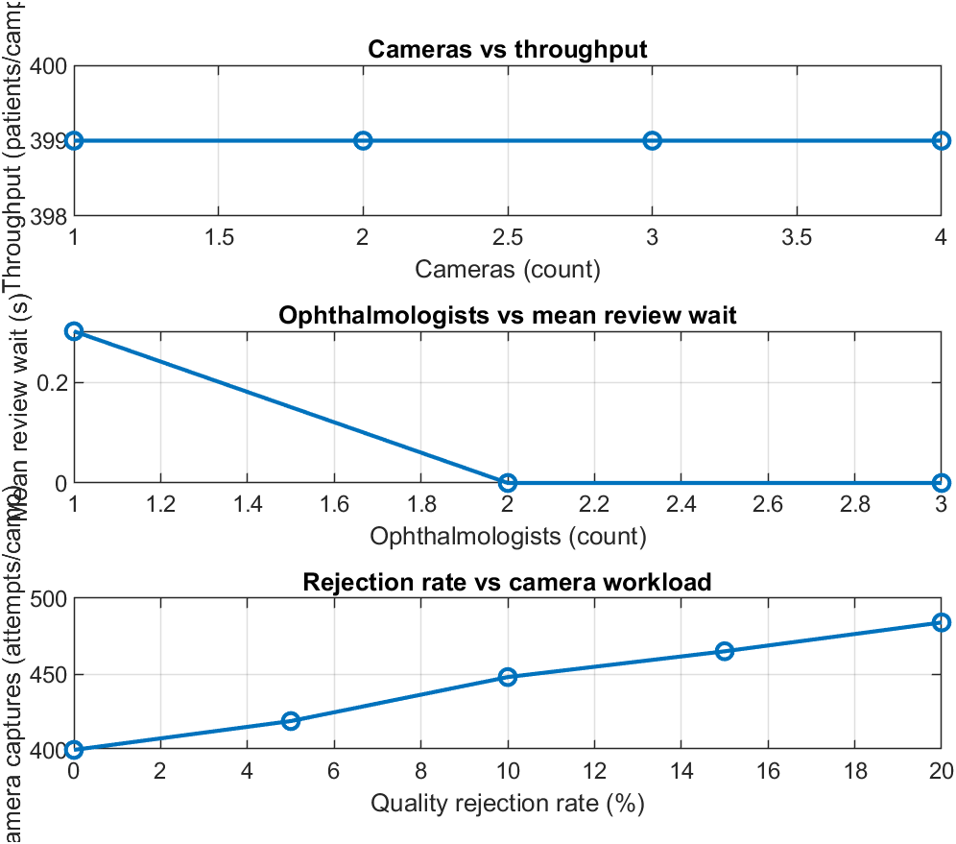
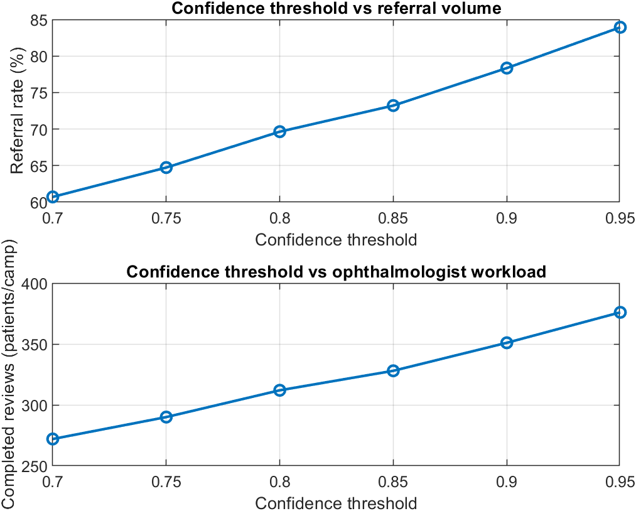
Confidence and quality scenarios
Higher routing threshold increases simulated referral volume. Higher rejection raises camera attempts.

Slide 5
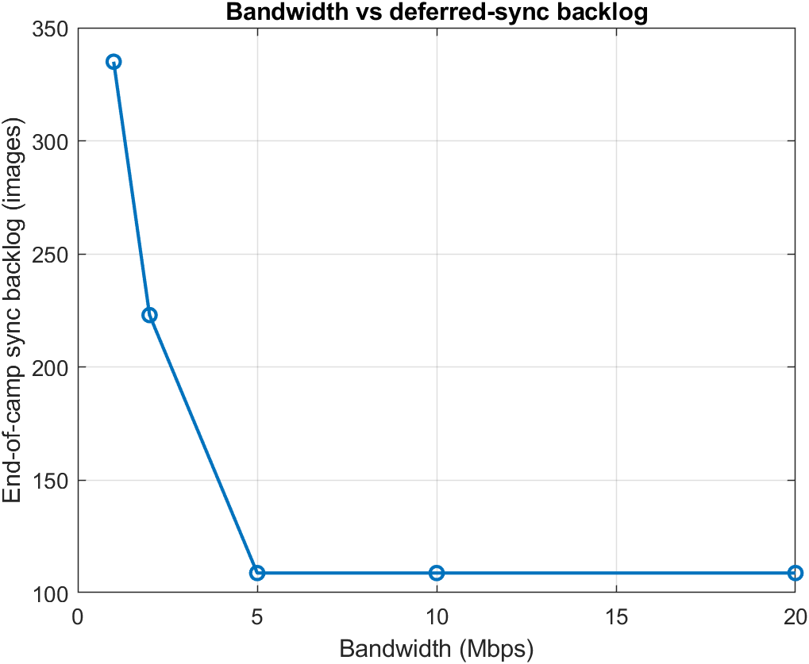
Bandwidth and minimum configuration
Minimum feasible configuration under current illustrative assumptions
1 camera
1 ophthalmologist
5 Mbps bandwidth
399 patients per camp
0 end-of-camp sync backlog
Replace config.m placeholders with measured field telemetry before making deployment claims.
Demo: AI-OFF vs AI-ON, quality rejection, low bandwidth, restored connectivity, then resource recommendation.

