Slide 1
Hive Minds and Boids : Multi-Agent Warehouse Routing
Page
01
Henin Rio M
Mayank Gaikwad
Rohit Nukala
Shashant Vairamuthu
1262251978
1262251650
1262251929
1262250804

Slide 2
What is our project?
Page
02
Compares two distinct multi-agent coordination strategies in real-time.
Simulates dozens of delivery bots navigating rails, picking up crates, and dropping them off at stations.
Features a "Race Mode" to visually and statistically compare which algorithm delivers N orders faster under high traffic.
A split-screen simulation of an automated warehouse grid (similar to and based on Ocado’s hive delivery and warehouse systems).

Slide 3
Problem Statement
Page
03
In dense multi-agent grid environments, textbook pathfinding (like standard A*) leads to severe traffic jams, head-on collisions, and deadlocks
Objectives
Implement a highly optimized A* search algorithm using a custom binary heap.
Develop a "Baseline" controller using standard cell-reservation and wait-timeouts.
Develop a "Flagship" controller integrating Boid-like swarm rules into the grid.
Provide real-time telemetry to measure efficiency (latency, wait times, reroutes).

Slide 4
Technologies Used
Page
04
SDL3: Window lifecycle, hardware-accelerated 2D graphics rendering, and event handling and Callback systems.
Dear ImGui: Powers the interactive sidebars, live configuration sliders, and floating bot inspectors.
C++20 : Core simulation engine, agent kinematics, vector mathematics , namespaces and mature featureful IDE’s
Custom Memory Arenas: Bypassing standard malloc/new for completely fragmented-free, high-speed memory allocation.

Slide 5
The Algorithms
Page
05
Baseline
Flagship
Static Routing: Calculates the absolute shortest physical path using standard A*, ignoring current traffic conditions.
Bidirectional Travel: Treats all rails equally, which frequently results in head-on traffic and gridlock.
Strict Clearances: Uses exclusive cell-reservation; bots must wait for an intersection to completely clear before entering.
Timeout Recalculation: Handles deadlocks by waiting patiently, then running a computationally heavy A* recalculation if stuck.
Separation (Dynamic Routing): Evaluates a 5x5 heatmap, sacrificing the shortest path to route around crowded areas.
Alignment (Lane Polarization): Records recent traffic flow to naturally polarize rails into one-way lanes.
Cohesion (Platooning): Bots heading to the same station link up and tailgate in continuous "trains" through intersections.
Instant Sidestepping: Handles conflicts by immediately dodging onto free parallel rails instead of waiting in line.

Slide 6


Agent Simulation & Kinematics
Page
06
Deadlock Breaking: If bots get stuck in a head-on standoff, the system forces a randomized "sidestep" out of the way to clear the jam. Idle bots are asked to "vacate" if they are parked in a working bot's path.
Continuous Physics: Bots aren't just teleporting. They use real kinematics (acceleration, braking, max speed, and cornering speed limits).
Task Assignment: Bots claim the nearest available orders, with logic for "opportunistic on-the-way pickups."

Slide 7
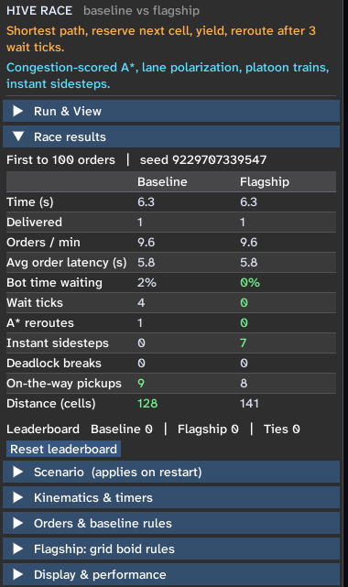
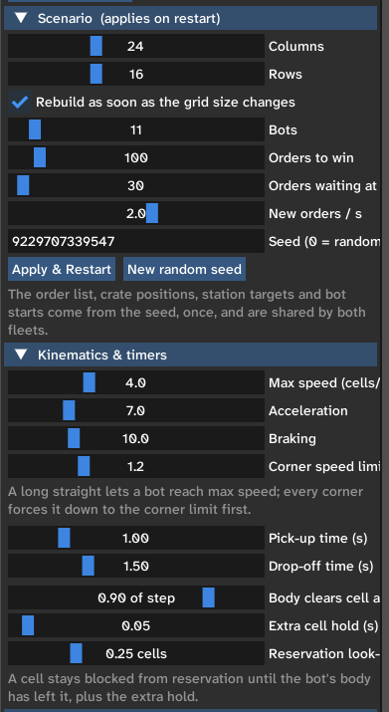
Simulation Outputs & UI
Page
07
Real-Time Analytics Board: Tracking Orders per Minute, Average Latency, and the percentage of time bots spend waiting vs. moving.
Interactive Visualizers: Toggles for bot path overlays, traffic heatmaps, lane direction arrows, and bot states (picking, dropping, yielding).
Bot Inspector: Users can click on a specific bot to "pin" its telemetry and watch its individual speed, cargo, and active local memory of blocked cells.
Split-Screen Comparison: Side-by-side supersampled views of the exact same scenario (same seed, same orders).

Slide 8
Page
08
Real-World Applications and Future Use
Future Development:
In the future, STL-based systems can be improved by integrating machine learning to optimize product arrangement, predict demand, and manage warehouse operations dynamically. The system could automatically select suitable storage locations based on product demand and availability, prioritize urgent orders, and plan efficient routes for automated robots. Battery monitoring and charging schedules could also be introduced to ensure continuous operation. These improvements would help make storage and retrieval systems more organized, efficient, and reliable.

Slide 9
Page
09
THANK YOU

