Slide 1


G17 – Fine-Tune a Small LLM with LoRA/PEFT + Simple Agent
Mayank Garg — 2023UAI1797 | Rishabh Kumar — 2023UAI1803
Notes:
1

Slide 2

Problem Statement
Large AI coding assistants require expensive hardware and cloud infrastructure — making local deployment difficult for students and developers with limited resources.
Fine-Tune Compact LLM
Optimize a small model for coding tasks
Reduce Cost & GPU Usage
Enable training on limited hardware
Lightweight Agent
Build an agent-based local workflow
Better Code Assistance
Improve explanation & instruction following
Notes:
2

Slide 3

Proposed Solution
Core Stack
Assistant Capabilities
Explain code & suggest refactors
Generate helper functions
Understand repository context
Small Open-Source LLM
LoRA / QLoRA Fine-Tuning
Prompt Engineering
AI Agent Workflow
Notes:
3

Slide 4
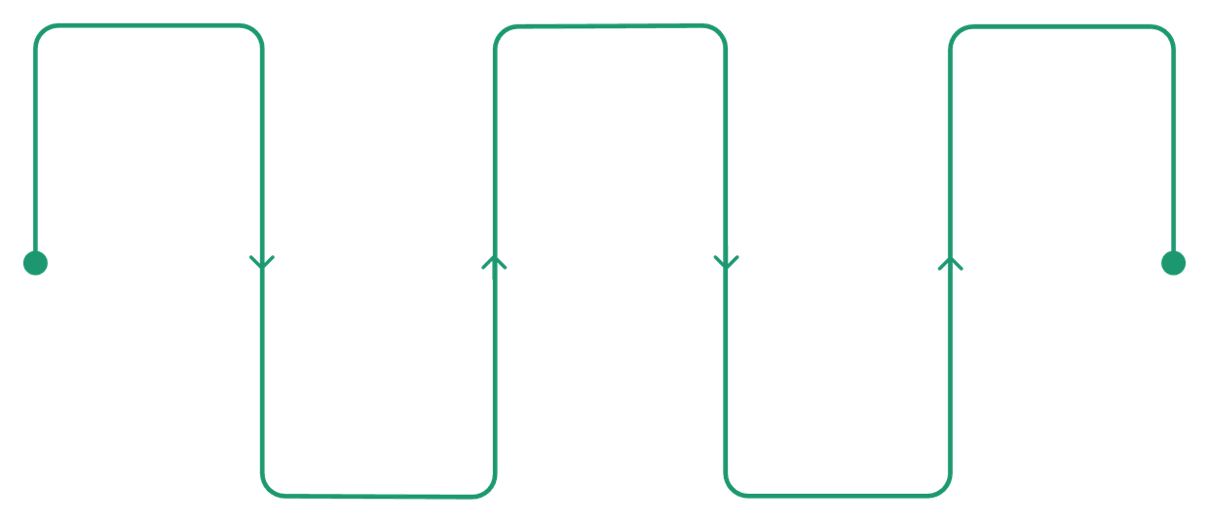
System Architecture & Deep Learning Concepts
Key DL Concepts
Transformers
User Prompt
Fine-Tuned LLM
Structured Output
Input from user or client
PEFT/LoRA adapted model
Generate validated response
LoRA — Low-Rank Adaptation
PEFT — Parameter-Efficient Fine-Tuning
Context Injection
Agent Orchestration
Augment prompt with embeddings
Coordinate tools and actions
Prompt Engineering & Embeddings
Modular architecture keeps the system lightweight and scalable.
Instruction Tuning & Agent Inference
Notes:
4

Slide 5





Training & Implementation
Dataset Prep
Curated, tokenized coding data
LoRA Fine-Tuning
Low-rank adapters via PEFT + PyTorch
Optimization
Small batches, reduced sequence length, checkpointing
Evaluation & Export
Metrics-driven evaluation, model export
Stack: Hugging Face Transformers · PEFT · PyTorch · Python
Notes:
5

Slide 6

Agent Workflow & Results
Inference Flow
User Input
Prompt Processing
Improvements After Fine-Tuning
Metrics: Code correctness · Response clarity · Task completion · Prompt consistency
Fine-Tuned LLM
Agent
The agent handles prompt formatting, context management, structured responses, and output validation.
Better instruction following
Improved code explanations
More structured outputs
Reduced hallucinations
Better repository awareness
Notes:
6

Slide 7

Challenges, Solutions & Future Work
Challenges & Solutions
Future Improvements
Challenge
Solution
01
RAG Integration
GPU memory limits
LoRA / QLoRA optimization
Retrieval-Augmented Generation for richer context
Noisy datasets
Focused dataset curation
02
Overfitting risks
Prompt engineering + regularization
Tool & API Integration
External tools, web interface, API deployment
Inconsistent outputs
Iterative evaluation
03
Advanced Agent Workflows
Better repo retrieval and multi-step reasoning
Notes:
7

Slide 8
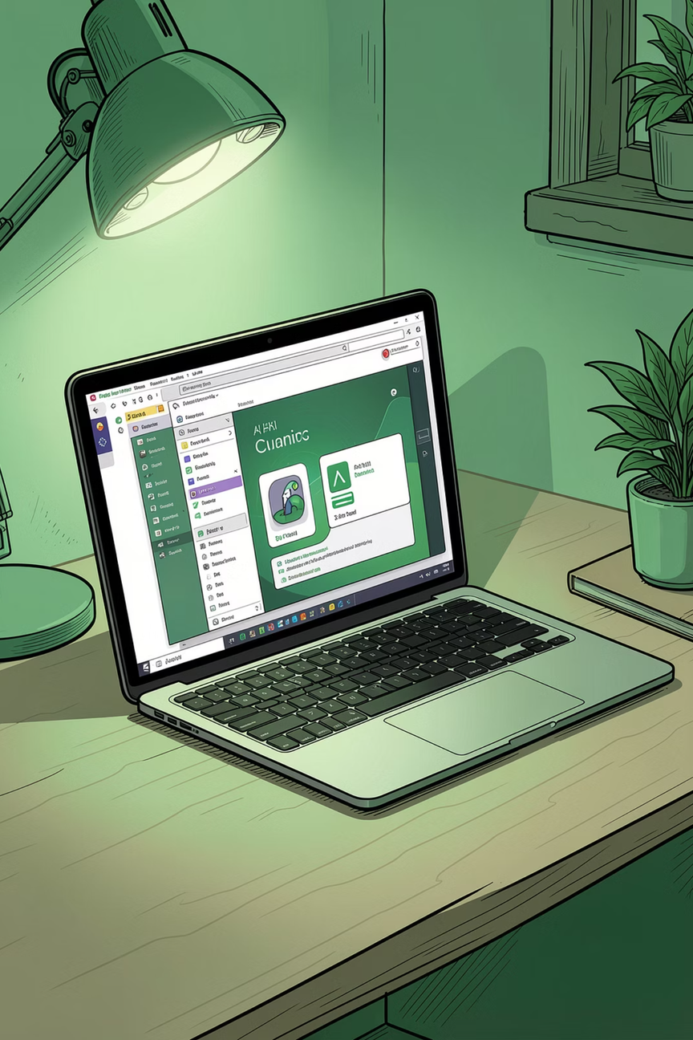
Conclusion
Small LLMs combined with LoRA/PEFT can become efficient, affordable AI coding assistants — no expensive cloud required.
Lower Cost
Reduced computational overhead
Better Performance
Improved coding-task quality
Local Deployment
Runs on limited hardware
Practical AI Dev
Real-world assisted development
References: LoRA · QLoRA · Attention Is All You Need · Hugging Face Transformers · PEFT · PyTorch · LangChain
Notes:
8

