Slide 1
Big Data Hadoop with Spark

Slide 2
Objective
Gain an understanding of Apache Spark.
How Hive works behind the scenes?
How Apache Spark libraries work on a Hadoop cluster?

Slide 3
Key Take-aways
Big Data solutions :: Distributed Storage and Distributed Computing
Hadoop
An open source for Distributed Storage and Distributed Computing
Distributes large datasets using HDFS
Performs computational tasks in parallel using MapReduce
Resource Management and Job Scheduling are handled by YARN (Yet Another Resource Negotiator)
Spark is an open-source unified analytics engine for large-scale data processing under Apache Foundation.

Slide 4
Spark 100X faster than Hadoop MapReduce?
MapReduce stores intermediate result to disc, and spark improved on the parallel processing by storing intermediate results in memory, spark can also write to disk if it runs out of memory.
With Spark, large scale data processing can be done at a much faster pace.
Spark can do, not just batch processing but can also handle real time streaming data.
Additionally, with resource management responsibility moving to a new component YARN, Hadoop allowed non-MapReduce jobs(Spark) to work with HDFS data.

Slide 5
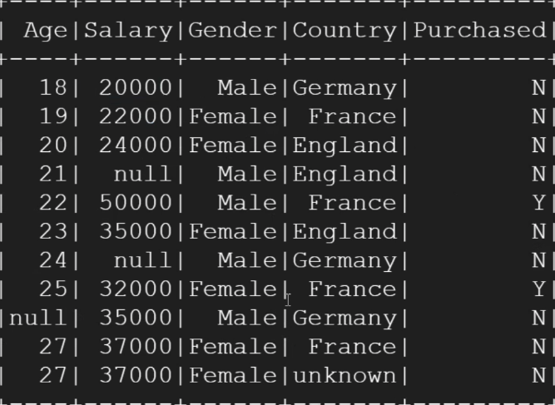
Problem Statement
A bank is launching a new credit card and wants to identify prospects it can target in its marketing campaign.
It has received prospect data from various internal and 3rd party sources. The data has various issues such as missing or unknown values in certain fields. The data needs to be cleansed before any kind of analysis can be done.
Since the data is in huge volume with billions of records, the bank has asked you to use Big Data Hadoop and Spark technology to cleanse, transform and analyze this data.

