Slide 1


Project Id:-2026-MPJ-3CSDS-23
RepoGuard
Department of Computer Science & Engineering (Data Science)
PRESENTED BY:
1. Students Name:- Mayank Jindal
Roll No: 240290154079
2. Students Name:-Yash Kumar
Roll No:2402901540141
3. Students Name:-Saina Sharma
Roll No: 2402901540100
3. Students Name:-Rishika Garg
Roll No: 2402901540097
ABES Institute of Technology , Ghaziabad
Affiliated to:
DR. A.P.J. Abdul Kalam Technical University
Session 2026-27

Slide 2

Table of Content
1. Problem Statement
2. Introduction
3. Objective
4. Literature Survey
5. Proposed Methodology
6. Proposed Implementation
7. Key features
8. Teck Stack
9. SDG Goals
10. Refrences
2

Slide 3
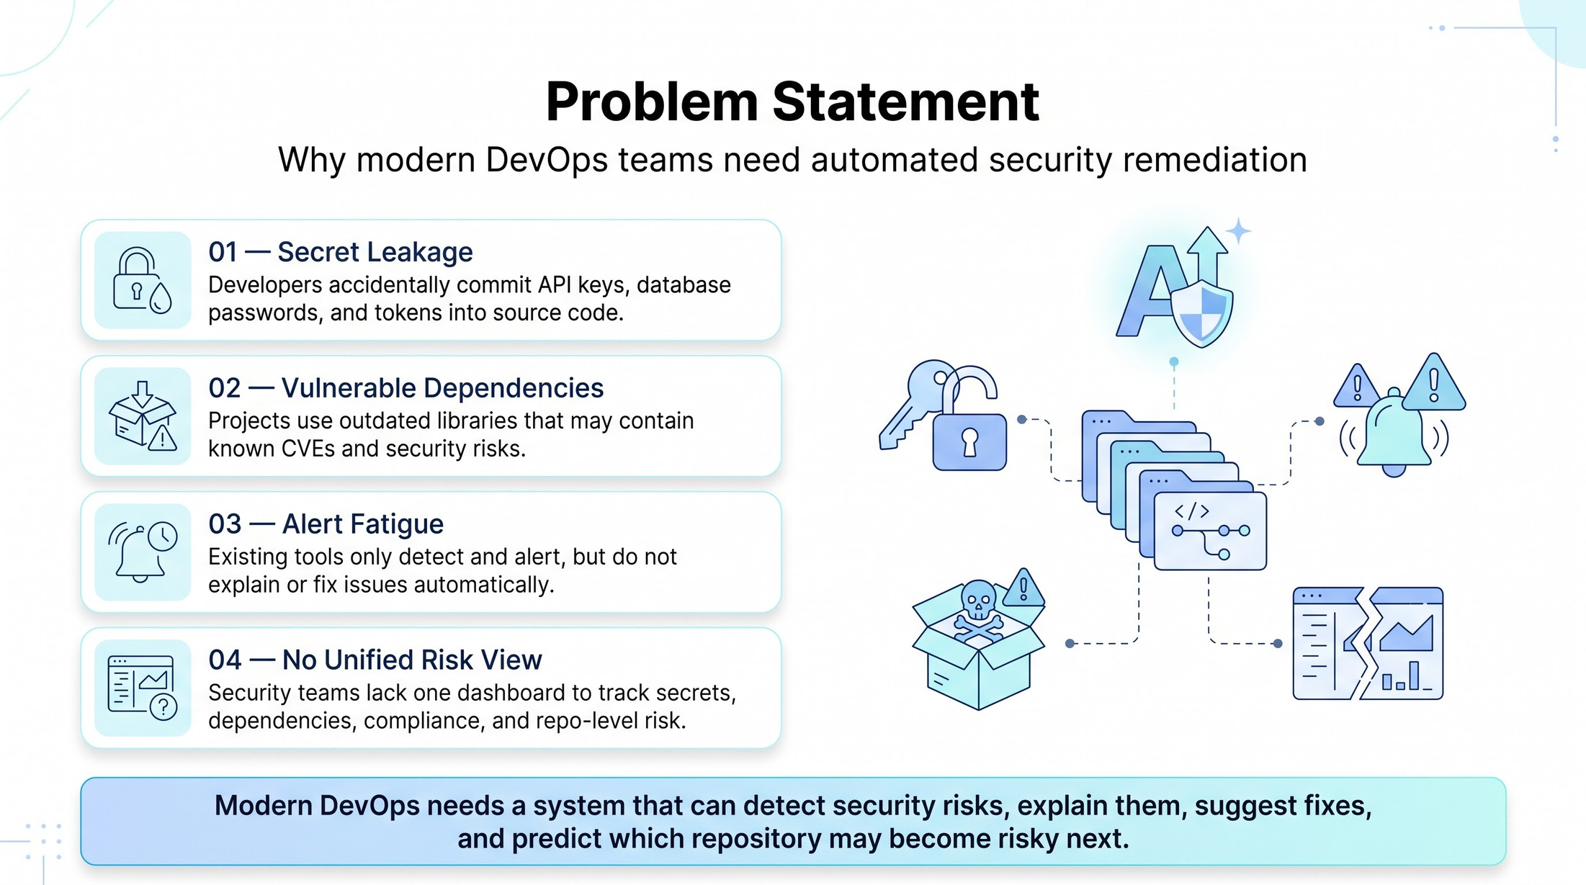

Slide 4
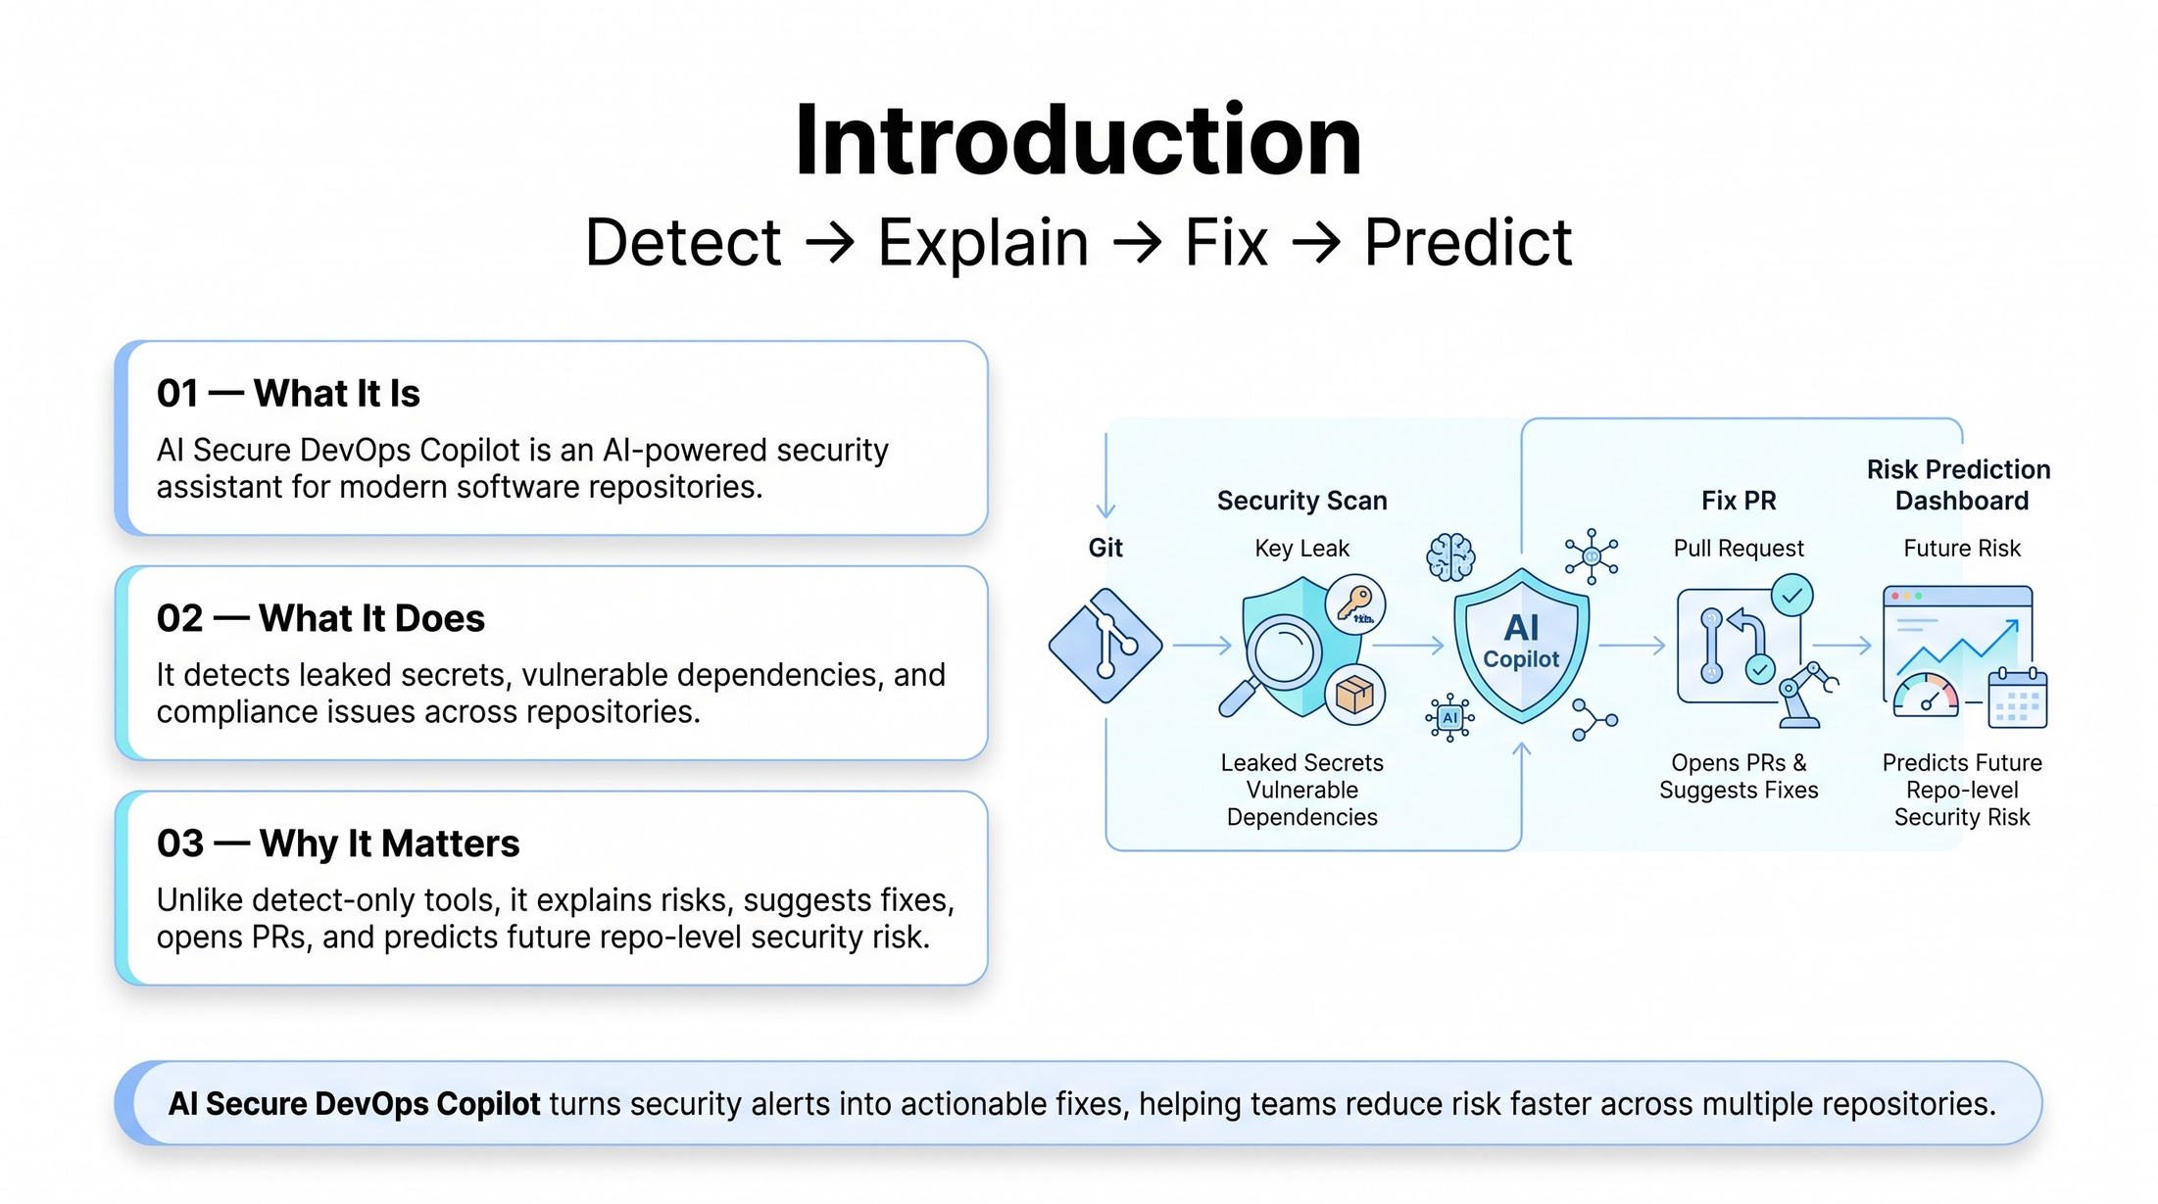

Slide 5
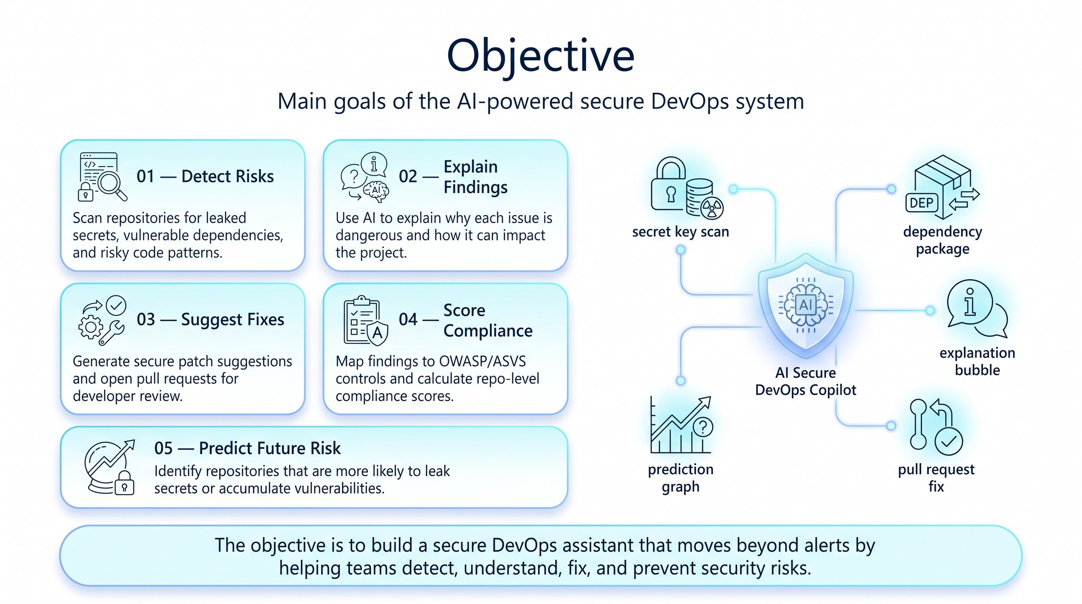

Slide 6
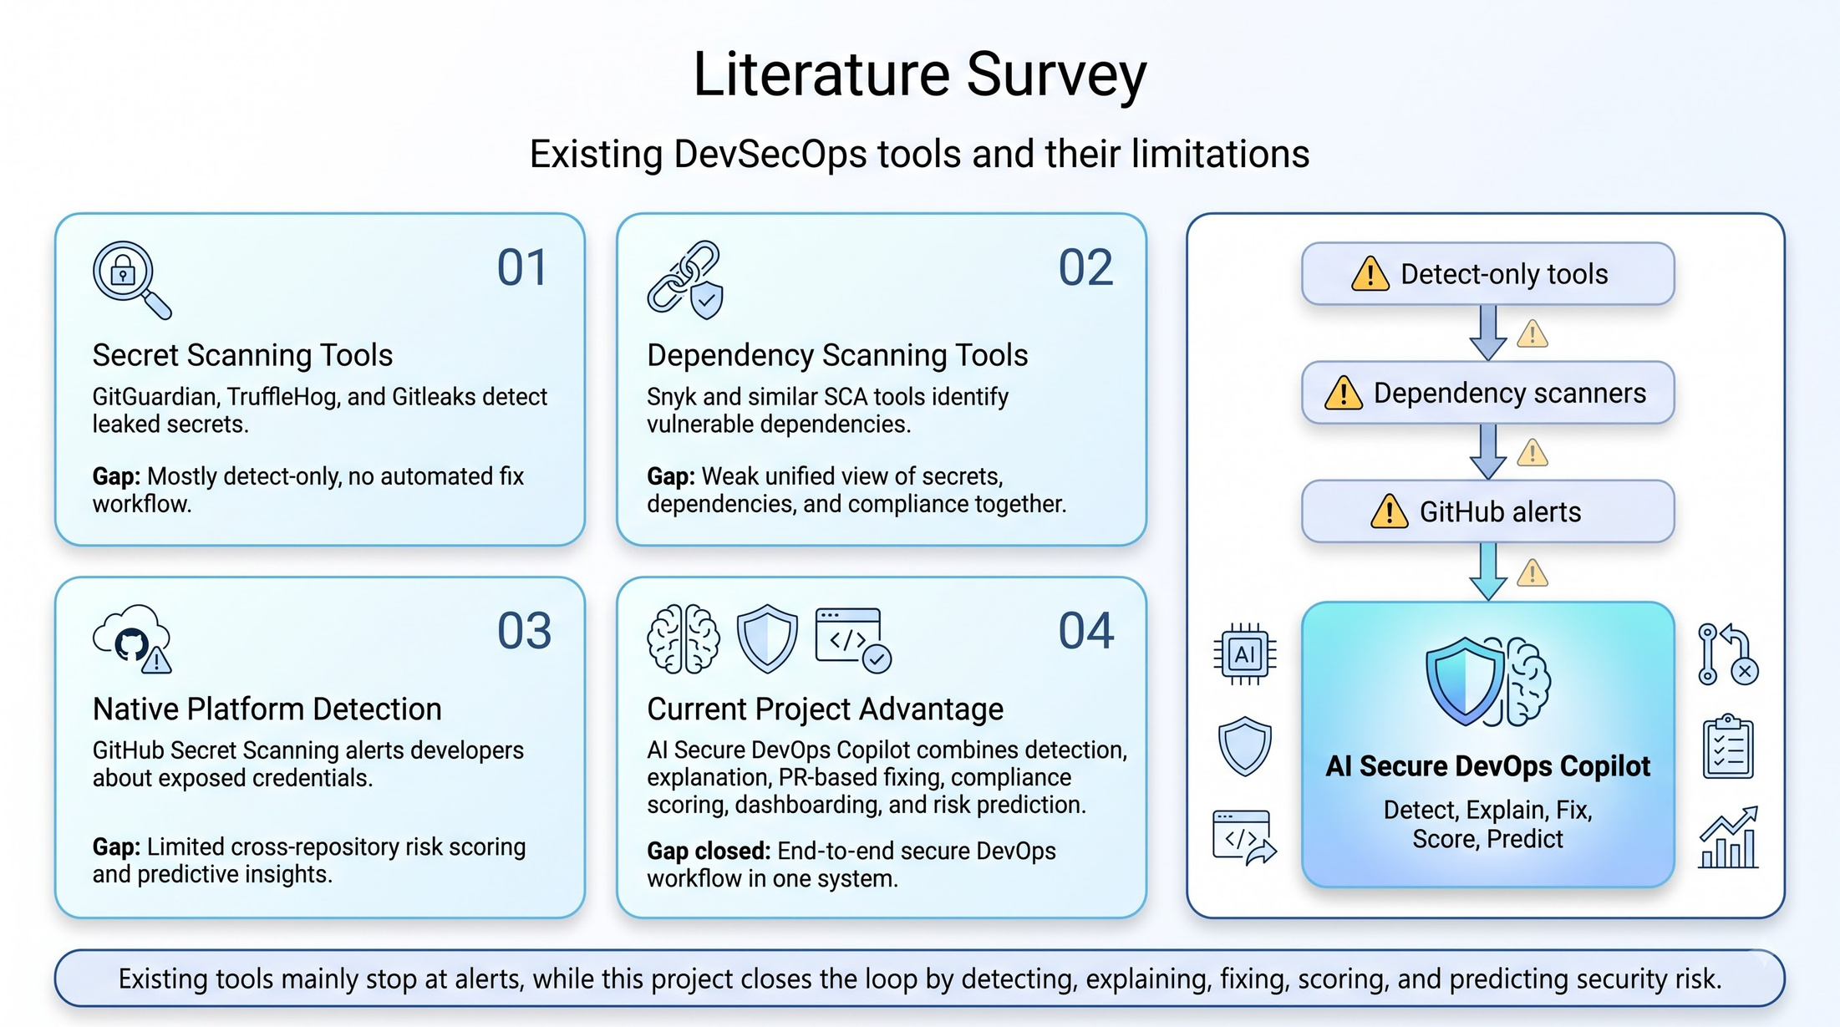

Slide 7
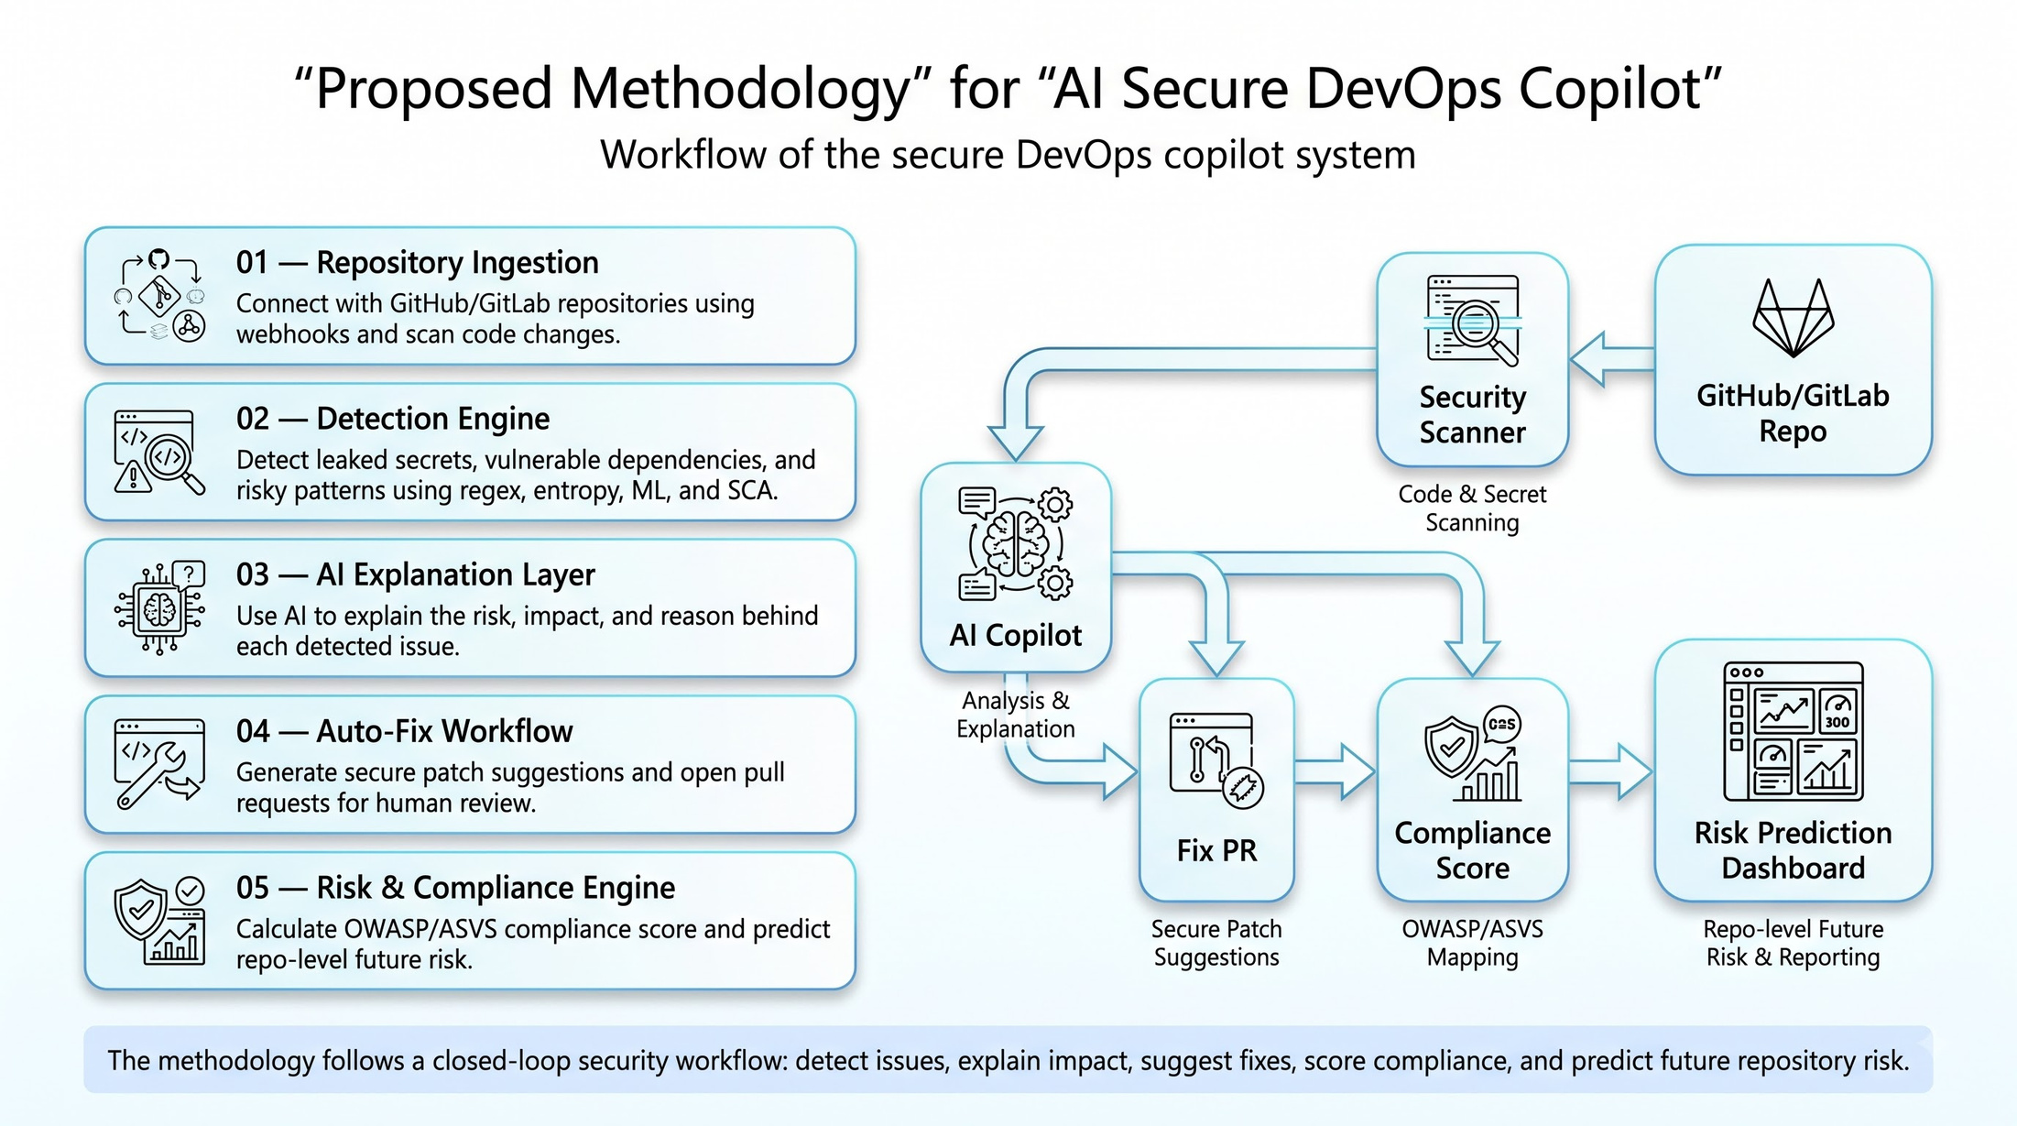

Slide 8
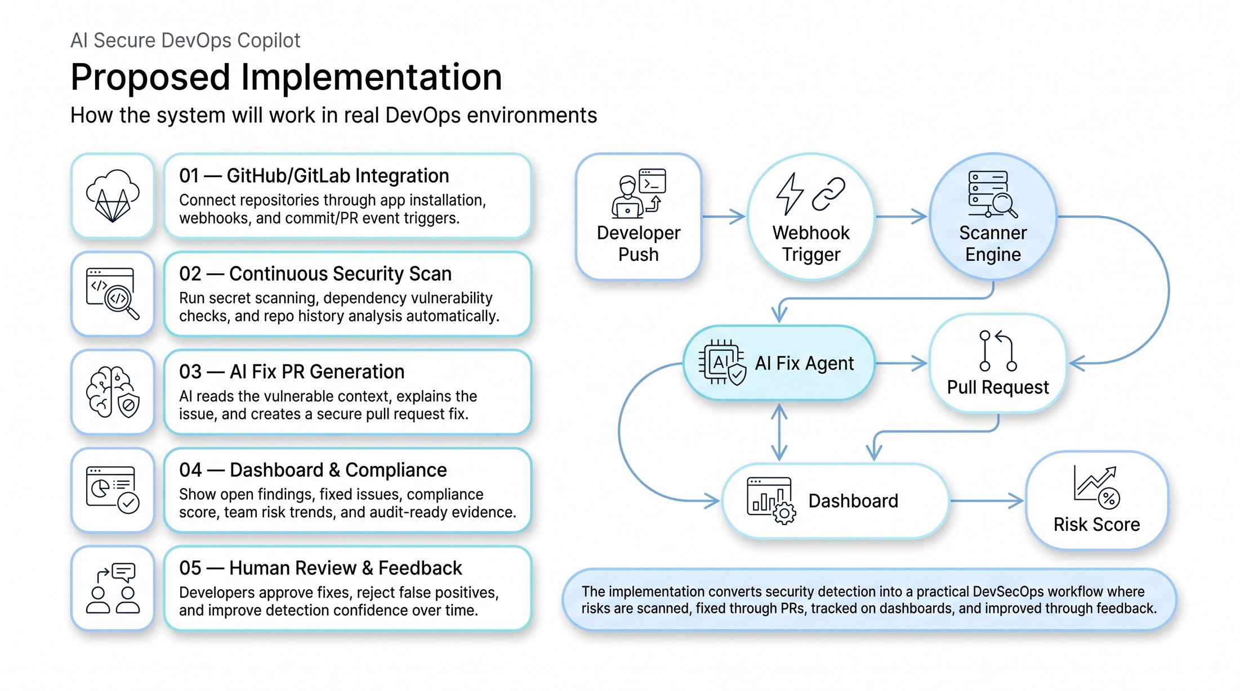

Slide 9
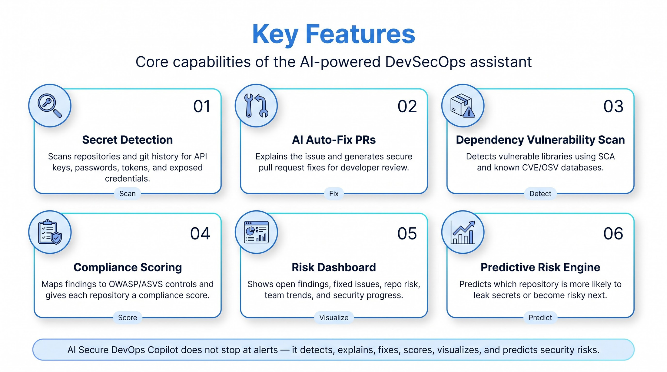

Slide 10
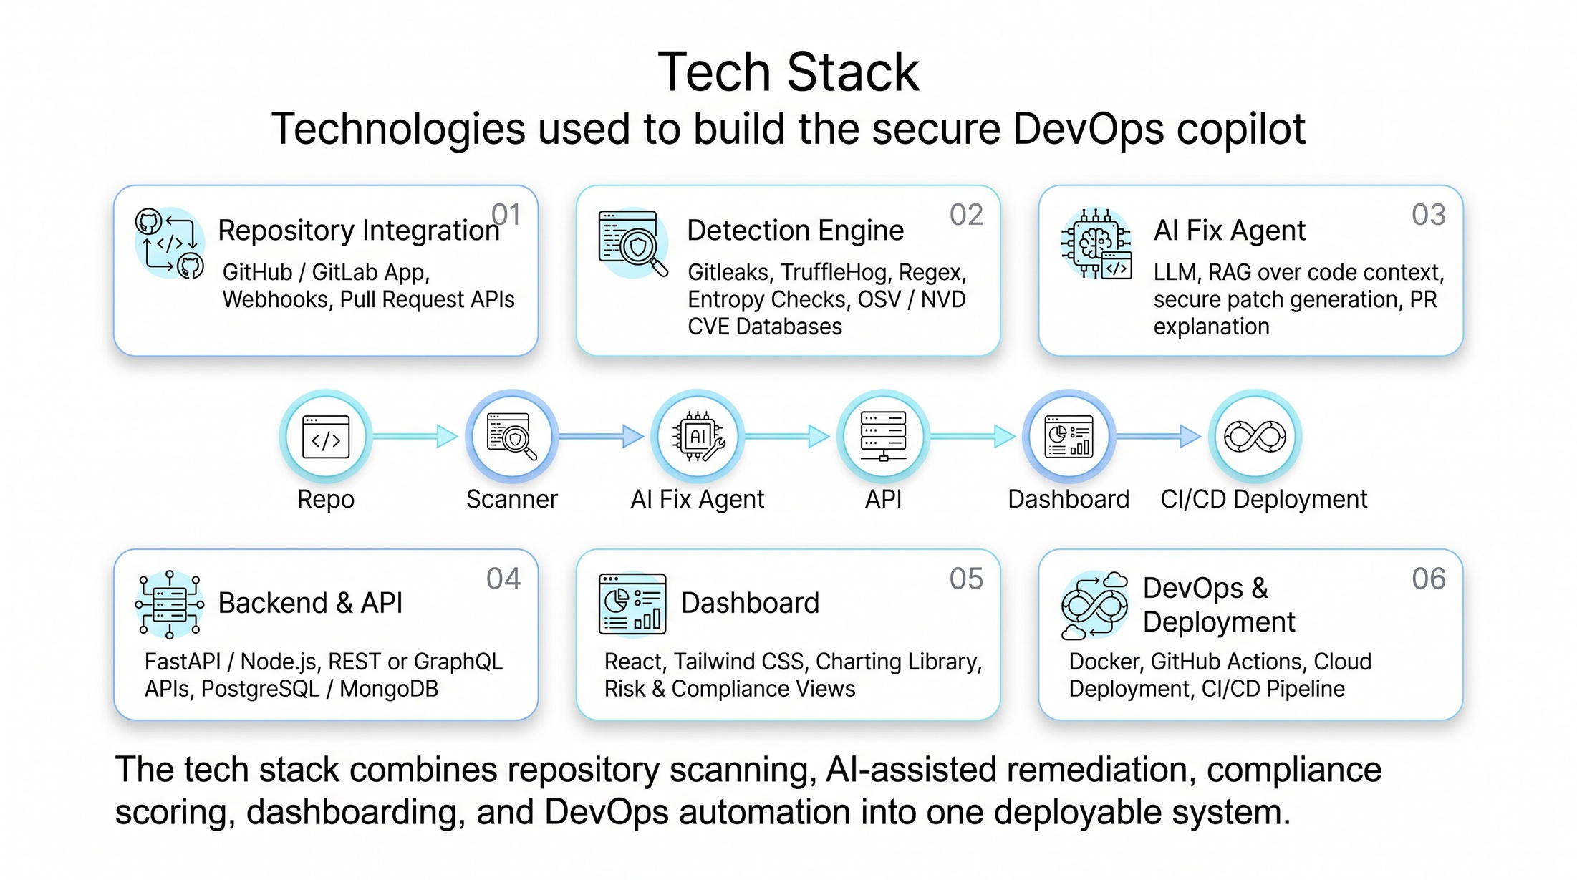

Slide 11
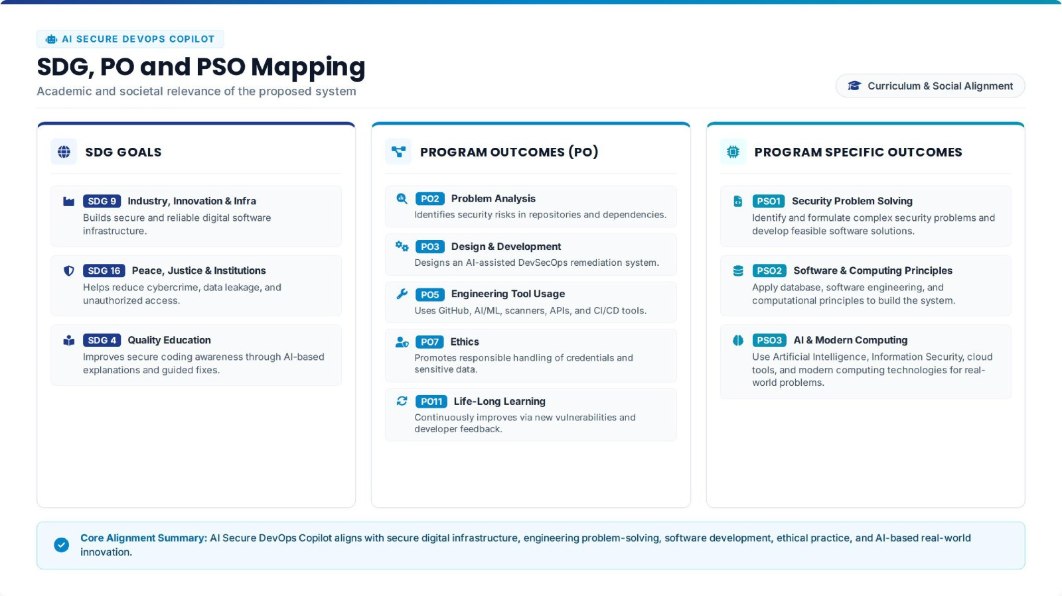

Slide 12
References:
[1] M. Meli, M. R. McNiece, and B. Reaves, “How Bad Can It Git? Characterizing Secret Leakage in Public GitHub Repositories,” in Network and Distributed System Security Symposium (NDSS), 2019.
[2] M. Zimmermann, C.-A. Staicu, C. Tenny, and M. Pradel, “Small World with High Risks: A Study of Security Threats in the npm Ecosystem,” in 28th USENIX Security Symposium, pp. 995–1010, 2019.
[3] OWASP Foundation, “OWASP Application Security Verification Standard (ASVS), Version 5.0.0,” 2025.
[4] GitHub, “About Secret Scanning,” GitHub Documentation, accessed Aug. 1, 2026.
[5] Google, “OSV.dev: Open Source Vulnerability Database,” OSV Documentation, accessed Aug. 1, 2026.
[6] Z. Rice and Contributors, “Gitleaks: Detecting Secrets in Git Repositories, Files, and Directories,” Gitleaks Open-Source Project, accessed Aug. 1, 2026.
9

