Slide 1

Scripted By :-
Mayank Khurana

Slide 2
INTRODUCTION
A python script which enables the end user to sniff and manipulate packets/data over wireless networks.
Technically known as the “ MAN IN THE MIDDLE” attack.

Slide 3
HARDWARE AND SOFTWARE USED
Raspberry Pi 3
Wireless Adapter
Python 3.6

Slide 4
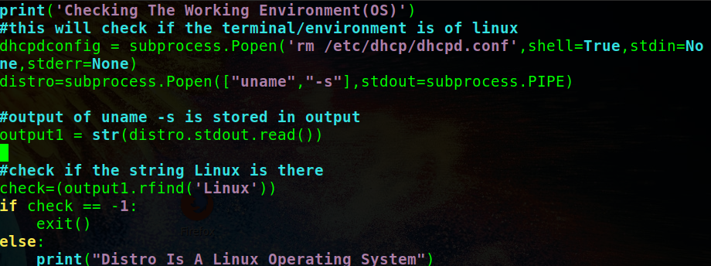
WORKING
Check if the working environment is Linux or not.

Slide 5
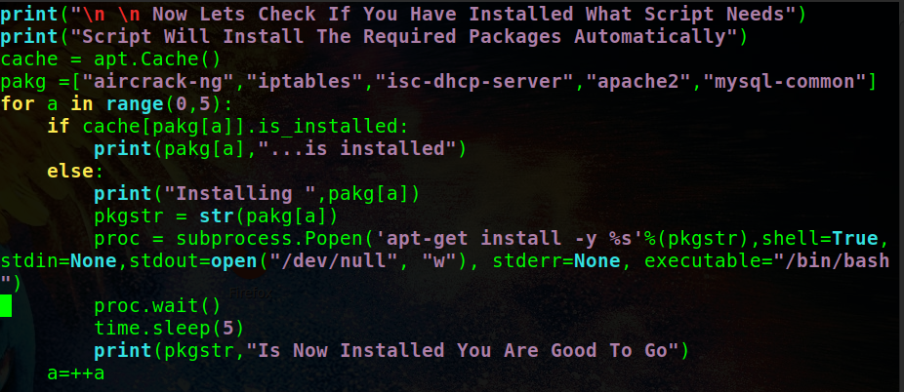
Checks for the prerequisite
If not present, automatically installs them.

Slide 6
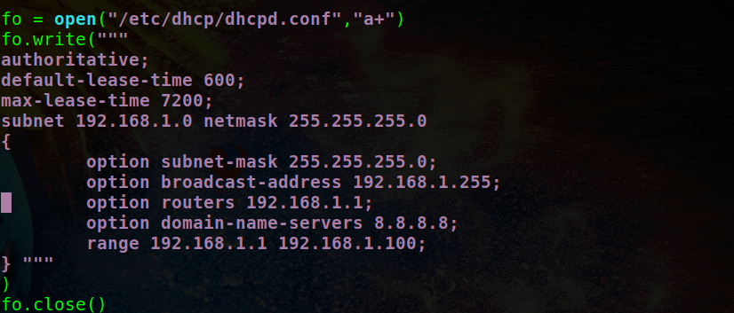
Configurations for DHCP server.
Writing the configurations in the dhcpd.conf file.

Slide 7
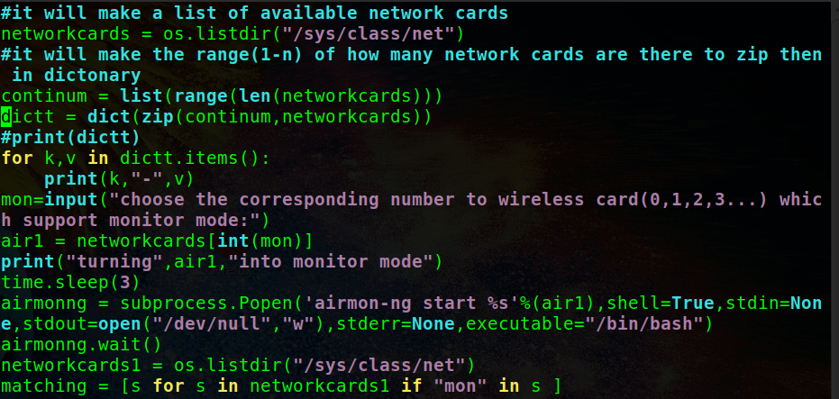
Collect all the bssid’s in the vicinity (wireless network names).
Write them into csv file in the required format.
Displays the essid’s for the user to choose.

Slide 8
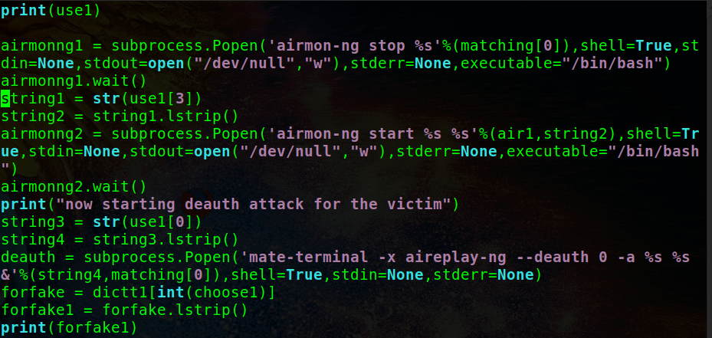
Start the de-auth attack for the chosen essid.

Slide 9
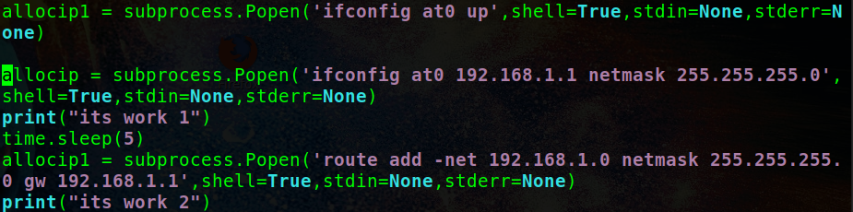
Create fake access point.
Configure the access point network to provide IP to victim through DHCP.

Slide 10
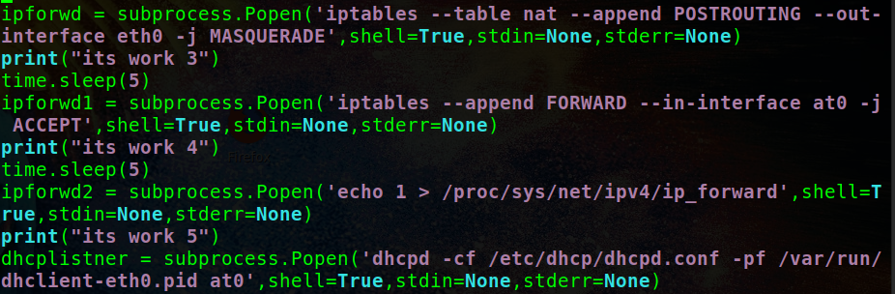
Configure IP tables to route the requested packets from Lan or another wireless card.
Starting the services.

