Slide 1
Creative Optimization Platform
Automated Creative Intelligence for Mobile Marketing
Platform Overview | May 2026

Slide 2
Business Problem
When a mobile app company (e.g. a game, fintech app, e-commerce app) wants to acquire users, they run paid ads on platforms like Facebook, Google, TikTok, etc.
Each ad has a creative — the actual image, video, or banner the user sees. A company might have hundreds or thousands of creatives running simultaneously across multiple platforms.
Which creative is performing best?
Are we wasting money showing the same creative twice (just slightly resized)?
When does a creative "burn out" and stop working?
How do we automatically shift budget to the best-performing creative?

Slide 3
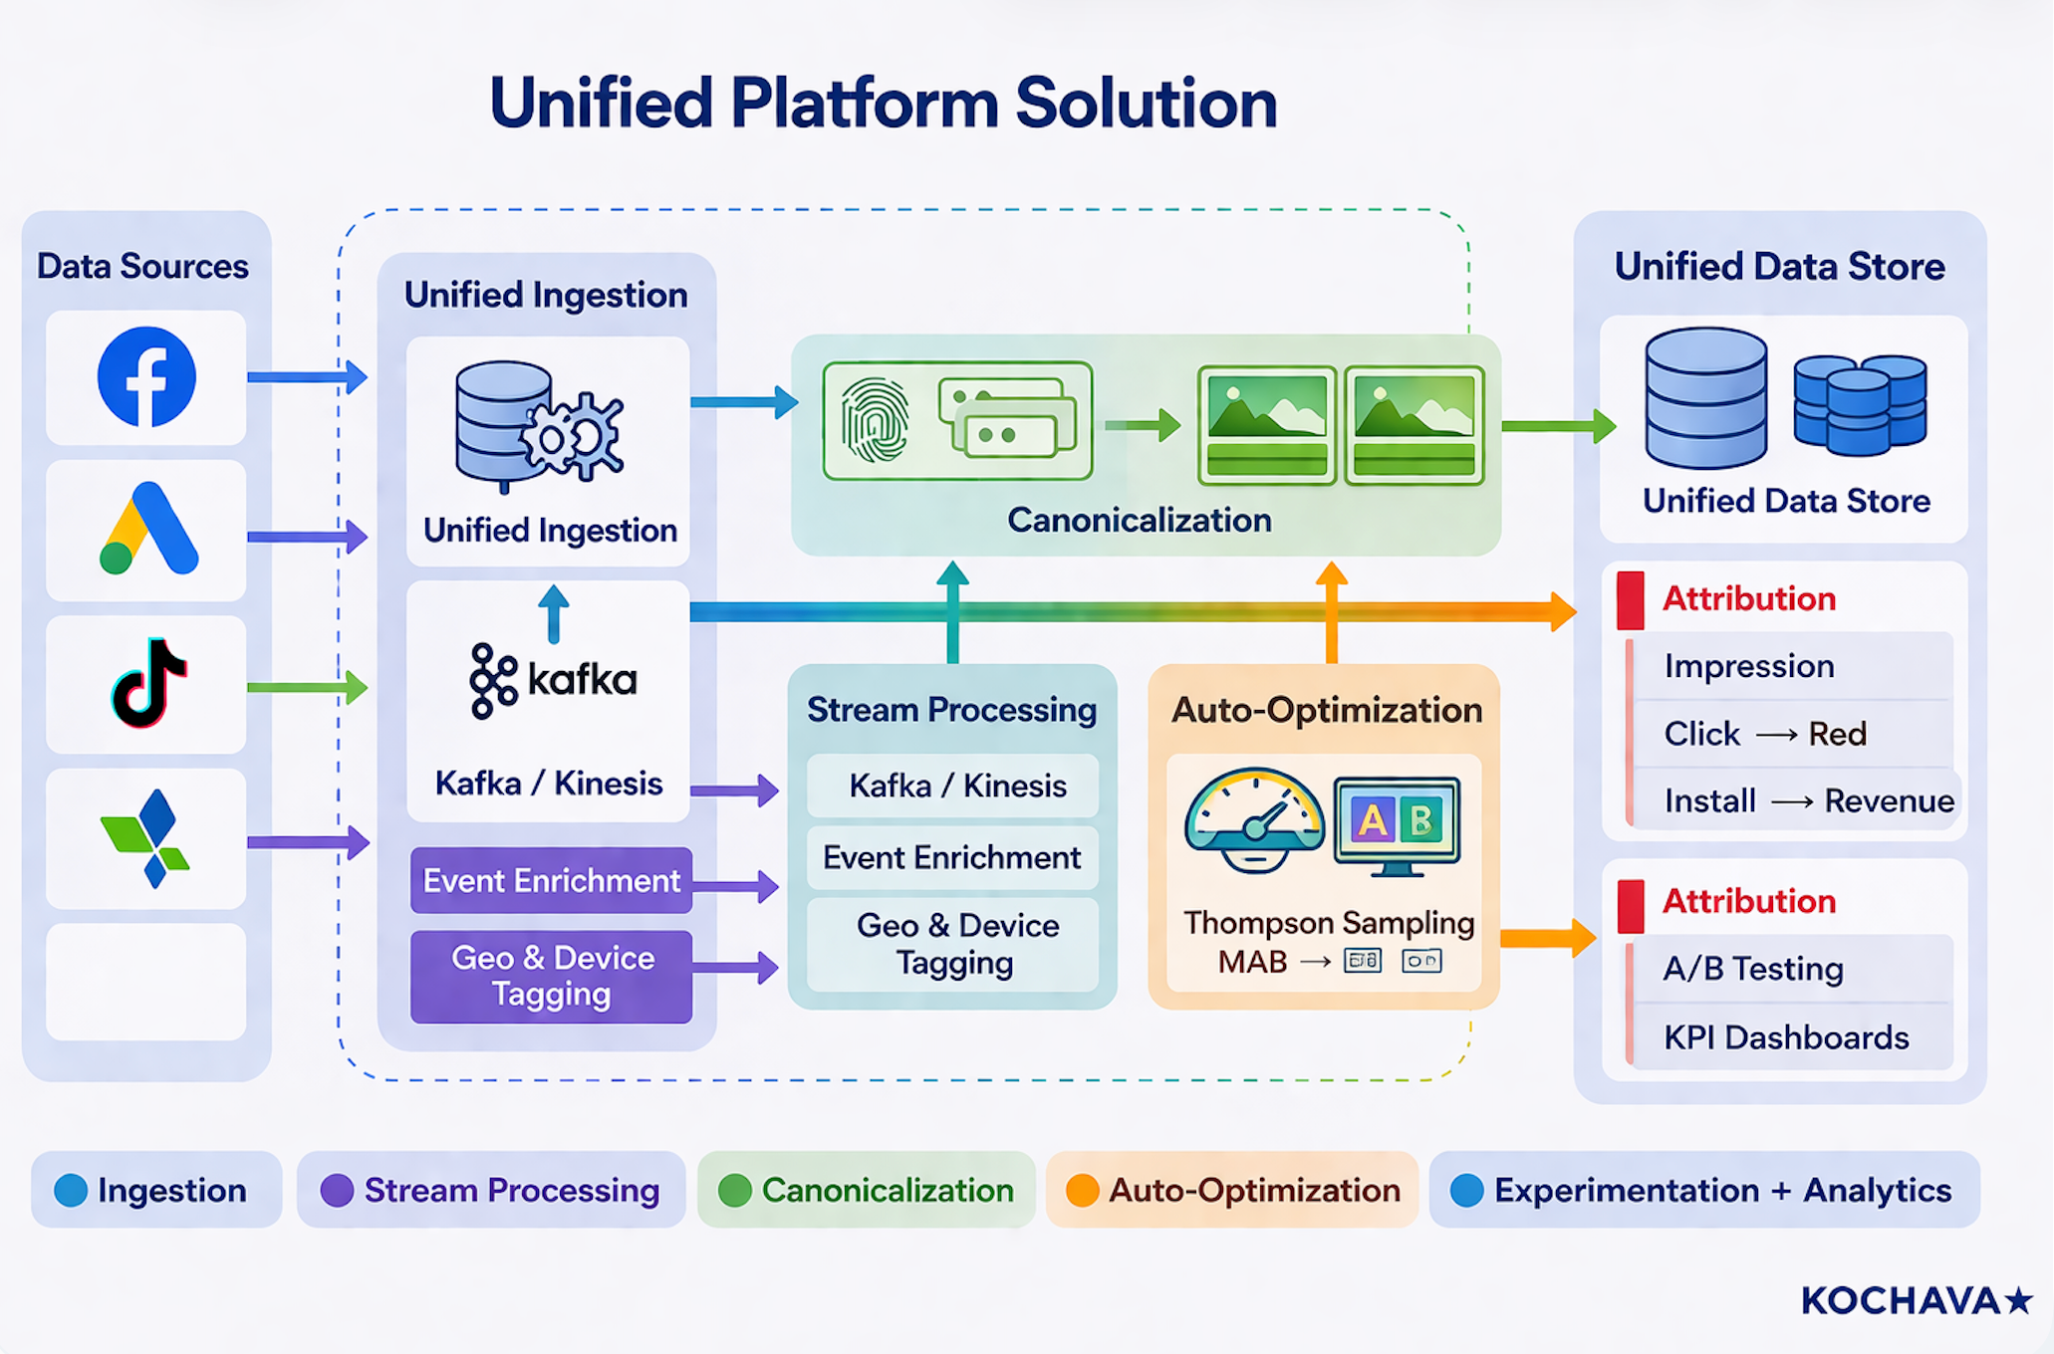

Slide 4
Issues Mobile Marketers Face with Creatives
Data Silos
Duplicate Creatives
Performance data lives in Facebook,
Same video uploaded 10× across
Google, TikTok — no single view
platforms — fragmented data
Slow A/B Testing
Creative Fatigue
Traditional 50/50 splits take weeks,
No automated signal when a creative
wasting budget on the losing creative
burns out — teams react too late

Slide 5
The Solution
One platform: ingest, deduplicate, and auto-optimise
Unified Ingestion
Smart Deduplication
Facebook, Google, TikTok, AppsFlyer
pHash fingerprints every creative —
all in one data store
detects duplicates across platforms
Auto-Optimisation
Fatigue Detection
Thompson Sampling MAB shifts traffic
>20% WoW decline auto-flagged —
to the best creative in real time
no manual monitoring needed

Slide 6
Platform Architecture
Ingestion
Facebook • Google Ads • TikTok • AppsFlyer
Stream Processing
Kafka / Kinesis → Event Enrichment → Geo & Device tagging
Canonicalization
pHash • Video Hashing • Cross-platform Deduplication
Feature Extraction
ResNet Vision • Tesseract OCR • BERT NLP
Attribution
Impression → Click → Install → Revenue
Experimentation + Analytics
Thompson Sampling • A/B Tests • KPI Dashboards

Slide 7
Thompson Sampling — How It Works
Bayesian Multi-Armed Bandit for real-time creative optimisation
1 Equal Start
Every creative starts with Beta(1,1) — no prior bias.
2 Sample
For each request sample θ ~ Beta(α, β) per creative.
3 Show Winner
Serve the creative with the highest sampled θ value.
4 Observe
Conversion? α += 1. No conversion? β += 1.
5 Learn
Posterior narrows — model grows more confident.
6 Auto-Allocate
Traffic concentrates on the winner automatically.

Slide 8
Thompson Sampling vs Traditional A/B Testing
Multi-Armed Bandit (MAB)
Traditional A/B Testing
✓ Convergence: 500–1,000 impressions
✗ Needs 10,000+ impressions
✓ Traffic waste: ~10–15% only
✗ Wastes ~50% traffic on loser
✓ No manual action required
✗ Manual decision to pick winner
✓ Continuous real-time learning
✗ Static — does not adapt mid-test
✓ +30–40% CVR vs. equal split
✗ Baseline CVR only
✓ No fixed sample size needed
✗ Requires pre-defined sample size

Slide 9
Creative Deduplication via Perceptual Hashing
Same creative detected across any platform — even after compression or resizing
Scale to 32×32
Convert to greyscale
Normalises resolution differences
Removes colour variation noise
Apply DCT
Keep top-left 8×8
Discrete Cosine Transform
Stable low-frequency features
Binarise around median
Hamming distance < 10
Produces 64-bit perceptual hash
Within-10 hashes = duplicates
< 1% collision rate | Resistant to watermarks, resizing & re-compression

Slide 10
KPIs & Analytics
Track every creative end-to-end: impression → click → install → revenue
CTR
CVR
CPI
Clicks / Impressions
Installs / Clicks
Spend / Installs
Engagement rate
Conversion rate
Cost per install
ROAS
LTV
Fatigue
Revenue / Spend
Revenue 1d/7d/28d
WoW decline > 20%
Return on ad spend
Lifetime value
Burn-out auto-detection

Slide 11
Roadmap — Phase 0 & Phase 1
Phase 0 — MVP ✅ COMPLETE
Phase 1 — Production 🔨 8-16 wks
✅ Database models & REST API
⬜ Google Ads full connector
✅ Facebook connector
⬜ TikTok Marketing API
✅ Perceptual hashing & deduplication
⬜ AppsFlyer data ingestion
✅ Thompson Sampling MAB
⬜ Vision features (ResNet)
✅ Epsilon-Greedy & UCB
⬜ OCR pipeline (Tesseract)
✅ A/B testing (Z-test & t-test)
⬜ NLP for ad copy (BERT)
✅ Analytics endpoints (CTR/CVR/ROAS)
⬜ Real-time Kafka pipeline
✅ Docker Compose one-command setup
⬜ React dashboard UI

Slide 12
Roadmap — Phase 2 (Advanced / Continuous)
Advanced ML
Real-time Bidding
• Uplift modelling — predict incremental impact
• DSP integration for live bid adjustments
• Contextual bandits by geo & device
• Dynamic Creative Optimisation (DCO)
Privacy & Compliance
Infrastructure
• Advanced SKAdNetwork aggregation
• Kubernetes horizontal auto-scaling
• GDPR / CCPA compliance tooling
• Global CDN + CI/CD pipeline

Slide 13
Technology Stack
API & Backend
Streaming
Observability
Python 3.11 • FastAPI
Apache Kafka • Zookeeper
Prometheus / Grafana
SQLAlchemy • PostgreSQL 15
Kinesis (Phase 1)
Sentry • ELK • Airflow
Vision & NLP
Infrastructure
ML / Stats
OpenCV • Pillow • imagehash
Docker / Docker Compose
Thompson Sampling • SciPy
Tesseract OCR • BERT
Redis 7 • S3 • BigQuery
scikit-learn • PyTorch

Slide 14
Current Status & Performance Targets
✅ MVP — Complete
⚡ Performance Targets
• Core data models & REST API
< 50 ms API creative selection
• Facebook ingestion connector
10,000+ /s Throughput (scaled)
• Perceptual hashing & deduplication
100M+ /day Events (partitioned DB)
• Thompson Sampling (production-ready)
500–1,000 Impressions to converge
• Analytics endpoints (CTR, CVR, ROAS)
+30–40% CVR vs. 50/50 A/B
Next Steps — Phase 1 (8-16 weeks, 2-3 engineers)
▸ Implement attribution engine (full funnel)
▸ Develop React dashboard with real-time charts
▸ Complete Google / TikTok / AppsFlyer connectors
▸ Build Vision + NLP + OCR feature pipeline

Slide 15
Creative Optimization Platform
Spend less. Earn more. Optimise automatically.
API Docs: http://localhost:8000/docs
Status: MVP Complete ✅ | Phase 1 ready to begin
Timeline: Phase 1 = 8–16 weeks | 2–3 engineers

Slide 16
Images
(Sample AF images from Internet)

Slide 17
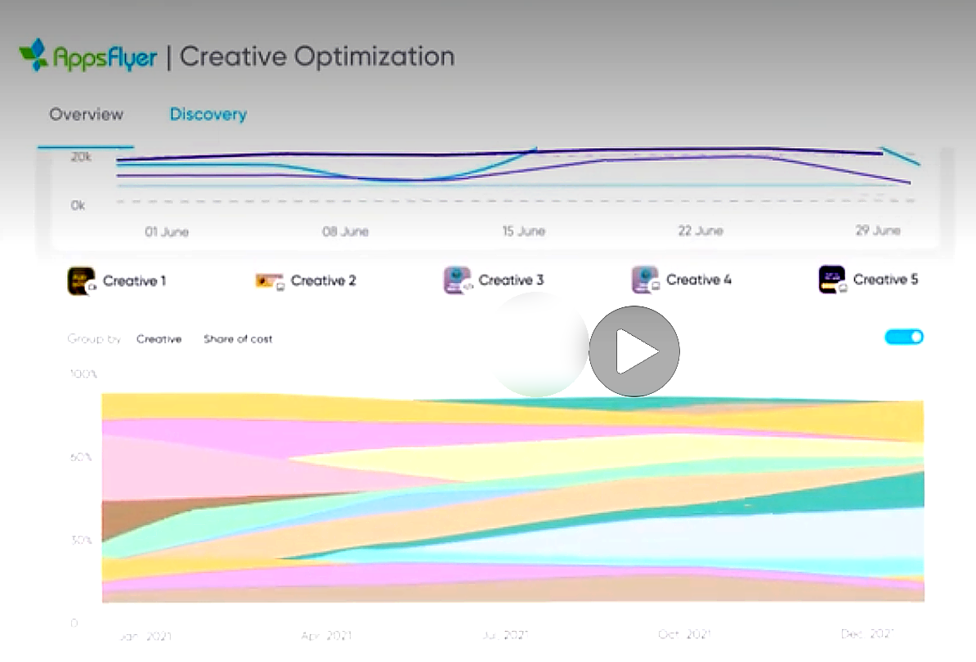
https://youtu.be/l5CkrU22zZI?si=e-_lxSMBAmzw4ie4

Slide 18
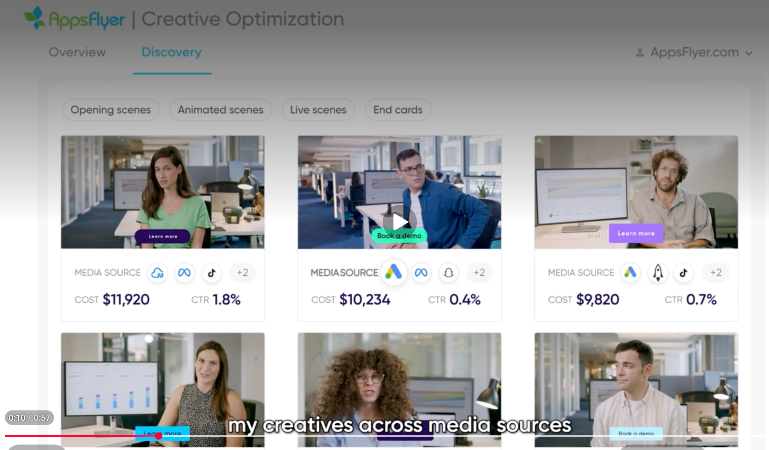

Slide 19
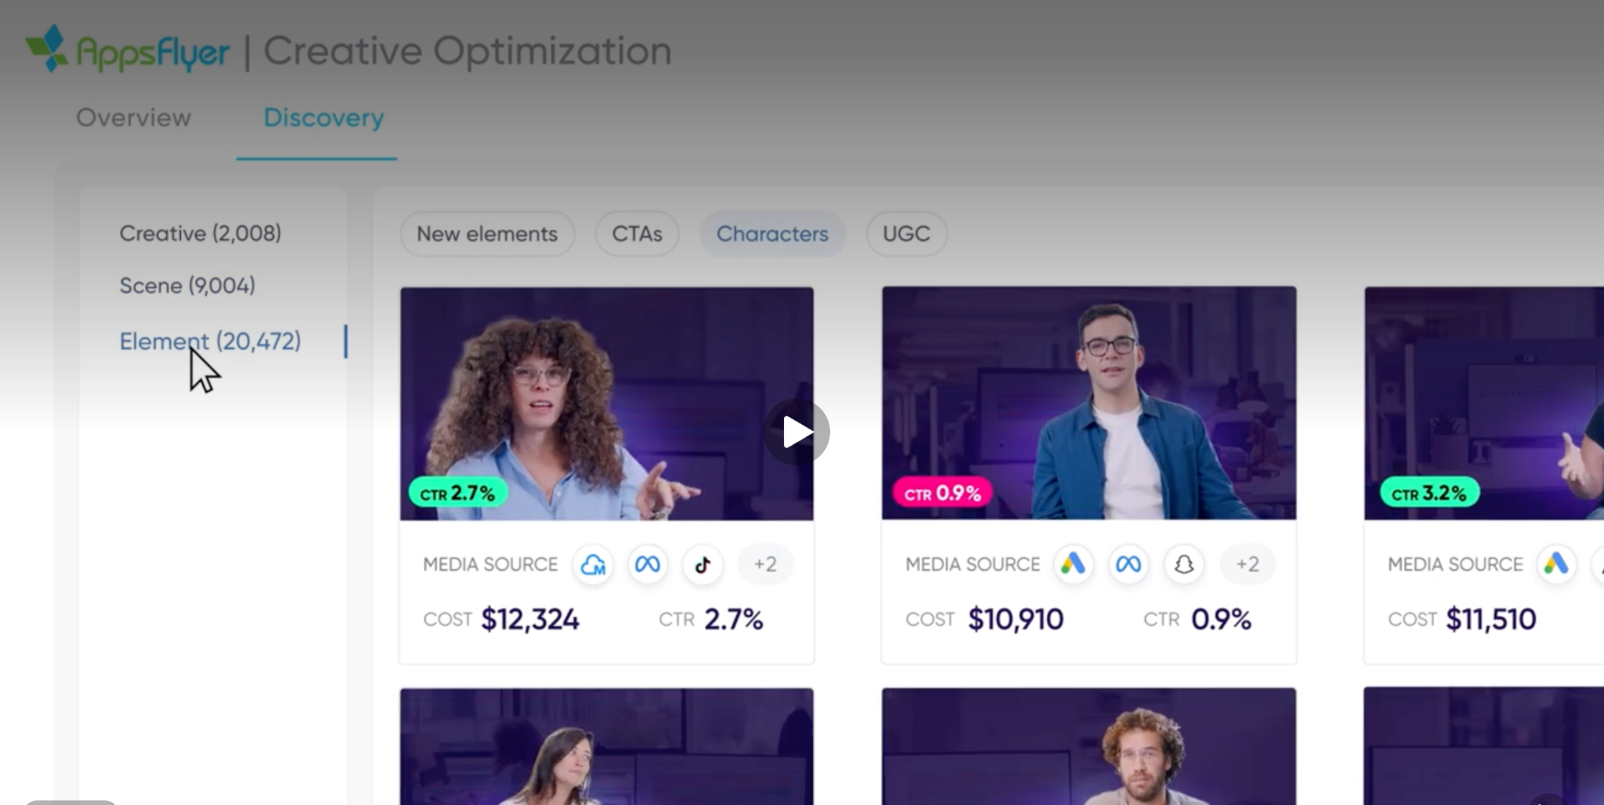
Analyse opening scenes or even the characters

Slide 20
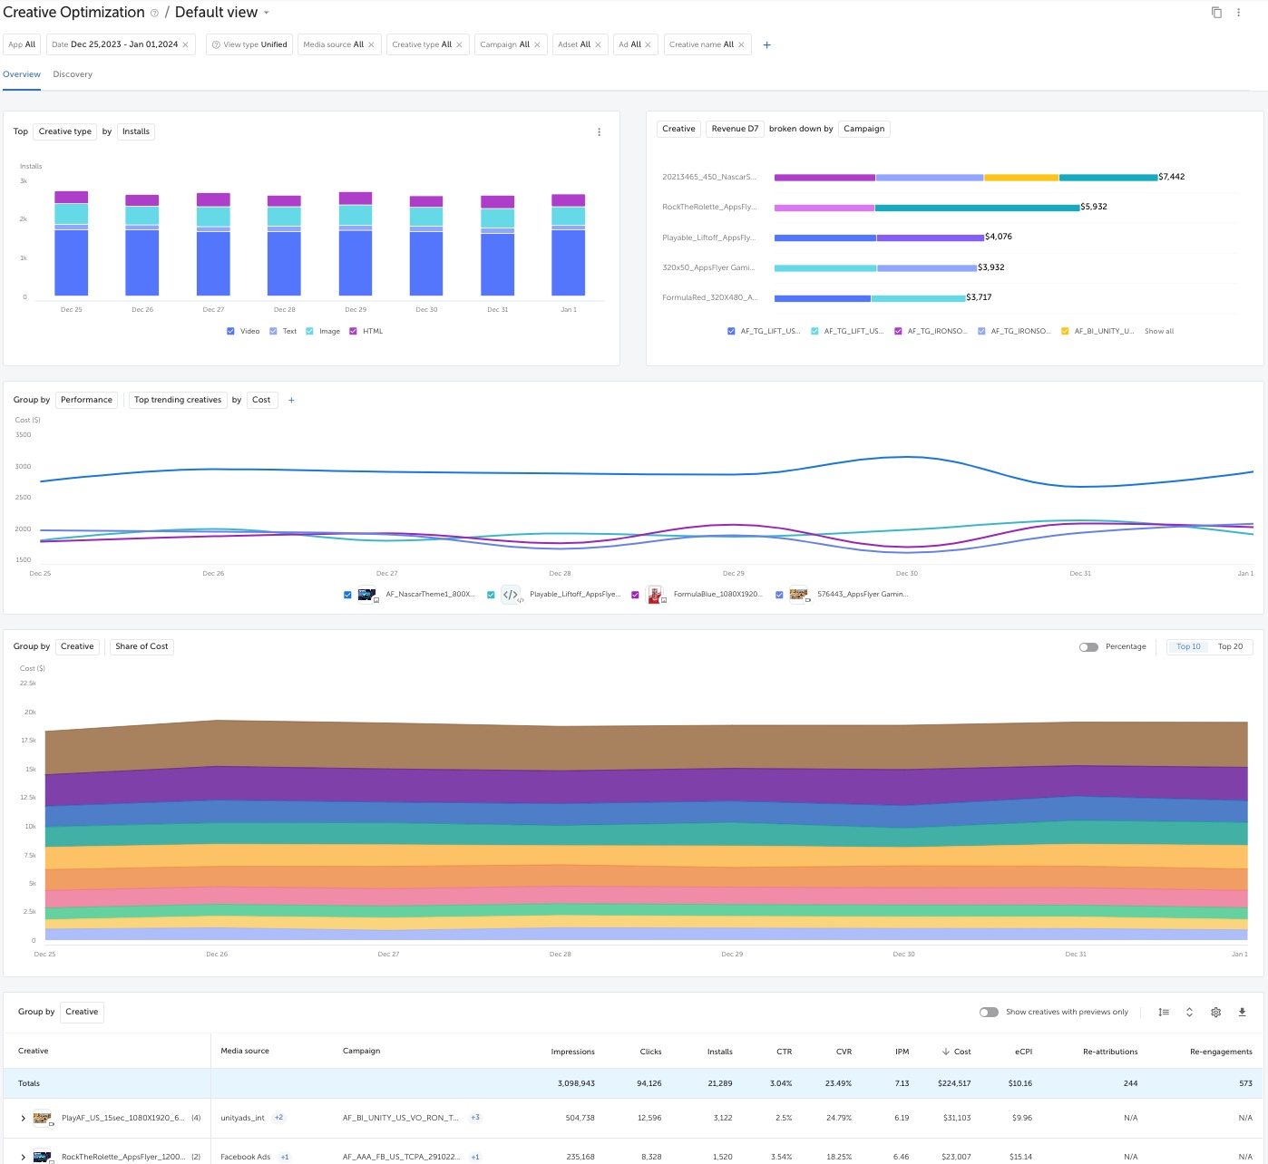
https://support.appsflyer.com/hc/en-us/articles/18564718580625-Creative-Optimization-guide?utm_source=chatgpt.com

Slide 21
