Slide 1
Enhancing Entertainment Experience through Data Analytics
Utilizing Data Analytics to Improve Audience Engagement and Satisfaction
BY:- MAYANK KUSH

Slide 2
Problem Statement:
Normal life can be stressful, and people need to relax. Being entertained by others is a wonderful way to take some time out of life. It can reduce stress and make life's issues easier to face. The media and entertainment industry consists of film, television, radio and print. These segments include movies, TV shows, radio shows, news, music, newspapers, magazines, and books. The entertainment industry is a group of sub-industries devoted to entertainment. The entertainment industry is used to describe the mass media companies that control the distribution and manufacture of mass media entertainment.
IMPORTANCE OF ENTERTAINMENT
Relaxation and Stress Relief: Entertainment provides a means for people to relax and unwind after a long day. Whether it's watching a movie, playing a game, or attending a concert, entertainment activities offer a break from the stresses of daily life.
Cultural Expression: Entertainment often reflects the culture and values of society. Through music, literature, film, and other forms of entertainment, people can explore different perspectives and gain insights into diverse cultures.
Social Bonding: Shared entertainment experiences can strengthen social bonds. Whether it's attending a sporting event with friends, watching a TV show with family, or discussing books with a book club, entertainment activities provide opportunities for people to connect and share experiences.
Education and Learning: Entertainment can be a powerful tool for education and learning. Documentaries, historical dramas, and other forms of entertainment can convey important information and stimulate curiosity about various subjects.

Slide 3

SCOPE OF THE PROJECT
Audience Analysis:
Analyzing viewer demographics, including age, gender, location, and socio-economic status.
Understanding viewer preferences in terms of genres, actors, directors, and specific content.
Exploring viewing habits such as binge-watching patterns, time of day preferences, and device usage.
2.Content Analysis:
Evaluating the performance of existing entertainment content across different platforms.
Identifying trends in popular genres, themes, and storytelling techniques.
Assessing the impact of content attributes (e.g., duration, language, rating) on audience engagement.
3.Predictive Modeling:
Forecasting future trends in the entertainment industry based on historical data and market analysis.
Predicting audience behavior and preferences to inform content creation and distribution strategies.
Anticipating shifts in viewer demand and adjusting business strategies accordingly.

Slide 4
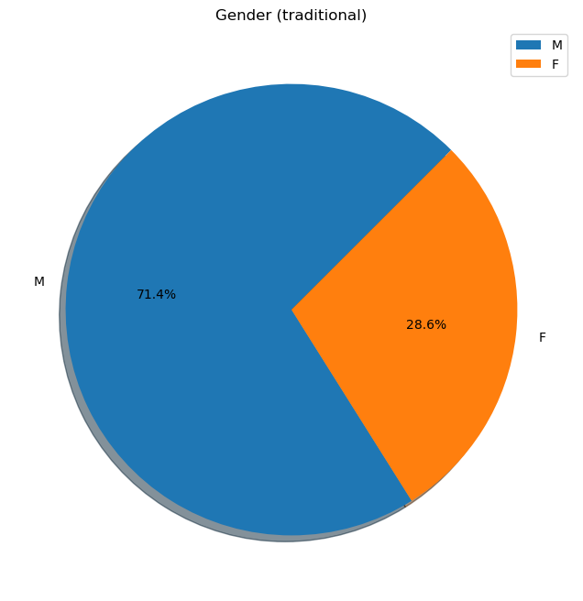
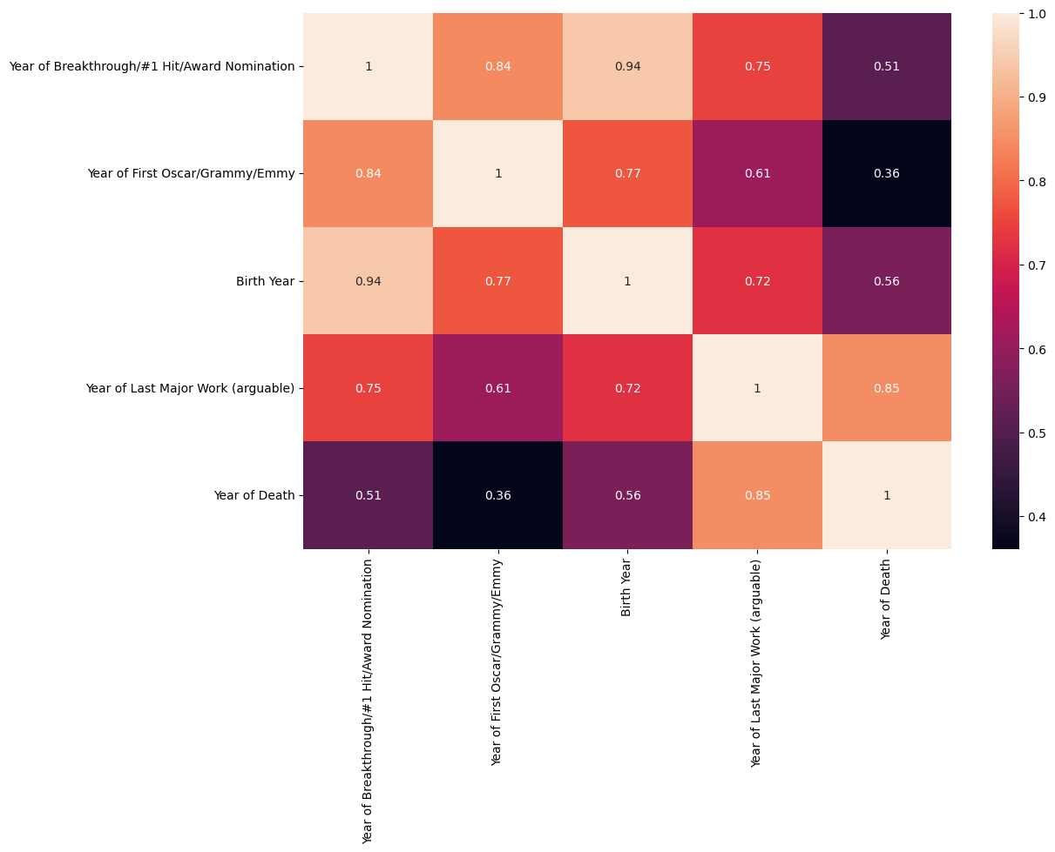
GRAPHS AND PLOTS

Slide 5
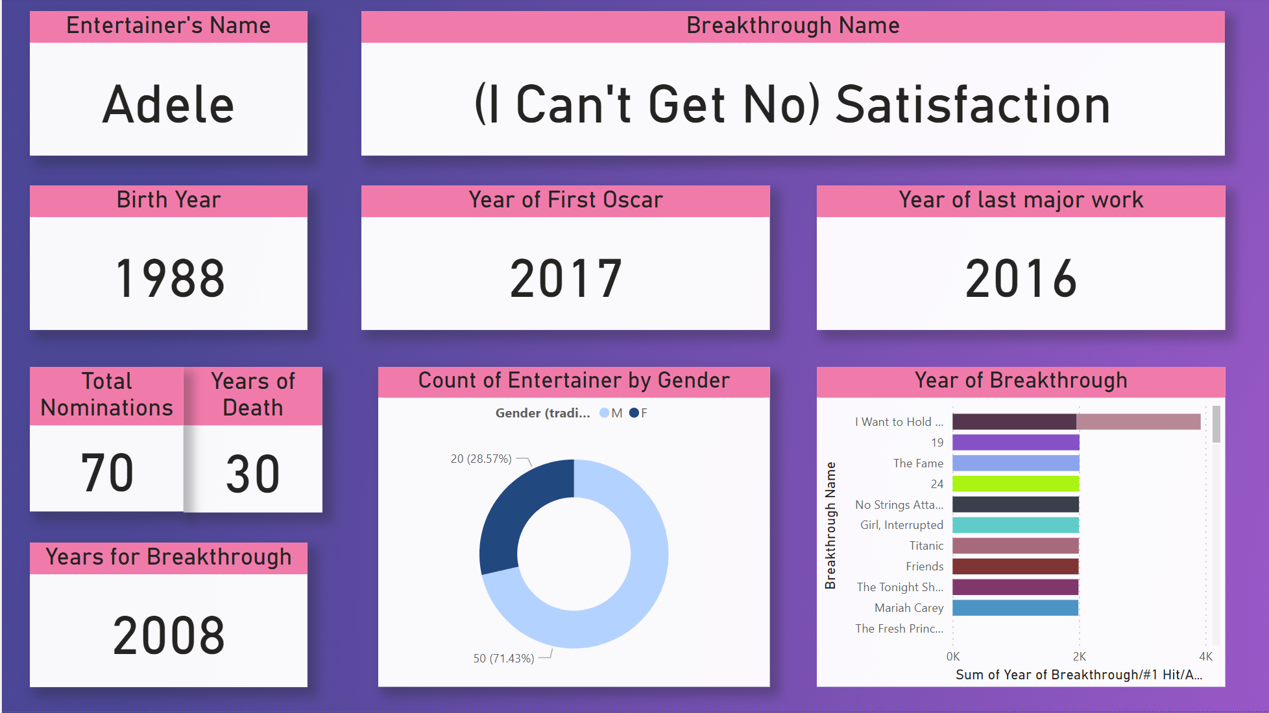
Dashboard

Slide 6

KEY findings
Around 71% of all the entertainers were male where as only 28% were female.
The most famous entertainer was ADELE as known as (I can’t get no) Satisfaction.
Adele got his first Oscar in 2017 and he stopped producing music in 2016.

Slide 7
SWOT Analysis and Conclusion
01
02
SWOT Analysis
Data analytics empowers businesses to identify strengths, weaknesses, opportunities, and threats, guiding strategic decision-making and business growth.
Conclusion
Leveraging data analytics in the entertainment industry is pivotal for driving innovation, enhancing audience experiences, and achieving sustainable business growth.

Slide 8

Thank you
MAYANK KUSH

