Slide 1
Problem statement: Studying the difference in lag of inter microservice transaction using rest api vs apache kafka with varying payload size, no. of clusters, environment etc.
By: Mayank kumar Agrawal gen id: 18777121

Slide 2
Event-Driven Microservices Using Spring Cloud Stream and Apacke Kafka

Slide 3
Network
Kafka uses a binary protocol over TCP. The protocol defines all apis as request response message pairs.
The client initiates a socket connection and then writes a sequence of request messages and reads back the corresponding response message. No handshake is required on connection or disconnection.
The server guarantees that on a single TCP connection, requests will be processed in the order they are sent and responses will return in that order as well.
Producers get an acknowledgement back when they publish a message containing the record's offset.

Slide 4
Batching
Batching small things together for efficiency. A clever client can make use of this and support an "asynchronous" mode in which it batches together messages sent individually and sends them in larger clumps.
Batching across multiple topics and partitions, so a produce request may contain data to append to many partitions and a fetch request may pull data from many partitions all at once.

Slide 5
Terms:
Source: is the application that consumes events
Processor: consumes data from the Source, does some processing on it, and emits the processed data to the next application in the pipeline
Sink: either consumes from a Source or Processor and writes the data to the desired persistence layer
Consumer Groups:
Consumer Types: Message-driven (sometimes referred to as Asynchronous)
Polled (sometimes referred to as Synchronous)

Slide 6
Programming Model:
Destination Binders: Components responsible to provide integration with the external messaging systems.
Destination Bindings: Bridge between the external messaging systems and application provided Producers and Consumers of messages (created by the Destination Binders).
Message: The canonical data structure used by producers and consumers to communicate with Destination Binders (and thus other applications via external messaging systems).

Slide 7
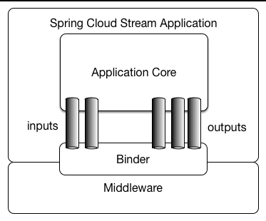

Slide 8
Benchmarking Apache Kafka:
https://engineering.linkedin.com/kafka/benchmarking-apache-kafka-2-million-writes-second-three-cheap-machines

Slide 9
Serialization:
It is the process of translating data structures or object state into a format that can be stored or transmitted (for example, across a network connection link) and reconstructed later (possibly in a different computer environment). When the resulting series of bits is reread according to the serialization format, it can be used to create a semantically identical clone of the original object. For many complex objects, such as those that make extensive use of references, this process is not straightforward. Serialization of object-oriented objects does not include any of their associated methods with which they were previously linked.

Slide 10
Send Custom Java Objects to Kafka Topic
If we intend to send custom java objects to producer, We need to create a serializer which implements org.apache.kafka.common.serialization.Serializer and pass that Serializer class during creation of your producer

Slide 11
RabbitMq vs Apache Kafka

