Slide 1
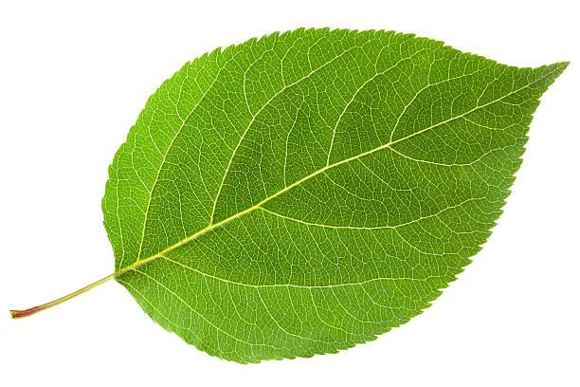
CVML Assignment 2
Plant disease detection using machine learning
Abhishek Kumar: 150101003 Gaurav: 150101024
Mayank Agrawal: 150101033 Saswata De: 150101058
Vaibhav Singh: 150101081

Slide 2
Why this is important
Agricultural productivity is something on which economy highly depends. This is the one of the reasons that disease detection in plants plays an important role in agriculture field, as having disease in plants are quite natural. If proper care is not taken in this area then it causes serious effects on plants and due to which respective product quality, quantity or productivity is affected.
A proper disease detection will ensure the well being of plants. Experts on plant
disease can detect diseases by seeing the plants. But a farmer on a normal gardener can’t detect these symptoms by bare eye. This implementation will help in these cases.

Slide 3
Input Dataset
Appropriate datasets are required at all stages of object recognition research, starting from training phase to evaluating the performance of recognition algorithms.
For our use case, we will be using “https://github.com/salathegroup/plantvillage_deeplearning_paper_dataset”
This dataset contains 54306 images, consisting of 14 type of plants and 26 diseases.

Slide 4
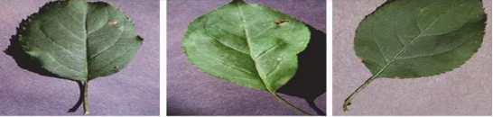
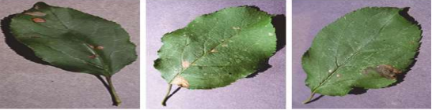
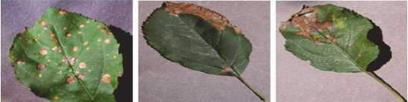
Dataset Images

Slide 5
Image Preprocessing
Building an effective neural network model requires careful consideration of the network architecture as well as the input data format. We need to remove the differences in the images due to different aspect ratios, intensity differences and background clutter for better performance.
Maintain uniform aspect ratio and scaling
Remove background of leaf images
Zoom on input image
Dimensionality reduction
Image augmentation
Normalizing image input

Slide 6
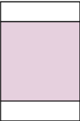
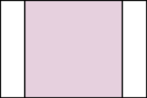
Uniform Aspect Ratio & Scaling
One of the first steps is to ensure that the images have the same size and aspect ratio. Most of the neural network models assume a equal sized square shape input image, so the first step should be cropping image to fit in our window.

Slide 7
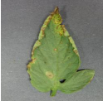
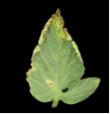
Removing Background
We need to remove the background of the image as there might be various type of background, which if we don’t remove, their influence might affect the performance of the training process.

Slide 8

Zoom in Input Image
We need to zoom into proper region of input leaf image so that only affected regions will be used to train our neural network. This way we can reduce the effects of the background even more.

Slide 9

Dimensionality Reduction
We could choose to collapse the RGB channels into a single greyscale channel. It is often considered to reduce other dimensions, when the neural network performance is allowed to be invariant to that dimension, or to make the training problem more tractable.

Slide 10
Image Augmentation
Another common pre-processing technique involves augmenting the existing data-set with perturbed versions of the existing images. Scaling, rotations and other affine transformations are typical done to expose the neural network to a wide variety of variations.

Slide 11
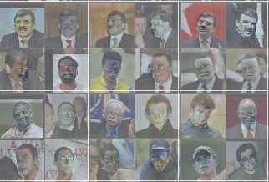
Normalizing Image
Data normalization is an important step which ensures that each input parameter (pixel, in this case) has a similar data distribution. This makes convergence faster while training the network. Data normalization is done by subtracting the mean from each pixel, and then dividing the result by the standard deviation.

Slide 12
Implementation of CNN
This set of experiments was done to understand if the neural network actually learns the “notion” of plant diseases, or if it is just learning the inherent biases in the dataset.
Experiment with coloured version. Using CNN methods on colored image of the leaf.
Experiment with TCNN version separately using CNN on RGB values of the image.
Experiment with a gray-scaled version. Experimenting on the gray scaled version of the image to get different results.
Removing extra background information. removing all the extra background information which might have the potential to introduce some inherent bias in the dataset due to the regularized process of data collection.

Slide 13
Proposed Architecture: AlexNet
AlexNet is the name of a convolutional neural network, invented by Alex Krizhevsky, Ilya Sutskever and Geoffrey Hinton. AlexNet has had a large impact on the field of machine learning, specifically in the application of deep learning to machine vision.
AlexNet contained eight layers; the first five were convolutional layers, and the last three were fully connected layers. It used the non-saturating ReLU activation function, which showed improved training performance over tanh and sigmoid.

Slide 14
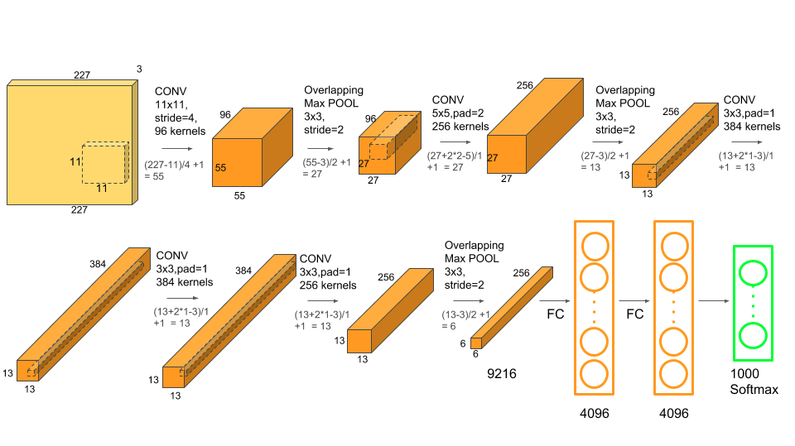
Proposed Architecture: AlexNet

Slide 15
Proposed Architecture: AlexNet
AlexNet consists of 5 Convolutional Layers and 3 Fully Connected Layers.
Multiple Convolutional Kernels (a.k.a filters) extract interesting features in an image. In a single convolutional layer, there are usually many kernels of the same size. For example, the first Conv Layer of AlexNet contains 96 kernels of size 11x11x3.
The first two Convolutional layers are followed by the Overlapping Max Pooling layers. The third, fourth and fifth convolutional layers are connected directly. The fifth convolutional layer is followed by an Overlapping Max Pooling layer.
The output of fifth convolution layer goes into a series of two fully connected layers. The second fully connected layer feeds into a softmax classifier with 1000 class labels. ReLU nonlinearity is applied after all the convolution and fully connected layers.

Slide 16
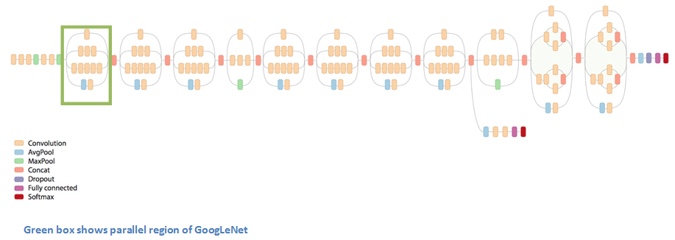
Proposed Architecture: GoogLeNet

Slide 17
Limitations
Many diseases don’t present themselves on the upper side of leaves only (or at all), but on many different parts of the plant. Thus, new image collection efforts should try to obtain images from many different perspectives, and ideally from settings that are as realistic as possible.
Tested on a set of images taken under conditions different from the images used for training, the model’s accuracy can reduce substantially, still this accuracy should be higher than the one based on random selection of classes.
Many diseases are hard to identify under normal outdoor lighting condition, the patterns maybe very fine and could be in the size of few micrometers.

Slide 18
References
https://www.frontiersin.org/articles/10.3389/fpls.2016.01419/full
https://www.hindawi.com/journals/cin/2016/3289801/
https://arxiv.org/ftp/arxiv/papers/1604/1604.03169.pdf
https://www.sciencedirect.com/science/article/pii/S1389041717303236
https://arxiv.org/ftp/arxiv/papers/1805/1805.08692.pdf
https://becominghuman.ai/image-data-pre-processing-for-neural-networks-498289068258

Slide 19
THANK YOU

