Slide 1


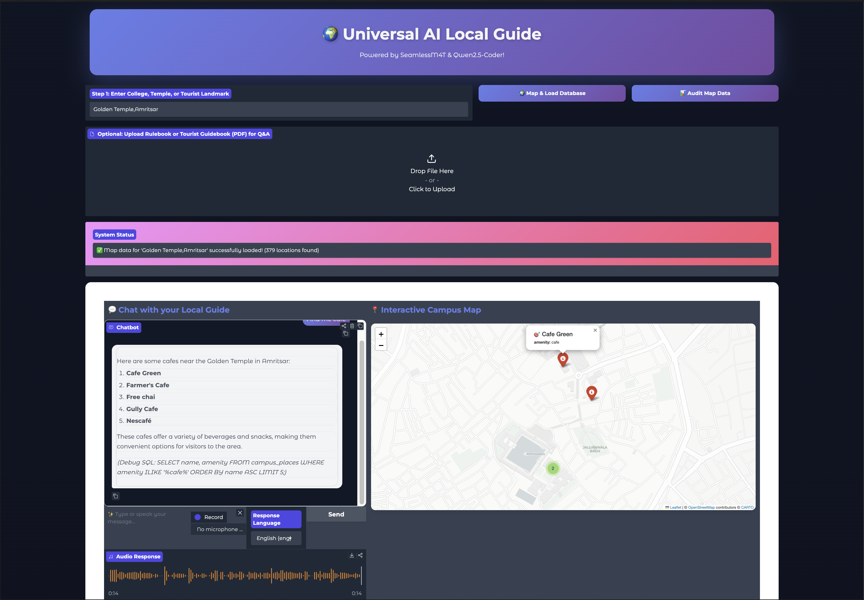
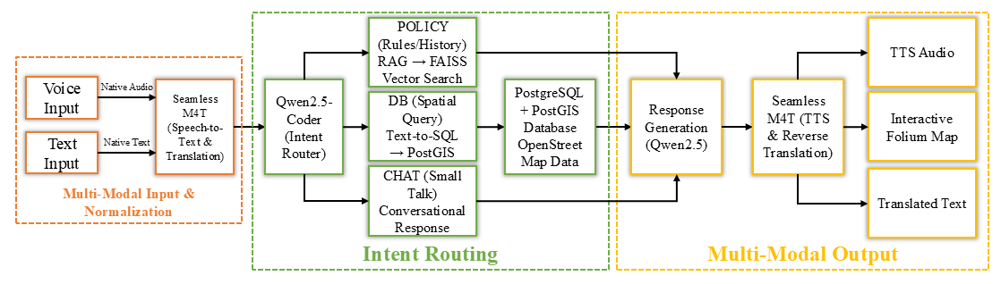
Visiting Summer Research Internship (ViSRI) 2026
Intent-Driven Spatial Search Engine
A Hybrid NL-to-SQL Architecture for Conversational Geographic Queries
Abstract
Results: Text-to-SQL Model Selection
Traditional digital maps rely on rigid keyword searches, failing when users ask for places naturally. To solve this, we built an Intent-Driven Spatial Search Engine that translates conversational, multilingual queries directly into structured database commands.
Running entirely offline on a local GPU, the system combines SeamlessM4T for speech translation with Qwen2.5-Coder for SQL generation.
Validated by our custom Hybrid Evaluation Framework, the architecture achieved a 78% success rate on complex geographic intents. It successfully bridges the gap between abstract human needs (like "a quiet place to study") and rigid mapping databases.
Four open-weight models evaluated on a 50-query benchmark:
• Qwen2.5-Coder (Winner): Excelled at native POSTGIS spatial logic without custom finetuning.
• SQLCoder-8B (Failed): Broke down when handling multi-step spatial joins (CTEs) and spatial exclusion queries.
• CodeS-7B (Failed): Exhibited severe schema hallucination due to over-finetuning on the BIRD benchmark.
• DeepSeek-Coder-7B (Failed): Struggled with PostGIS syntax alignment, producing malformed queries.
Model | Pass Rate | Fail Rate | Avg F1
Qwen2.5-Coder-7B | 78.0% | 4.0% | 0.780
SQLCoder-8B | 46.0% | 54.0% | 0.459
CodeS-7B | 32.0% | 68.0% | 0.385
DeepSeek-Coder-7B | 28.0% | 72.0% | 0.297
Problem Statement
Local Intent Failure:
When a user searches "quiet places near me," traditional maps look for a business literally named "Quiet" — suggesting a restaurant 1,000 km away, ignoring the spatial constraint.
The India-Specific Challenge:
Indian spatial navigation is informal and code-mixed (e.g., Hinglish). A query like "koi chai ki tapri hai kya paas mein?" requires translating slang, identifying the category, and enforcing a geographic radius.
Results: Translation Model Selection
56-query multilingual dataset across 5 Indian languages + slang:
• Sarvam-Translate (Winner): Successfully normalized complex Hinglish internet slang into formal English suitable for SQL parsing.
• NLLB & Seamless (Failed): Spelled out Hindi slang in English letters instead of translating it, which crashed the SQL engine.
• Google Translate: Provided a strong accuracy baseline, but was unable to achieve the strict 100% offline requirement.
Objectives
1. Dynamic Intent Capturing:
Translate conversational queries into PostGIS spatial constraints.
2. Colloquial Multilingual Translation:
Bridge regional Indian dialects/slang to formal English for the SQL AI.
3. Empirical Evaluation:
Validate SQL structure (AST parsing) and live database results (Semantic F1).
4. End-to-End System Integration:
Deploy a 100% offline pipeline for colleges, tourist places, and temples.
Model | Overall | Slang | Failures
Google Translate | 96.4% | 71.4% | 0
Sarvam-Translate (4B) | 87.5% | 71.4% | 2
NLLB-200 (1.3B) | 85.7% | 57.1% | 3
SeamlessM4T v2 | 83.9% | 42.9% | High
Results: Voice Recognition (ASR)
Dataset Curation (OpenStreetMap)
Tested on synthetic multilingual audio. Offline capability is required:
• SeamlessM4T v2 (Winner): Delivered fast, direct speech-to-English transcription while maintaining strict 100% offline capability.
• Sarvam API (Runner-up): Achieved the highest overall accuracy but requires internet (API).
• OpenAI Whisper (Failed): Struggled with low-resource Indian languages, failing heavily on Telugu and Marathi audio inputs.
• Google Speech (Failed): Provided moderate accuracy but requires internet (API).
To rigorously test spatial reasoning and linguistic robustness, we built a local PostGIS database using OpenStreetMap data (3km radius around IIT Bombay).
1. The English Golden Benchmark:
50 complex spatial queries across 5 difficulty tiers (Easy, Medium, Hard, Extra Intent, Extreme Spatial Math) designed to prevent structural redundancy.
2. The Multilingual Translation Dataset:
56 complex requests in Hindi, Tamil, Telugu, Marathi, and Punjabi (Native Script, Romanized, and Colloquial Slang) evaluated on text and synthetic audio.
Model | Pass Rate | WER | Type
Sarvam API | 83.9% | 0.339 | Cloud
SeamlessM4T v2 | 82.1% | 0.470 | Offline
Google Speech | 78.6% | 0.514 | Cloud
OpenAI Whisper | 66.1% | 0.632 | Offline
Hybrid Evaluation Framework
To rigorously test the Text-to-SQL models, we developed a two-step evaluation pipeline inspired by Spider and BIRD:
1. Structural Validation (AST Parsing):
Using sqlglot, we parse the generated SQL into an Abstract Syntax Tree to evaluate 7 dimensions (SELECT clauses, spatial JOINs, WHERE logic, ORDER BY, LIMIT, and PostGIS function accuracy). This ensures safe query structure and prevents hallucinated columns or unbounded data retrieval.
2. Execution Validation (Semantic F1):
Structurally safe queries are executed live against a PostGIS database loaded with OpenStreetMap data. The returned locations are compared against a manually-curated Golden Benchmark to calculate Precision, Recall, and F1 scores, ensuring the spatial math actually works.
Interactive Map UI
The Final End-to-End App
The final offline product is a fully integrated pipeline that natively supports spatial routing and policy lookups:
1. User Input: User provides a query via Voice (Microphone) or Text (Keyboard) in their native language.
2. Audio/Text Processing: SeamlessM4T instantly transcribes audio and translates the native query (Voice or Text) to English
3. Small-Talk Filter: Qwen intercepts small talk (e.g., 'Hello') without wasting database time.
4. Generating SQL: Qwen translates spatial intent into strict PostGIS code.
5. Database Search: SQL is executed on the local PostGIS map, returning coordinates.
6. Reverse Translation: Qwen summarizes results; SeamlessM4T translates the English summary back to the user's native language.
7. Map & Voice Output: Locations are plotted interactively on a map; SeamlessM4T generates a synthetic voice clip (TTS Audio) and outputs the Translated Text.
Conclusion
System Architecture
Qwen2.5-Coder handles SQL generation while SeamlessM4T provides multilingual translation — together, they replace traditional keyword search with intelligent spatial querying. Voice input and interactive maps allow users to search for places the way they naturally speak, in any language.
Key Achievement: A multilingual spatial search pipeline that converts natural language into precise map results.
References
[1] V. Zhong, C. Xiong, and R. Socher, "Seq2SQL: Generating structured queries from natural language using reinforcement learning," arXiv preprint arXiv:1709.00103, 2017.
[2] T. Yu et al., "Spider: A large-scale human-labeled dataset for complex and cross-domain semantic parsing and text-to-sql task," in Proc. EMNLP, 2018.
[3] J. Li et al., "Can LLM already serve as a database interface? A BIg Bench for Large-Scale Database Grounded Text-to-SQLs," in Proc. NeurIPS, 2023.
[4] S. Chang et al., "Dr.Spider: A diagnostic evaluation benchmark for robust text-to-sql," in Proc. ICLR, 2023.
[5] H. Jiao et al., "GeoSQL-Eval: First evaluation of LLMs on PostGIS-based NL2GeoSQL queries," Expert Syst. Appl., 2026.
Candidate Name: Mayank Pillai Supervisor: Prof. Yashvardhan Sharma
Institute Name: Newton School of Technology Department: Computer Science & Information Systems

