Slide 1

Flight Delay Prediction with Deep Learning
Project 21 · CSAI
Phase 2: MLP with Entity Embeddings
Asad Ali · Divyansh Bhartia · Vikrant Yadav · Mayank Pillai · Prashant Raj
Notes:
Suggested presenter: Mayank Pillai.
Phase 2 adds a deep learning model to the same flight delay problem from Phase 1: a multilayer perceptron with learned embeddings for carrier, origin and destination.

Slide 2


From Phase 1 to Phase 2
Phase 1 (Machine Learning)
Predict arrival 15+ min late, before departure
Leakage-free features, split by date
Logistic Regression: PR AUC 0.376
XGBoost: PR AUC 0.391 (best)
Phase 2 (Deep Learning)
MLP with learned embeddings for carrier, origin and destination
Same data, features, split and metrics: a fair comparison
Regularisation, seed stability and an ablation study
Calibration and a what-if rescheduling analysis
Phase 2 changes only the model, so any difference in results comes from the model itself.
Notes:
Suggested presenter: Mayank Pillai.
Recap Phase 1: the task, the leakage rules and the best model (XGBoost, PR AUC 0.391). Phase 2 keeps everything identical except the model, so any difference in the results comes from the model itself.

Slide 3




What the deep learning literature tells us
Entity embeddings
Guo & Berkhahn (2016): map each category to a learned vector, as word embeddings do for words (Mikolov et al., 2013)
Regularisation
Dropout (Srivastava et al., 2014), AdamW weight decay (Loshchilov & Hutter, 2019), early stopping (Prechelt, 1998)
Trees are strong on tables
Grinsztajn et al. (2022), Shwartz-Ziv & Armon (2022): boosted trees often match or beat deep nets on tabular data
Calibration
Guo et al. (2017): neural networks are often over-confident; temperature scaling fixes it with one number
Notes:
Suggested presenter: Mayank Pillai.
Four ideas from the literature shape the model: entity embeddings for categorical inputs, standard regularisation, the known strength of boosted trees on tabular data (so XGBoost is a strong reference, not a weak baseline), and the calibration problem of neural networks. Full references are in the report.

Slide 4


Preparing the data for a neural network
Same 327,346 flights, leakage rules, features and date split as Phase 1. Three changes for the network:
Categories to ids
Carrier, origin and destination become integer ids from the training set. Id 0 means 'never seen' (57 test flights).
Standardised numbers
The 14 numeric features are scaled to mean 0 and std 1 with training statistics; missing history gets the training mean.
No class weights
Plain cross-entropy keeps probabilities close to the real delay rate. Ranking (PR/ROC AUC) is barely affected.
Split: train Jan to Aug (217,727) · validation Sep to Oct (55,628) · test Nov to Dec (53,991)
Notes:
Suggested presenter: Asad Ali.
The network needs numbers: categories become integer ids that index the embedding tables, with a shared 'unknown' id for destinations that only appear in the test months. Numeric inputs are standardised so that all features have a similar scale, which helps gradient descent. We do not use class weights, because they would push the probabilities up without improving the ranking.

Slide 5
Architecture: MLP with entity embeddings
14 numeric features
time (sin/cos), distance, congestion, 7-day delay rates
Carrier id → 8-d vector
17 ids
Concatenate
40 values
Dense 128
ReLU + Dropout 0.3
Dense 64
ReLU + Dropout 0.3
Output
1 logit → sigmoid → P(delay)
Origin id → 2-d vector
4 ids
Destination id → 16-d vector
103 ids
Key facts
15,361 trainable parameters, 1,792 of them in the embeddings
Embeddings are learned together with the network by back-propagation
Loss: binary cross-entropy on the logit
Notes:
Suggested presenter: Divyansh Bhartia.
Each category id selects a row of its embedding table: an 8-number vector for the carrier, 2 for the origin airport and 16 for the destination. These are concatenated with the 14 numeric features into 40 inputs, then two hidden layers with ReLU and dropout, and one output logit turned into a probability by the sigmoid. The embedding sizes are small and grow with the number of categories. The embeddings start random and are learned with the rest of the network.

Slide 6
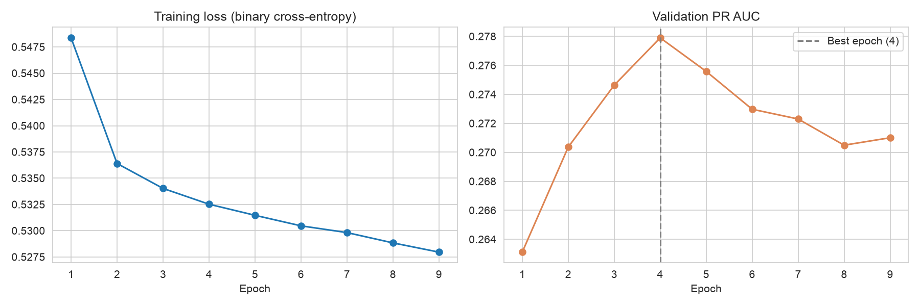
Training and regularisation
Optimiser
AdamW, learning rate 0.001, mini-batches of 1,024
Regularisation
Dropout 0.3 and weight decay 0.0001
Early stopping
Keep the best validation epoch, stop after 5 without gain
Notes:
Suggested presenter: Vikrant Yadav.
The training loss keeps falling, but the validation PR AUC peaks at epoch 4 and then drops: the network starts fitting patterns of the training months that do not repeat in autumn. Early stopping keeps the epoch-4 weights. Dropout switches off random neurons during training and weight decay keeps the weights small; both reduce overfitting.

Slide 7
Stable across random seeds
Seed | Epochs | Val PR AUC | Test PR AUC | Test ROC AUC
0 | 9 | 0.278 | 0.386 | 0.653
1 | 13 | 0.273 | 0.383 | 0.653
2 | 8 | 0.271 | 0.386 | 0.649
3 | 11 | 0.272 | 0.380 | 0.651
4 | 8 | 0.271 | 0.387 | 0.653
0.385 ± 0.003
test PR AUC over 5 seeds
Random start, batch order and dropout change with the seed
Differences under about 0.005 are noise, which matters when reading the ablation
Notes:
Suggested presenter: Vikrant Yadav.
Neural network training is random. We trained the same model with five seeds: the test PR AUC stays between 0.380 and 0.387. So we only trust differences bigger than about half a point.

Slide 8
The MLP lands between the two Phase 1 models
Model | PR AUC | ROC AUC | Rec@P0.5 | Brier
Log. Reg. | 0.376 | 0.645 | 0.059 | 0.228
XGBoost | 0.391 | 0.656 | 0.111 | 0.219
MLP | 0.386 | 0.653 | 0.094 | 0.182
What it means
MLP clearly beats Logistic Regression
XGBoost still ranks flights slightly better, as the literature expects for tabular data
MLP has the best probabilities (lowest Brier score)
Notes:
Suggested presenter: Prashant Raj.
On the November to December test set, the MLP reaches PR AUC 0.386: better than Logistic Regression, slightly behind XGBoost. This matches studies showing that boosted trees are very strong on tabular data. But the MLP's Brier score of 0.182 is the best of all models, so its probabilities are the most reliable.

Slide 9
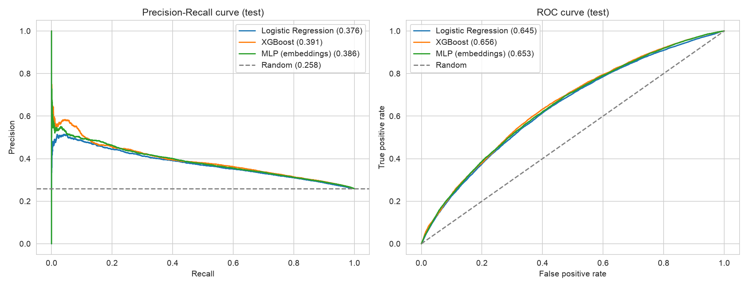
Precision-recall and ROC curves on the test set
The MLP and XGBoost curves almost overlap; both stay clearly above random guessing. Logistic Regression is a little lower.
Notes:
Suggested presenter: Prashant Raj.
The curves show the same picture as the table at every threshold: MLP and XGBoost close together, Logistic Regression slightly lower, all well above random.

Slide 10
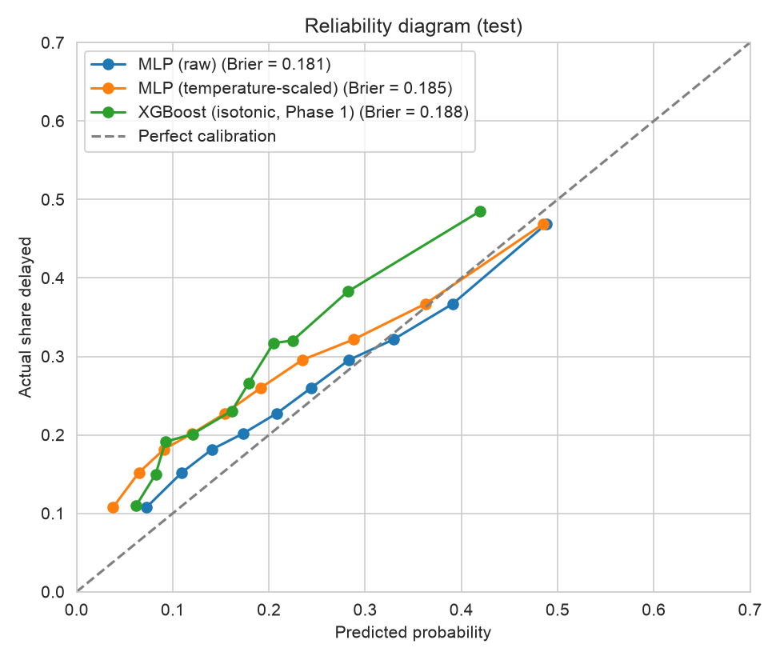
The raw MLP gives the best-calibrated probabilities
MLP (raw)
best: no calibration needed
0.182
MLP + temperature scaling
T = 0.785, slightly worse
0.185
XGBoost + isotonic (Phase 1)
under-predicts delays
0.188
Brier score, lower is better. Calibration fitted on Sep to Oct (15.7% delayed) pulls test predictions (25.8% delayed) too low.
Notes:
Suggested presenter: Prashant Raj.
Trained without class weights, the MLP's probabilities are already close to the diagonal. We tried temperature scaling, the standard fix for neural networks: it learned T = 0.785 on the calm validation months and made the probabilities slightly worse on the busier test months. So we keep the raw probabilities. The same seasonal shift affects the isotonic calibration of XGBoost.

Slide 11
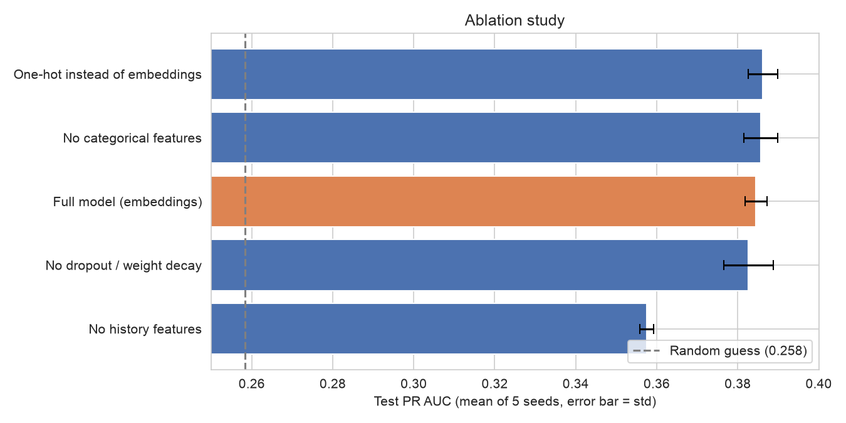

Ablation: history features matter most
History features
Without them PR AUC drops from 0.385 to below 0.36
Embeddings
Same as one-hot or no categories at all: the history features already carry that information
Regularisation
Small gain, and half the seed-to-seed spread
Each variant: 5 seeds; bars show the mean test PR AUC, error bars one standard deviation.
Notes:
Suggested presenter: Mayank Pillai.
We removed one part at a time and retrained with five seeds. Removing the 7-day history features hurts a lot. Replacing embeddings with one-hot vectors, or dropping the categories completely, changes nothing beyond noise, because the recent delay rates of carrier, airports and route already summarise them. Regularisation mainly makes results more stable.

Slide 12
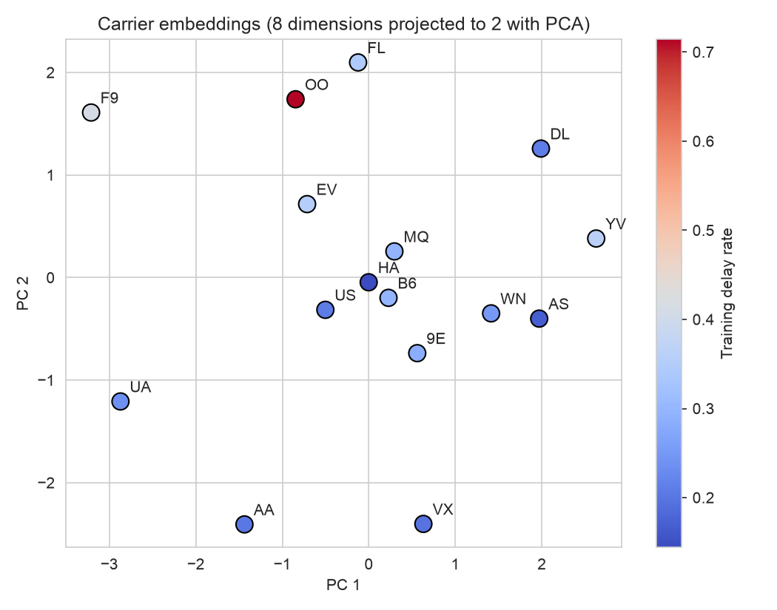



What did the carrier embeddings learn?
8 numbers per carrier
Projected to 2 dimensions with PCA for plotting
Weak link to delay rate
PC 1 correlates only weakly with each carrier's delay rate (r = -0.25)
Why
The carrier's recent delay rate is already an input, so the embedding learns smaller differences instead
OO is an outlier: only 7 training flights.
Notes:
Suggested presenter: Divyansh Bhartia.
Each carrier is an 8-number vector. PCA squeezes them to 2 numbers for this plot. Carriers do not line up by delay rate, which agrees with the ablation: the network gets the delay level from the history features, so the embeddings capture other, smaller differences.

Slide 13
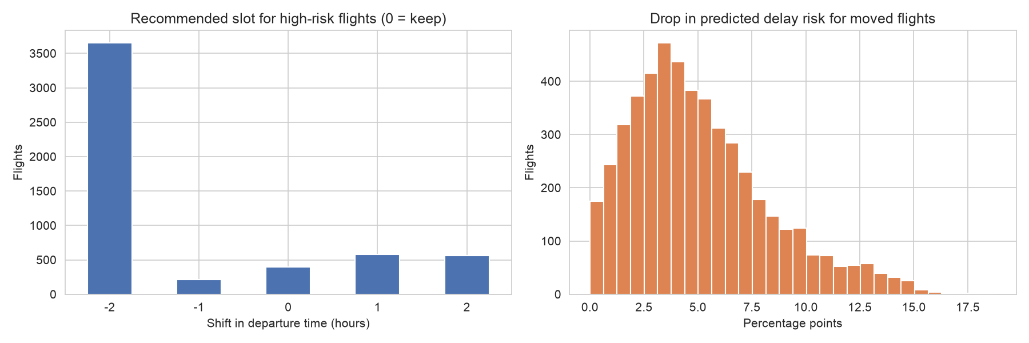
What-if: moving high-risk flights
92.7%
have a lower-risk slot
40.7%
drop 5+ points of risk
Assumptions
Top 10% riskiest test flights (5,400); move -2 to +2 hours, same day, no arrival after midnight
Congestion recomputed; route, carrier and history unchanged
One flight at a time; crews, aircraft and gates ignored. Not causal.
0.488 → 0.441
mean predicted risk
Notes:
Suggested presenter: Prashant Raj.
The brief asks for an offline rescheduling analysis with explicit assumptions. We re-score the riskiest 10% of test flights at alternative departure times and recommend a move only if risk drops. Most recommendations are two hours earlier, because delays build up during the day. These are model estimates, not causal effects: moving thousands of flights would itself change congestion.

Slide 14


Takeaways and limitations
What we found
MLP: PR AUC 0.386, between LR (0.376) and XGBoost (0.391)
Best-calibrated probabilities (Brier 0.182)
History features drive the predictions; embeddings add little
Limitations
No weather or air traffic data
One city, one year; calmer validation months
What-if is a model estimate, not causal
Next steps
Weather forecasts as inputs
Sequence model over ordered aircraft or airport history
Hybrid: learned embeddings fed to XGBoost
Notes:
Suggested presenter: Mayank Pillai.
The deep model learns the same signal as the trees and gives the most reliable probabilities, but it does not beat XGBoost at ranking, which matches the tabular-data literature. Most predictive power comes from the engineered history features.

Slide 15

Thank you
Questions?
Asad Ali · Divyansh Bhartia · Vikrant Yadav · Mayank Pillai · Prashant Raj
github.com/mayank-pillai-99/flight-delay-prediction
Notes:
Open the floor to questions. Each member should be ready to explain their own part and the whole pipeline.

