Slide 1

Flight Delay Prediction via Gradient Boosting
Project 21 · CSAI
Phase 1: Machine Learning
Asad Ali · Divyansh Bhartia · Vikrant Yadav · Mayank Pillai · Prashant Raj
Notes:
Suggested presenter: Mayank Pillai.
Introduce the team and the project: Project 21, predicting flight delays. Phase 1 is the Machine Learning part: data, features, Logistic Regression and XGBoost. Phase 2 will add deep learning.

Slide 2



Can we predict a delay before the flight leaves?
Target
Arrival 15 or more minutes late, the US standard definition of a delayed flight
24.5%
Decision time
Before departure (the morning of the flight day): only the schedule and past days may be used
of flights were delayed
2013 New York City departures
About 1 in 4, so the classes are imbalanced: accuracy is misleading, PR AUC is used instead
Why it matters
Airlines can plan spare crews and aircraft, and warn passengers early
Notes:
Suggested presenter: Mayank Pillai.
The task is binary classification: will the flight arrive 15+ minutes late? The key constraint is timing: the prediction is made before departure, so any information from after the plane leaves is forbidden. About a quarter of flights are delayed, so always predicting 'on time' would already be 75% accurate. That is why we use PR AUC.

Slide 3
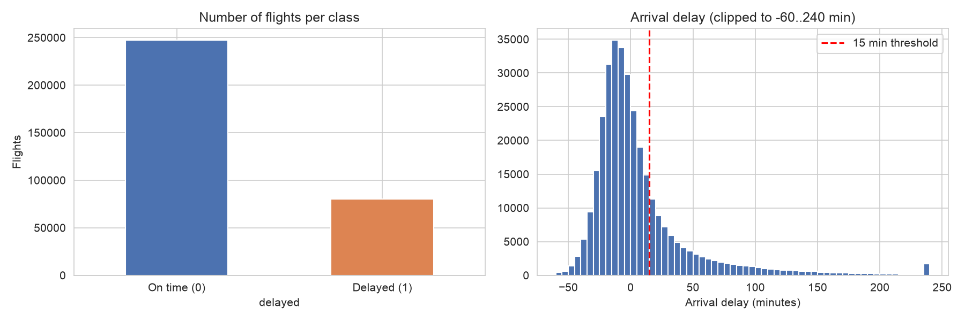
Dataset: every NYC departure in 2013
336,776
flights in the raw data
3
airports: JFK, LGA, EWR
327,346
flights kept after cleaning
Data quality
9,430 flights have no arrival delay (cancelled or diverted), so they are removed
0 duplicate rows
Delays have a long right tail: a few flights are hours late
Notes:
Suggested presenter: Asad Ali.
The dataset is nycflights13, the Kaggle Flights 2013 data: all flights that left the three New York airports in 2013. Cancelled and diverted flights have no arrival delay, so we cannot build the target for them and they are removed. There are no duplicates. The left chart shows the class imbalance; the right chart shows that most flights are early or on time, with a long tail of large delays.

Slide 4
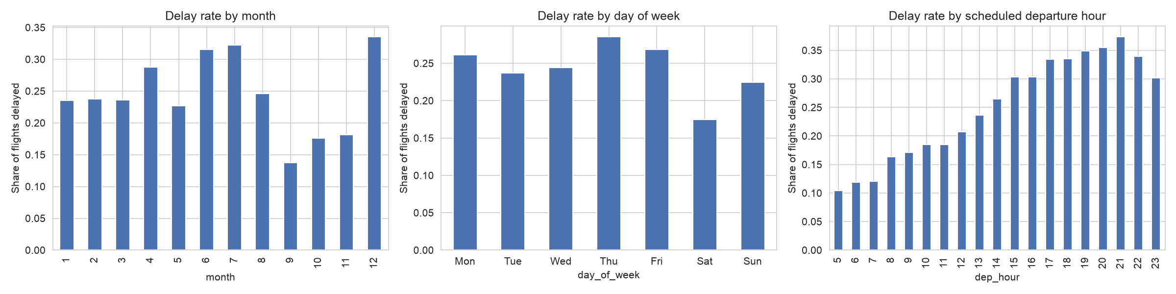
Delays build up through the day
Hour of day
About 10% of 5 am flights are late, rising to about 37% at 9 pm
Season
Dec, Jul and Jun are worst (over 30%); Sep to Nov are calmest (under 20%)
Day of week
Saturday is the best day (about 18% delayed)
Notes:
Suggested presenter: Asad Ali.
The strongest pattern is the hour of the day: delays accumulate through the network, so late flights are much more often delayed. The delay rate also changes a lot over the year, which matters because we split by date. Saturdays have the fewest delays.

Slide 5
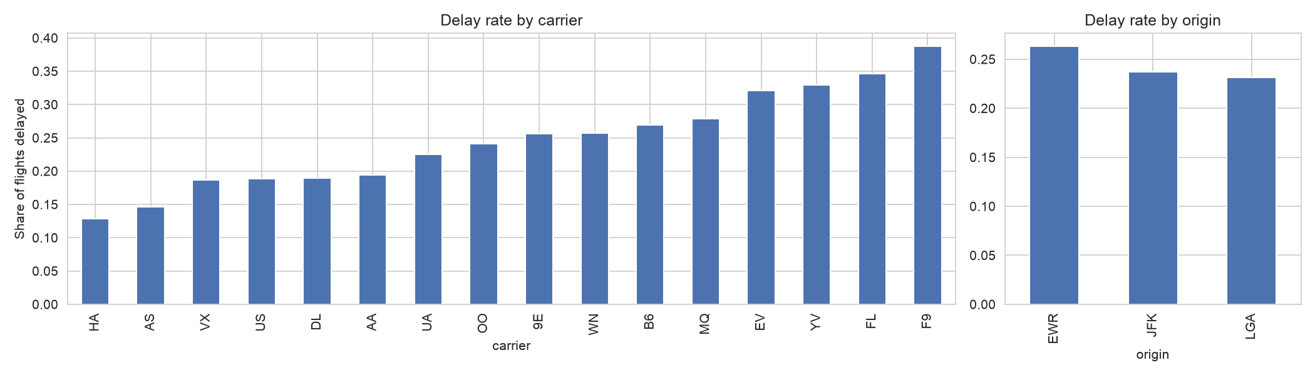
Carrier and airport matter too
Carriers
From 13% delayed (HA) to 39% (F9)
Airports
EWR is the most delayed of the three (26%)
What it means
Carrier, airport and hour are useful features
Notes:
Suggested presenter: Asad Ali.
Carriers differ a lot: some are delayed three times as often as others. Newark is the most delayed airport. Together with the hour of day, this tells us which features to build.

Slide 6



No information from after departure
Decision time: the morning of the flight day. Every feature must be known by then.
Removed (only known after departure)
Actual departure time and delay
Actual arrival time and delay (used only for the target)
Air time
Tail number and flight number (IDs)
Kept (known in advance)
Date, scheduled departure and arrival time
Carrier, origin, destination, distance
The published schedule of all flights
Outcomes of past days only
Congestion counts use the full schedule, including flights that were later cancelled. Counting only completed flights would leak the weather: bad days have many cancellations.
Notes:
Suggested presenter: Divyansh Bhartia.
Data leakage means using information the model could not have at prediction time. We fix the decision time first and then remove every column only known after departure. A subtle case: if we counted only flights that actually flew, days with many cancellations (bad weather) would look quiet, and that would secretly tell the model about the weather. So congestion is counted on the full schedule.

Slide 7




Four groups of pre-departure features
Calendar and schedule
Weekend flag and distance. Hour and day of week use cyclic encoding: sin(2πt/P) and cos(2πt/P), so hour 23 sits next to hour 0
Airport congestion
Flights scheduled to leave the same airport in the same hour and on the same day
Recent delay history
Share of delayed flights for the carrier, origin, destination and route over the previous 7 days, today excluded
Categories and route
Carrier, origin and destination one-hot encoded; route = origin and destination pair (223 routes)
Month is left out on purpose: the test months (Nov to Dec) never appear in training.
Notes:
Suggested presenter: Divyansh Bhartia.
Four feature groups, all available before departure. Cyclic encoding puts time on a circle so that 23:00 and 00:00, or Sunday and Monday, are neighbours. The history features use a 7-day window shifted by one day, so a flight never sees its own day or the future. Month is not used because, with a date-based split, the model never sees November or December in training.

Slide 8

Split by date, not at random
Train
Jan to Aug
217,727 flights · 26.4% delayed
Validation
Sep to Oct
55,628 · 15.7%
Test
Nov to Dec
53,991 · 25.8%
XGBoost tuning: expanding-window time-series folds
Fold 1: train Jan to Apr
May to Jun
Fold 2: train Jan to Jun
Jul to Aug
Fold 3: train Jan to Aug
Sep to Oct
The test months are never used for tuning. They are used once, for the final results.
Notes:
Suggested presenter: Mayank Pillai.
A random split would mix days, so the model would learn from the same days it is tested on, which is impossible in real life. We train on January to August, validate on September to October and test on November to December. Because one validation period is a noisy guide (September and October were very calm), XGBoost is tuned with three expanding-window folds and we average the PR AUC.

Slide 9


A linear baseline and boosted trees
Tuning results (mean PR AUC of 3 folds)
Depth | Trees | PR AUC
3 | 100 | 0.377
4 | 100 | 0.376
6 | 100 | 0.376
3 | 300 | 0.370
4 | 300 | 0.369
6 | 300 | 0.367
Logistic Regression
P(delay) = σ(w·x + b)
L2-regularised log loss
Inputs standardised
Balanced class weights
Simple and interpretable baseline
XGBoost
Sum of small trees, each fixing the errors of the ones before
Learns non-linear effects and interactions
Learning rate 0.05, subsample 0.8, min child weight 50
scale_pos_weight = 2.79 for imbalance
Best: depth 3, 100 trees. Bigger models did worse on future months.
Notes:
Suggested presenters: Vikrant Yadav (Logistic Regression) and Mayank Pillai (XGBoost).
Logistic Regression is a linear model of the log-odds, trained with L2 regularisation; class weights make the rare delayed class count more. XGBoost adds small decision trees one after another, each fitted to the gradient of the loss, with a second-order approximation and a penalty on tree size. The tuning table shows that the smallest model generalised best to later months.

Slide 10
XGBoost is the best model on the test set
Model | PR AUC | ROC AUC | Brier
Random | 0.258 | 0.500 | -
Log. Reg. | 0.376 | 0.645 | 0.228
XGBoost | 0.391 | 0.656 | 0.219
11.1%
of delayed flights caught when half of the alerts must be real delays (Logistic Regression: 5.9%)
Notes:
Suggested presenter: Prashant Raj.
On the November to December test set, both models beat random guessing (PR AUC equal to the delay rate, 0.258). XGBoost has the best PR AUC, ROC AUC and Brier score. Its biggest advantage is at high precision: if we only raise an alert when we are fairly sure, XGBoost catches almost twice as many delayed flights.

Slide 11
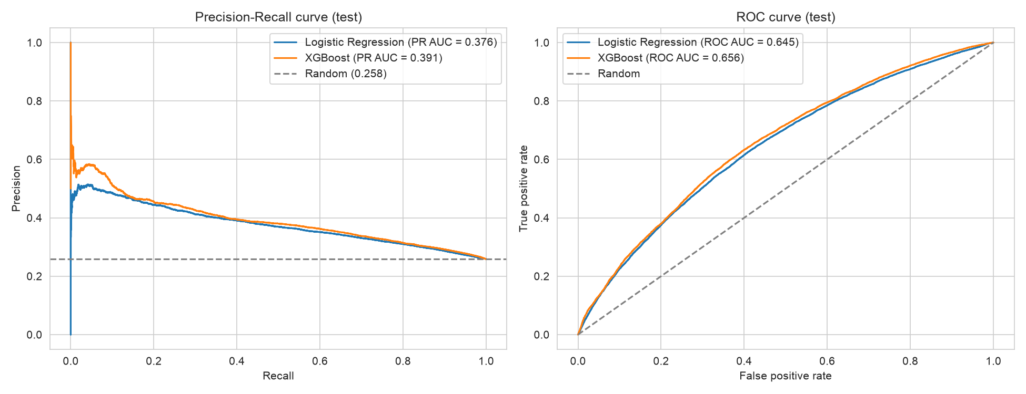
Precision-recall and ROC curves on the test set
Dashed lines show a random guess. Both models are clearly above it, but delays stay hard to predict before departure: weather and air traffic control are not in the features.
Notes:
Suggested presenter: Prashant Raj.
The PR curve shows precision against recall for every threshold; the area under it is PR AUC. The ROC curve shows true against false positive rate. An ROC AUC around 0.65 is normal for schedule-only features: most delay causes, like weather, are not known in advance.

Slide 12
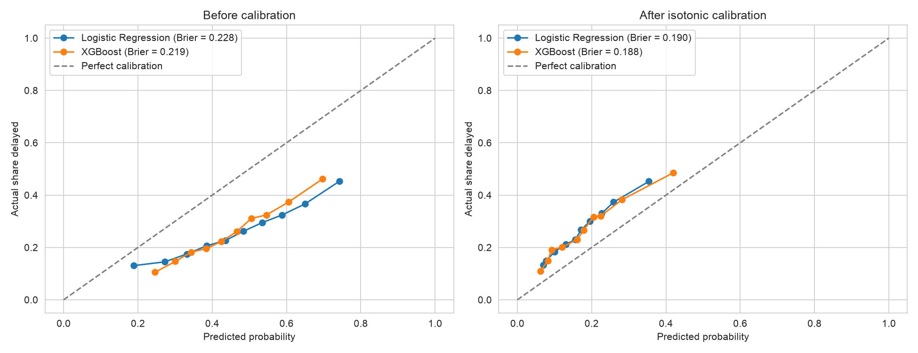
Calibration fixes over-confident probabilities
Brier score (lower is better)
Logistic Regression
0.228 → 0.190
XGBoost
0.219 → 0.188
A constant guess scores 0.192. The calibrated models slightly under-predict, because Sep to Oct were calmer than Nov to Dec.
Isotonic regression is fitted on the validation set and applied to the test set.
Notes:
Suggested presenter: Prashant Raj.
Calibrated means: of the flights given a 30% delay probability, about 30% really are delayed. Class weighting makes the raw probabilities far too high (curves below the diagonal). Isotonic regression maps the scores to calibrated probabilities and cuts the Brier score from about 0.22 to 0.19. Be honest in the viva: a constant guess scores 0.192, so the probabilities are reliable but only somewhat sharper than the average.

Slide 13
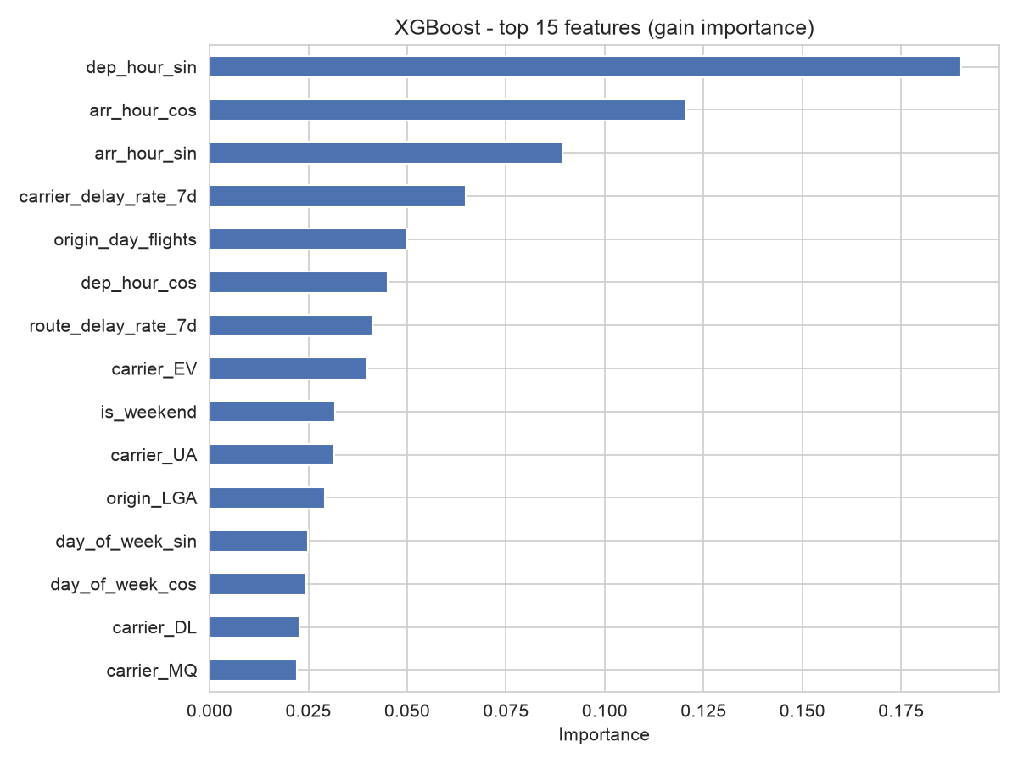
Time of day and recent delays drive predictions
Hour of day comes first
The sin and cos of the departure and arrival hour rank highest: later flights are riskier
Recent delays carry over
The carrier's and route's delay rate over the last 7 days
Busy days add risk
More flights scheduled at the origin that day means more delays
Logistic Regression's largest coefficients agree.
Notes:
Suggested presenter: Mayank Pillai.
Gain importance measures how much each feature improves the trees' splits. The encoded hour features dominate, then the recent delay rate of the carrier, the number of flights scheduled that day and the route's recent delay rate. Logistic Regression agrees: the sine of the departure hour has a large negative weight, which means afternoon and evening flights get a higher risk.

Slide 14


Takeaways and next steps
What we found
XGBoost beats Logistic Regression, most clearly at high precision
Calibration makes the probabilities usable
Time of day and recent delays are the strongest signals
Limitations
Weather and air traffic control are not in the data
Only NYC airports and only 2013
Test months differ from training months
Phase 2
Neural network with learned embeddings for carrier, origin and destination
Same date split and metrics for a fair comparison
Notes:
Suggested presenter: Mayank Pillai.
Summarise: pre-departure information carries a real but limited delay signal; XGBoost is the better model, especially when we want confident alerts; calibrated probabilities are usable for planning. Limitations: no weather, one city, one year, seasonal shift. Phase 2 will add a deep learning model with embeddings and compare it fairly on the same split.

Slide 15

Thank you
Questions?
Asad Ali · Divyansh Bhartia · Vikrant Yadav · Mayank Pillai · Prashant Raj
github.com/mayank-pillai-99/flight-delay-prediction
Notes:
Open the floor to questions. Each member should be ready to explain their own part and the overall pipeline.

