Slide 1
Integrate Grafana with Azure Virtual Machine
A Step-by-Step Guide

Slide 2
Team Members
Mayank Tiwari (TL)
Sandeep Singh
Naman Singh
Kartik Bajpai
Lokesh Kushwaha
Mahi Kushwaha
Mrigank Mishra

Slide 3
Introduction
Grafana is an open-source platform for monitoring and observability.
Azure Virtual Machines provide scalable cloud infrastructure.
This presentation explains how to integrate Grafana with an Azure VM.

Slide 4
Prerequisites
1. An active Azure subscription.
2. A virtual machine (VM) set up in Azure.
3. Basic knowledge of Grafana and Azure.
4. Admin access to install software on the VM.

Slide 5
Step 1: Prepare the Azure VM
1. Connect to the Azure VM using SSH or RDP.
2. Update the package manager (e.g., apt, yum).
3. Install necessary dependencies (e.g., wget, curl).

Slide 6
Step 2: Install Grafana
1. Download the Grafana package from the official website.
2. Install Grafana using the appropriate package manager.
3. Start and enable the Grafana service.

Slide 7
Step 3: Configure Grafana
1. Access Grafana's web interface via the VM's public IP and port 3000.
2. Log in using default credentials (admin/admin).
3. Change the admin password for security.

Slide 8
Step 4: Add Data Sources
1. Navigate to 'Configuration' > 'Data Sources'.
2. Add Azure Monitor or other supported data sources.
3. Configure connection settings with required credentials.

Slide 9
Step 5: Create Dashboards
1. Go to 'Create' > 'Dashboard'.
2. Add panels to visualize data.
3. Customize dashboards with graphs, alerts, and filters.

Slide 10
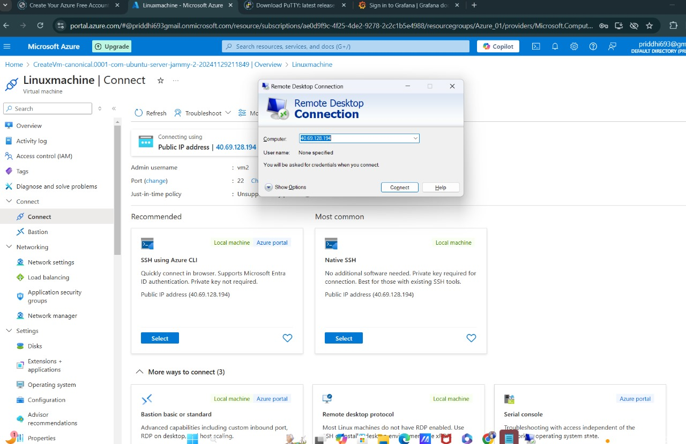
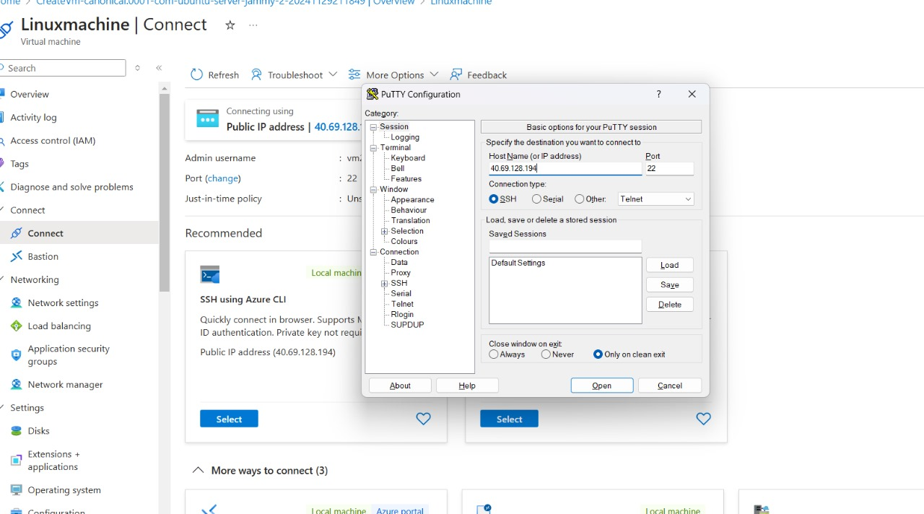
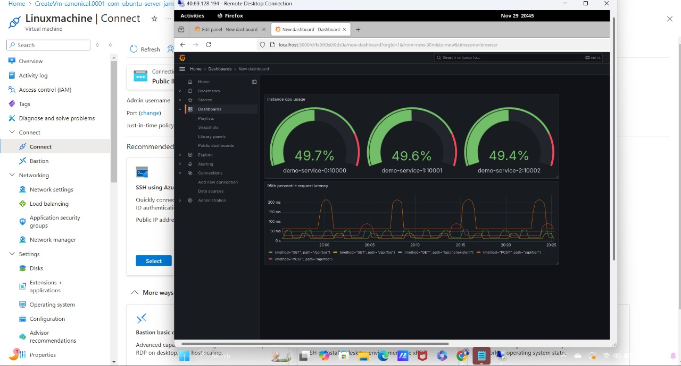
snapshots

Slide 11
Conclusion
Integrating Grafana with an Azure VM provides powerful visualization and monitoring capabilities.
Follow the outlined steps to set up and configure Grafana on Azure.

