Slide 2
Minor Project - I Optimizing real road networks by applying time efficient shortest path algorithms
MEMBER’S NAME | ROLL NUMBER | SAP ID | BRANCH
DIVYAM VERMA | R103218043 | 500067103 | CSE-BAO
DEVANSH MESSON | R103218037 | 500067983 | CSE-BAO
MAYANK RASTOGI | R103218081 | 500069069 | CSE-BAO
Under the guidance of
Mr.Amit Singh

Slide 3
CONTENTS
Abstract
Introduction
Motivation
Literature Review
Problem Statement
Objective
Methodology
Flow Chart, Algorithm & Implementation
Progress (results if any)
References

Slide 4
Abstract
This Project’s goal is to optimize the naive algorithms in terms of space and time which will thereby improve efficiency. This project successfully achieves the goal.In Dijkstra algorithm,the proposed algorithm named as Bidirectional Dijkstra algorithm takes just 3 milliseconds to process graph of 1 lakh nodes and 10 lakh edges while bruteforce based solution takes 37172 milliseconds to process the same graph.In Travelling Salesman Problem, Genetic algorithm takes nearly 6 seconds to process a graph of 13 nodes while bruteforce based solution takes nearly 1 minute to process the same graph.

Slide 5
Introduction
2 algorithms are applied to compute the shortest path from a particular source to one or more destinations:
Dijkstra algorithm:
Computes shortest path from a particular source to a particular destination.
Solution: Greedy method
Single source shortest path
Travelling Salesman Problem:
Given a set of cities and distance between every pair of cities, the problem is to find the shortest possible route that visits every city exactly once and returns to the starting point.
Solution: Recursion with bit-masking, nature inspired optimizations
NP hard problem

Slide 6
Motivation
Motivation to optimize Dijkstra algorithm and TSP comes from the fact that for large number of nodes and edges, naive approaches are not efficient in terms of execution time and space.
For example , V=10¹⁸
Time complexity of Naive approach for Dijkstra – O(V²)
Total iterations – 10³⁶ [~10²⁸ seconds]
For example , V=14
Time complexity of Naive approach for TSP – O(V!)
Total iterations – 14! = 10¹¹ [~1000 seconds]
To improve the running time of the algorithm, following techniques can be used:
Advanced data structures (Eg. binary heap)
Nature-inspired methods (Eg. Genetic algorithm)
Heuristic/mathematical techniques (Eg. A-star algorithm)

Slide 7
Literature Review
Dijkstra algorithm applies a greedy method to optimally solve single source shortest path problem. [1][2]
Binary heap is the implementation of modern priority queue which efficiently finds and deletes top element and decreases value of an element in O(log n) iterations ,where n is the number of elements in heap.[4]
Fibonacci heap is the implementation of priority queue which finds and deletes top element in O(log n) iterations(amortized) ,where n is the number of elements in heap and decreases key in O(1) (amortized).[5]
Bidirectional Dijkstra algorithm runs the Dijkstra algorithm from the source vertex and destination vertex simultaneously [6]
Travelling Salesman Problem states that Given a list of cities and the distances between each pair of cities ,” Find the shortest possible route that visits each city exactly once and returns to the origin city”.[9]
Naive approach to solve travelling salesman problem is to generate (n-1)! Permutations and calculate each permutation’s cost.[10]
Naive approach is optimized by a method called Recursion with bitmasking .This method generates 2^{n} subsets of the total number of nodes and stores it in a bitmask.
Recursion with bit-masking approach is optimized by applying Genetic algorithm. Genetic algorithm works by generating random numbers in a range and thereby making a route.[11]

Slide 8
Problem Statement
In this pandemic, many people encountered various lethal health problems, therefore it becomes an emergency case and such situation expects an ambulance to reach the patient’s place as soon as possible. Obviously, ambulance must take the shortest possible path from the hospital to patient’s place in the real road network given in the form of a graph to reach the destination faster to save a life.

Slide 9
Objective
Suggest the ambulance a shortest possible path as soon as possible in the real road network by applying time efficient shortest path algorithms.
For single destination: determine the shortest possible path from source to destination.(Dijkstra algorithm)
For multiple destinations: determine a route such that the vehicle visits all the destinations and comes back to the source location in the least possible time.(Travelling Salesman Problem)

Slide 10
Methodology
For Dijkstra algorithm-
4 solving optimizations are being proposed:
Brute-force method
Fibonacci heap implementation
Binary heap implementation
Bi-directional Dijkstra algorithm (Giving Least execution time)
For solving Travelling Salesman Problem-
3 solving optimization is being proposed:
Brute-force/Backtracking method
Recursion with bit-masking method
Genetic algorithm (Giving Least execution time)

Slide 11
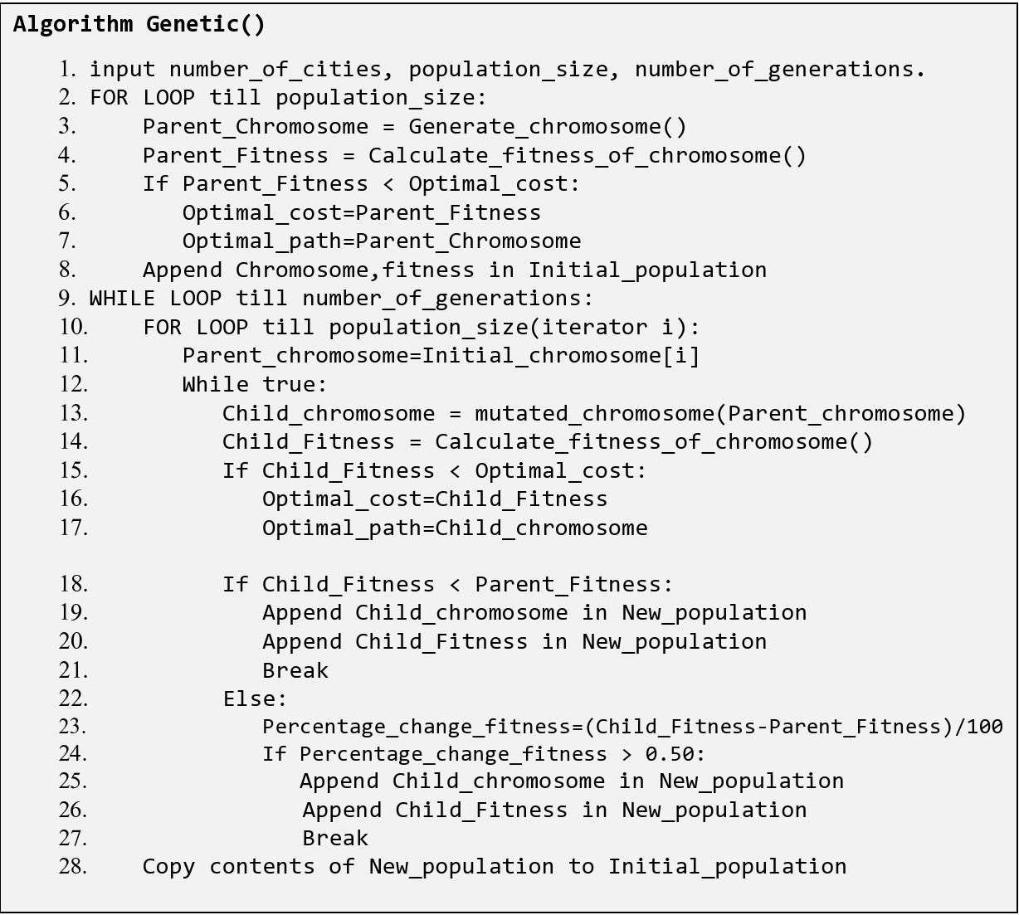
Optimizing
Travelling Salesman Problem
Pseudocode
Of
Genetic algorithm

Slide 12
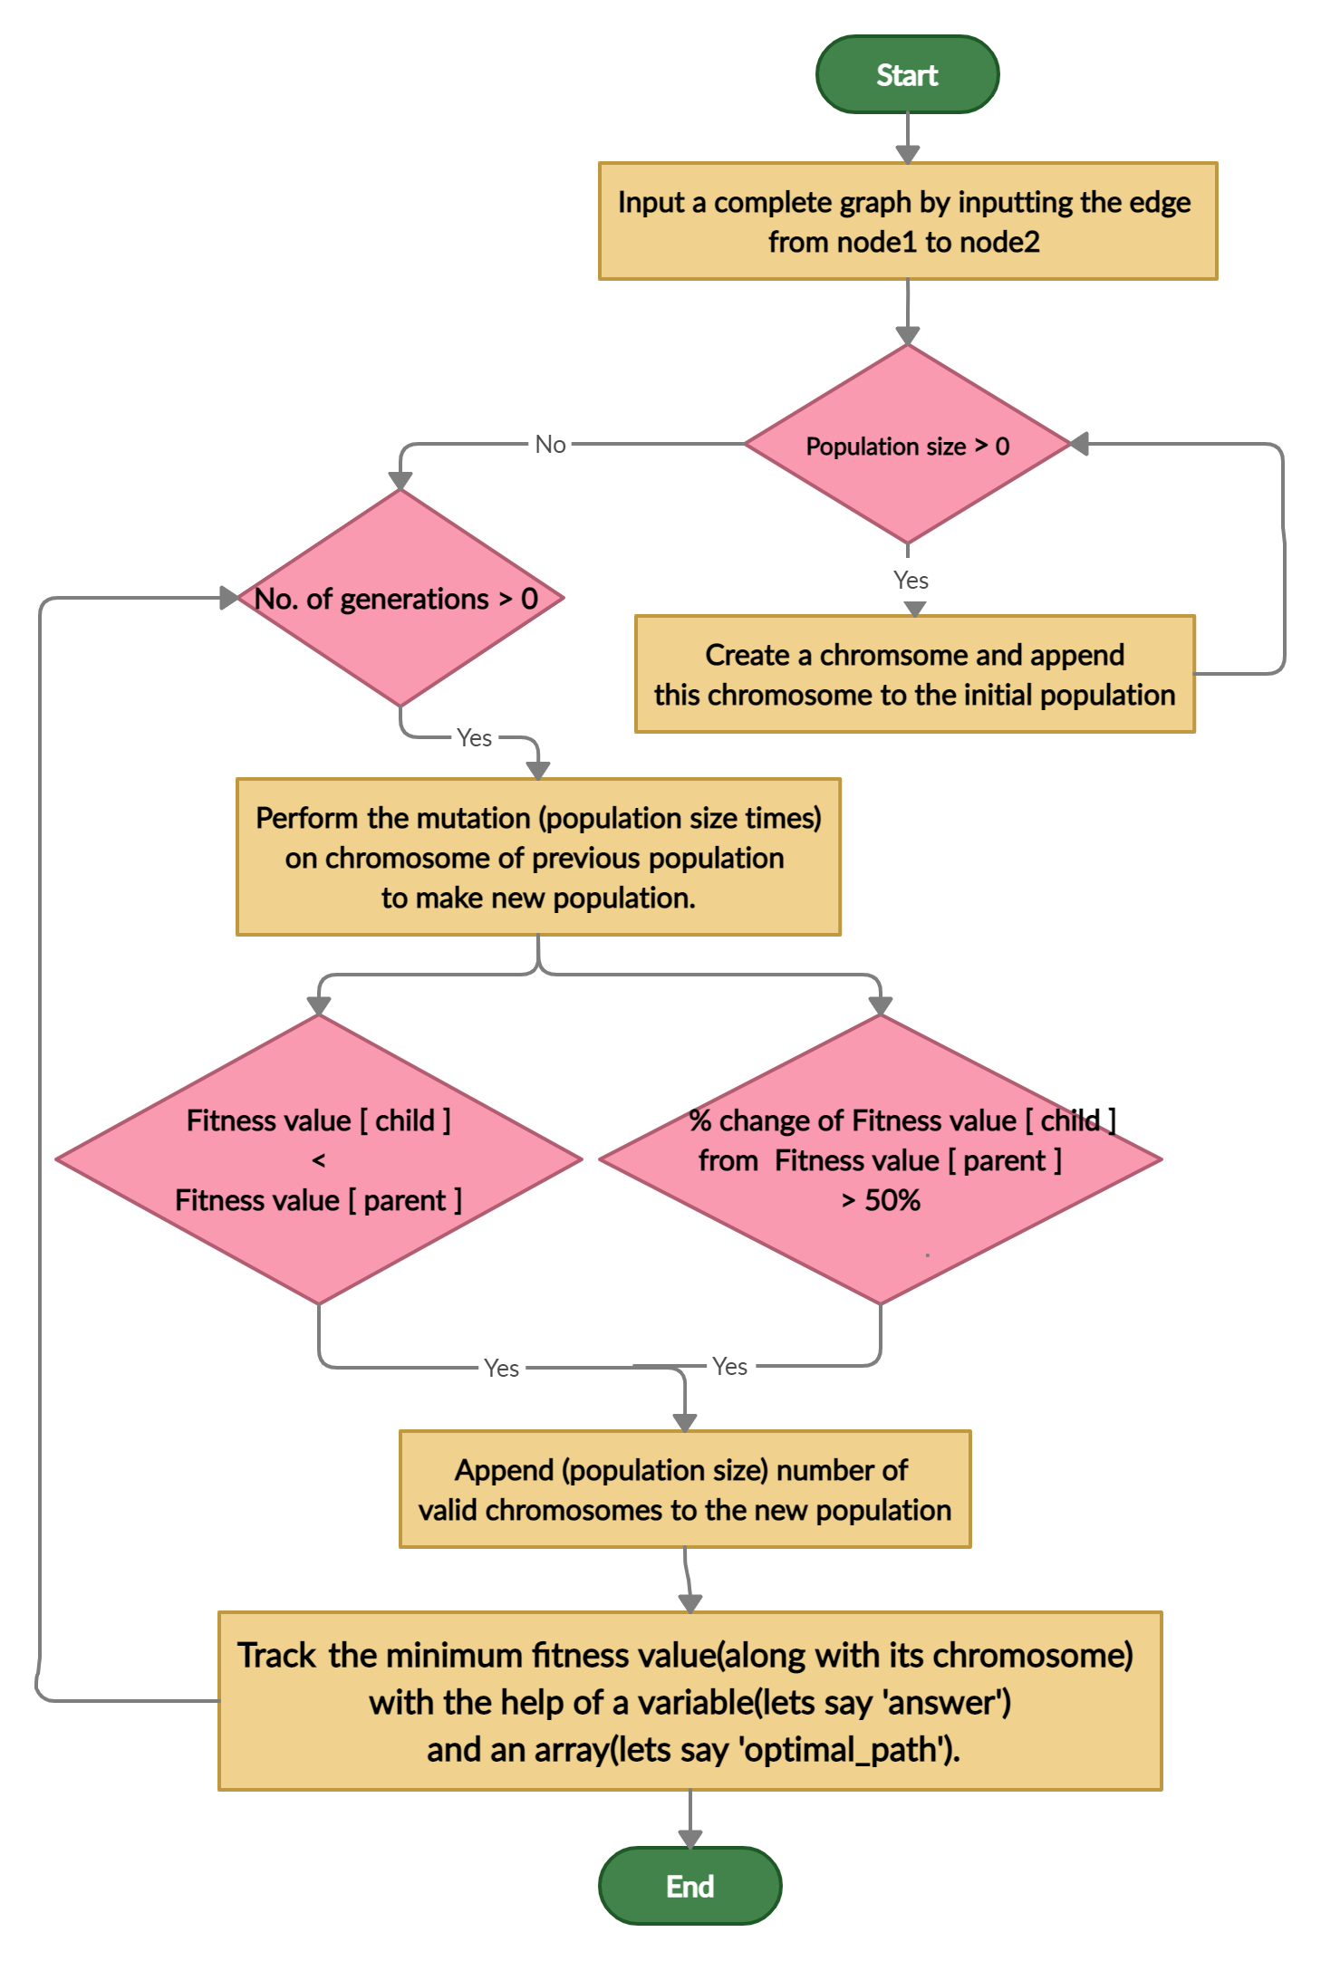
Flowchart
for
Genetic algorithm

Slide 13
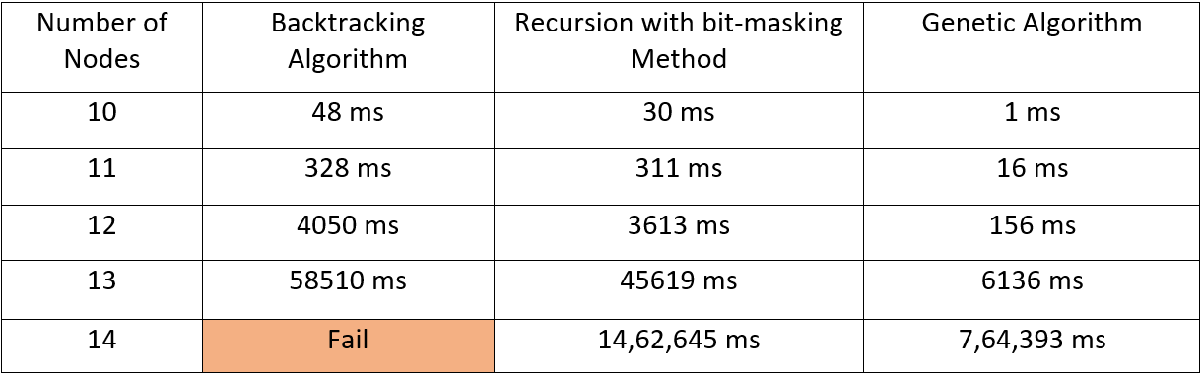
Results
For
Proposed solutions of Travelling Salesman Problem

Slide 14
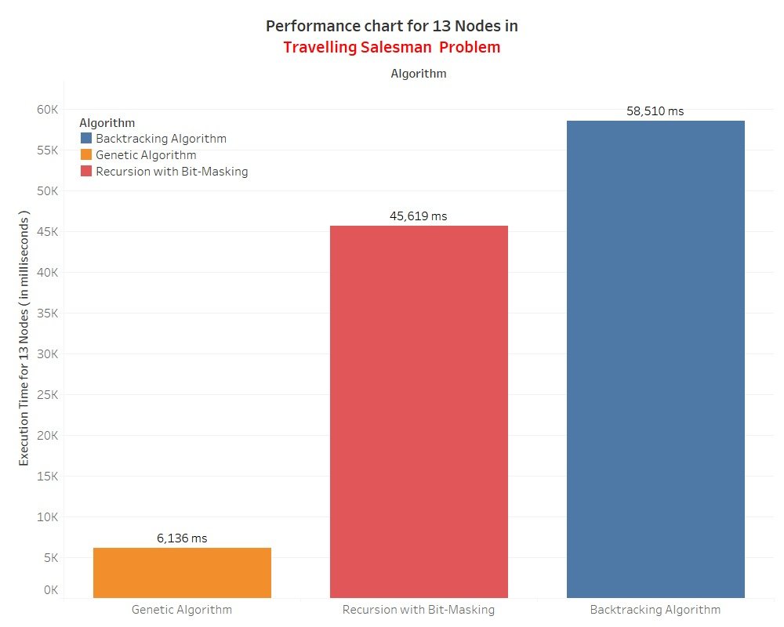

Slide 15
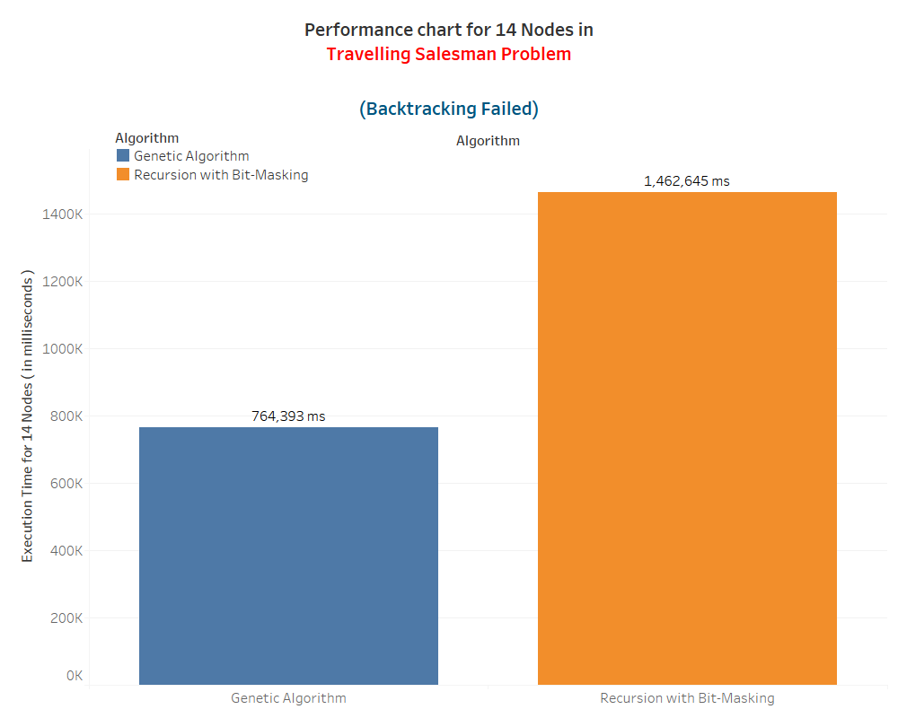

Slide 16
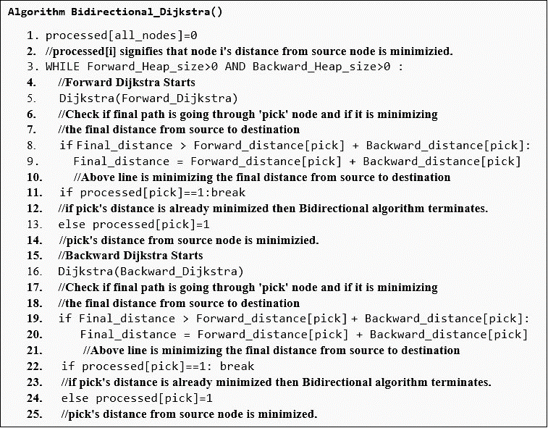
Optimizing
Dijkstra algorithm
Pseudocode
Of
Bidirectional Dijkstra algorithm

Slide 17
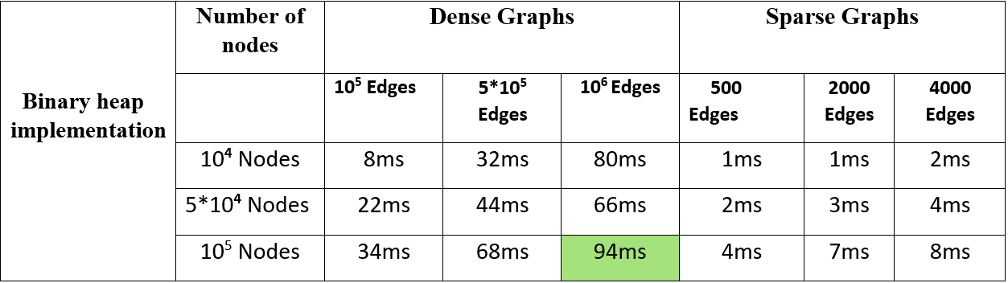
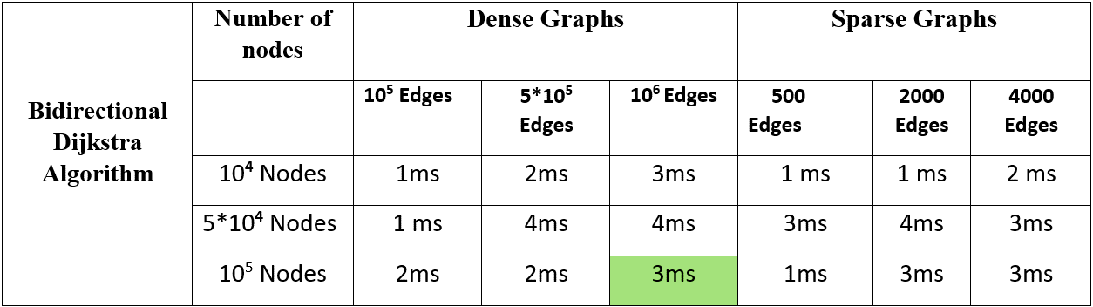
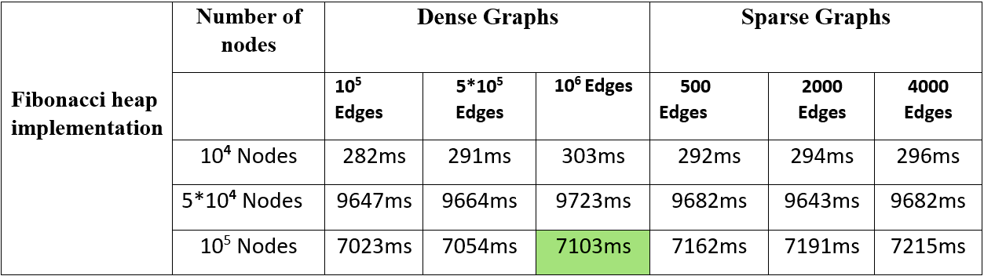
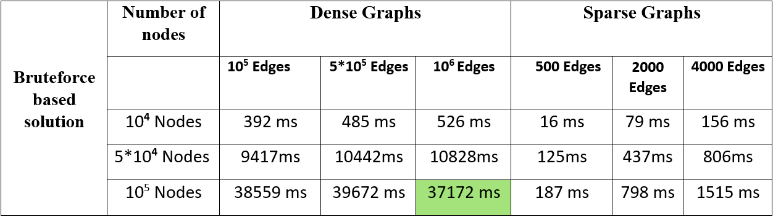
Results
For
Proposed solutions of Dijkstra algorithm

Slide 18
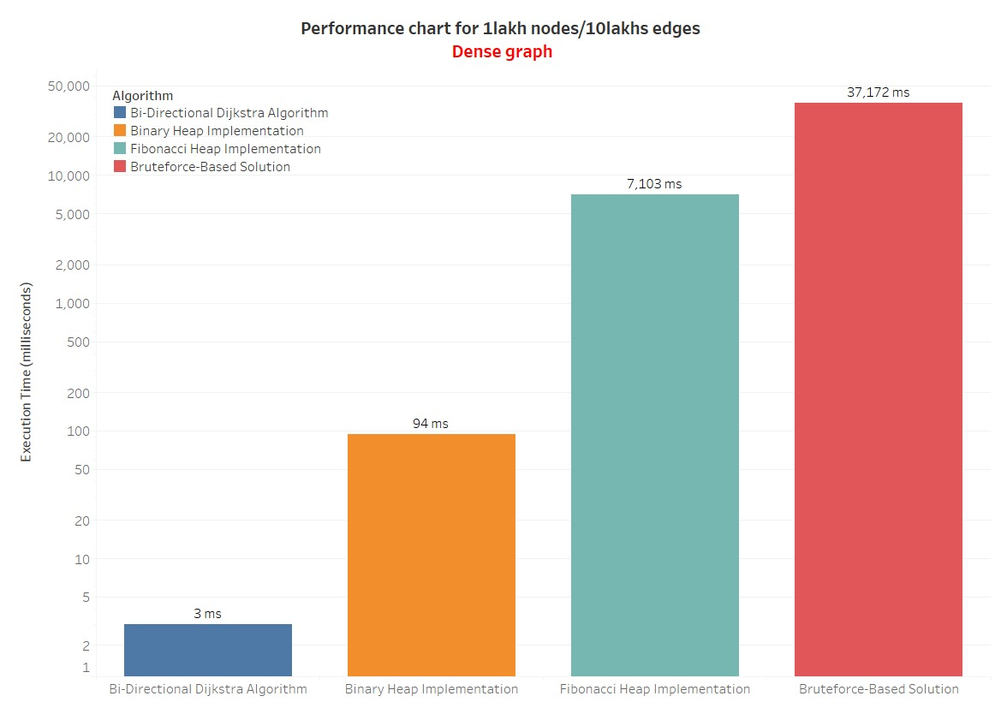

Slide 19
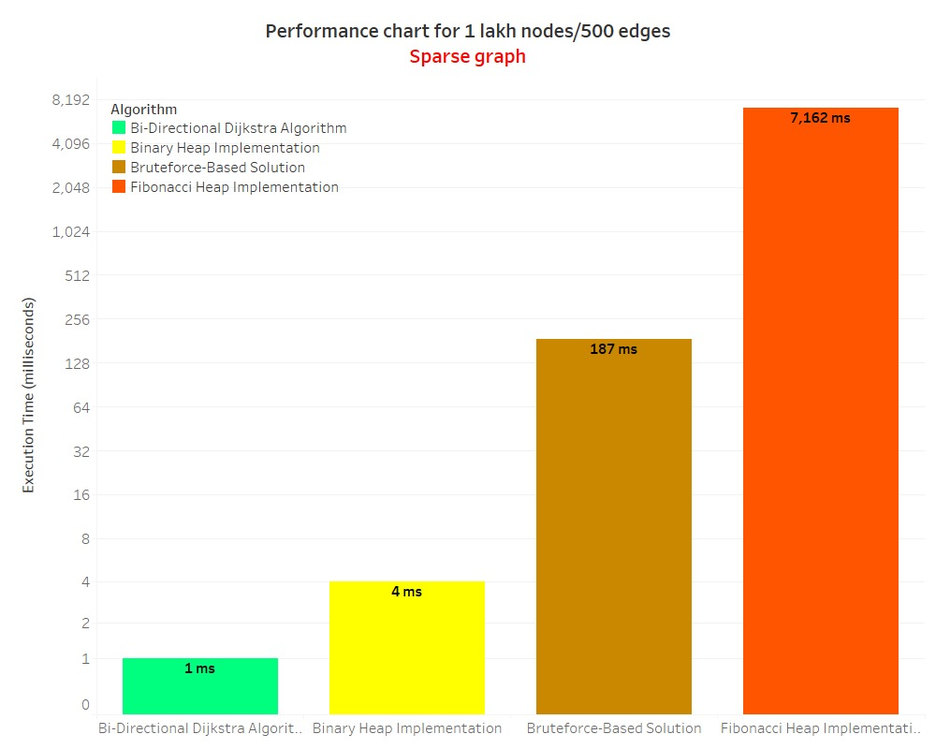

Slide 20
References
[1] https://en.wikipedia.org/wiki/Shortest_path_problem
[2] https://en.wikipedia.org/wiki/Dijkstra%27s_algorithm
[3] https://www.geeksforgeeks.org/dijkstras-shortest-path-algorithm-greedy-algo-7/
[4] https://www.geeksforgeeks.org/binary-heap/
[5] https://en.wikipedia.org/wiki/Fibonacci_heap
[6] Luyao Chen*, Ji Zhou , Jing Li & Yunhao Chen, Bidirectional dijkstra algorithm for best-routing of Urban traffic network Beijing : doi: 10.1117/12.764679
[7] https://en.wikipedia.org/wiki/A*_search_algorithm
[8] https://en.wikipedia.org/wiki/Contraction_hierarchies
[9] https://en.wikipedia.org/wiki/Travelling_salesman_problem
[10] https://www.geeksforgeeks.org/travelling-salesman-problem-set-1/
[11] https://en.wikipedia.org/wiki/Genetic_algorithm
[12] https://en.wikipedia.org/wiki/Ant_colony_optimization_algorithms

